Slide 1
How to find the literature when you don’t have a library
April 2025

Slide 2
Today’s session
What we’ll be covering…
What we won’t…
Free resources for finding health literature
How to find full text papers
How to do complex or systematic searching
Advanced search techniques
Illegal resources

Slide 3
The official guidance…
When doing a literature search you should use bibliographic databases.
Bibliographic databases index published journal articles and other academic literature.
Indexing and functionality allow for a structured and complex search
Enable reproducible searches
But what do you do if you don’t have access to subscription databases?

Slide 4
NHS Core Content
NHS Core Content available to:
All NHS staff
GPs and practice staff
Social care, public health staff, prison healthcare staff
Community pharmacists and dentists
Commissioners, ICBs, CSUs, local authorities, staff in a public health role.
Regulatory services staff (DHSC, Special Health Authorities)
Check your eligibility: https://www.nice.org.uk/about/what-we-do/evidence-services/journals-and-databases/openathens/openathens-eligibility

Slide 5
The most used search engine in the world
Search engine not a database.
Use discretion and consider the sources of information.
Useful for finding guidelines, reports, patient information

Slide 6
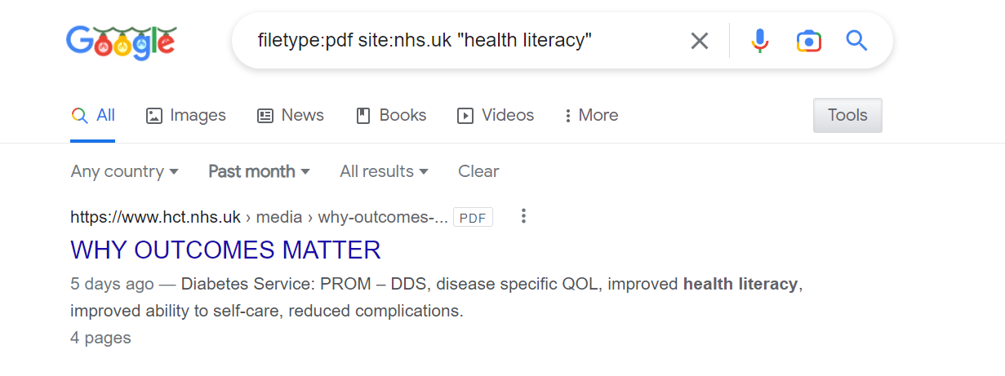
site: to search only URLs
filetype: to search .PDF, .DOC or .XLS (For looking at say hospital admissions data)
Google also allows you to search for data indexed over the past month.
Lots more handy ‘Google Search Operators’ at https://www.googleguide.com/advanced_operators_reference.html

Slide 7
Pros
Cons
Covers pretty much everything
Multi-disciplinary
Includes Google Books
Searches within full text
Familiar/easy-to-use
Not reproducible
‘Black box’ functionality
Volume of results
Predatory publishers
Not easy to download results

Slide 8
Lens.org
Scholarly discovery and citation index tool
200 million scholarly records
Free to use
Powerful advanced search
Powerful filters, customisable visualization capability and bulk export functions
Doesn’t index full text

Slide 9
PubMed
Produced by the US National Library of Medicine
Comprises more than 37 million citations
Includes MEDLINE, life science journals and online books
https://pubmed.ncbi.nlm.nih.gov/

Slide 10
Cochrane Library
Cochrane Database of Systematic Reviews
Cochrane Central Register of Controlled Trials (CENTRAL)
Clinical Answers
https://www.cochranelibrary.com/

Slide 11
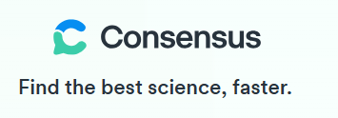
Consensus is a search engine powered by AI.
Source materials comes from Semantic Scholar database.
Uses a Large Language Model to find the most relevant papers.
You can use a natural language question or phrase to search.
Basic search functionality is free but advanced features require a premium account to access.
Be aware, it can sometimes return irrelevant results and inaccurate summaries!
https://consensus.app/search/

Slide 12
ConnectedPapers
“Connected Papers is a unique, visual tool to help researchers and applied scientists find and explore papers relevant to their field of work”
Search for a paper to get a graph of similar and connected papers
Similarity is based on co-citations and bibliographic coupling.
https://www.connectedpapers.com/

Slide 13
Finding the full text – Open Access
Open Access means that the results of research that is publicly funded is made available free of charge.
Around 40% of papers are published Open Access and can be accessed for free.
Pre-print/unedited versions of papers are also sometimes made available online.

Slide 14
EndNote Click
Free internet browser plugin
Produced by Clarivate
Works on thousands of academic websites to get you the full-text PDF
Works with organisational subscriptions but will search for open access alternatives if you don’t have access.
Download from: https://click.endnote.com/

Slide 15
Access To Research
Provides free access to over 30 million academic papers in public libraries.
It is walk-in access, so you need to physically visit your local library to access the papers.
You can see which articles and journals are available online before you visit.
Check first to see whether your local library participates.
https://www.accesstoresearch.org.uk/

Slide 16
Elsevier Patient Access Programme
Patients and non-professional caregivers can make requests for individual papers.
Email the details of the paper to patientaccess@elsevier.com
Elsevier aim to provide requested articles within 48 hours.

Slide 17
Other free health resources…
TRIP Database: https://www.tripdatabase.com/Home
Global Index Medicus: https://www.globalindexmedicus.net/
Epistemonikos: https://www.epistemonikos.org/en/
International HTA Database: https://database.inahta.org/
Europe PMC: https://europepmc.org/
PEDro: https://pedro.org.au/
Diagnostic Test Accuracy Database: https://dita.org.au/

Slide 18
Other free multidisciplinary resources…
OpenAlex - https://openalex.org/
BASE: https://www.base-search.net/
CORE: https://core.ac.uk/
Directory of Open Access Journals: https://doaj.org/
OSF Preprints: https://osf.io/preprints/
Perplexity AI: https://www.perplexity.ai/

