Slide 1
Dementia Research

Slide 2
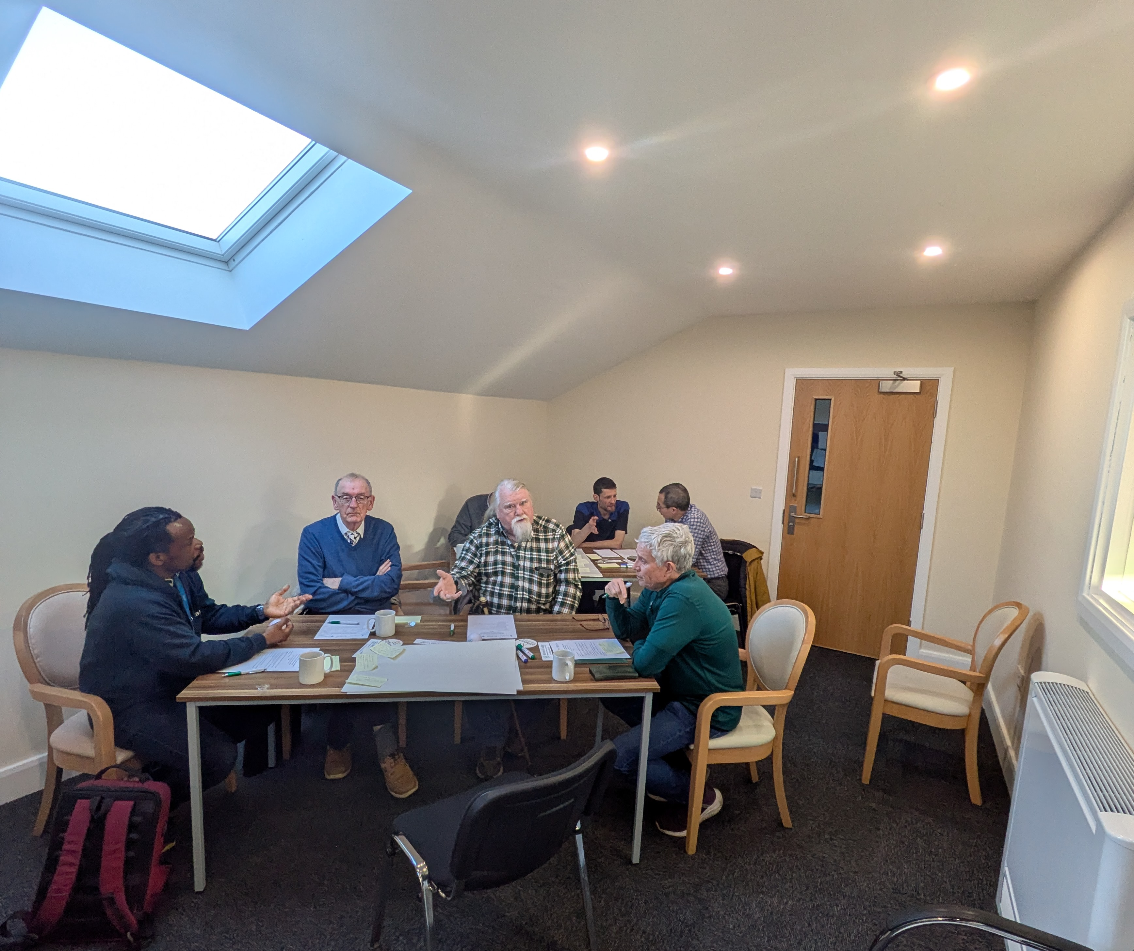
Advanced care home co-design

Slide 3
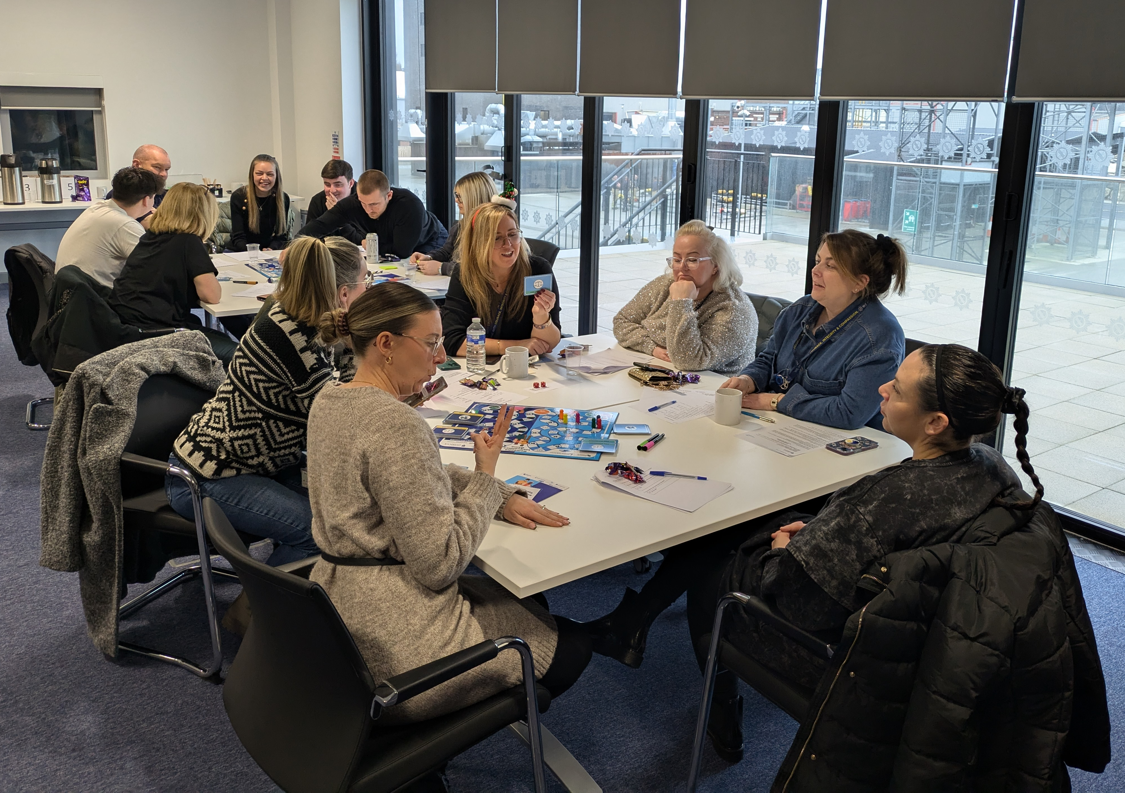
Dementia inequalities boardgame

Slide 4
Details of further research
If you want any further details of the research studies or the dementia research group, please contact:
Dr Clarissa Giebel: clarissa.giebel@liverpool.ac.uk
Dementia Research Group Lead
OR
Dr James Coleman Watson: james.watson2@liverpool.ac.uk Postdoctoral Research Associate

