Slide 1
Anticholinergic Medicines Medicines Reviews Brain Health
Pieta Schofield
Care & Health Informatics (CHI)

Slide 2
Content
Anticholinergic Medications
Anticholinergic Burden
Structured Medications Reviews
Sefton Study
Reflections on Health Equity
Actions

Slide 3
Anticholinergic Medications:
Painkillers (Analgesics) opioid-derived:
Tramadol - Meperidine (Demerol) - Fentanyl - Methadone
Antidepressants tricyclic antidepressants (TCAs):
Amitriptyline - Nortriptyline - Imipramine - Doxepin
Antihistamines First-generation H1 blockers:
Diphenhydramine (Benadryl) - Chlorpheniramine - Promethazine - Hydroxyzine
Antipsychotics older “typical” & some newer “atypical”:
Chlorpromazine - Clozapine - Olanzapine - Quetiapine
Bladder Medications bladder relaxants:
Oxybutynin - Tolterodine - Solifenacin
Gastrointestinal Medictaions GI antispasmodics:
Dicyclomine - Hyoscyamine - Scopolamine

Slide 4
Action and Effects
Mechanism of Action
Anticholinergic drugs block acetylcholine neuro-transimitter, affecting multiple systems.
Side effects:
dry mouth,
constipation,
blurred vision,
confusion (especially in elderly)
tiredness/drowsiness
risk of falls
linked to long-term cognitive decline & delirium in older adults.

Slide 5
AC-Burden Increases with Age
As people age, they develop more conditions that require treatment:
Pain (Arthritis, Neuropathy) → AC Painkillers (Tramadol, TCAs)
Urinary Incontinence → Bladder relaxants (Oxybutynin, Tolterodine)
Allergies/Itching → Antihistamines (Diphenhydramine, Hydroxyzine)
Depression & Anxiety → AC Antidepressants (Amitriptyline, Doxepin)
Sleep Issues → Sedating ACs (Quetiapine, Promethazine, Trazodone)

Slide 6
Why Does This Matter?
Older adults have reduced ability to clear drugs, leading to higher AC accumulation.
Brain effects: Increased risk of cognitive impairment, delirium, & dementia.
Physical effects: Increased falls, dizziness, urinary retention, constipation.
Prescribing Cascade:
One AC drug → Side effect (e.g., dry mouth, constipation)
Another drug is added to treat that side effect, worsening AC burden.

Slide 7
Strategies to Reduce AC Burden
Medication Review – Identify & replace high-AC drugs (if possible)
Non-AC alternatives – E.g., SSRIs instead of TCAs for depression.
Minimize Polypharmacy – Reduce unnecessary prescriptions.
Monitor Cognition – Watch for confusion, memory loss, falls.

Slide 8
Sefton Study

Slide 9
What we found
Frailty
AC Burden
Deprivation
High Burden not reviewed

Slide 10
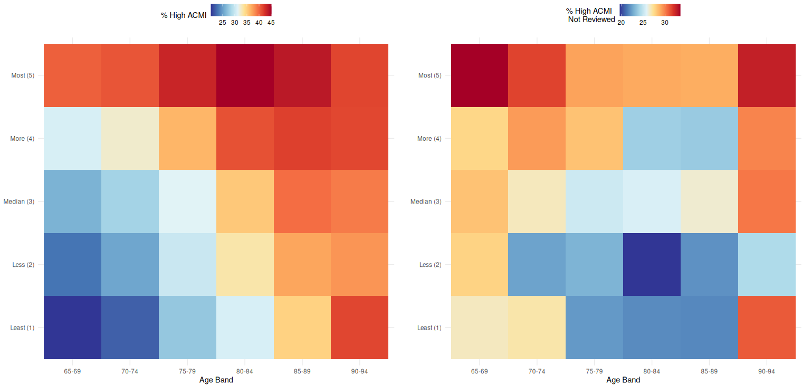
Reflection Health Equity
Deprivation
Age

Slide 11
Options
Raise awareness among prescribers → Many may not consider the cumulative effect of multiple drugs on cognition.
Improve access to medication reviews → Targeting areas with higher burden could reduce inequalities.
Better integration of medication risk into brain health policies → Could deprescribing strategies be part of dementia prevention?

Slide 12
Discussion
If we care about brain health, we need to care about the medications people are taking every day—and make sure the people most at risk aren’t the ones slipping through the cracks.
What can we do to make sure medication reviews are reaching those who need them most?

