Slide 1
The value of action: mitigating the impact of neurological conditions
11 March 2025

Slide 2
About the Neurological Alliance
Vision: Every person affected by a neurological condition can access the right treatment, care and support at the right time.
Mission: To harness the energy and passion of the neurological community to ensure public policy in health reflects the realities of living with a neurological condition, so that everyone can access treatment, care and support whenever they need it.

Slide 3
The NHS XXX Council and MND XXX have been exemplary in 'joined up' thinking and support co-ordinated by the MND nurse, GP and neurology specialist and including occupational therapy, adaptations, speech and language therapy, wheelchair services, dietetics, physiotherapy, respiratory support, etc. We perhaps have won the postcode lottery but are grateful for the world-class support we have received since receiving the MND diagnosis earlier this year is great.
My child is 16 and now has been past from pillar to post from hospital neurology to adult services but isn't 18 so they wont accept him. There is a loop hole with in this system that your left for 2 years with no one
Better communication, not being treated as another patient, but a person with its own life and needs and struggles specific to me
I had very little (none) advice or care following my diagnosis, no referral to occupational health or specialist nurses. The consultant, and I appreciate that he is a busy man, gave us very little information. It was only through googling the condition that we discovered the Ataxia Society and, through their information, managed to get a referral to the specialist unit at Sheffield Hospital

Slide 4
About neurological conditions
I have changed completely, friends have gone, I look ok but inside I am scared all the time
At least 1 in 6 people in the UK live with a neurological condition.
There are an estimated 600 neurological conditions – any condition which affects the brain, spine or nervous system.
Everyone experiences neurological conditions differently.
I can no longer enjoy the things I used to do, like walking, hiking, rambling, keep fit.
It's exhausting as a parent as I have to fight for all my daughter gets and search for people who may help, I don't I feel alone fighting for everything and hope I have what she needs

Slide 5
Poll
In the UK, how many £billion was spent on the direct health costs and indirect economic costs of neurological conditions in 2019?
36 billion
66 billion
96 billion

Slide 6
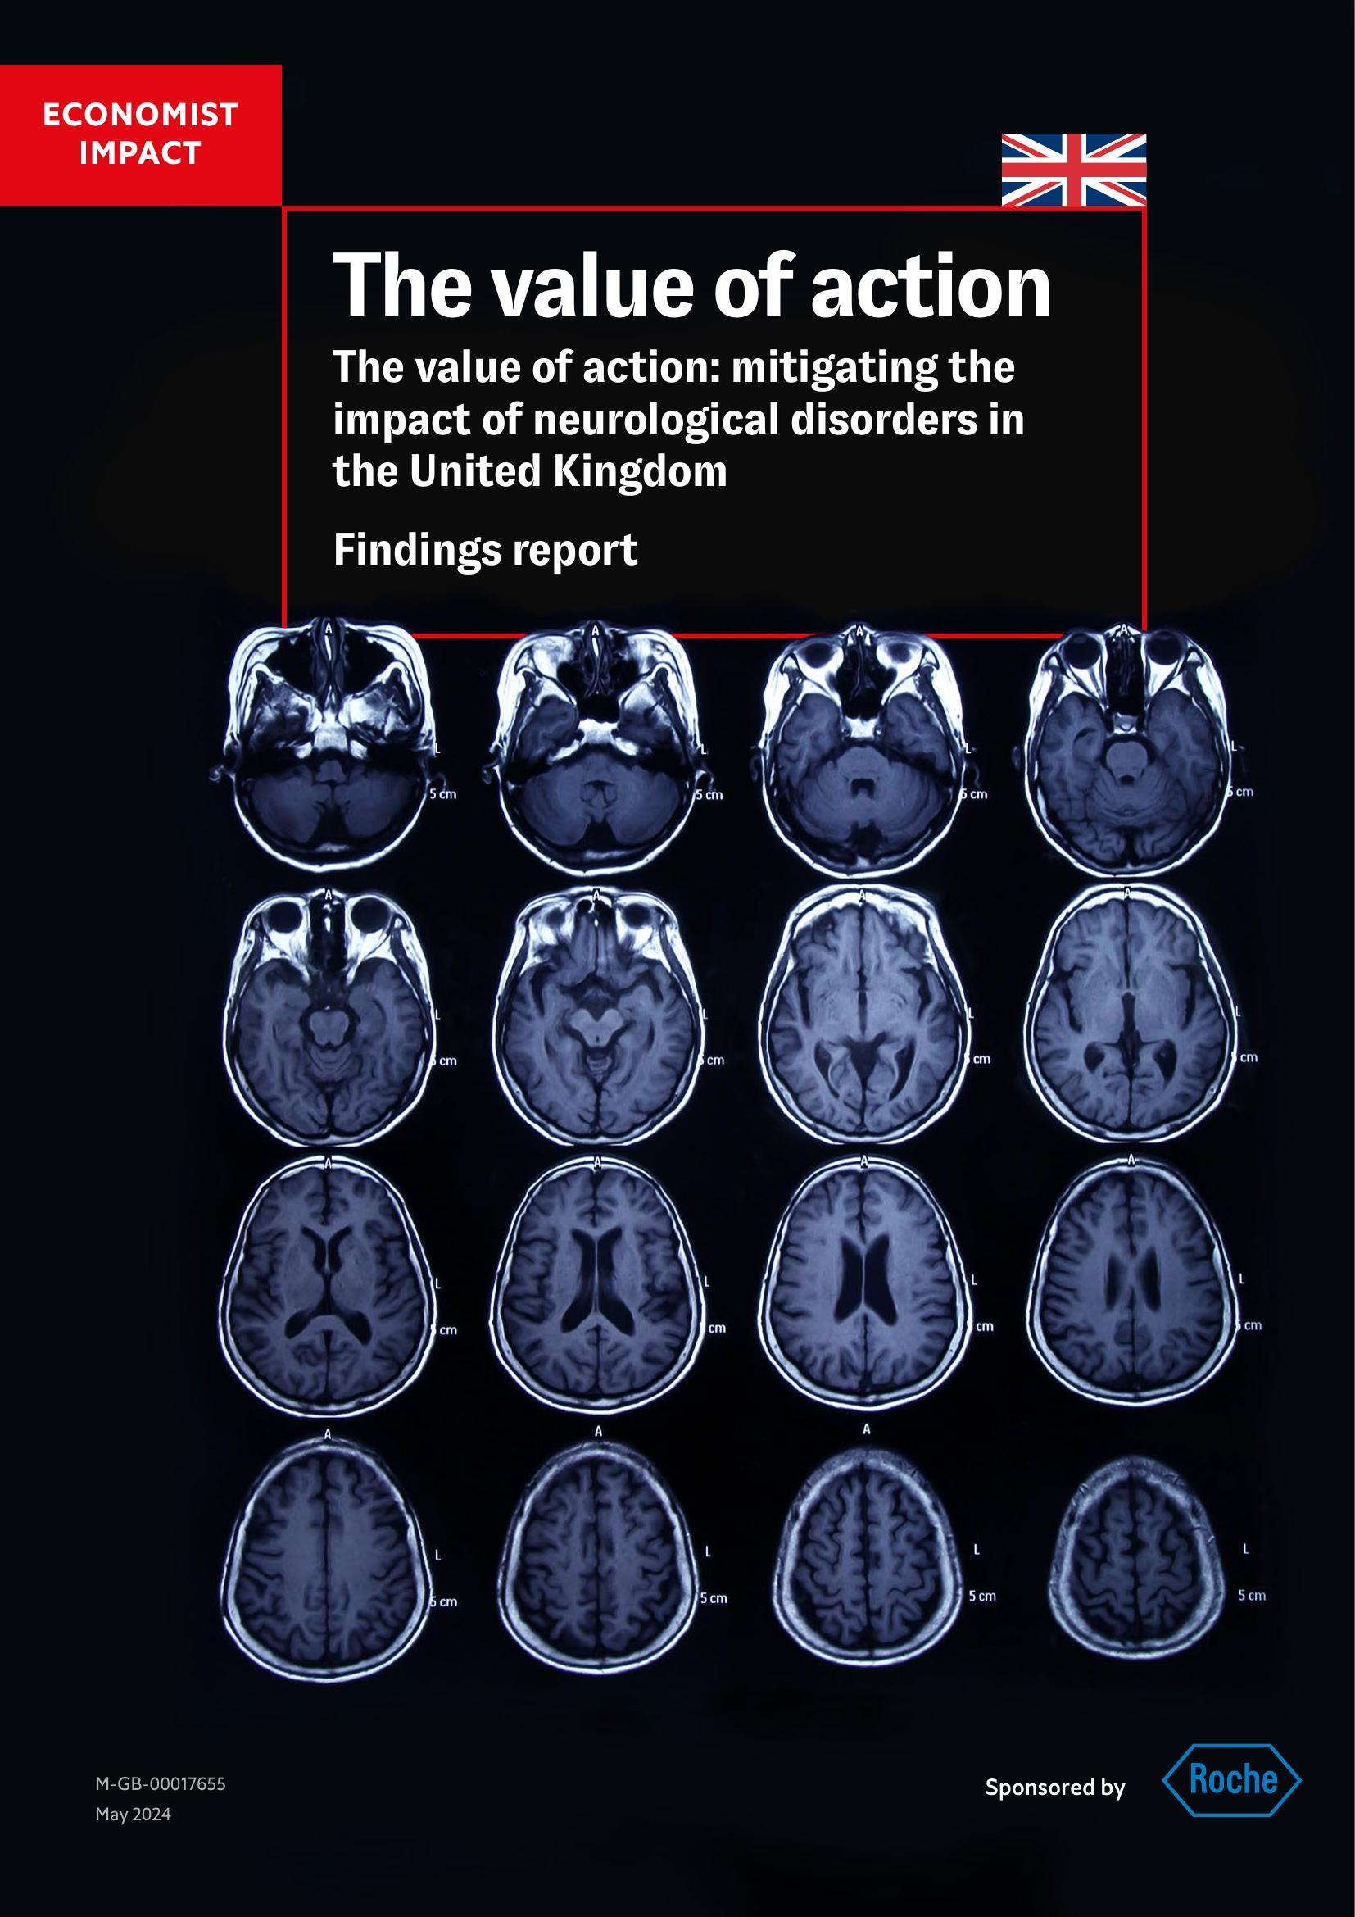
Estimating the economic impact of neuro conditions
Methods:
Based on a 2022 Economist Impact study covering 11 countries
Economic analysis of direct and indirect costs of neurological conditions
Focused on five conditions: Alzheimer's, Epilepsy, MS, Parkinson’s, SMA Type I
Key Findings:
1 in 6 people in the UK has a neurological condition
Neurological conditions cost the UK over 4.3% of GDP (£96bn in 2019)
Existing interventions could reduce this burden by up to £30.8bn
Three major challenges: lack of strategy, workforce shortages, and access delays

Slide 7
About My Neuro Survey
Patient Experience Survey conducted by the NA – conducted every 2 years
For the first time the survey in 21/22 was UK-wide and included a version for children and young people – open to everyone in the UK with a (or suspected) neuro condition
Delivered in collaboration with the Wales Neurological Alliance, Neurological Alliance of Scotland and the Northern Ireland Neurological Charities Alliance (niNCA)
Responses collected between 25 October 2021 – 6 February 2022 via:
An online survey, promoted in clinic, member websites and social media
A paper-based survey, returned through freepost envelopes
An easy read version of the survey
A language line
Rolled out across 35 clinics, through our membership and other partners
Endorsed by the ABN, BPNA, Royal College of Psychiatry and ACPIN
Data from the fifth iteration is being analysed at the moment.

Slide 8
Who responded?
93% (n=7,258) of adult respondents reported living with a neurological condition
59% (n=4,509) of adult respondents reported having a condition other than their reported neurological condition(s)
In the adult survey, the most reported conditions were:
multiple sclerosis 16% (n=1,245)
epilepsy 13% (n=1,006)
= Migraine 11% (n=851)
3. = Functional Neurological Disorder 11% (n=849)
Notes:
The graphs are for respondents to the adult survey
Adult respondents skewed slightly older than the UK average of 40.4 years
Females were also overrepresented as is often the case with self-selecting surveys
We received responses from people with over 60 different neurological conditions

Slide 9
Too many people are not being asked about, signposted or referred to support for their mental wellbeing
Have you been asked about your mental wellbeing by a health or social care professional in the last three years?
Have you been referred or directed to support for your mental wellbeing by a health professional within the last three years?
 | Adults (%) | CYP (%) | 2018/19 (%)
Yes | 23% | 39% | 26%
No, but I would have liked this | 36% | 36% | 30%
No, and I did not want/ need this | 41% | 25% | 44%
Notes:
CYP more likely to have been asked about, referred or directed to support for their mental wellbeing

Slide 10
Key services are not always being offered
I have been told quite plainly by a consultant that because I live in the Midlands I can't receive any type of rehabilitation or physio for FND as there is no-one qualified in this region to work with FND patients, it is very disturbing

Slide 11
Too many people continue to face long waits to see specialists and get a diagnosis
After 2 years of being passed from pillar to post I was eventually seen by a Physiotherapist who recognised my symptoms and referred me to see a Neurologist who after just 10 minutes diagnosed me with Parkinson's disease. If I had been diagnosed 6 months earlier I might have been able to keep working but without the correct medication I just couldn't function.
Notes:
This graph is for adult respondents only
Dark purple – first experiencing symptoms to getting a diagnosis
Gold – first seeing a GP to seeing a neurologist

Slide 12
Impact of neurological condition by deprivation
High score = more positive
Low score represents more significant impact.
Notes:
We were also able to map the results against deprivation.
These three lines represent three different measures of the impact of our respondents’ conditions: on overall quality of life; on day-to-day activities; and in terms of causing pain or discomfort.
The scoring scale is slightly complex. But essentially a low score means more impact – with 10% or below meaning a severe impact.
There were a range of responses, of course. But this chart shows the averages. And if you look from left to right it’s very clear that the impact is significantly less for those in the least deprived areas. But that there are impacts for everybody, wherever you live…

Slide 13
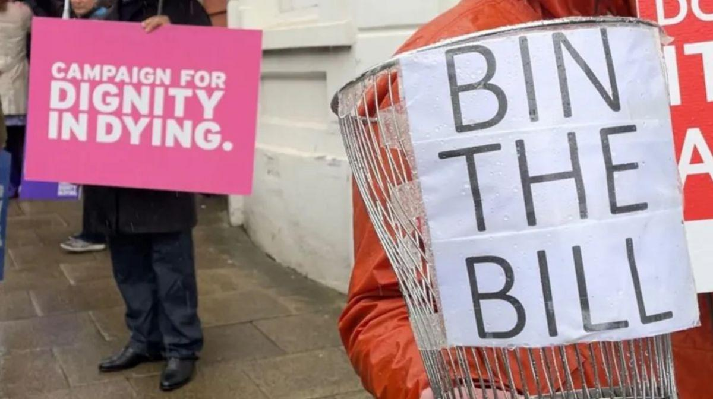
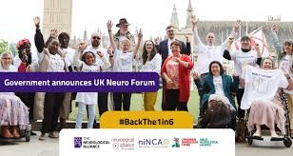
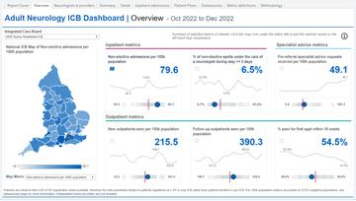
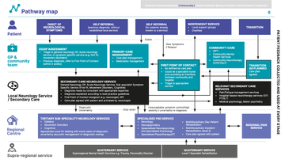
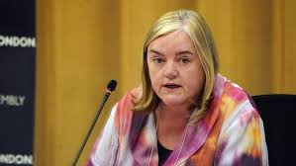
Key public policy initiatives
Neuro specific
Third party
Gov
Condition specific
Independent reviews

Slide 14
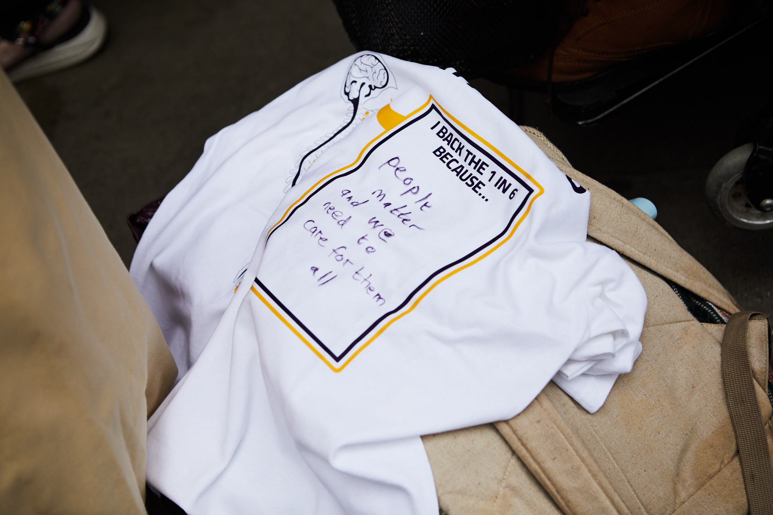
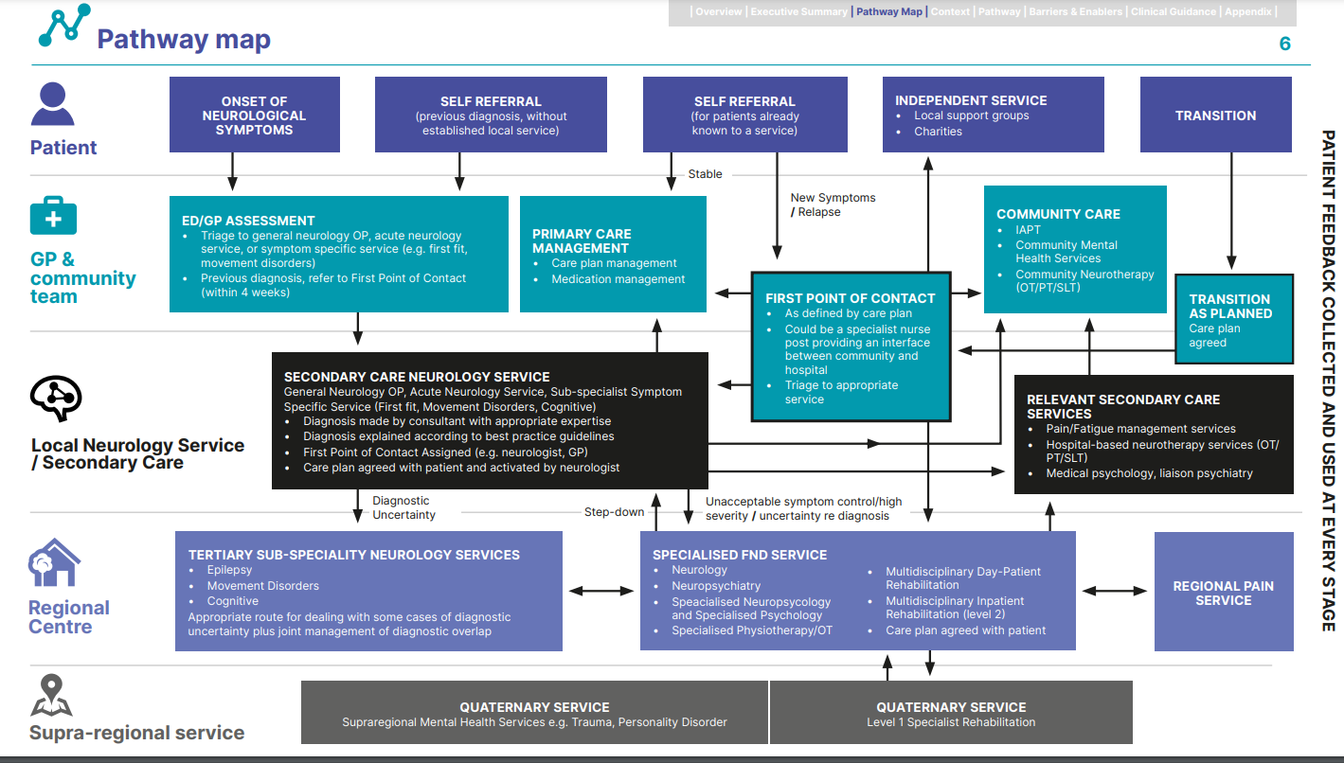
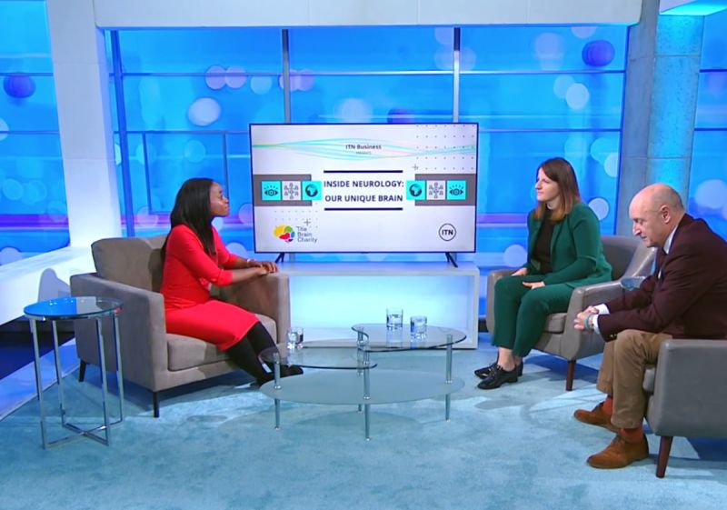
How are we trying to affect change?
Supporting people affected by neurological conditions are supported to speak up and out
Developing evidence that changes minds
Ensuring neuro has a seat at the table…

Slide 15
#BackThe1in6 and #NeuroChampions
Back The 1 in 6 – launched in June 2022
DHSC petition supported by 100+ orgs and over 19,000 people
Dozens of PQs, 2 Parliamentary events, a House of Lords debate.
Neuro Champion campaign – June/July 2024
946 campaigner e-actions, 2,222 candidates contacted in 451 constituencies
12 Neuro Champion MPs elected

Slide 16
Delivering change - UK Neuro Forum
Campaigning and public affairs activities played a critical role in delivering the UK Neuro Forum
First of its kind UK-wide government forum focusing on services and support for neuro community
Significant policy win directly linked to Back The 1 in 6 campaign – stronger together

Slide 17
Parliamentary Neuro Reception
Largest and most successful Parliamentary event to date
1,400 people invited their MP to attend – reaching 548 MPs
35 MPs represented - double our previous best MP attendance

Slide 18
Brain health and public policy
Increasing recognition of the importance of brain health in public policy
No “brain health” national plan/programme
Further evidence required

Slide 19
Final thoughts
Engagement of people with neurological conditions throughout is absolutely central
The voluntary sector is a huge resource for you and we share common goals – please use us.

Slide 20
Thank you
Email: georgina.carr@neural.org.uk
| 20

