Slide 1
Framework for Knowledge Mobilisation and Impact
Jane Cloke, Sian Cunningham and Darren Charles
On behalf of NIHR ARC NWC

Slide 2
Workshop outcomes
Greater awareness of actions to generate and demonstrate impact
Familiar with the ‘building blocks’ approach
Encouraged and inspired to nurture and demonstrate the impact of your research

Slide 3
Summary of our approach
Build a credible story: what changed, why, and so what?
Thinking beyond direct impacts and identify other changes generated by your research
Examine relationships between knowledge mobilisation activities that lead to impacts
Reflecting on what has happened and how we could improve in the future
Notes:
By using the framework, research teams and their partners are able to translate isolated examples of impact and reasons for impact into narratives for both learning and dissemination by:
• thinking beyond the direct impacts on policy and practice decisions (so-called ‘instrumental’ impacts) and to identify other changes generated by their work.
• considering the relationships between processes that had led, or could lead, towards impacts, including uncovering less-tangible reasons
• critical reflection of what has happened and what could be improved in the future
The goal of the framework is to build a credible ‘story’, with the help of our research partners, can we reach a consensus on ‘what changed, why, and so what?’.

Slide 4
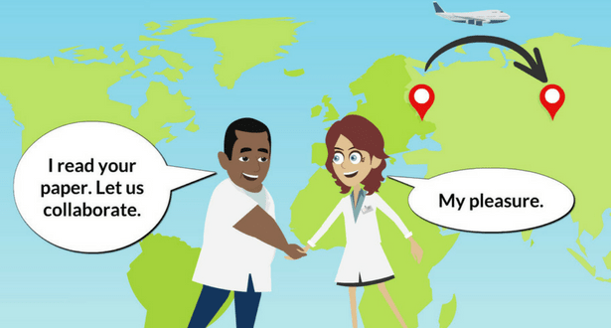
Types of impacts
Notes:
Instrumental: changes to plans, decisions, behaviours, practices, actions, policies
Conceptual: changes to knowledge, awareness, attitudes, emotions
Capacity-building: changes to skills and expertise
Enduring connectivity: changes to the number and quality of relationships and trust
Culture/attitudes towards knowledge exchange, and research impact itself

Slide 5
What changed as a result of the research?
changes to plans, decisions, behaviours, practices, actions, policies
Instrumental
changes to knowledge, awareness, attitudes, emotions
Conceptual
changes to the number and quality of relationships and trust
Capacity building
Culture and attitudes
changes to skills and expertise
Enduring connectivity
Towards knowledge mobilisation and research impact itself
Notes:
Instrumental: changes to plans, decisions, behaviours, practices, actions, policies
Conceptual: changes to knowledge, awareness, attitudes, emotions
Capacity-building: changes to skills and expertise
Enduring connectivity: changes to the number and quality of relationships and trust
Culture/attitudes towards knowledge exchange, and research impact itself

Slide 6
What more could be done to generate impact?
Work with local and government policy groups
Instrumental
Publish your findings in an open-access journals
Conceptual
Nurture collaborations with other research groups
Capacity building
Culture and attitudes
Develop online training to promote your findings
Active planning of knowledge exchange events and activities
Enduring connectivity
Notes:
Instrumental: changes to plans, decisions, behaviours, practices, actions, policies
Conceptual: changes to knowledge, awareness, attitudes, emotions
Capacity-building: changes to skills and expertise
Enduring connectivity: changes to the number and quality of relationships and trust
Culture/attitudes towards knowledge exchange, and research impact itself

Slide 7
Who changed?
Local-level
National
International
Public
Private
NGOs
Policy makers
Practitioners
Influencers and Influenced
Who else?
Researchers
Practitioners
Of place;
Of interest;
The general public
Within and beyond the project and institution

Slide 8
Who changed?
Director of Public Health;
Government Chief Scientific Advisor; World Health Organisation
NHS, veterinary practices, care homes, local authorities
Charities
Policy makers
Influencers and Influenced
Practitioners
Who else?
Researchers
Communities
Residents of Liverpool;
Patients and carers;
Pet owners;
Specialisms
Other Faculties;
Other Universities;
Inter-disciplinary

Slide 9
Reasons for impact- why or how did change happen?
How were these impacts generated?
What factors influenced success?
Which strategies were used to generate impact?
Which else, beyond the control of the project, helped or hindered its success?

Slide 10
Framing of the problem
The policy or practice ‘problem’ was agreed as important but also solvable
The research questions were framed appropriately, addressing underlying problems, consulting or co-producing with interested parties

Slide 11
Research Management
Where the aims of the research, its design, plan and execution provide a realistic and timely response to a problem
Where the research partners, along with their interests, influence and roles, are identified and acknowledged
Where there is effective management and a focus on strong project governance and partnership working.

Slide 12
Inputs
Adequate resources – researchers, funding, access to equipment and facilities
Building on substantial investment in the research topic/area

Slide 13
Engagement
Interdisciplinarity
Dialogue between researchers, practitioners, policy makers and the public throughout the project
Helping to inform the approach and managing expectations
Dissemination activities influencing, and influenced by, target audiences

Slide 14
Users; including social and organisational factors
Influence of ‘champions’ and ‘knowledge brokers’.
Willingness or ability to use outputs
Organisational culture & attitudes towards research.
Incentives to encourage uptake e.g. requirement for certification, included in professional guidelines

Slide 15
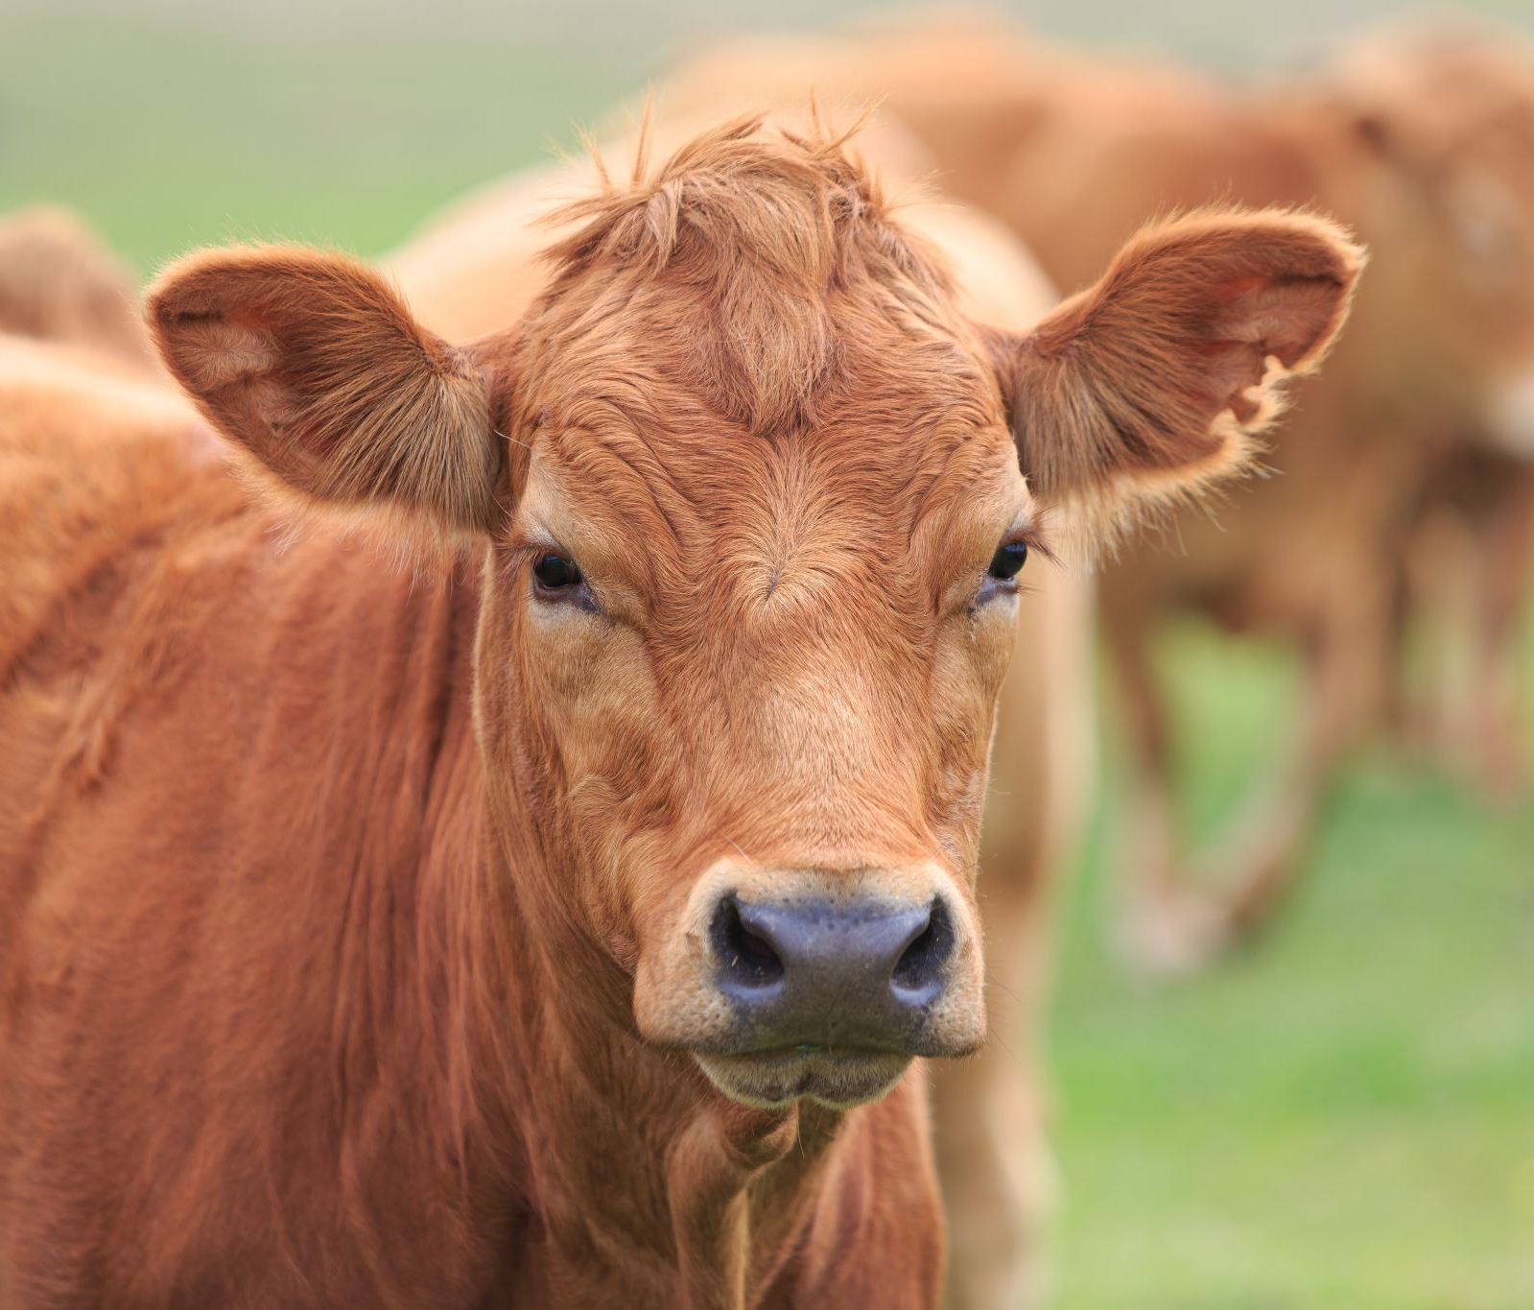
Context: Societal, political, economic and geographical factors
Examples include
Climate change
Cleaner air
Severe outbreaks of disease, including global pandemics
Social and health inequalities
Adult social care reform
Sustainable farming
Anti-microbial, anti-parasitic and pesticide resistance in pathogens and pests of animals and plants
State of Health in the City: Liverpool 2040

Slide 16
Outputs and Dissemination
Outputs: Quality and usefulness of content; appropriate format
Dissemination: Targeted and efficient delivery of outputs to users and other audiences

Slide 17
Reflective questions to determine lessons learned
What worked?
What could have been done differently?
What could (or should) be done in the future?

Slide 18
What’s next? What impact stories do you want to develop? How will you apply this approach? What further help do you need to take this forwards?

Slide 19
Further information: Web resources: Contacts:

