Slide 1
SAM MEREDITH
JUNE 2024
The Social Determinants of Multimorbidity Within Emergency Hospital Admissions
ARC FEST JUNE 2024
Institute of Systems, Molecular and Integrative Biology
Department of Pharmacology and Therapeutics
ARC NWC – Person-Centred Complex Care
Supervisors:
Dr Jennifer Downing
Professor Tony Marson
Professor Sarah Rodgers
Dr Keith Bodger

Slide 2
What is Multimorbidity?
Two or more coexisting chronic long-term conditions. [1]
54.0% of people over 65 in the UK have multimorbidity as of 2015. [2]
Two-thirds (67.4%) of people aged over 65 in the UK are estimated to have multimorbidity by 2035. [2]
Life expectancy gains (2-3 years) in men and women will be spent with 4+ conditions in 65.9% of men and 85.2% of women. [2]
Multimorbidity prevalence increases with deprivation. [1]
Onset of multimorbidity occurs 10 – 15 years earlier in individuals from the most deprived areas compared to the most affluent. [1]
Associated with increased hospital costs, primary care use, emergency department use & hospitalisations. [3]
WHY DOES IT MATTER?

Slide 3
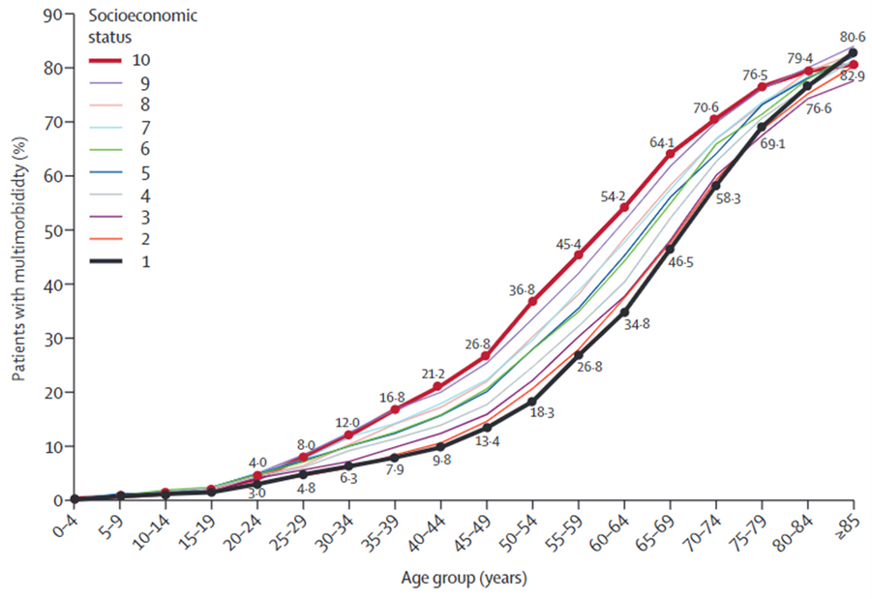
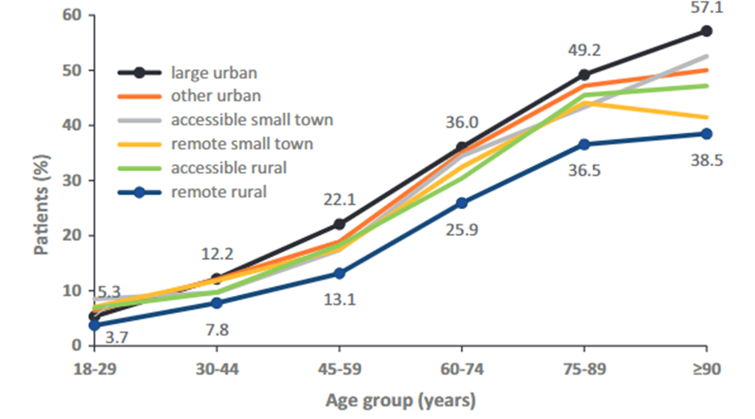
Social Determinants of Health
HOW ARE THEY CONNECTED TO THE PROBLEM?
Prevalence of multimorbidity by age and urban-rural category.
(Robertson et al., 2020)
Robertson, L., Ayansina, D., Johnston, M., Marks, A., & Black, C. (2020). Urban–rural and socioeconomic status: Impact on multimorbidity prevalence in hospitalized patients. Journal of Comorbidity, 10, 2235042X1989347. https://doi.org/10.1177/2235042x19893470
Prevalence of multimorbidity by age and socioeconomic status. Socioeconomic status scale: 1 - most affluent and 10 - most deprived. (Barnett et al, 2012).
Barnett, K., Mercer, S. W., Norbury, M., Watt, G., Wyke, S., & Guthrie, B. (2012). Epidemiology of multimorbidity and implications for health care, research, and medical education: A cross-sectional study. The Lancet, 380(9836), 37–43. https://doi.org/10.1016/S0140-6736(12)60240-2

Slide 4
Objectives
WHAT WE WANT TO ACHIEVE
Identify the demographic and socioeconomic patterns of multimorbid patients within emergency hospital admissions.
Identify prevalence rates of multimorbidity within emergency hospital admissions.
Identify potential study design and methodology issues.

Slide 5
Why Did We Undertake This Research?
BACKGROUND
This review seeks to uncover more granular detail surrounding the social determinants of health (SDH) associated with multimorbidity (MM) within emergency hospital admissions (EHA).
The need for this study was highlighted by research findings published by the Academy of Medical Sciences (AMS) in their 2018 report on MM.
The AMS indicated that individuals from deprived backgrounds experience MM at an earlier age, suffer worse health outcomes and use more health service resources than any other demographic.
Current research has not yet been synthesised and clarified around which SDH are associated with increased levels of MM emergency hospital admissions.
This review will provide evidence for researchers and healthcare providers to improve care for MM patients by indicating which SDH are significantly associated with the EHA of MM individuals.

Slide 6
Methodology
Inclusion and exclusion criteria domains informed by The Joanna Briggs Institute Approach: Conducting Systematic Reviews of Association.
Six databases searched. Including Ovid Medline, Embase, Web of Science, PsycINFO, CINAHL, and CENTRAL. Seven grey literature resources were searched.
Data extraction was informed and guided by the CHARMS-PF checklist and the PROGRESS-PLUS tool.
Quality Assessment was informed by the NICE quality appraisal checklist for assessing quantitative studies reporting correlations and associations.
Reporting of evidence was informed by the PRISMA-E statement to capture health inequality and health equity aspects of the results. Meta-analysis was not possible.

Slide 7
CANADA: 3 Studies
UK: 7 Studies
SWEDEN: 1 Studies
USA: 3 Studies
DENMARK: 1 Studies
WHERE DOES THE EVIDENCE COME FROM?

Slide 8
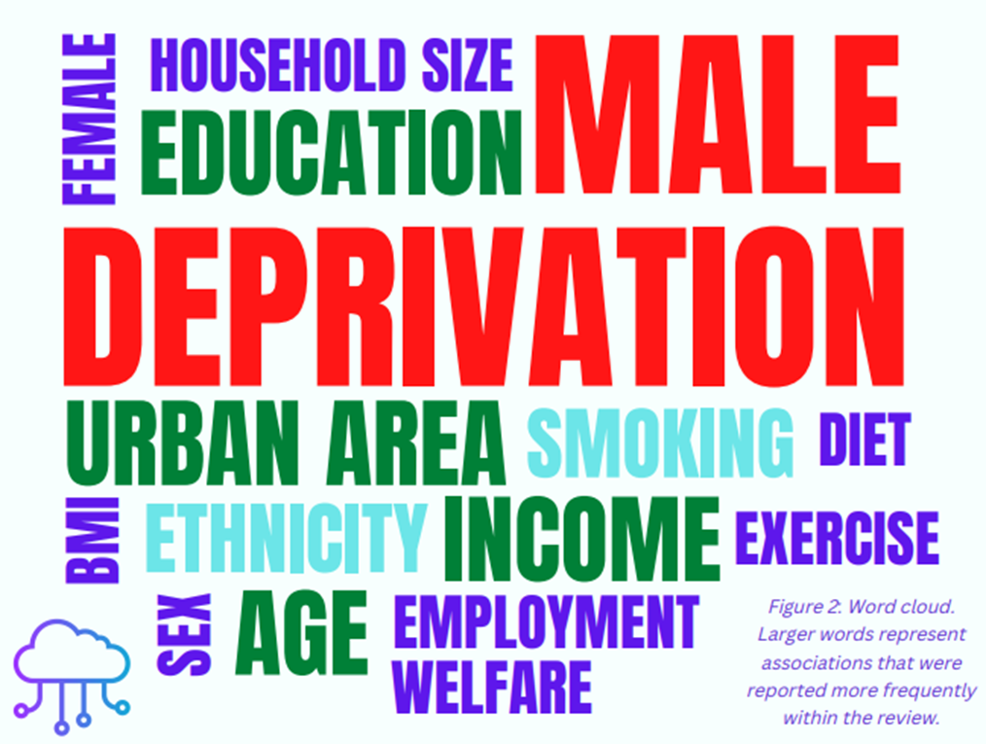
RESULTS.
Deprivation was reported as an associated factor of EHA of MM patients across six studies. One study unveiled notable synergistic effects between smoking, high deprivation and the EHA of MM patients.
Male sex was reported across four studies as an associated factor, with only one reporting Female sex. Male sex significantly modified the association between EHA and MM patients, whilst MM females generally displayed a lower risk of EHA.
low education attainment, urban living areas and old age were all reported across three studies. All three factors displayed significant associations with MM patients in EHA settings.
A relationship was unveiled within two studies whereby younger MM patients with mental health conditions were at higher risk of EHA than older MM patients with a mental health condition.
Other factors associated with EHA of MM patients were unemployment, lack of fruit and vegetable intake (diet), exercise, BMI, smoking, and mental health.
Prevalence rates varied between 7.8% and 87.6%.

Slide 9
Conclusions
Deprivation, old age and male sex are associated with increased risk of admission.
Some evidence to indicate a relationship between increased emergency admissions in younger multimorbid populations with mental health ailments.
Evidence suggested associations between smoking, diet low in fruit and vegetable intake, physical inactivity, BMI > 30, low education attainment, urban living areas, manual social class, and an increased risk of multimorbid emergency hospital admissions.
Evidence was unclear surrounding income, living arrangements, homelessness, and ethnicity across studies.
Strategies to reduce emergency admission of multimorbid patients alongside improved care and treatment can be more effective when accounting for how people live and work.
Future research must abide by a core set of conditions that are measured in relation to social determinants of health when investigating multimorbidity within emergency admission data to enable better comparability between research.

Slide 10
PhD Projects
THE SOCIAL DETERMINANTS OF MULTIMORBIDITY WITHIN HOSPITAL EMERGENCY ADMISSIONS: SYSTEMATIC LITERATURE REVIEW
WHAT ELSE ARE WE WORKING ON?
Synthesise evidence regarding the social determinants of health associated with the emergency hospital admission of multimorbid patients.
DEFINING MULTIMORBIDITY WITHIN EMERGENCY HOSPITAL ADMISSIONS: DELPHI SURVEY
Characterise a definition for multimorbidity within emergency hospital admissions.
SMALL AREA MULTIMORBIDITY INDICATOR (SAMI)
The UK’s first small area geographical health indicator aimed at identifying the admission burden of multimorbid populations within emergency hospital care.
CLUSTERING HES DATA IN SMALL GEOGRAPHICAL AREAS.
Analysing cluster compositions, demographic patterns of clusters and their associations with health care services within small areas within England using HES data.

Slide 11
Thanks for Listening
ANY QUESTIONS?
Email: S.Meredith@Liverpool.ac.uk

Slide 12
References
[1] Barnett, K., Mercer, S. W., Norbury, M., Watt, G., Wyke, S., & Guthrie, B. (2012). Epidemiology of multimorbidity and implications for health care, research, and medical education: A cross-sectional study. The Lancet, 380(9836), 37–43. https://doi.org/10.1016/S0140-6736(12)60240-2
[2] Kingston, A., Robinson, L., Booth, H., Knapp, M., Jagger, C., Adelaja, B., Avendano, M., Bamford, S. M., Banerjee, S., Berwald, S., Bowling, A., Burgon, C., Bustard, E., Comas-Herrera, A., Dangoor, M., Dixon, J., Farina, N., Greengross, S., Grundy, E., … Wittenberg, R. (2018). Projections of multi-morbidity in the older population in England to 2035: Estimates from the Population Ageing and Care Simulation (PACSim) model. Age and Ageing, 47(3), 374–380. https://doi.org/10.1093/ageing/afx201
[3] Soley-Bori, M., Ashworth, M., Bisquera, A., Dodhia, H., Lynch, R., Wang, Y., & Fox-Rushby, J. (2021). Impact of multimorbidity on healthcare costs and utilisation: a systematic review of the UK literature. The British Journal of General Practice : The Journal of the Royal College of General Practitioners, 71(702), e39–e46. https://doi.org/10.3399/bjgp20X713897

