Slide 1
Focussed wards & Embedding a voluntary organisation into the health service across North Lancashire Claire Niebieski (LSC ICB) & Carl Grace (The Well)

Slide 2
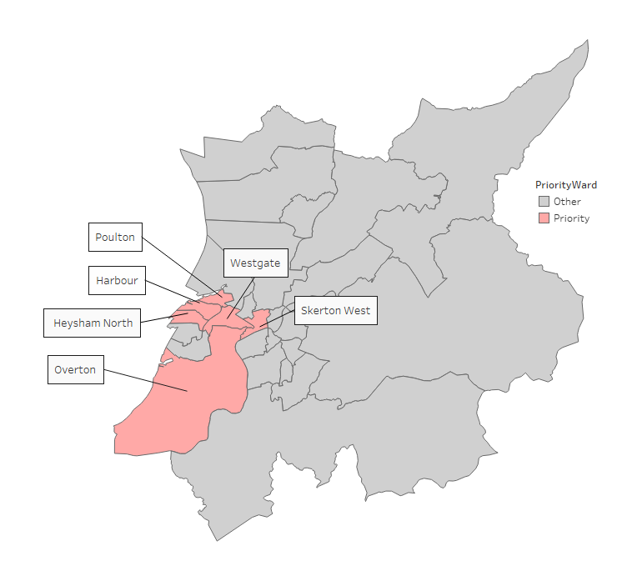
Focused Wards of interest Emergency admissions
By taking the wards in the top quartile for standardised emergency admission ratio, we can identify 6 focussed wards within Lancaster District. These are:
Poulton
Westgate
Skerton West
Harbour
Heysham North
Overton

Slide 3
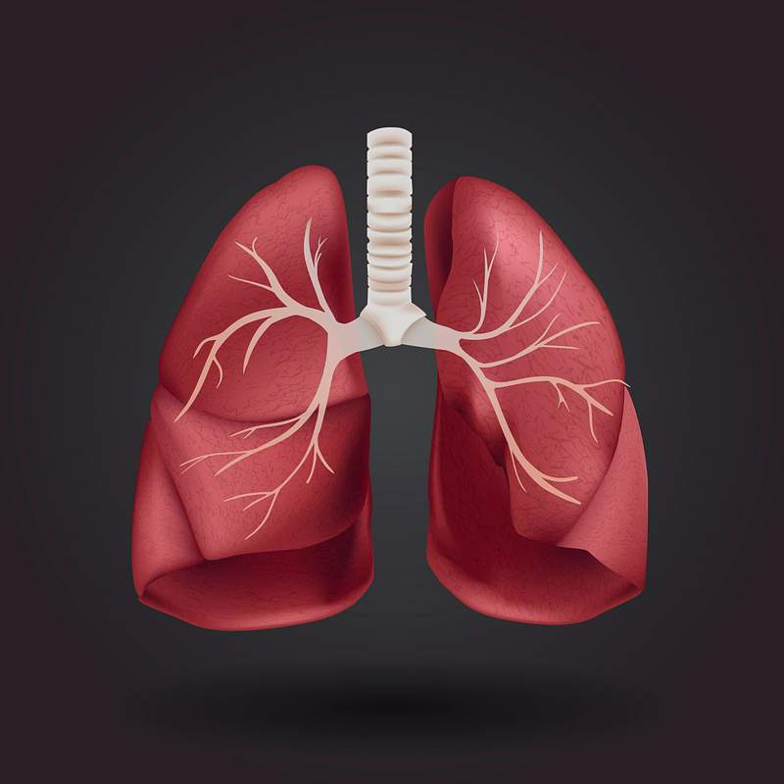
Why Focussed wards?
ED admissions Lancaster District: Diseases of Childhood and Neonates and Adults Respiratory disorder account for a disproportionately high percentage of all emergency admissions from the Focussed Wards when compared to all other wards across Lancaster District and wider Lancashire & South Cumbria
This Photo by Unknown Author is licensed under CC BY

Slide 4
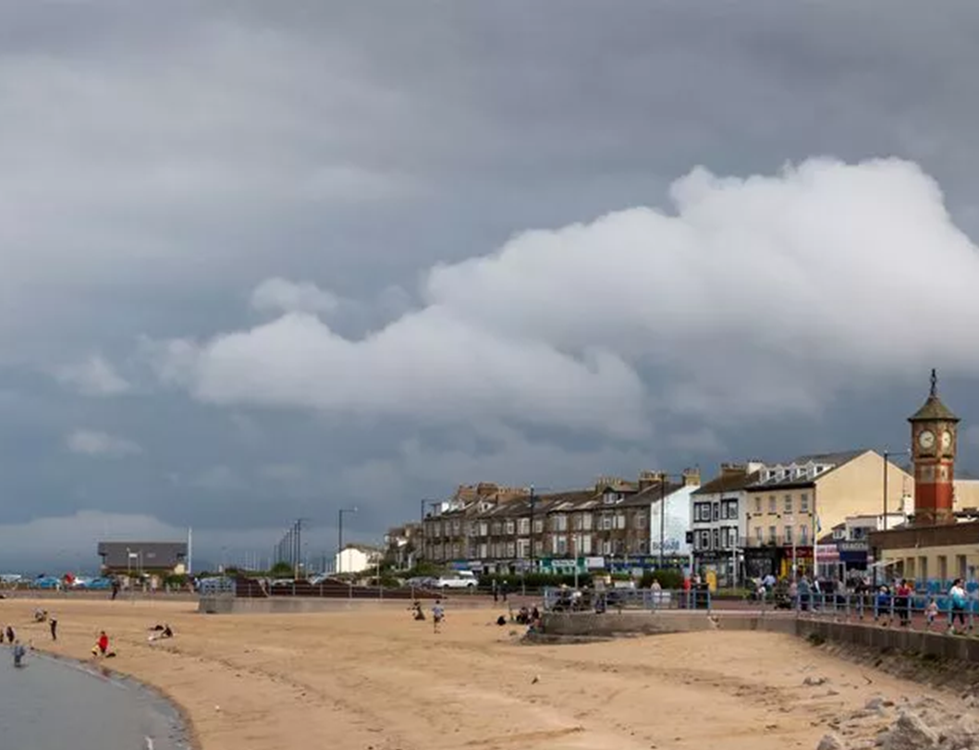
Why Focused Wards? Coastal communities & surrounding
Many already disadvantaged
More vulnerable population
Rising sea levels – loss of investment / jobs
→ Stress, anxiety ... Drug & alcohol issues... crime
Low house values – harder to leave
Higher levels of poverty
Disproportionate levels of poor health, multiple long-term conditions, lower life expectancy
Notes:
Many coastal communities already suffer disadvantage (think Barrow, Morecambe, Blackpool).
They often have a more vulnerable population (greater proportion of older people – e.g. Lytham)
The threat of sea level rises and damage can put off investors, leading to a worsening of the problems already faced, and their knock-on effects: reduced job prospects, more unemployment, money worries, poor diets, substance abuse, crime, drugs, even gangs… All too familiar, all bad for health.
Climate change will make these HIs worse.
And it will be harder to move away as house values are low compared to other areas.

Slide 5
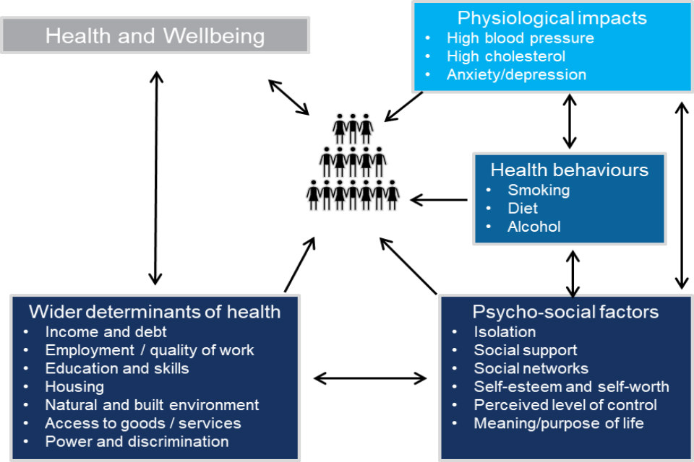
System map of the causes of health inequalities (Bentley / PHE 2019)
People do not lead single issue lives !!

Slide 6
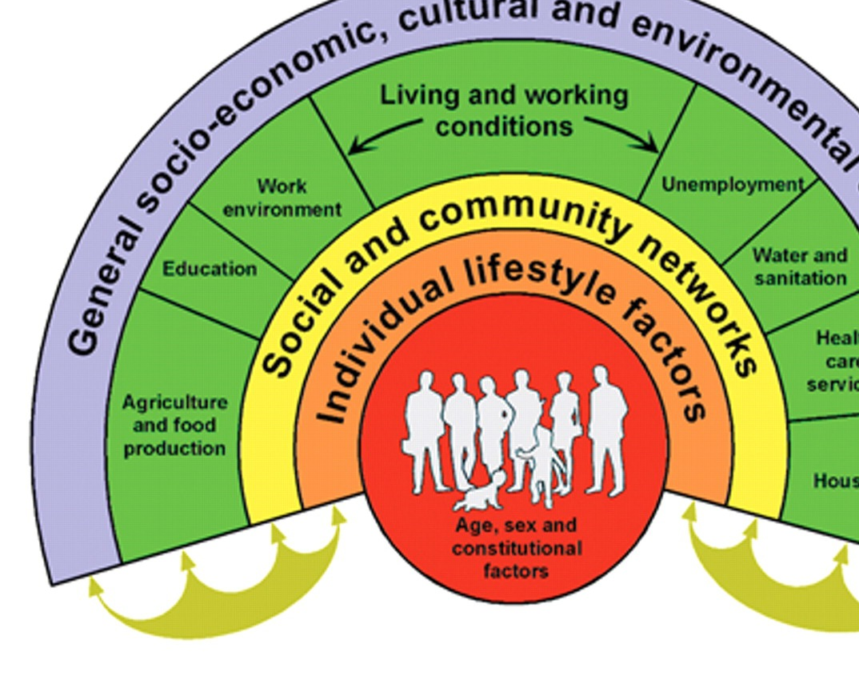
What are we doing?
Working together to pro-actively find and better support people to improve their health and wellbeing through the lens of respiratory conditions in conjunction with addressing wider issues in the focussed wards
This Photo by Unknown Author is licensed under CC BY-SA-NC

Slide 7
19 Bed, Intensive supported housing
Alcohol Assertive Outreach Workstream
Well Fed Social Supermarket
Food Clubs each week with homeless partners
Royal Lancaster Infirmiry Alcohol Liason Service
Sub Contractwith CGL Substance Misuse Service
Changing Futures Complex Needs Worksstream
L/E Training provision for schools, etc
NORTH LANCASHIRE
Bay Medical Primary Care Network inreach and outreach model
Facilited Access to Mutual Aid
7-day Electronic Platform
Out of hours Recovery Support provision for all cohorts
Eating Disorder Online Support

Slide 8
Any Questions / further thoughts?

