Slide 1
NIHR INSIGHT Programme North West
ARCFest
11th June 2024, 13:45-14:00, Online
Professor Dame Caroline Watkins
On behalf of INSIGHT Programme North West Partners

Slide 2
Session Overview
Background and context
NIHR INSIGHT Programme North West
How to apply
Practical hints and tips

Slide 3
What is the NIHR’s mission?
Notes:
The NIHR is funded by the Department of Health and Social Care. They work in partnership with NHS, universities, local government, other research funders, patients and the public to enable and deliver world-leading health and social care research that improves people's health and wellbeing and promotes economic growth.

Slide 4
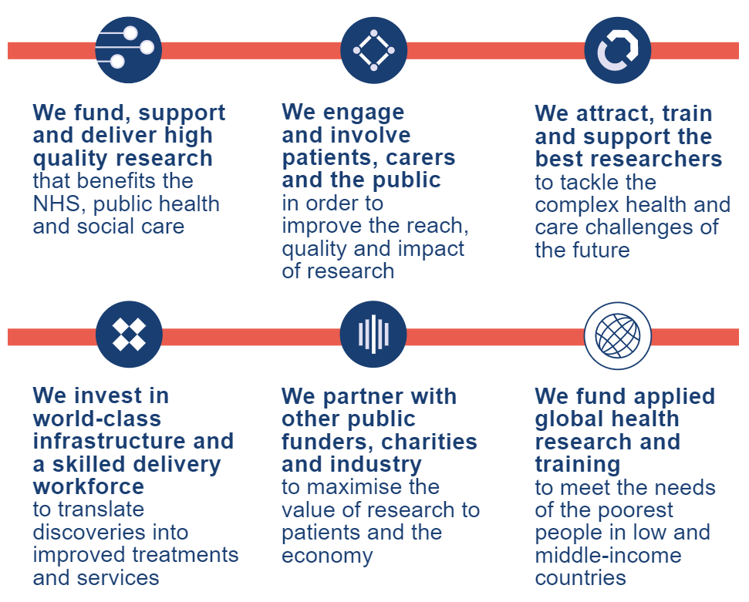
What is the NIHR’s mission?
Notes:
They have a number of workstreams
Funding research
Involving those affected by the research in its development
And seek to attract and train people to undertake research that tackles complex issues to improve the delivery of health and social care services.

Slide 5
What we do at the NIHR Academy
Develop and coordinate NIHR academic training,
career development and research capacity development
Manage national competitions for training and career
development awards
Attract, train and support the people conducting leading-
edge research focused on the needs of patients and the
public
Develop the skills of the next generation of health and care researchers to find lifesaving solutions to key emerging health and care problems
Notes:
The Academy is the specific arm of the NIHR infrastructure, which is responsible for the development and coordination of academic training, and career development.
They coordinate national research training, manage national competitive funding streams such as the Pre-doctoral and doctoral fellowships.
Their activities fall under the broad term of Research Capacity development.

Slide 6
Research Capacity Building
Notes:
Research Capacity Building has been defined as…
“…enhancing the abilities of individuals, organisations and systems to undertake and disseminate high quality research efficiently and effectively”
The term Research Capacity describes the sum of capabilities of individuals and organisations to carry out this research.
The ultimate aim of applied health research is to increase the evidence base, inform practice and improve outcomes for patients and service users.
To achieve this, we require a workforce equipped with the knowledge and skills to undertake high quality research.
A number of factors can affect research capacity including lack of equipment, lack of resources, lack of skills, and capacity (in this context time and staffing levels).

Slide 7
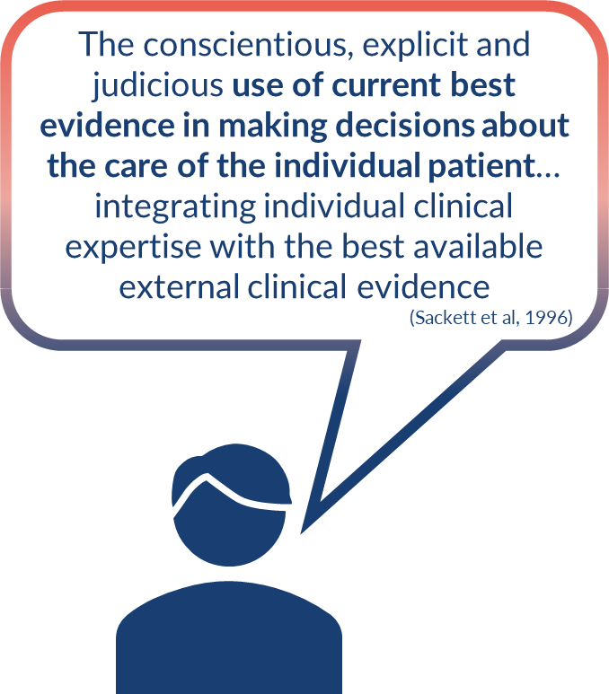
But why?
Patient’s Values and Circumstances
Best Research Evidence
Clinical Expertise
Evidence-Based
Practice
Information from the Practice Context
Evidence-Based Practice (EBP) involves clinical reasoning to integrate information from four sources
Notes:
But why do we have this national focus on research capacity building?
IT’s because it’s important that decisions about health and social care provision should be based on the best available, current, valid and relevant evidence.
The most recent definition of EBP suggests that practitioners should draw on 4 sources of information, their patients individual circumstances, their expertise, context-specific information from their service, and research evidence.
Evidence demonstrates that Professionals who utilise evidence in their practice, and institutions with a positive research culture, deliver services to a high standard

Slide 8
How?
VALIDITY
Setting research priorities… first-hand experience
Generating research ideas, shaping research questions
Drafting research applications and protocols
Designing studies to be relevant to health and social care staff and patients
Supporting recruitment
Data collection
Data analysis
Sharing insights
Dissemination… to the right people
Implementation in practice
Helping colleagues to develop new skills
IMPACT
RELEVANCE
Notes:
H&SC Professionals contribute to research in various ways, such as applying their expertise to identify the most important areas to be researched, and ensuring the research outputs are shared with the right people
their contributions increase…
Validity – trustworthiness, ensure the results are truly representative of the participants and similar individuals outside the study
Impact – Ensure research is undertaken which has the potential to produce important results
Relevance – ensure research is relevant and the results can be applied to those who access services

Slide 9
What motivates engagement in research?
Reasons include:
Interest in the research area
Desire to improve health and social care
Belief that research, and the evidence generated can improve quality and safety
Frustration with existing practice
Positive previous experience with research
Belief that research is “part of the job”
Potential for career development
Marajanovic et al, 2019
Notes:
And research shows that people get into research for numerous reasons, whether it is a previous good experience with research, at undergraduate, or in practice, or simply if you have been practicing for a while and noticed areas that need improvement.
People are motivated to undertake research for a variety of reasons, and they need opportunities that are realistic and suitable for their experience and career stage.

Slide 10
Notes:
Despite the evidence acknowledging that having people and institutions who are research active, research has shown that opportunities to engage in research are not equitably dispersed across the health and social care workforce.

Slide 11
NIHR INSIGHT: Inspiring Students into Research Scheme
AIM
To attract students, and new graduates in registered healthcare, social work and public health roles (not including doctors and dentists) into the full range of research careers, at a very early stage as they are starting out in their professions
OBJECTIVES
Innovative engagement programmes to showcase and attract people to research
Research Master’s Studentships to provide valuable training for individuals with limited of experience of real world research
Notes:
So the Academy have launched The INSIGHT programme to address that inequity…. Through the collaborative delivery of engagement and masters student programmes to inspire people to engage in research and implement it in their practice

Slide 12
NIHR INSIGHT Programme North West
Inspiring Students into Research
Notes:
The INISIGHT Programme North West includes 4 higher education institutions and is led by the University of Central Lancashire

Slide 13
NIHR INSIGHT Programme North West
A collaboration of over 30 health and social care partners, to date,
helping you to grow your research insight and expertise
Health Innovation North West Coast
Lancashire & South Cumbria Integrated Care Board
Lancashire & South Cumbria NHS Foundation Trust
Lancashire County Council
Lancashire Teaching Hospitals NHS Foundation Trust
Lancaster University
Liverpool City Council
Liverpool University Hospitals NHS Foundation Trust
Liverpool Women's NHS Foundation Trust
Manchester Biomedical Research Centre
Manchester University NHS Foundation Trust
NIHR Applied Research Collaboration Greater Manchester
NIHR Applied Research Collaboration North West Coast
NHS Cheshire and Merseyside Integrated Care System
NHS Greater Manchester Integrated Care Board
NHS Research and Development North West
North West Ambulance Service NHS Trust
Northern Care Alliance NHS Foundation Trust
Pennine Care NHS Foundation Trust
Stockport Metropolitan Borough Council
Tameside and Glossop Integrated Care NHS Foundation Trust
The Christie NHS Foundation Trust
The Walton Centre NHS Foundation Trust
University of Central Lancashire (UCLan)
University of Liverpool
University of Manchester
Vauxhall Primary Health Care
Wrightington, Wigan and Leigh NHS Foundation Trust
Active Lancashire
Alder Hey Children's NHS Foundation Trust
Blackpool Borough Council
Bridgewater Community Healthcare NHS Foundation Trust
Clinical Research Network (CRN) Greater Manchester
Clinical Research Network (CRN) North West Coast
East Lancashire Hospitals NHS Trust
Greater Manchester Mental Health NHS Foundation Trust
Notes:
The INSIGHT NW programme includes over 30 partner organisations who are dedicated to developing and delivering research that is relevant to the local, regional, national and global context
This number reflects those who we were able to contact prior to the launch, but we are actively working to engage all health and social care organisations in the NW
If you don’t see your employing organisation, you are still eligible to apply.

Slide 14
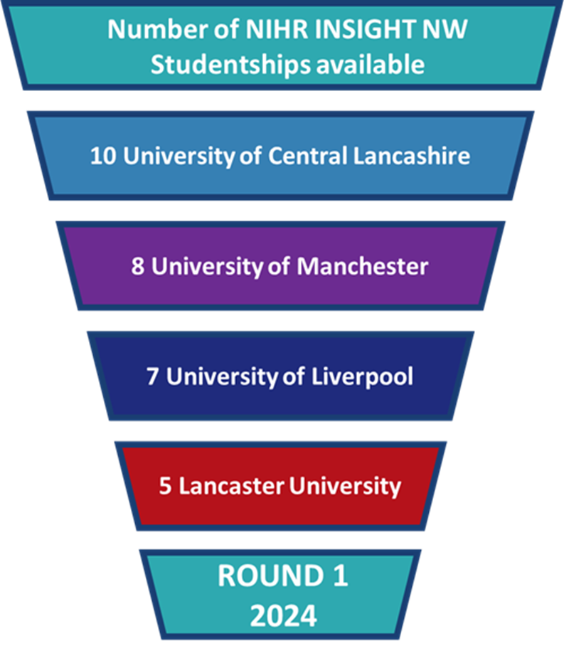
NIHR INSIGHT Programme North West: Research Master’s Studentships
Over three years, 90 studentships
30 available each year, 2024-2026
Tuition fees, at home rates (UK resident)
Tax-free stipend, Paid at UKRI rates, pro-rata
Full and part time study supported
4 research-intensive universities
6 Master’s programmes
Dissertation with a leading researcher
INSIGHT NW Master’s Student Network

Slide 15
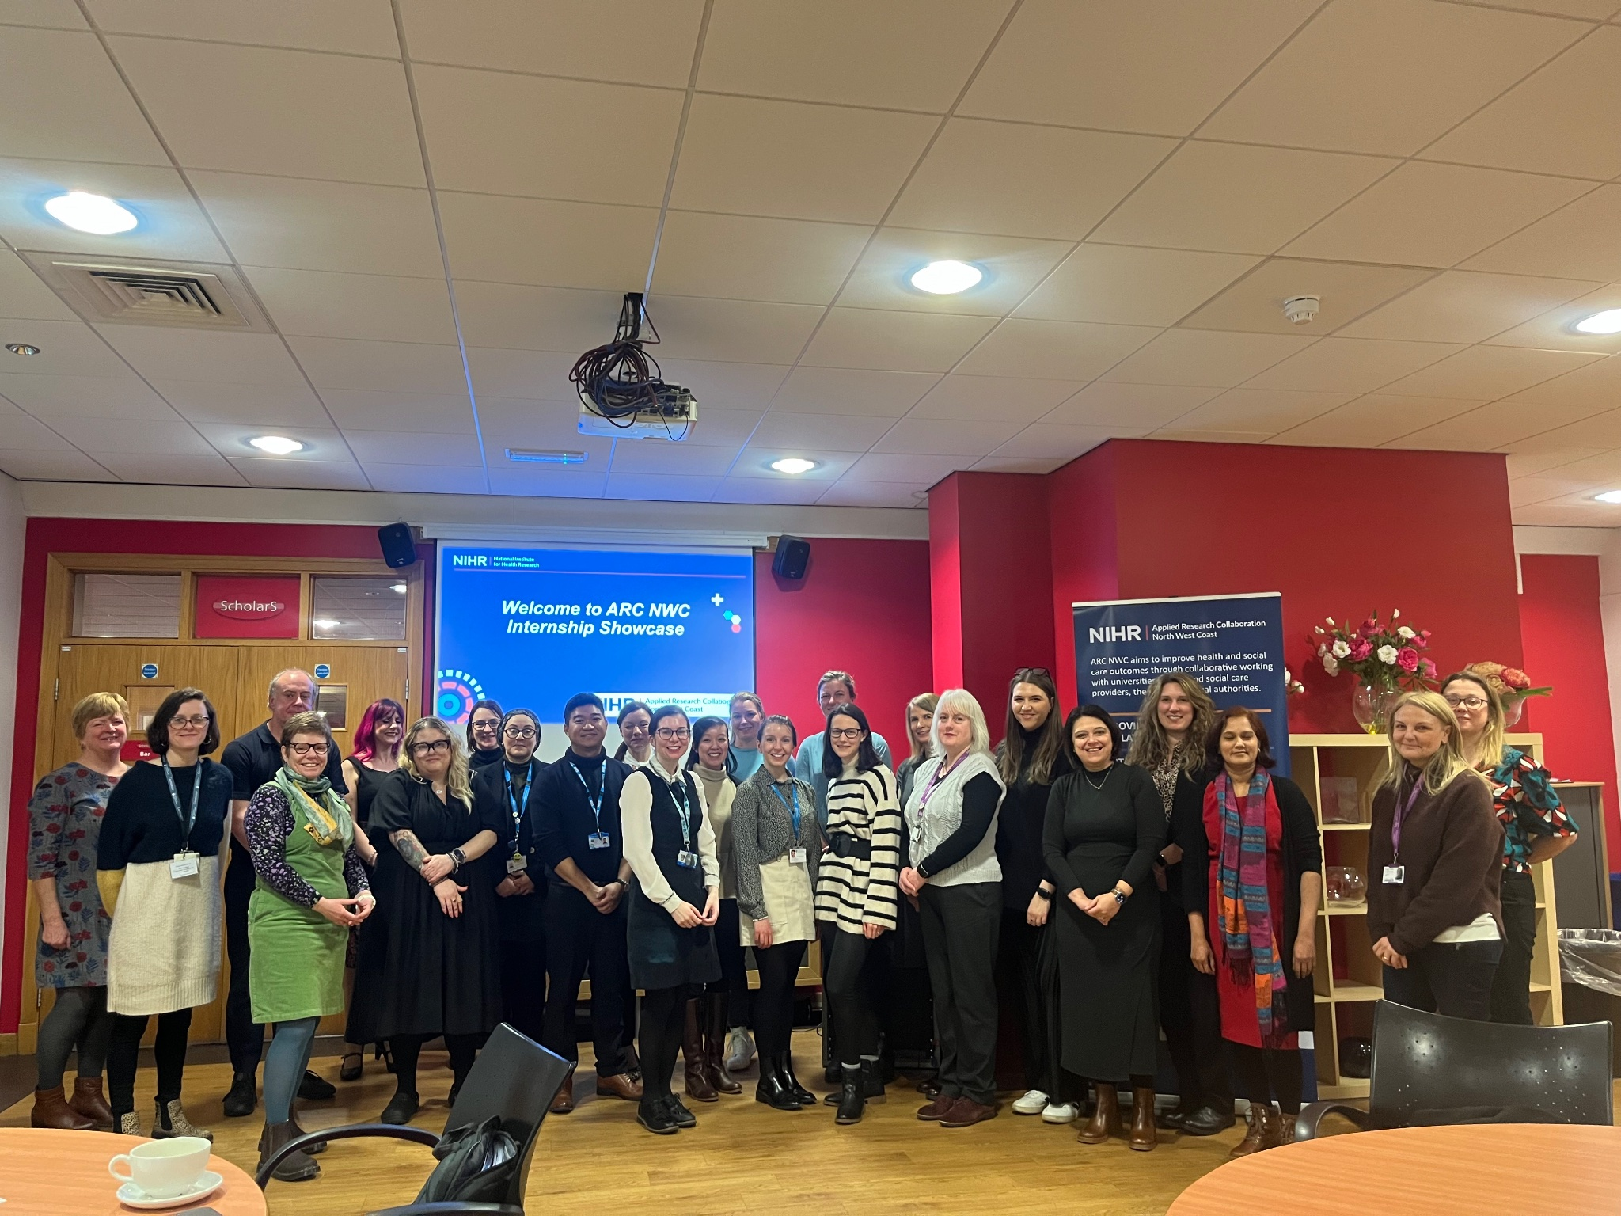
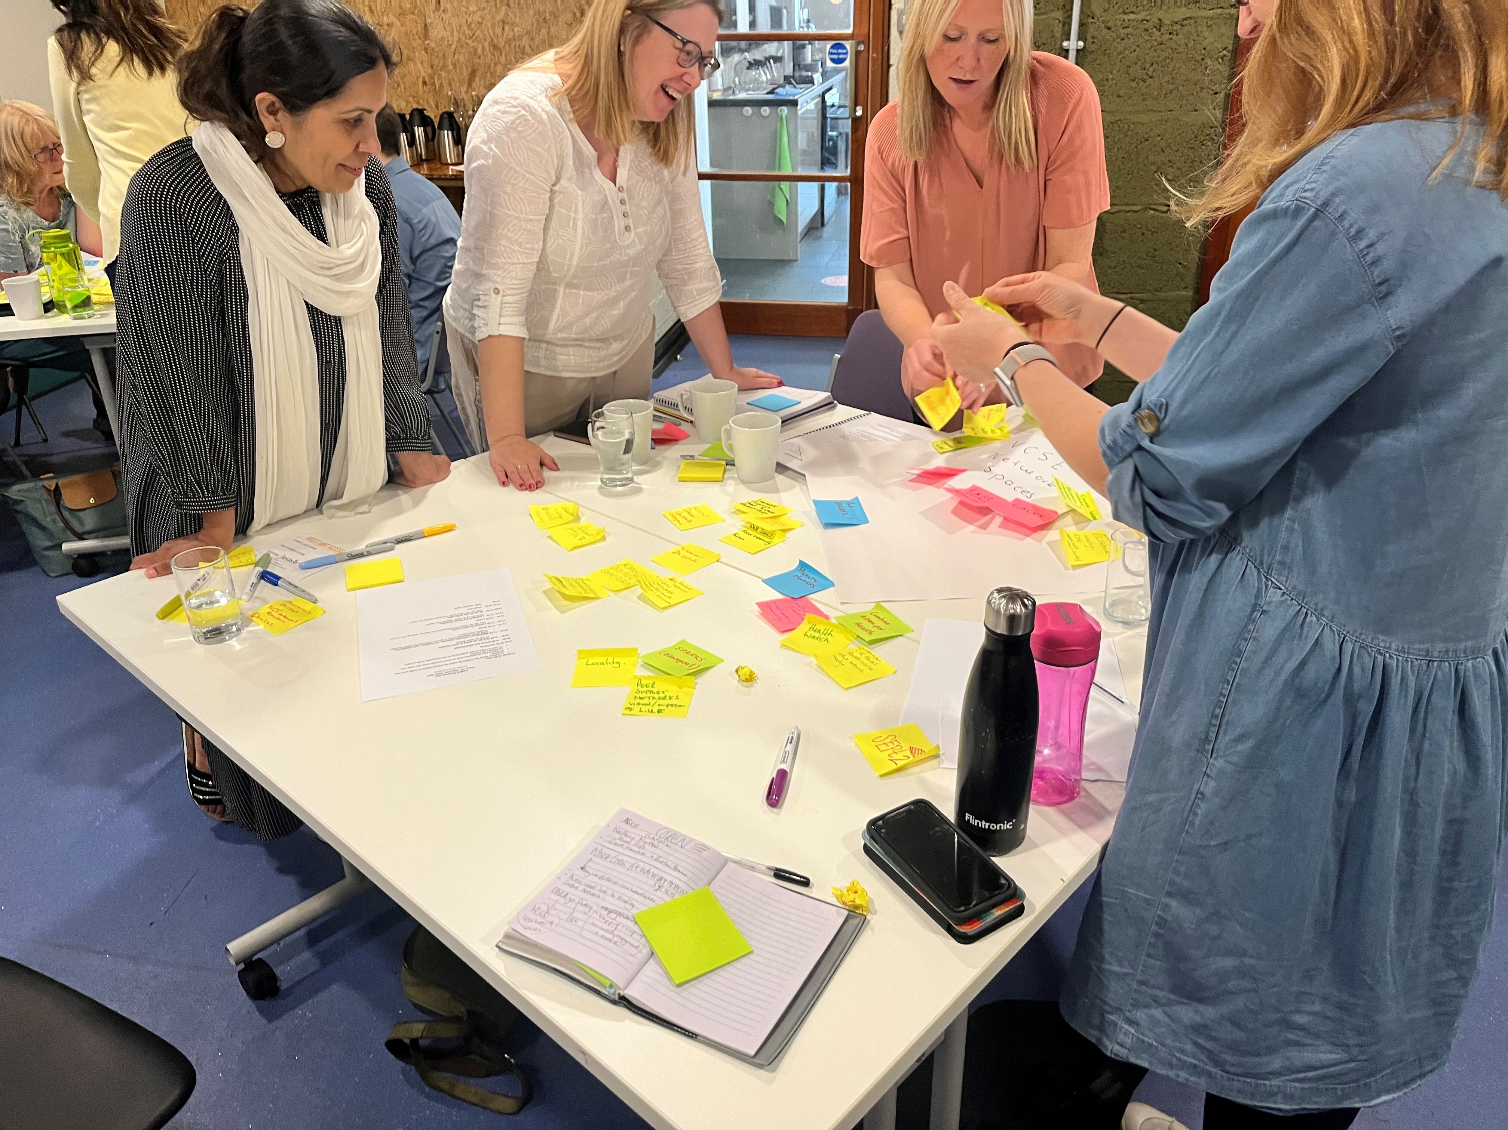
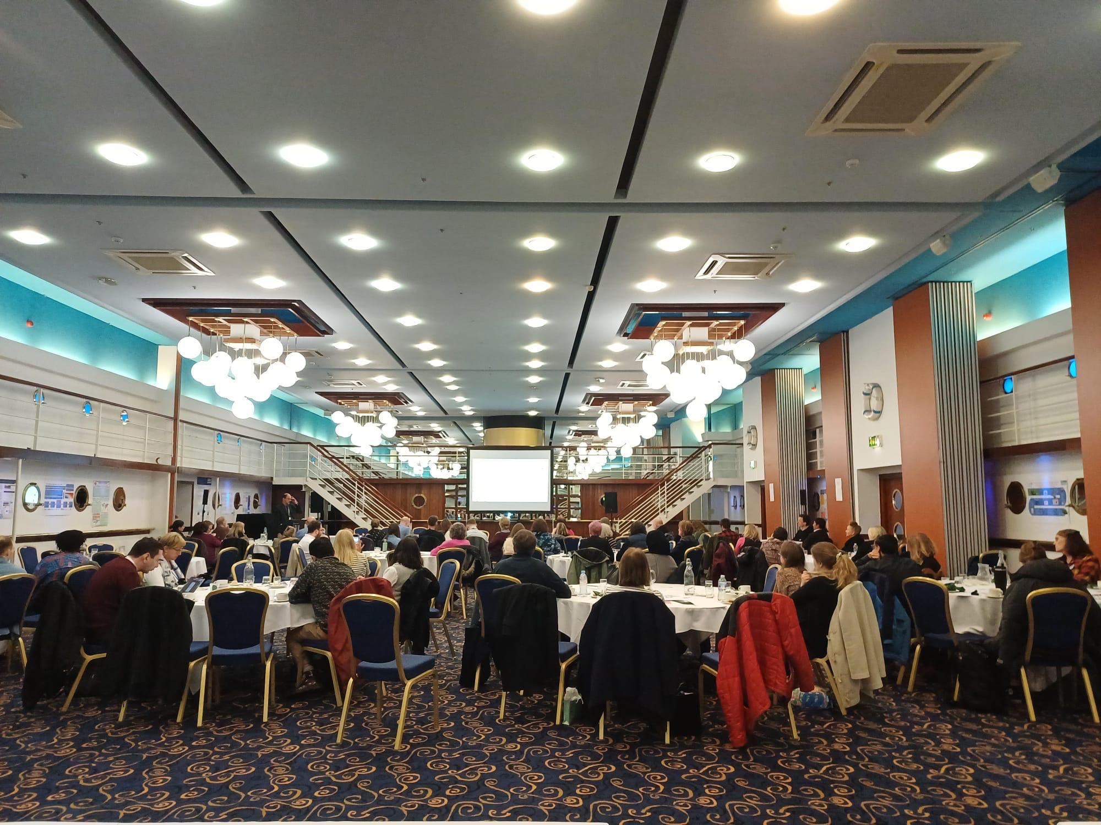
NIHR INSIGHT North West Programme: Engagement activities
INSIGHT NW Community of Practice
“Buddy system”
Master’s Network Meetings
Student-led conference
NIHR Academy
National conference
Wider infrastructure
ARC events e.g., ARCFests
Partner events e.g., Regional research events
Notes:
Master’s Network Meetings Biannual (May and December
Annual Student-led conference - September

Slide 16
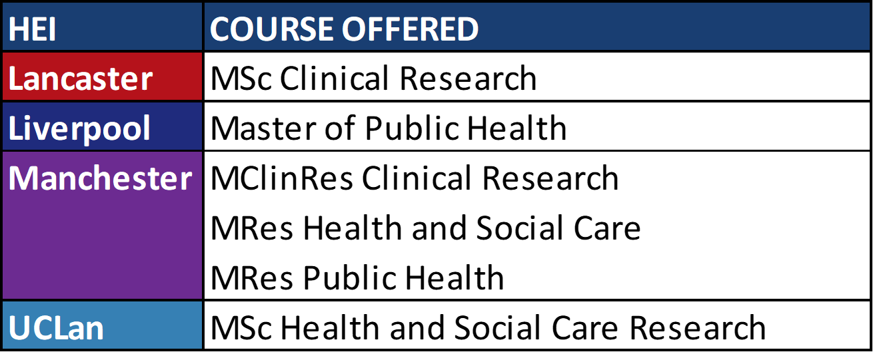
NIHR INSIGHT Programme North West: Master’s programmes supported

Slide 17
NIHR INSIGHT Programme North West: Recruitment Process
Round 1: Call Closes Monday 17th June 1pm

Slide 18
NIHR INSIGHT Programme North West: Eligibility Criteria
NIHR INSIGHT Studentships are designed for newly qualified,
or early career health and social care professionals who have
recently completed their professional registration.
This encompasses:
Those who have recently graduated from a health and social care undergraduate programme, including those graduating in summer 2024
Those who have been working in practice for up to 3 years.
We understand these definitions offer a perspective of who falls into these categories, and recognise that an individual may not easily fit into them depending on their personal circumstances, for example if a career break has been taken.
If you are unsure whether you are eligible, please contact the INSIGHT engagement team for advice
Please note: in addition to the INSIGHT NW eligibility criteria, each University has specific criteria, dependent on the Master’s programme in which you are interested, which you must fulfil

Slide 19
NIHR INSIGHT Programme North West: Application practicalities
Those wishing to undertake part-time study are required to have written support from their employer to enrol on their chosen Master’s programme and complete any necessary requirements.
All applicants will require two referees, able to comment on your character, academic ability, and your suitability for research work
The application form includes submission of a Supporting Statement, of up to 1000 words, detailing:
Your reasons for wishing to pursue a research master’s degree
Make a note of the set interview dates and negotiate with your employers
Slide 1 of 2
Notes:
Line manager support is not a pre-requisite of application, as we are aware the timeline for applications is tight and negotiating with employers may take time – however, if you are successful at interview, it will be a condition of the offer
The same principles apply to the references and we suggest you begin these discussions early to ensure you meet the appointment criteria

Slide 20
NIHR INSIGHT Programme North West
How will postgraduate study affect my earning ability?
Monthly Wage
£1,833
Full-Time Employment
Based on full-time employment with a salary of £28,407 (NHS Band 5, first pay point 23/24), £2367.25 per month, and assuming salary deductions:
£8 for Student Loan, post 2012 programme
£196.48 for Pension at 8.3% contributions
£330.23 for Tax ,and National Insurance at March 2024 8% rate
Full-Time Study – MSc Completion within 12 months
Based on full-time study plus 1 day of paid employment at £28,407 pro-rata:
Annual tax free stipend £19,237 per annum, or £1,603 per calendar month
One day (0.2FTE) paid employment at £5,681 per annum, or £473 per calendar month – tax free as the income is below the personal tax threshold
Please note full-time students can undertake no more than one day per week additional paid employment
Monthly Stipend £1,603 - £2,076
Monthly Stipend + Salary
£2,049
Part-Time Study + Employment – MSc Completion within 24 months
Based on part-time study plus 3 days (0.6FTE) of paid employment at £28,407 pro-rata:
Annual tax-free stipend £9,618 per annum, or £801 per calendar month
Three days (0.6FTE) paid employment at £17,044 per annum, or £1,248 per calendar month assuming deductions for pension, tax, and national insurance
Please note full-time students can undertake no more than three days per week additional paid employment
The above examples provide an illustration of your potential earning ability should you choose to undertake full or part time study
It is the responsibility of the award holder to ensure they are complying with tax laws should additional paid work be completed in addition to the tax-free stipend payment.
We are always happy to discuss options based on your individual circumstances. Please get in touch at INSIGHTNW@UCLan.ac.uk
Notes:
02.05.2024
https://www.net-paid.com/NHS-Band-5-Pay.php
From 1st April 2023 (with 2023/24 NHS pay rise of 5%), the annual salary for a Band 5 on the 1st pay point is £28,407. This is £2,367.25 a month before deductions. A person on this NHS pay point has to pay £131.93 a month of National Insurance, £196.48 a month NHS Pension contributions (from 1st April 2024) and £224.65 a month Income Tax. This makes their net (take home) pay £1,814.19 a month. – this is wrong as the NI has reduced
Stipend £19,237
https://community.hmrc.gov.uk/customerforums/sa/80e9e6f4-d845-ee11-a81c-00224800536f stipend not taxable and not to be included in tax return
https://www.gov.uk/income-tax-rates#:~:text=Your%20tax%2Dfree%20Personal%20Allowance,income%20is%20over%20%C2%A3100%2C000. Personal tax free allowance £12,570
0.6FTE

Slide 21
NIHR INSIGHT Programme North West Planting the seeds of research and nurturing the growth of the region’s health and social care professionals

Slide 22
For more information:
INSIGHTNW@UCLan.ac.uk
https://arc-nwc.nihr.ac.uk/insight/

Slide 23
References
Clarke M & Loudon K. (2011) Effects on patients of their healthcare practitioner's or institution's participation in clinical trials: a systematic review. Trials https://doi.org/10.1186/1745-6215-12-16
Sackett D et al. (1996) Evidence based medicine: what it is and what it isn’t. BMJ https://doi.org/10.1136/bmj.312.7023.71
Marjanovic S et al (2019). Involving NHS staff in research. The Healthcare Improvement Studies Institute. https://www.thisinstitute.cam.ac.uk/app/uploads/2019/02/Involving-NHS-Staff-In-Research-1.pdf

