Slide 1
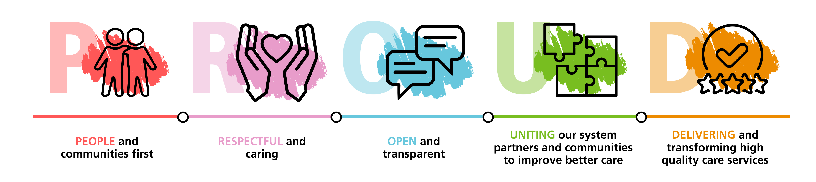
Accident & Emergency and Health Inequalities
Mr Andy Curran
Associate Medical Director, Lancashire & South Cumbria Integrated Care Board
Notes:
Thanks very much for the kind invite and welcome to our patch. Great to be here and just by that boosting our local economy and will help us reduce health inequalities so already this is a good news story.

Slide 2
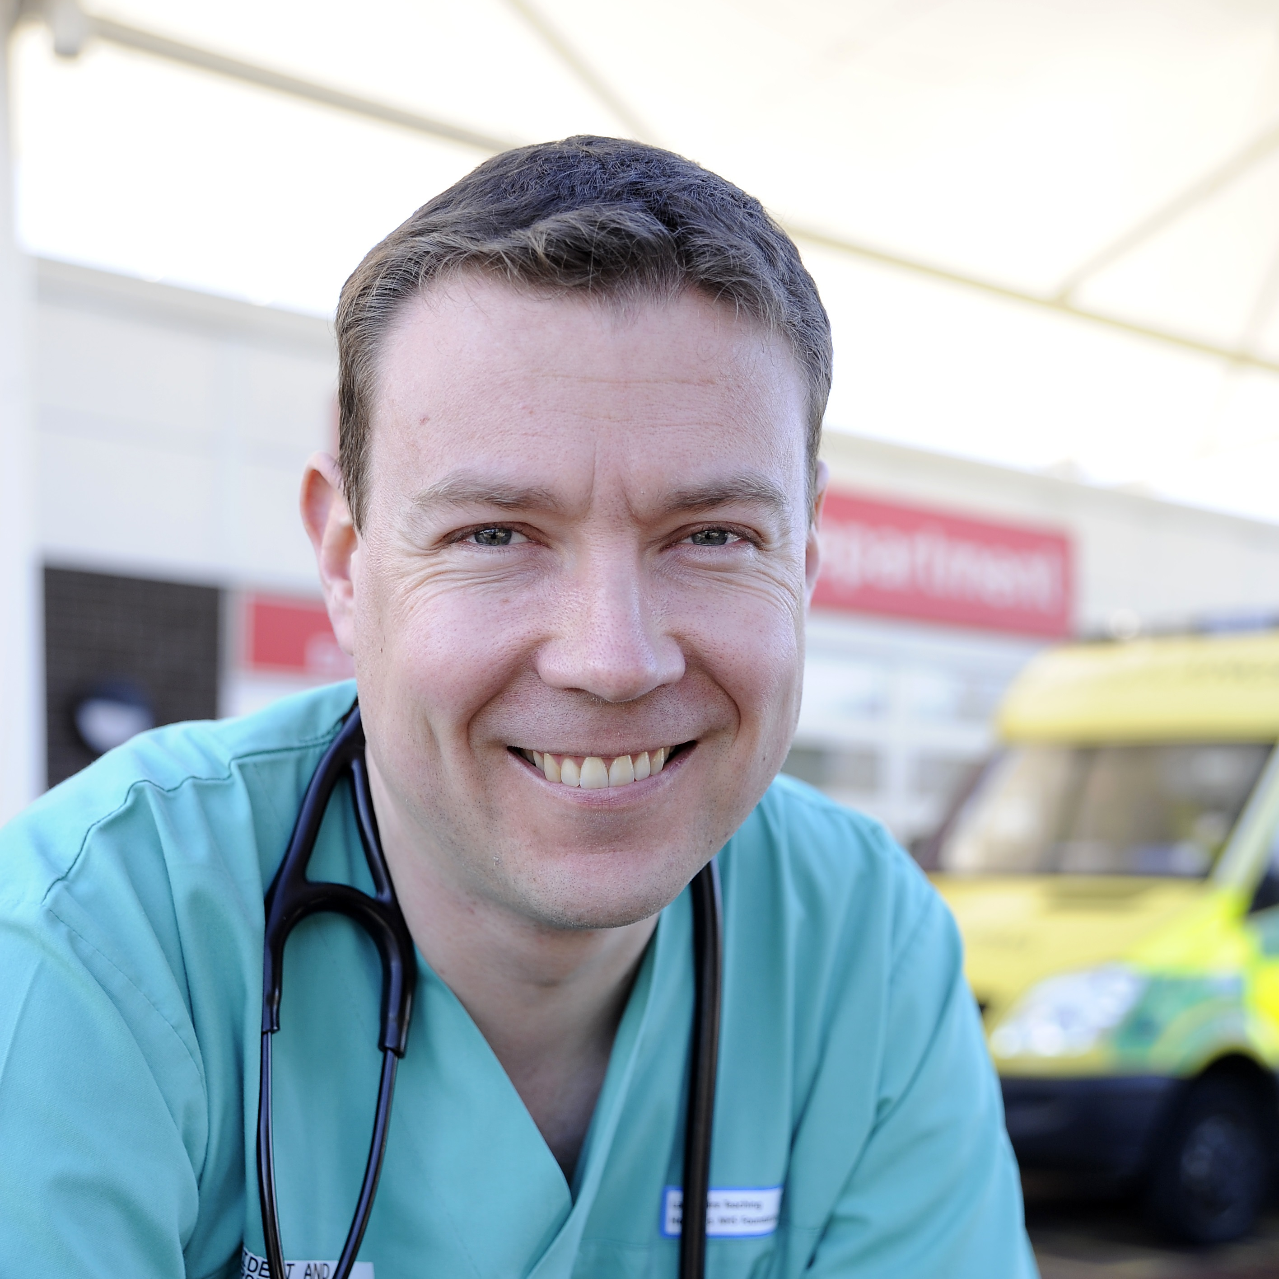

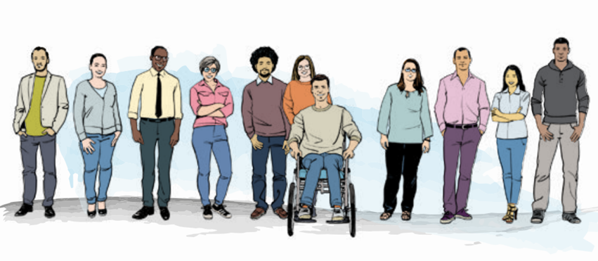
Casualty (Officer)
Accident and Emergency
Emergency Department
Notes:
Couldn’t let the moment pass to share about the evolution of Emergency Medicine into its own speciality and its what I wanted to do when I grew up!

Slide 3
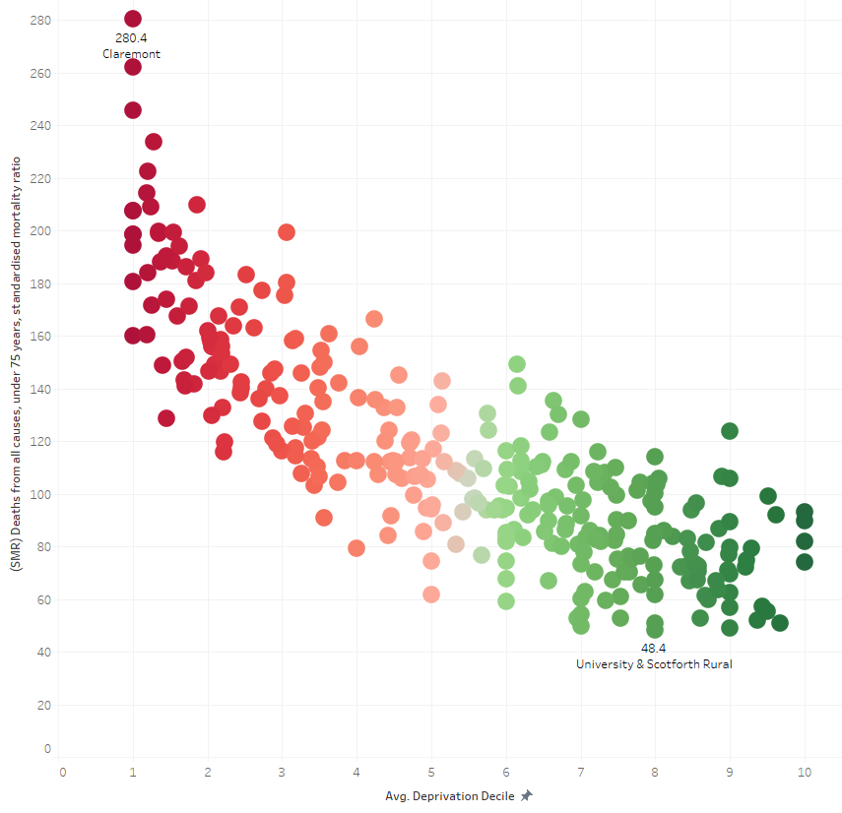
Lancashire & South Cumbria Premature Mortality by ward and deprivation
More deaths
Deaths from all causes, under 75 years, standardised mortality ratio
https://fingertips.phe.org.uk/profile/local-health/data#page/6/gid/1938133185/pat/401/par/E06000009/ati/8/are/E05001643/iid/93252/age/163/sex/4/cat/-1/ctp/-1/yrr/5/cid/4/tbm/1/page-options/car-do-0
Less deaths
More deprived
Less deprived
Notes:
So, lets look at some data and I’ve tried to put handy labels on the axis so we can take away the headline and not get lost in the detail.
Expected deaths for each area are calculated by applying age-specific death rates for England to each area's population. SMRs calculated by dividing the observed total deaths in the area by the expected deaths and multiplying by 100.

Slide 4
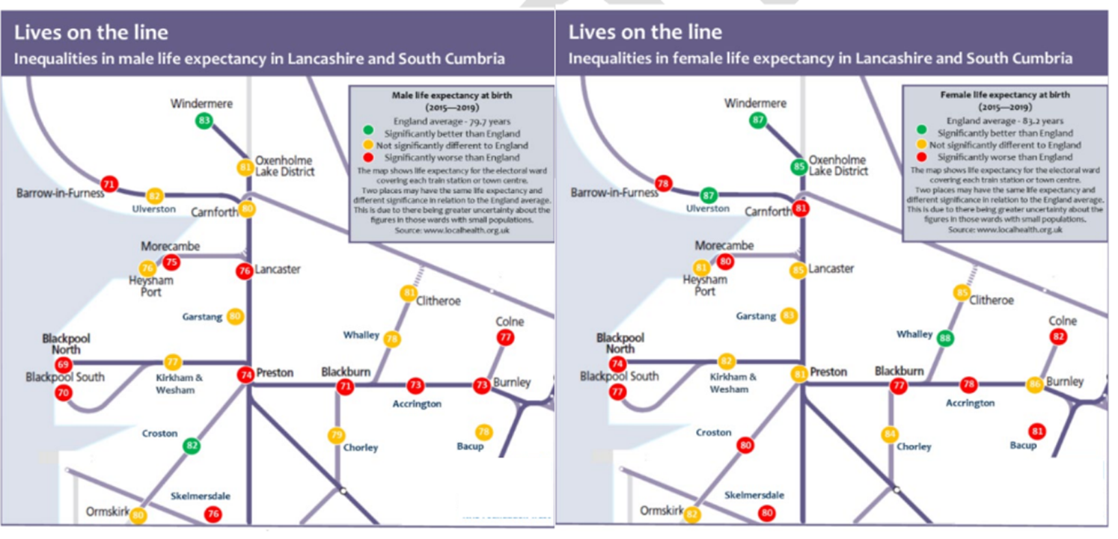
Where you live makes a difference.
Notes:
If we report UK, regional or even ICB wide we can miss important differences between populations and their needs. Using something as embedded as train lines gives us a snap shot and traffic light system applied to more death, about expected and less deaths than expected. But how local is local, does it come down to which side of a street we live on?
QUESTION FOR DALE, AS A TRAINEE MOVING AROUND DEPARTMENTS DO YOU SEE THE VARIABILITY IN POPULATIONS OR IS IT THE SAME EVERYWHERE?

Slide 5
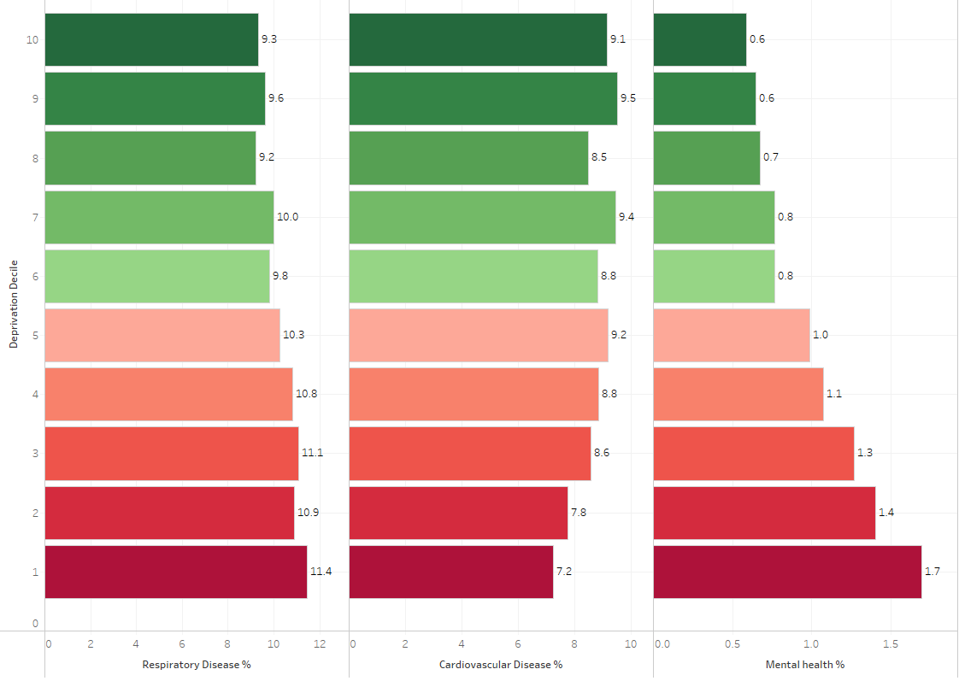
Lancashire & South Cumbria Disease prevalence by deprivation decile
Less deprived
More deprived
Respiratory
Cardiovascular
Mental Health
Notes:
So what leads to those variations in deaths? Lets look at three big health areas, respiratory, cvs and mental health. Not as big a variation in respiratory and CVS as you might expect, in fact less CVS illness in most deprived areas but look at mental health? A really key question to ask people is “what matters to you?”, not “whats the matter with you? Within Blackpool great work going on with Health and Wellbeing coaches in their commiunities, all of whom have been employed to do this work and just by giving them a job their wellbeing has soared. It will take time but it might not be all about health interventions that we need to look at.

Slide 6
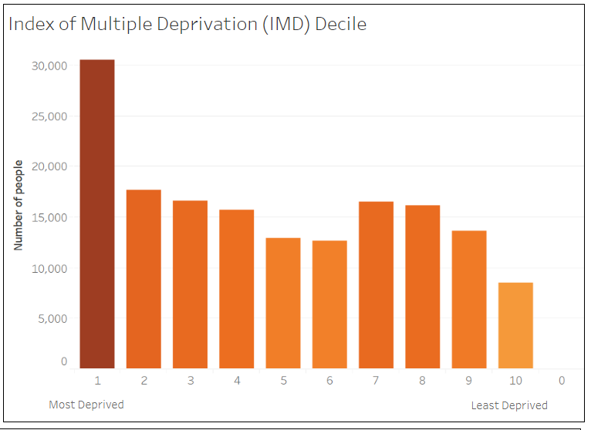
How many have 3 or more Long term Conditions?
Notes:
30,528 people in IMD 1 have 3 or more LTCs. Do we spend our money or deploy resources equally to every ward or do we target?

Slide 7
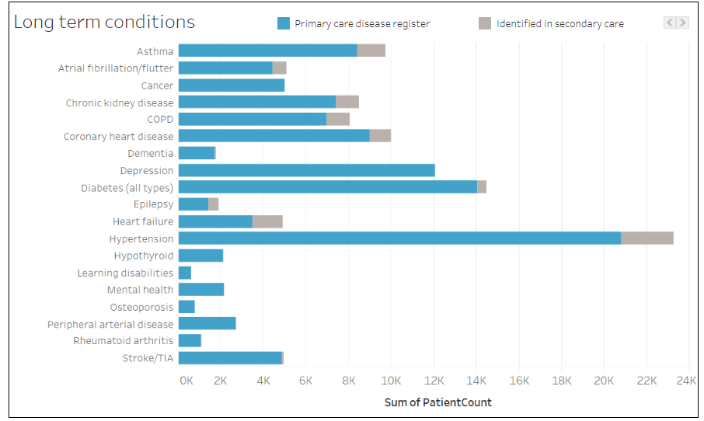
What are those Long Term Conditions?
Notes:
Remember that graph with respiratory, cvs and mental health? A massive driver of the CVS numbers is hypertension. Nationl screening campaigns have led to identification of large numbers of people at risk but which members of our population took up the screening offer? Its not that we should ignore it but sometimes we do need to delve into the details to understand it and then allow us to address it.

Slide 8
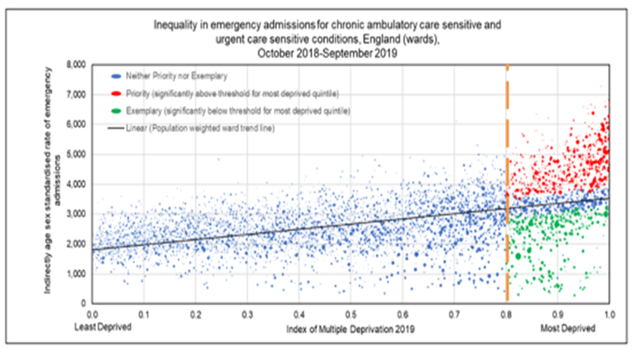
Emergency Admissions
More admissions
Less admissions
Less deprived
More deprived
Notes:
The chart below shows the distribution of all English LA wards (each dot), with a scale running left to right of deprivation score, and horizontally, the standardised emergency admission rate for ambulatory care and urgent care sensitive conditions.
The scatter plot reveals three important issues for consideration:
The sloping line within the Blue dot wards represents the absolute gradient of inequality (AGI). This clearly shows the graduated increase in admission rate the higher the ward deprivation score. The admission rate doubles from lowest to the highest deprivation score.
However, amongst the wards within the highest deprivation scores there is a much greater spread. The heavy dashed line identifies where the most deprived quintile (20%) of wards in England starts. In this segment:
Red dot wards are outliers, with significantly more admissions even than might be expected for their deprivation score. This is symptomatic of ward environments least supportive of prevention and pro-active management of health risks, which then present as crisis and emergency. These are the ‘Priority’ wards for attention
Green dot wards, in contrast, show as outliers with significantly less admissions than expected. The relatively low admission rates despite high deprivation scores suggests that effective forms of mitigation of risk must have been in place. Experience of these communities may well provide learning for how to support other similarly deprived wards. These are the ‘Exemplar’ wards.

Slide 9
Wealth = Health
It is fair to say that in population groups who live in poverty (defined by lowest 20% IMD) in Lancashire and South Cumbria compared with the England average; health equity is not being achieved. Being poor means that people are more likely to experience respiratory conditions that increase mortality rate, reduce life expectancy and healthy life expectancy, therefore widening the health inequalities gap between the groups that are poor and those who aren’t.
Exploring the data in this way makes the case for risk stratifying criteria to be applied to targeted groups
Notes:
QUESTION FOR KEITH, WHAT IS THE PUBLIC ACCEPTABILITY OF CLINICIANS FACTORING IN WEALTH TO STRATIFY HEALTH INTERVENTIONS AND TARGET POPULATIONS?

Slide 10
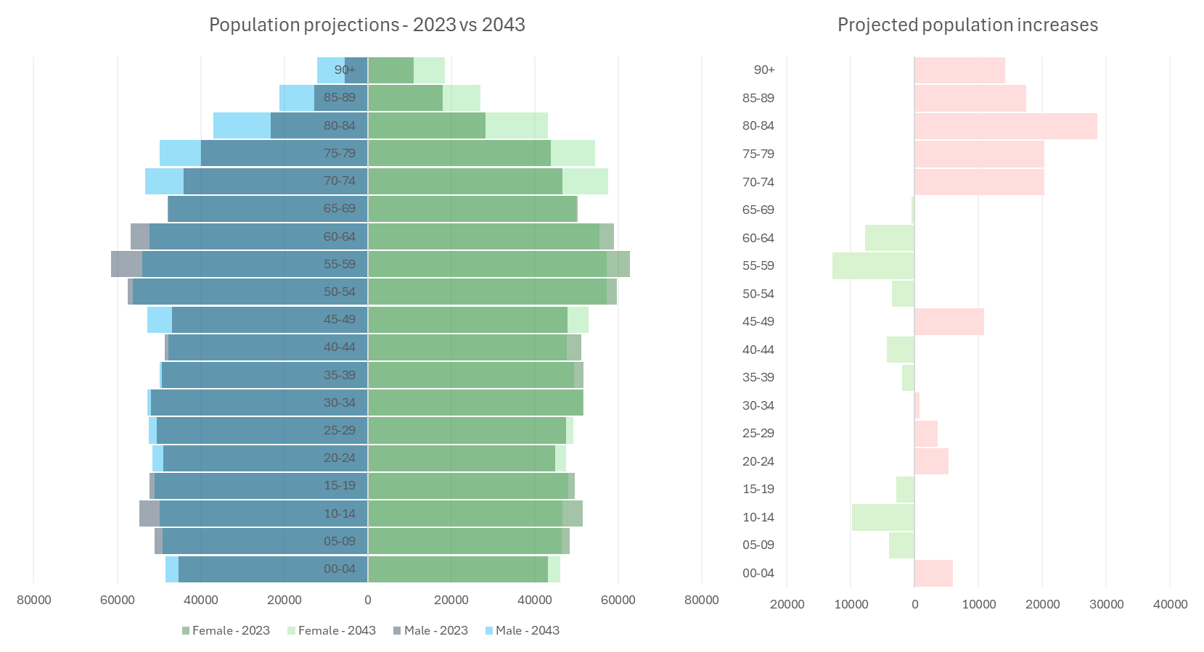
Isn’t just we are living longer?
ONS CCG population projection 2018
All L&SC CCGs
Notes:
The need to focus on residents maintaining independence and managing health conditions, feeling happy and have a safe warm home to live in. LA’s have a huge role to play in this
Healthy Life Expectancy – HLE, much wider gaps – prevent / delay disease.
More generalised clinicians / pathways to deal with multiple LTCs under one roof
Big focus on screening and earlier disease detection
Environments require adaption – transport, leisure facilities, predictions on housing for our aging population

Slide 11
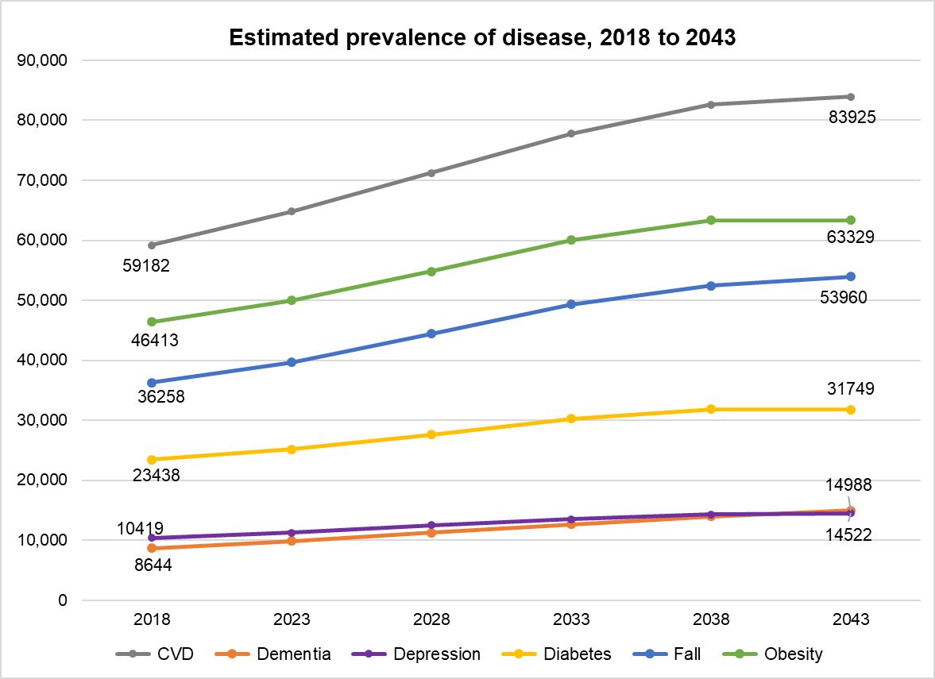
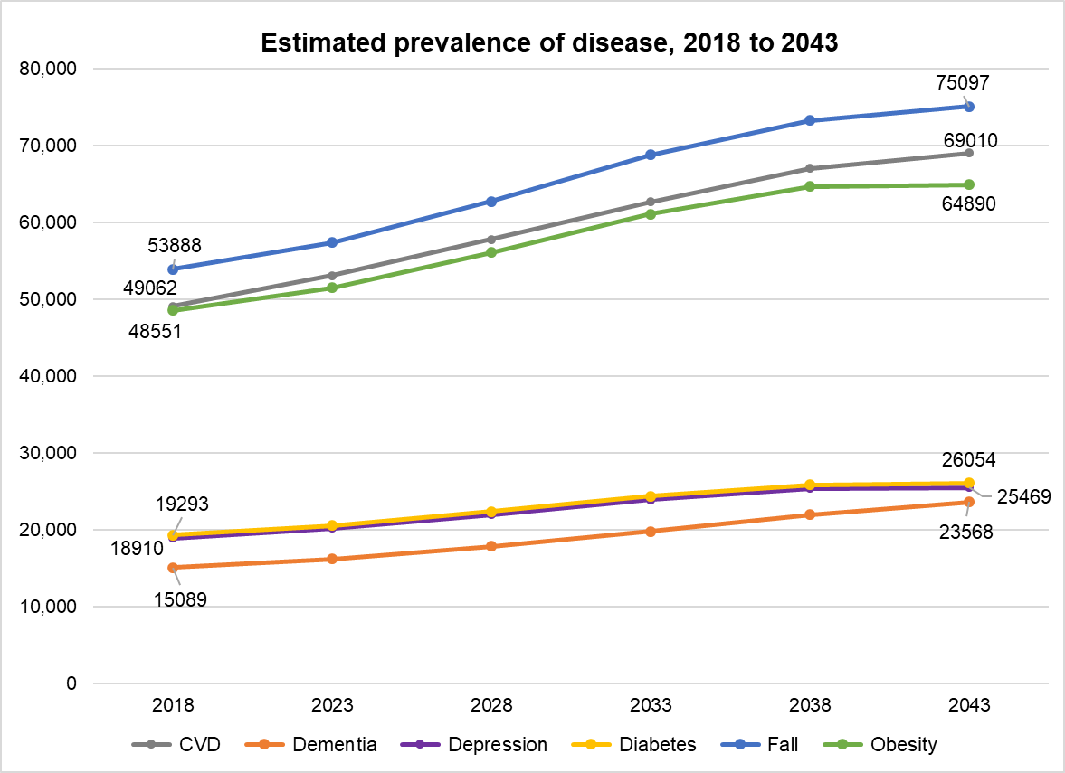
Estimated disease prevalence to 2043* Lancashire & South Cumbria ICS
Males 65+
Females 65+
Condition | 2018 | 2023 | 2028 | 2033 | 2038 | 2043
CVD | 59,182 | 64,772 | 71,216 | 77,778 | 82,606 | 83,925
Dementia | 8,644 | 9,833 | 11,249 | 12,627 | 13,942 | 14,988
Depression | 10,419 | 11,241 | 12,500 | 13,521 | 14,286 | 14,522
Diabetes | 23,438 | 25,159 | 27,592 | 30,223 | 31,842 | 31,749
Fall | 36,258 | 39,656 | 44,431 | 49,315 | 52,458 | 53,960
Obesity | 46,413 | 49,972 | 54,828 | 60,028 | 63,324 | 63,329
Condition | 2018 | 2023 | 2028 | 2033 | 2038 | 2043
CVD | 49,062 | 53,070 | 57,786 | 62,656 | 67,037 | 69,010
Dementia | 15,089 | 16,170 | 17,803 | 19,789 | 21,948 | 23,568
Depression | 18,910 | 20,172 | 21,926 | 23,914 | 25,356 | 25,469
Diabetes | 19,293 | 20,542 | 22,376 | 24,351 | 25,837 | 26,054
Fall | 53,888 | 57,351 | 62,726 | 68,759 | 73,280 | 75,097
Obesity | 48,551 | 51,490 | 56,093 | 61,099 | 64,693 | 64,890
*from 2018 ONS population projection data, applied to estimated disease prevalence from POPPI
Notes:
For males, there will be higher estimated prevalence of cardiovascular diseases, obesity and falls (the estimated count of at least one fall or more in a twelve-month period, it does not include admissions from falls), based on England estimated prevalence rates for those 65 and over. For females the highest prevalence conditions are falls, cardiovascular disease and obesity (again based on England prevalence). Looking at the projected figures, almost 84,000 males (65 and over) and 69,000 females (65 and over) are expected to have CVD by 2043. For falls this is almost 75,100 for females and almost 54,000 for males. All these conditions place a huge burden of demand on health services, including primary and secondary care, as well as pressure on adult social care services for local authorities. It is important to note that a person may experience more than one condition (for example, obesity and diabetes), so the individual condition values combined is not the total number of people affected. These values may be underestimated. The England prevalence applied to the area population figures will produce the similar trajectories for each disease/condition prevalence, only the numbers (estimated count) will vary across areas (depending on population change for each authority). There will be other local factors which will influence these future counts, such as deprivation, housing, employment, cost of living, access to health services, existing conditions, etc., meaning the values could be higher or lower than the England estimated prevalence.
QUESTION FOR MARK, HAVE YOU SEEN AN INCREASE IN AGE OF THOSE ATTENDING AND WHAT IMPACT DOES THAT HAVE ON YOUR DEPARTMENT?

Slide 12
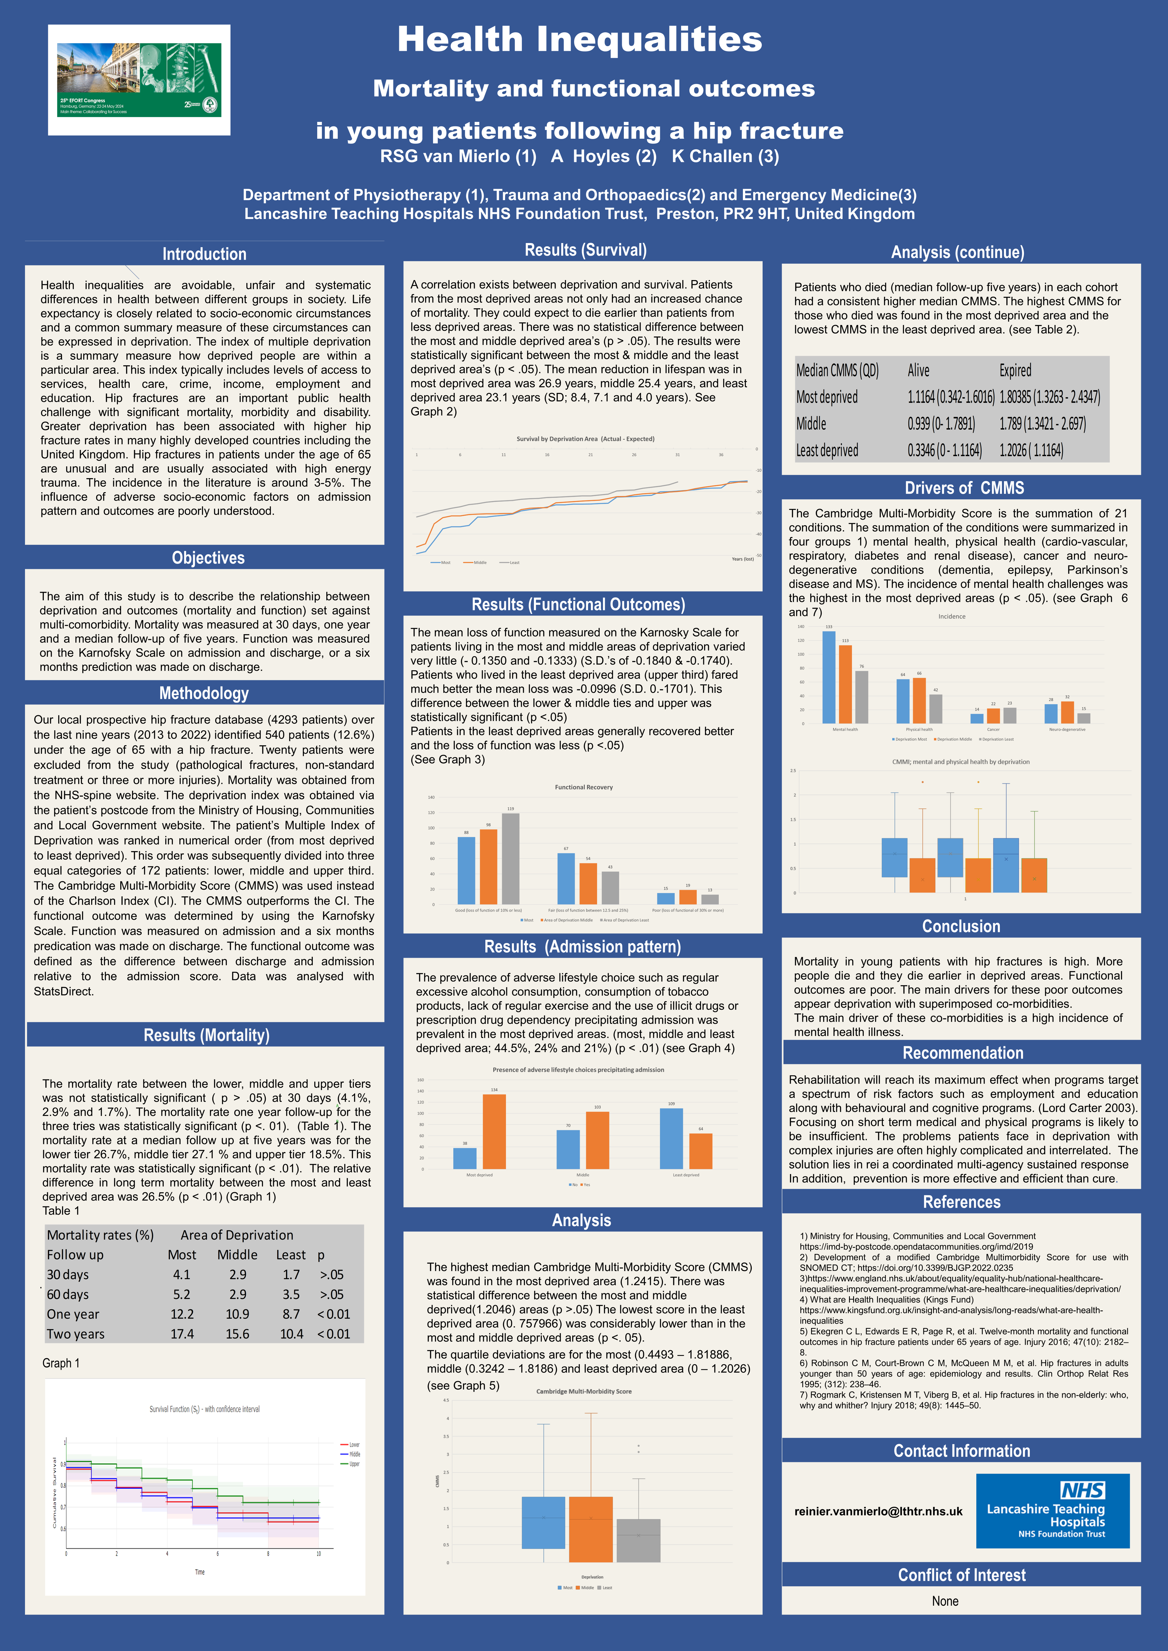
Notes:
We mentioned falls in the previous slide as being on the increase for the older population but lets look at falls in the younger (all relative) population, ie under 65’s.

Slide 13
Notes:
Colleagues of mine at LTHTR down the road, Riene now retired physiotherapist and Kirsty an ED consultant and self declared geek. For falls looking at fractured neck of femurs in those under 65 years and mortality at 30 days, one year and five years.

Slide 14
Notes:
Patients from the most deprived areas not only had an increase chance of mortality but they were more likely to die earlier than from less deprived areas. Makes us think about healthy life expectancy and how important that is to the wellbeing of the population, perhaps even more so than simple life expectancy?

Slide 15
Notes:
QUESTION FOR TONY, IS CONSIDERATION GIVEN FOR LEVEL OF DEPRIVATION IN RECOVERY FROM EMERGENCY AND OR ELECTIVE PROCEDURES?

Slide 16
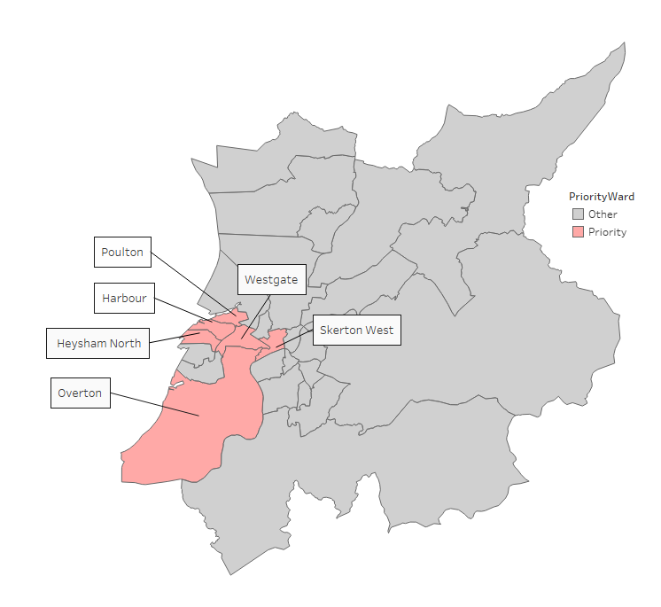
Focused Wards of interest
Emergency admissions
By taking the wards in the top quartile for standardised emergency admission ratio, we can identify 6 focused wards disproportionately driving ED attendance within Lancaster District. These are:
  Poulton
  Westgate
  Skerton West
  Harbour
  Heysham North
  Overton
Notes:
You will see this slide again later this afternoon but it is all about our local community here in and around Morecambe. We know where we need to focus and those areas are high users of ED’s and other emergency and urgent services, we probably know who they are too! High intensity users. Costs. In a world where money does rightly or wrongly make the world go round it’s a win win.

Slide 17
Diseases of interest
Emergency admissions
Emergency admissions between April 2018 and October 2023
Diseases of Childhood and Neonates and Respiratory disorder account for a high percentage of all admissions for the Priority Wards when compared to the non-Priority Wards in Lancaster, with Digestive System disorders and Hepatobiliary and Pancreatic System disorders also appearing high
Notes:
So while I said we focus on older people and then dropped the age for under 65 year olds with a fractured neck of femur lets go even younger! Within our wards local to here we can see the issue is not just an aging population but diseases of childhood/neonates too. So right from early life we may be sowing the seed of life long illness and whilst this is a depressing thought we need to recognise that a focus on the early years could lead to life long benefits for our population and we only get one chance.
We may need to focus on diseases of childhood and neonates even more than we realised as this is our future adult population.

Slide 18
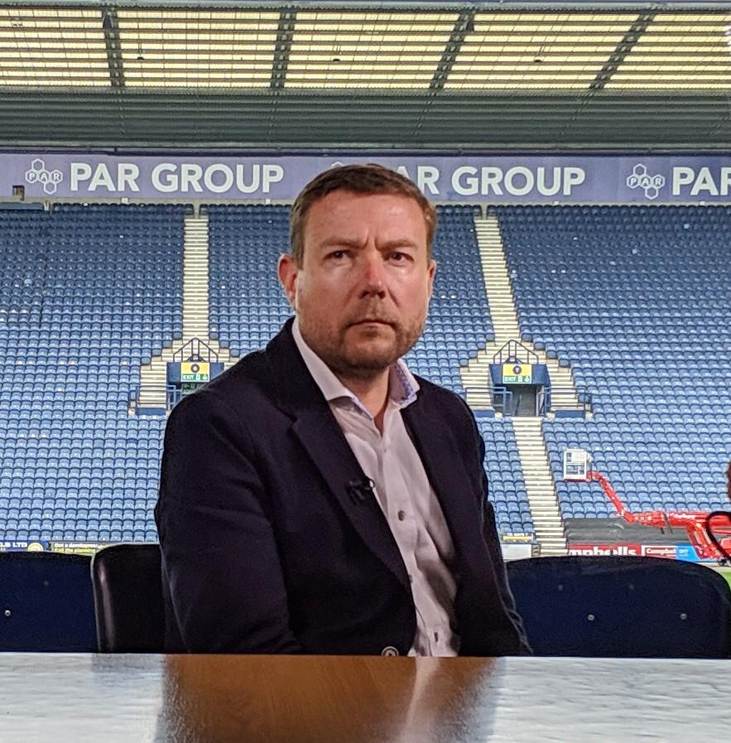
Thank you
andy.curran1@nhs.net
Notes:
So, having gone through the ages and started with a youthful picture it is only right to have an older one to finish with. Colloquially known as my football manager pose I would like to thank you for your attention, the contributions of the panelists who were far more eloquent than me, and I had time to prepare!,
TIME DEPENDENT QUESTIONS FROM THE AUDIENCE OR OFFER FOLLOW UP VIA THE QR CODE OR EMAIL.
Finish by wishing you well for the rest of what looks to be an exciting day and remember just by being here or online you are already contributing to reducing the inequalities in our local population, you are amazing, thank you.

