Slide 1
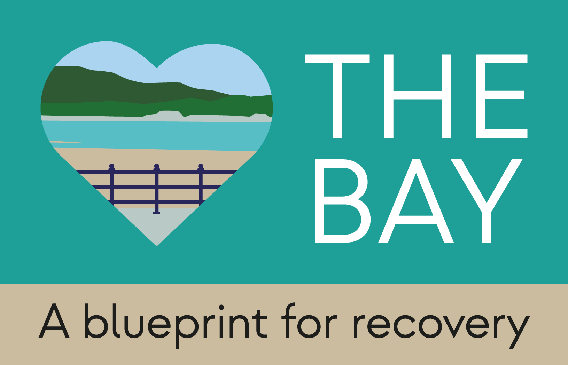
The Bay: A Blueprint for Recovery A person-centred approach to wellbeing in nature
Dr Alex Blomfield

Slide 2
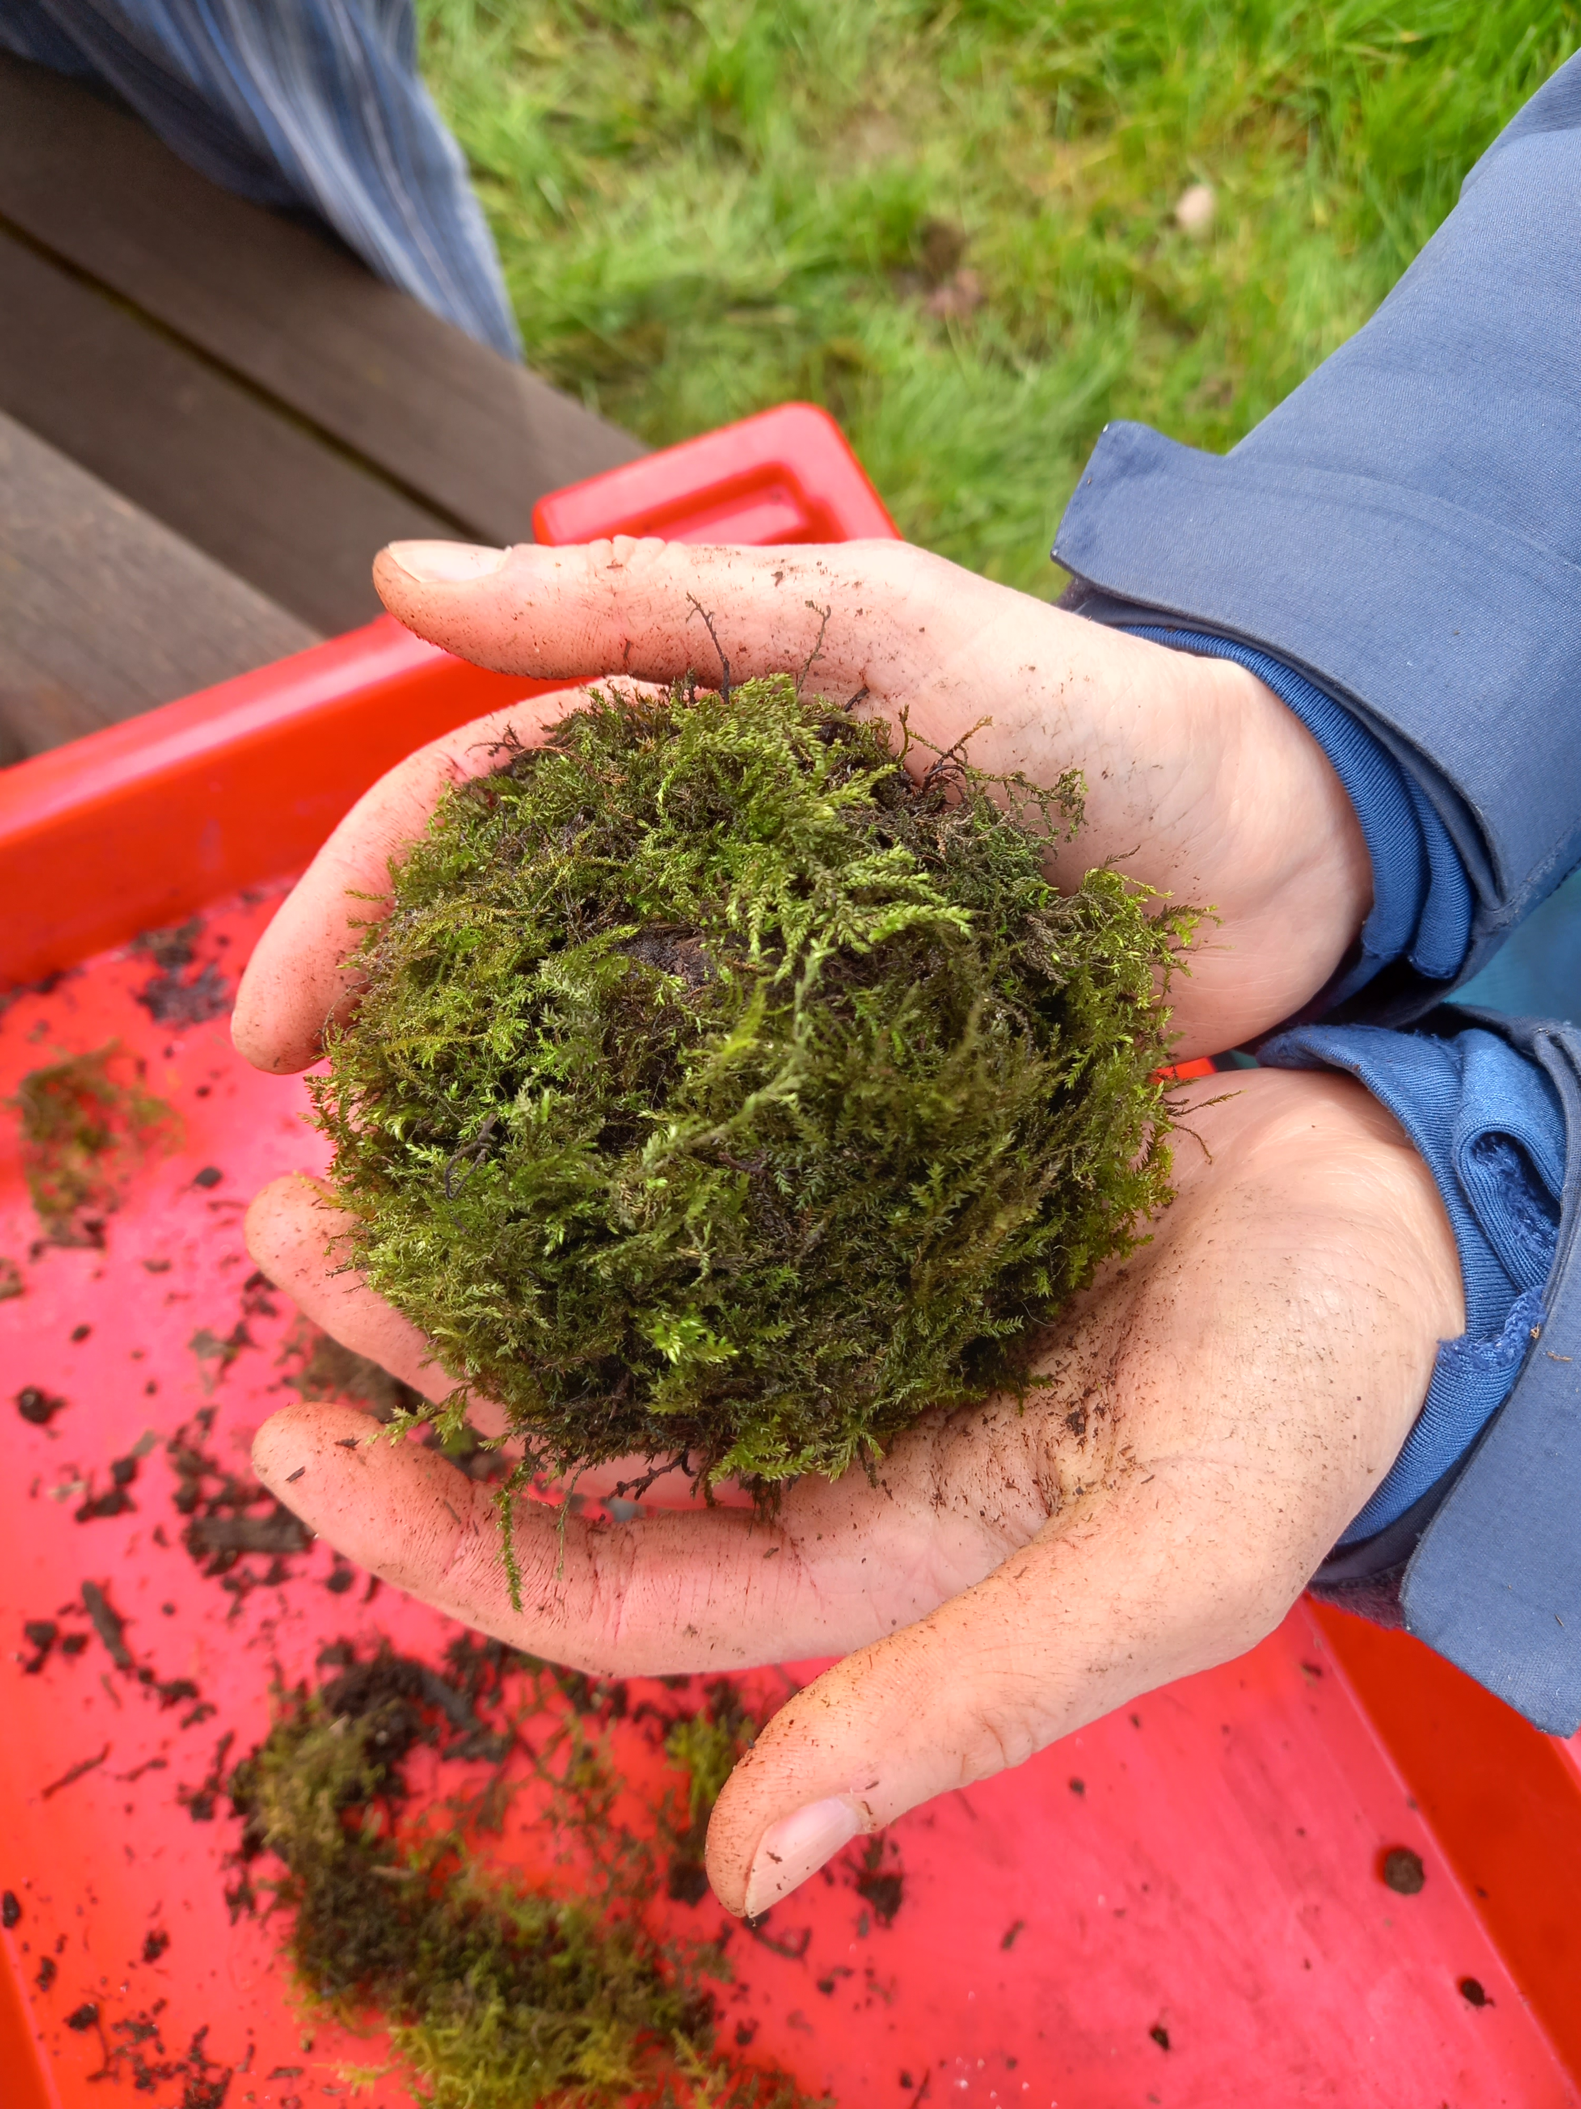
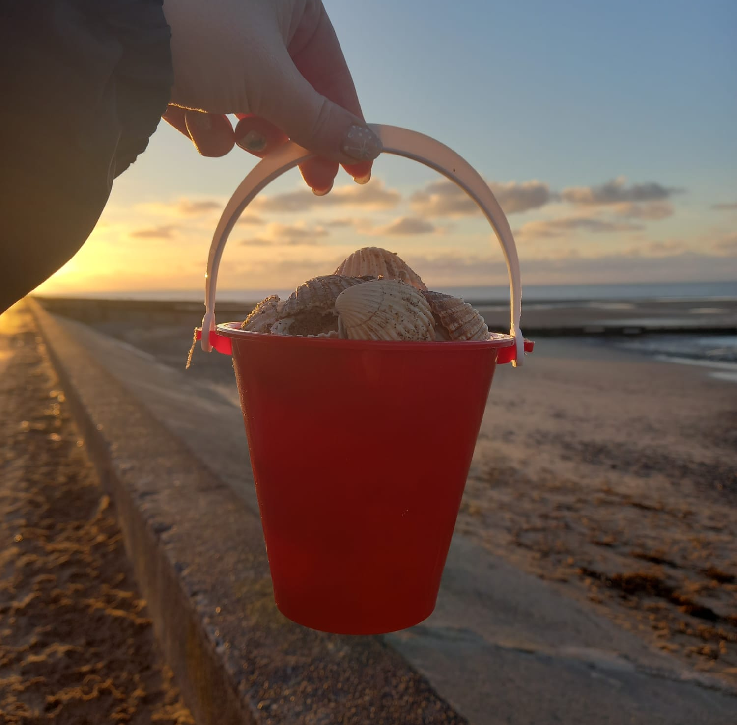
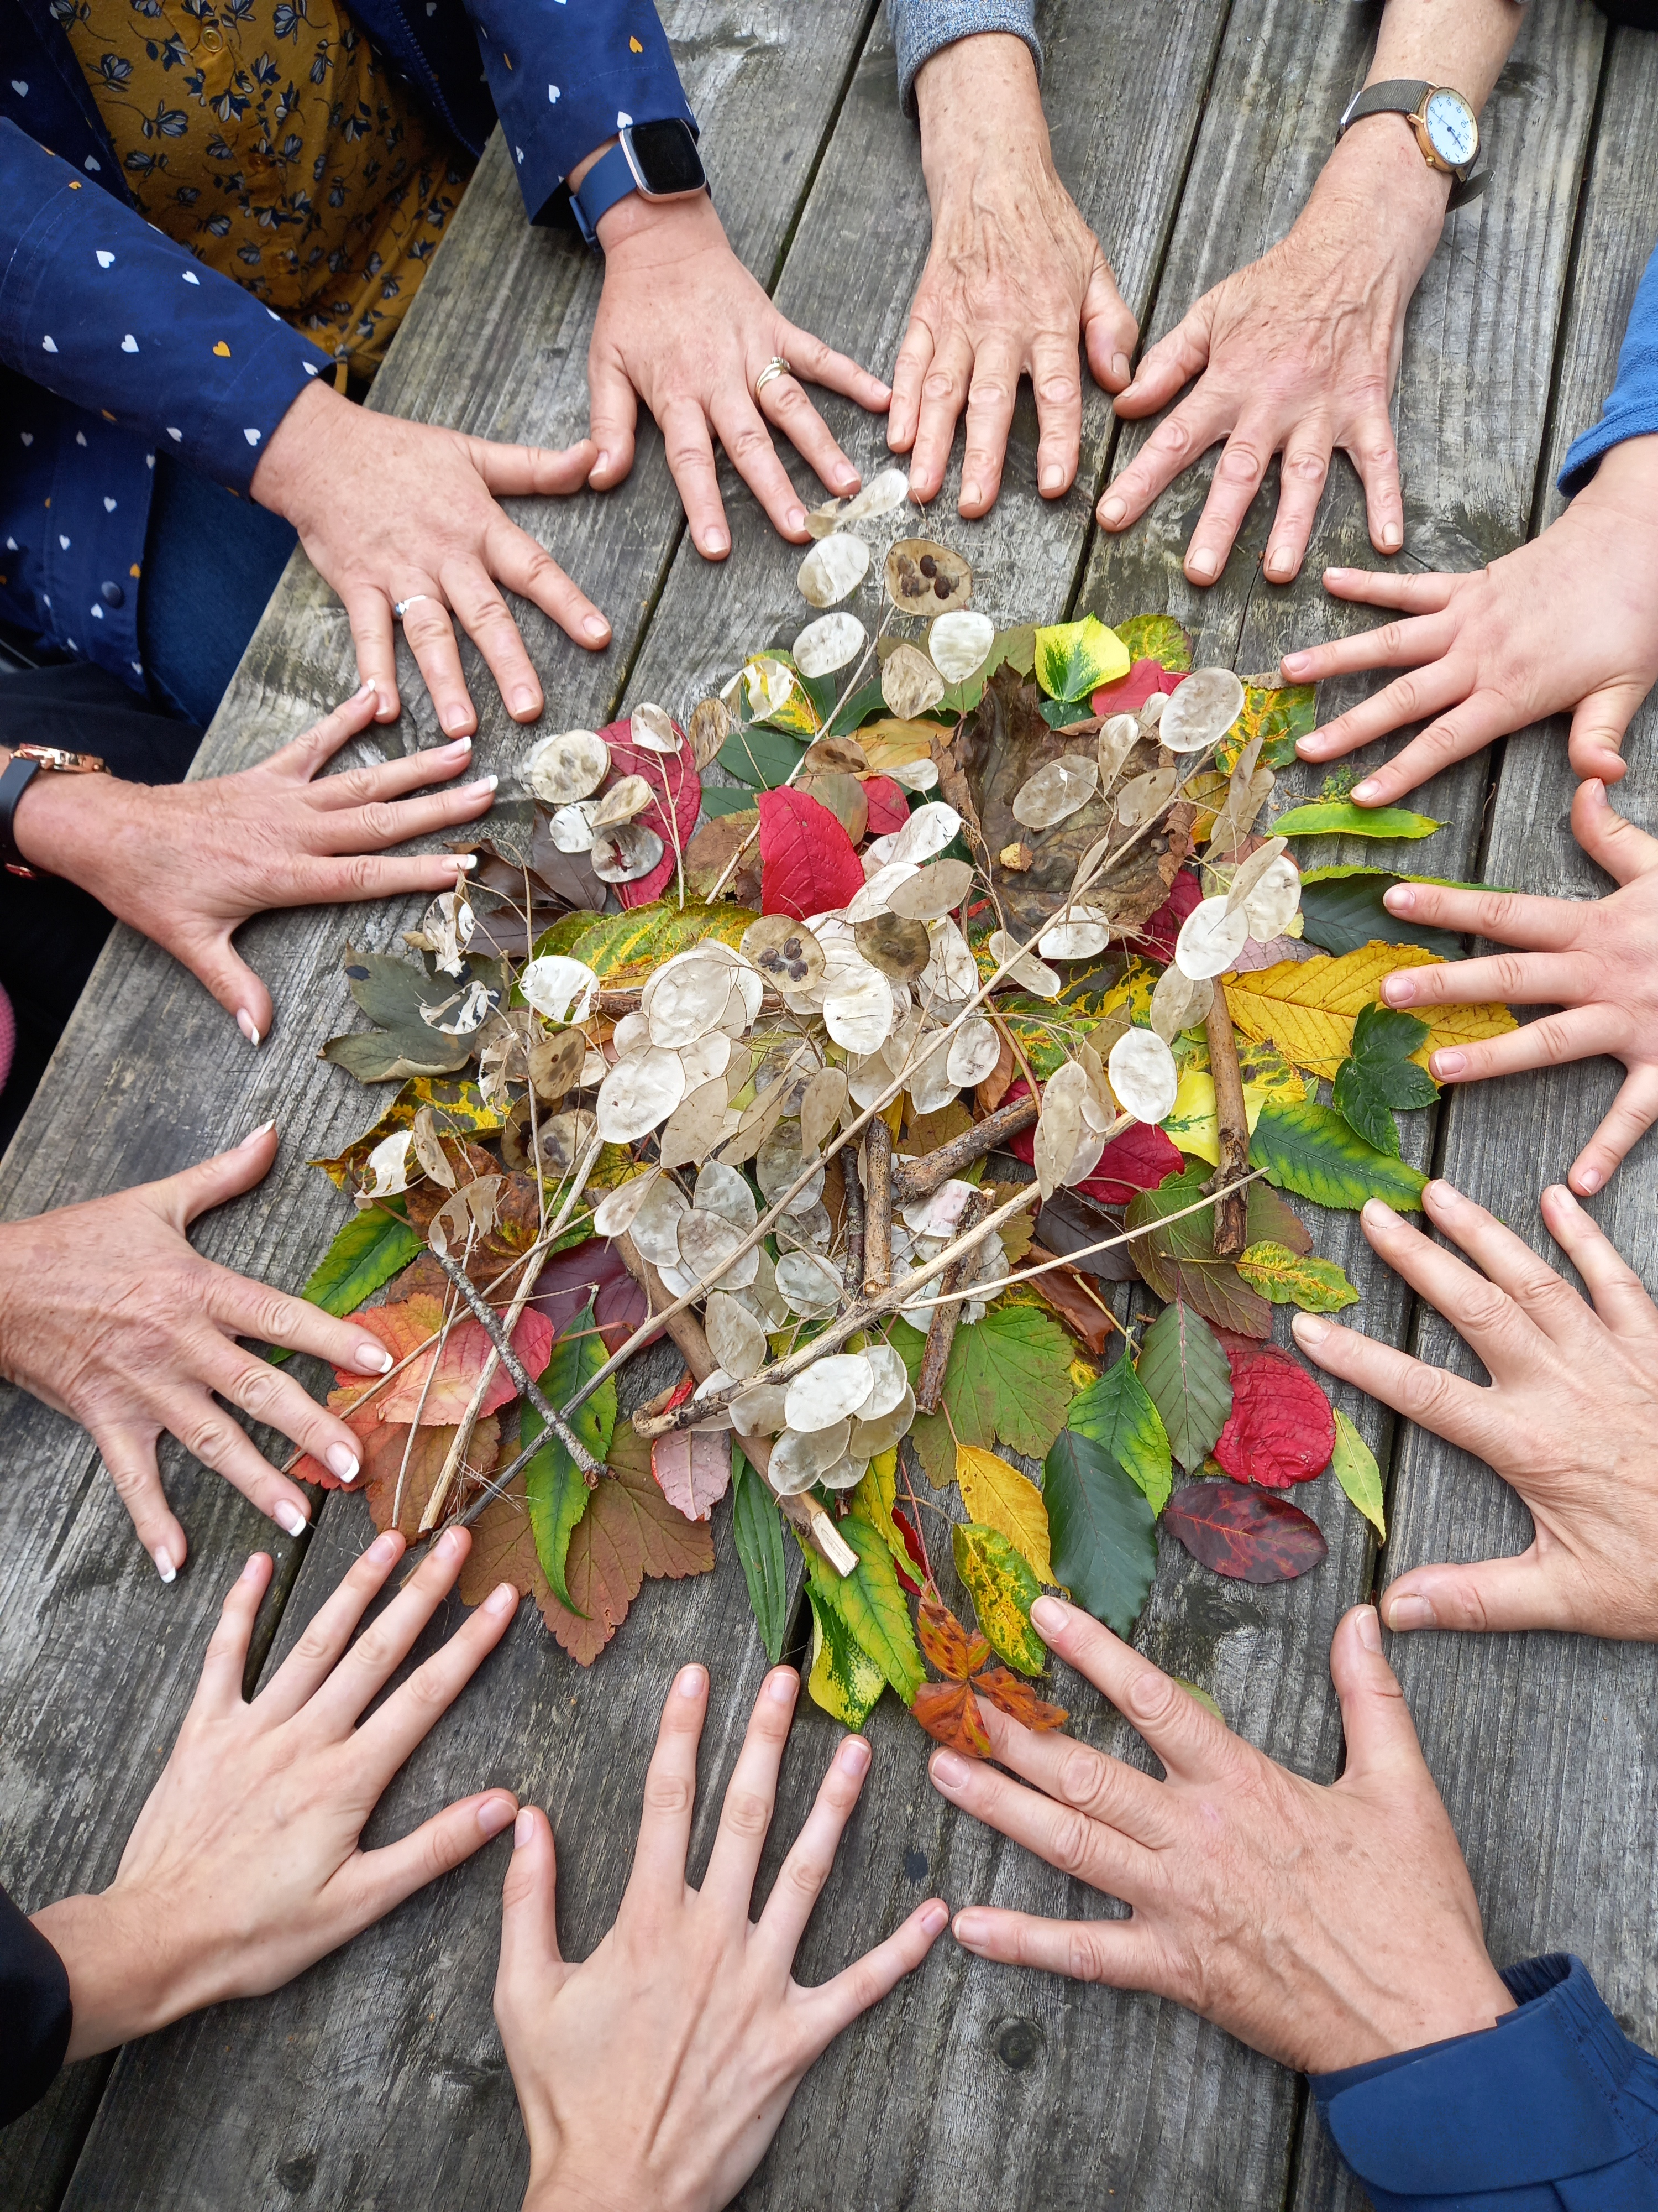
The Wellbeing Benefits
of Nature Connection

Slide 3
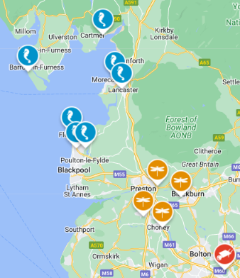
Nature & Wellbeing in the Northwest
Nature & Wellbeing Service
(formerly MyPlace)
The Bay: A Blueprint for Recovery
Notes:
In the northwest, the Lancashire Wildlife Trust has a well established Nature and Wellbeing service (formally known as Myplace, that covers areas around Preston, Blackburn, Chorley and greater Manchester).
The Bay is a partnership project combining the expertise of Lancashire Wildlife Trust with the Wildlife trust in Cumbria and the Eden Project and supported by the NHS.
The Bay is unique in its approach of blending blue and green social prescribing activities to benefit communities all around Morecambe Bay, we work out of three core delivery areas, Wyre, Morecambe and Barrow-in-furness connecting those most at need with nature.

Slide 4
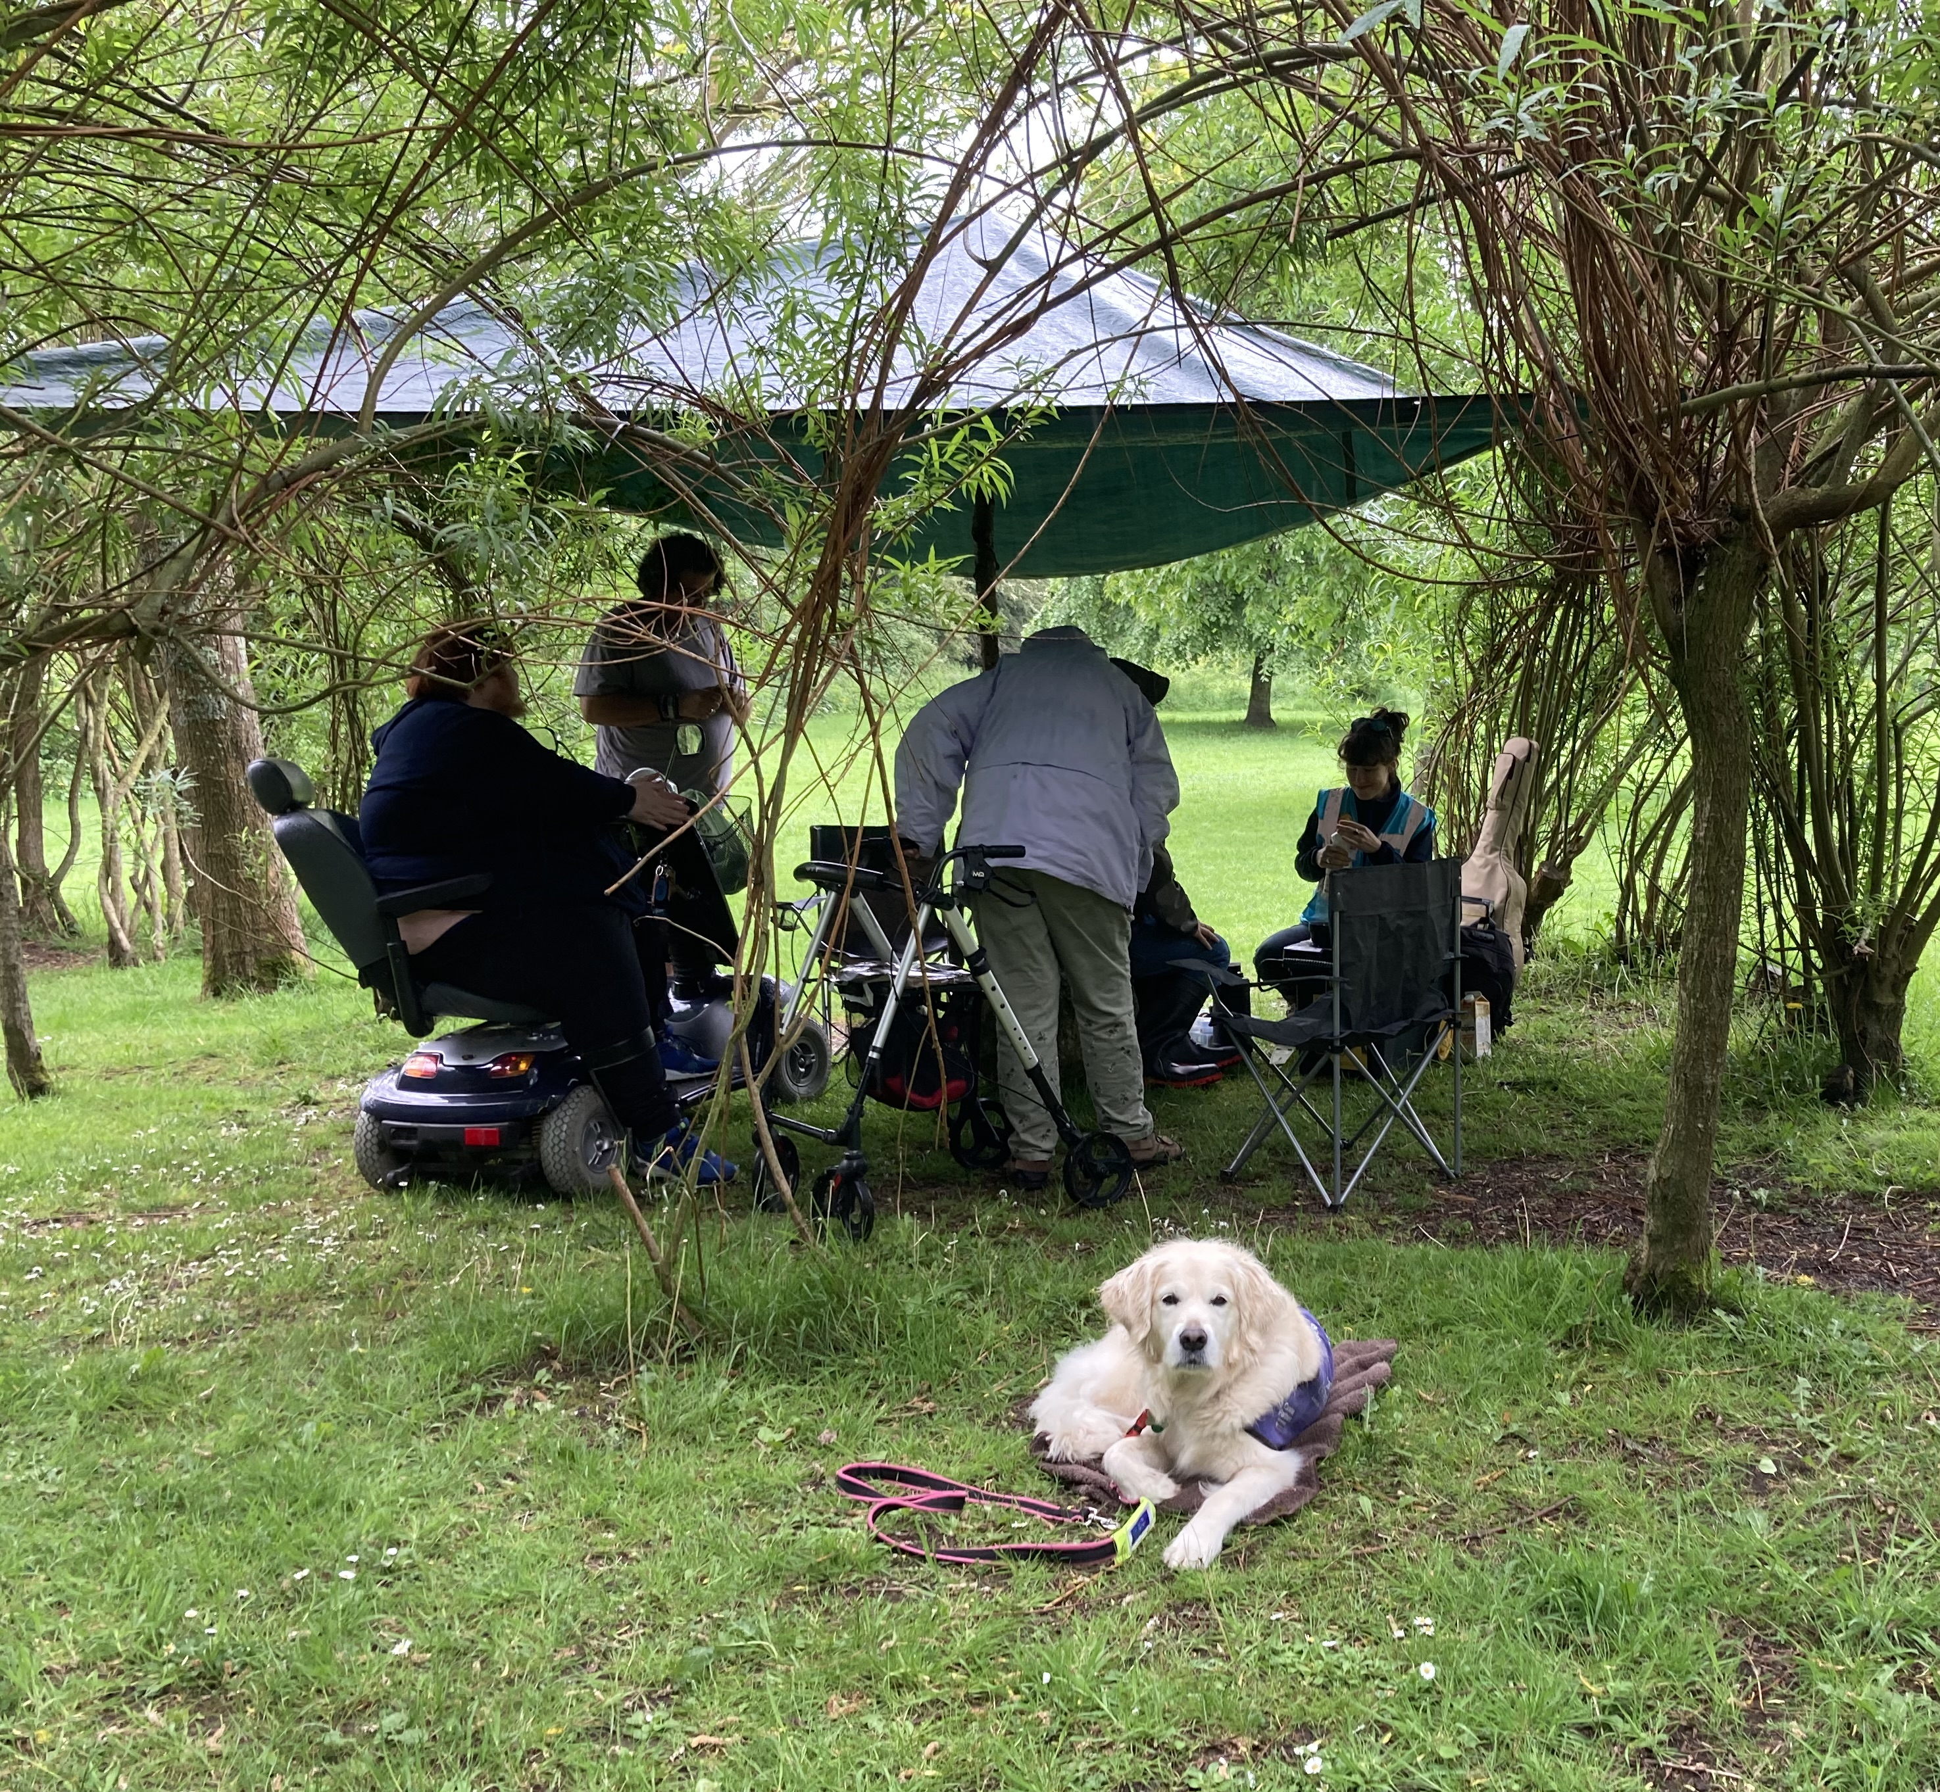
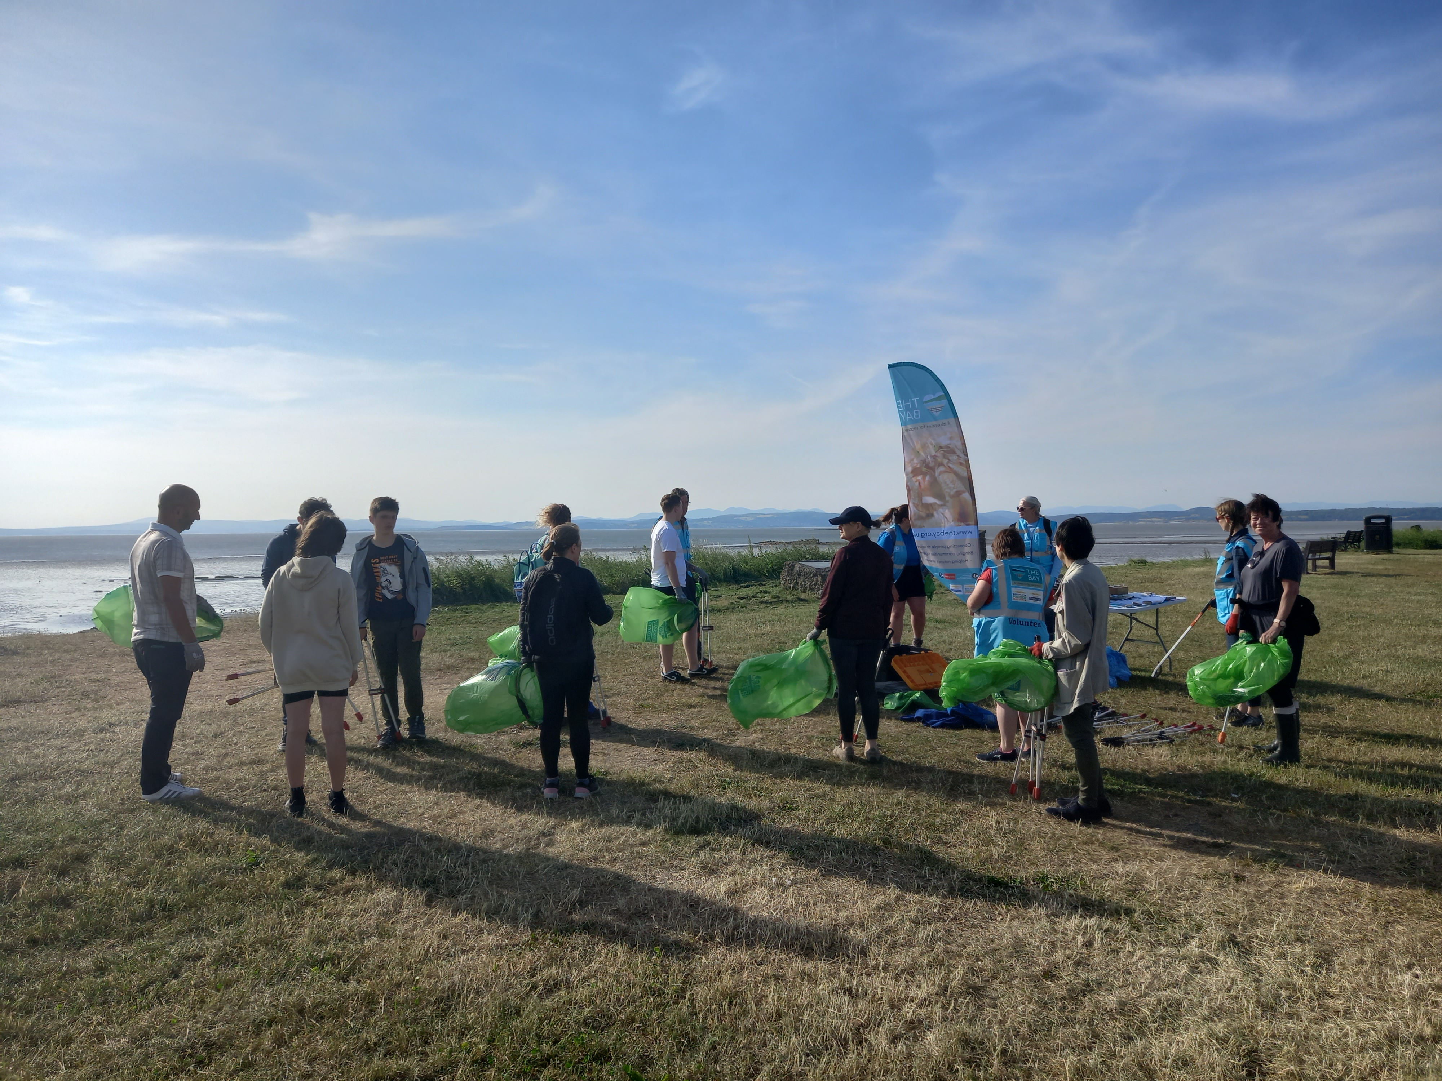
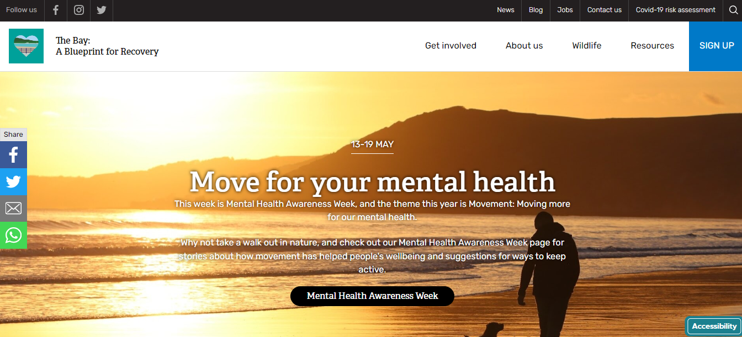
Specialist
Nature & Wellbeing Sessions
Targeted
Community Events
Whole Population
Digital Engagement

Slide 5
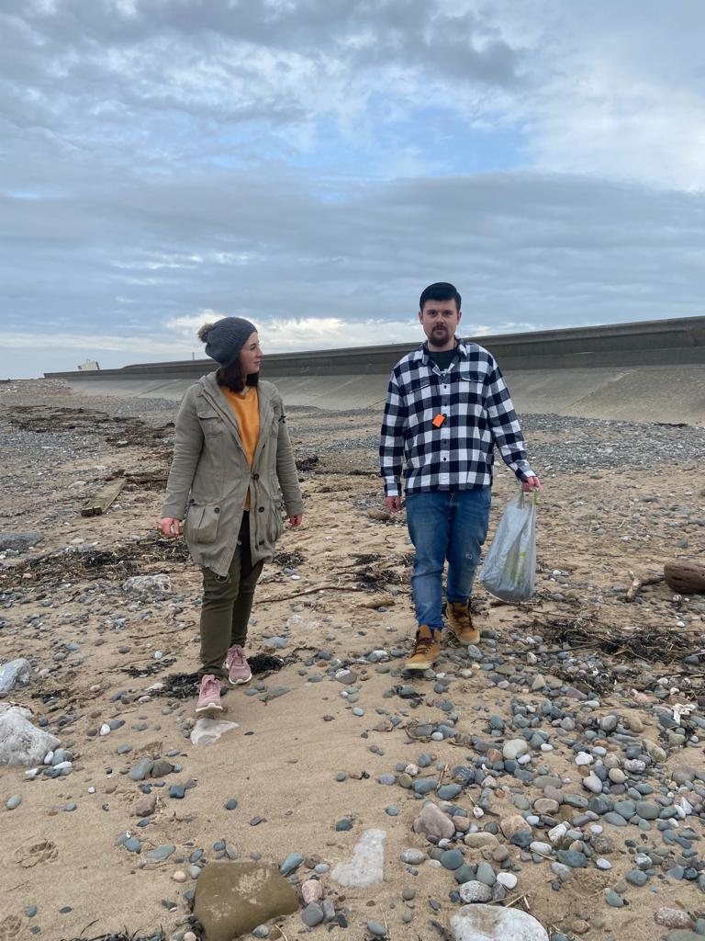
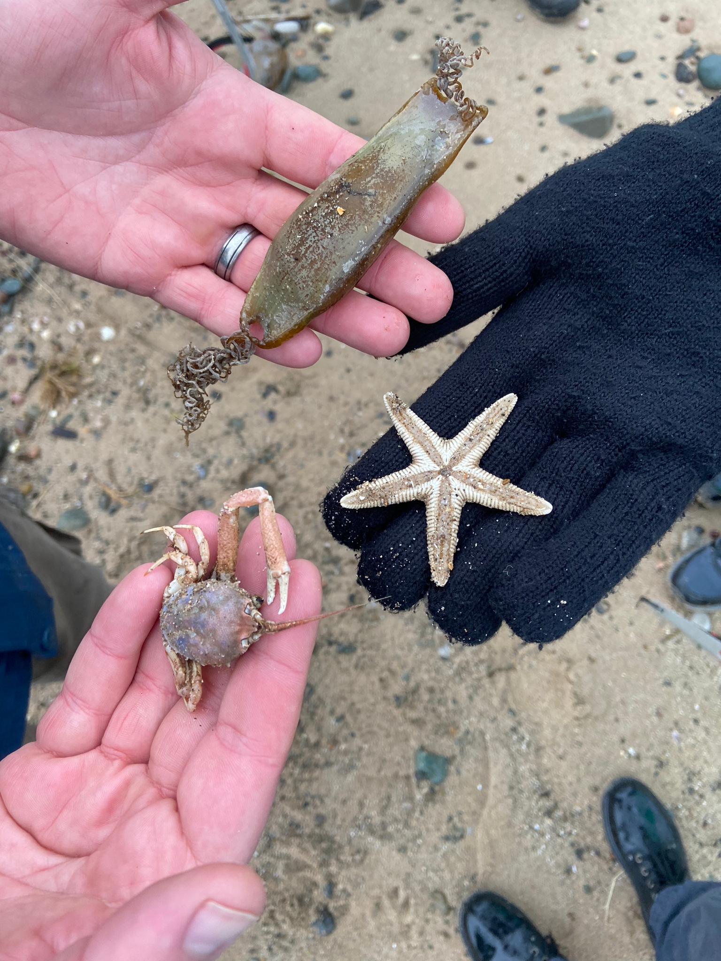
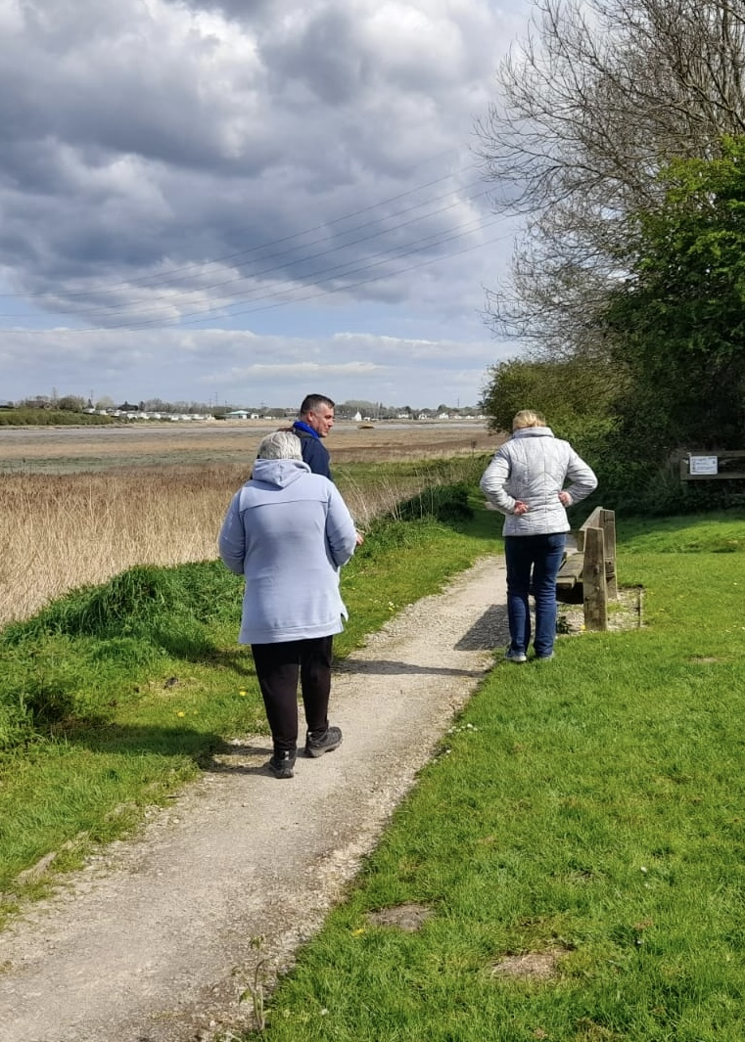
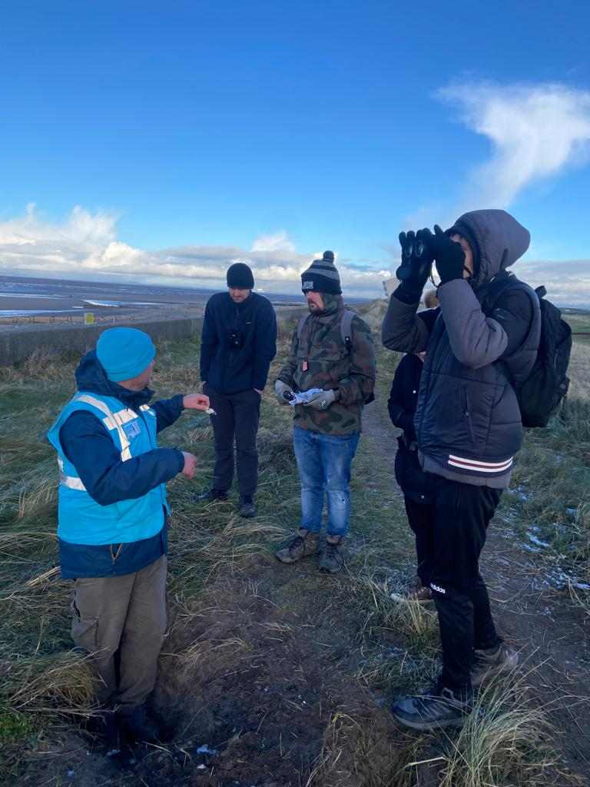
The 5 Ways to Wellbeing
Give
Connect
Take Notice
Be Active
Learn
Notes:
How we go about it
Our nature and wellbeing sessions are person centred but we structure activities around the New Economics Foundation’s 5-Ways to Wellbeing.

Slide 6
Why is Social Prescribing Important?
Create friendships
Volunteering & Employment
Change outlook in life
Give Hope
Notes:
Build confidence and self-esteem
Combat loneliness and isolation
Opportunity to learn new skills
Social prescribing does something that medication/therapy alone can’t. Some of the long term impacts include creating friendships, providing pathways to volunteering and employment
Peer support volunteers, several of our staff team started their journeys as group members.
New opportunities, new insights exploring the local area in a new way, diverse group of different ages, backgrounds and abilities. Can change people’s outlook on life and most importantly can give hope.

Slide 7
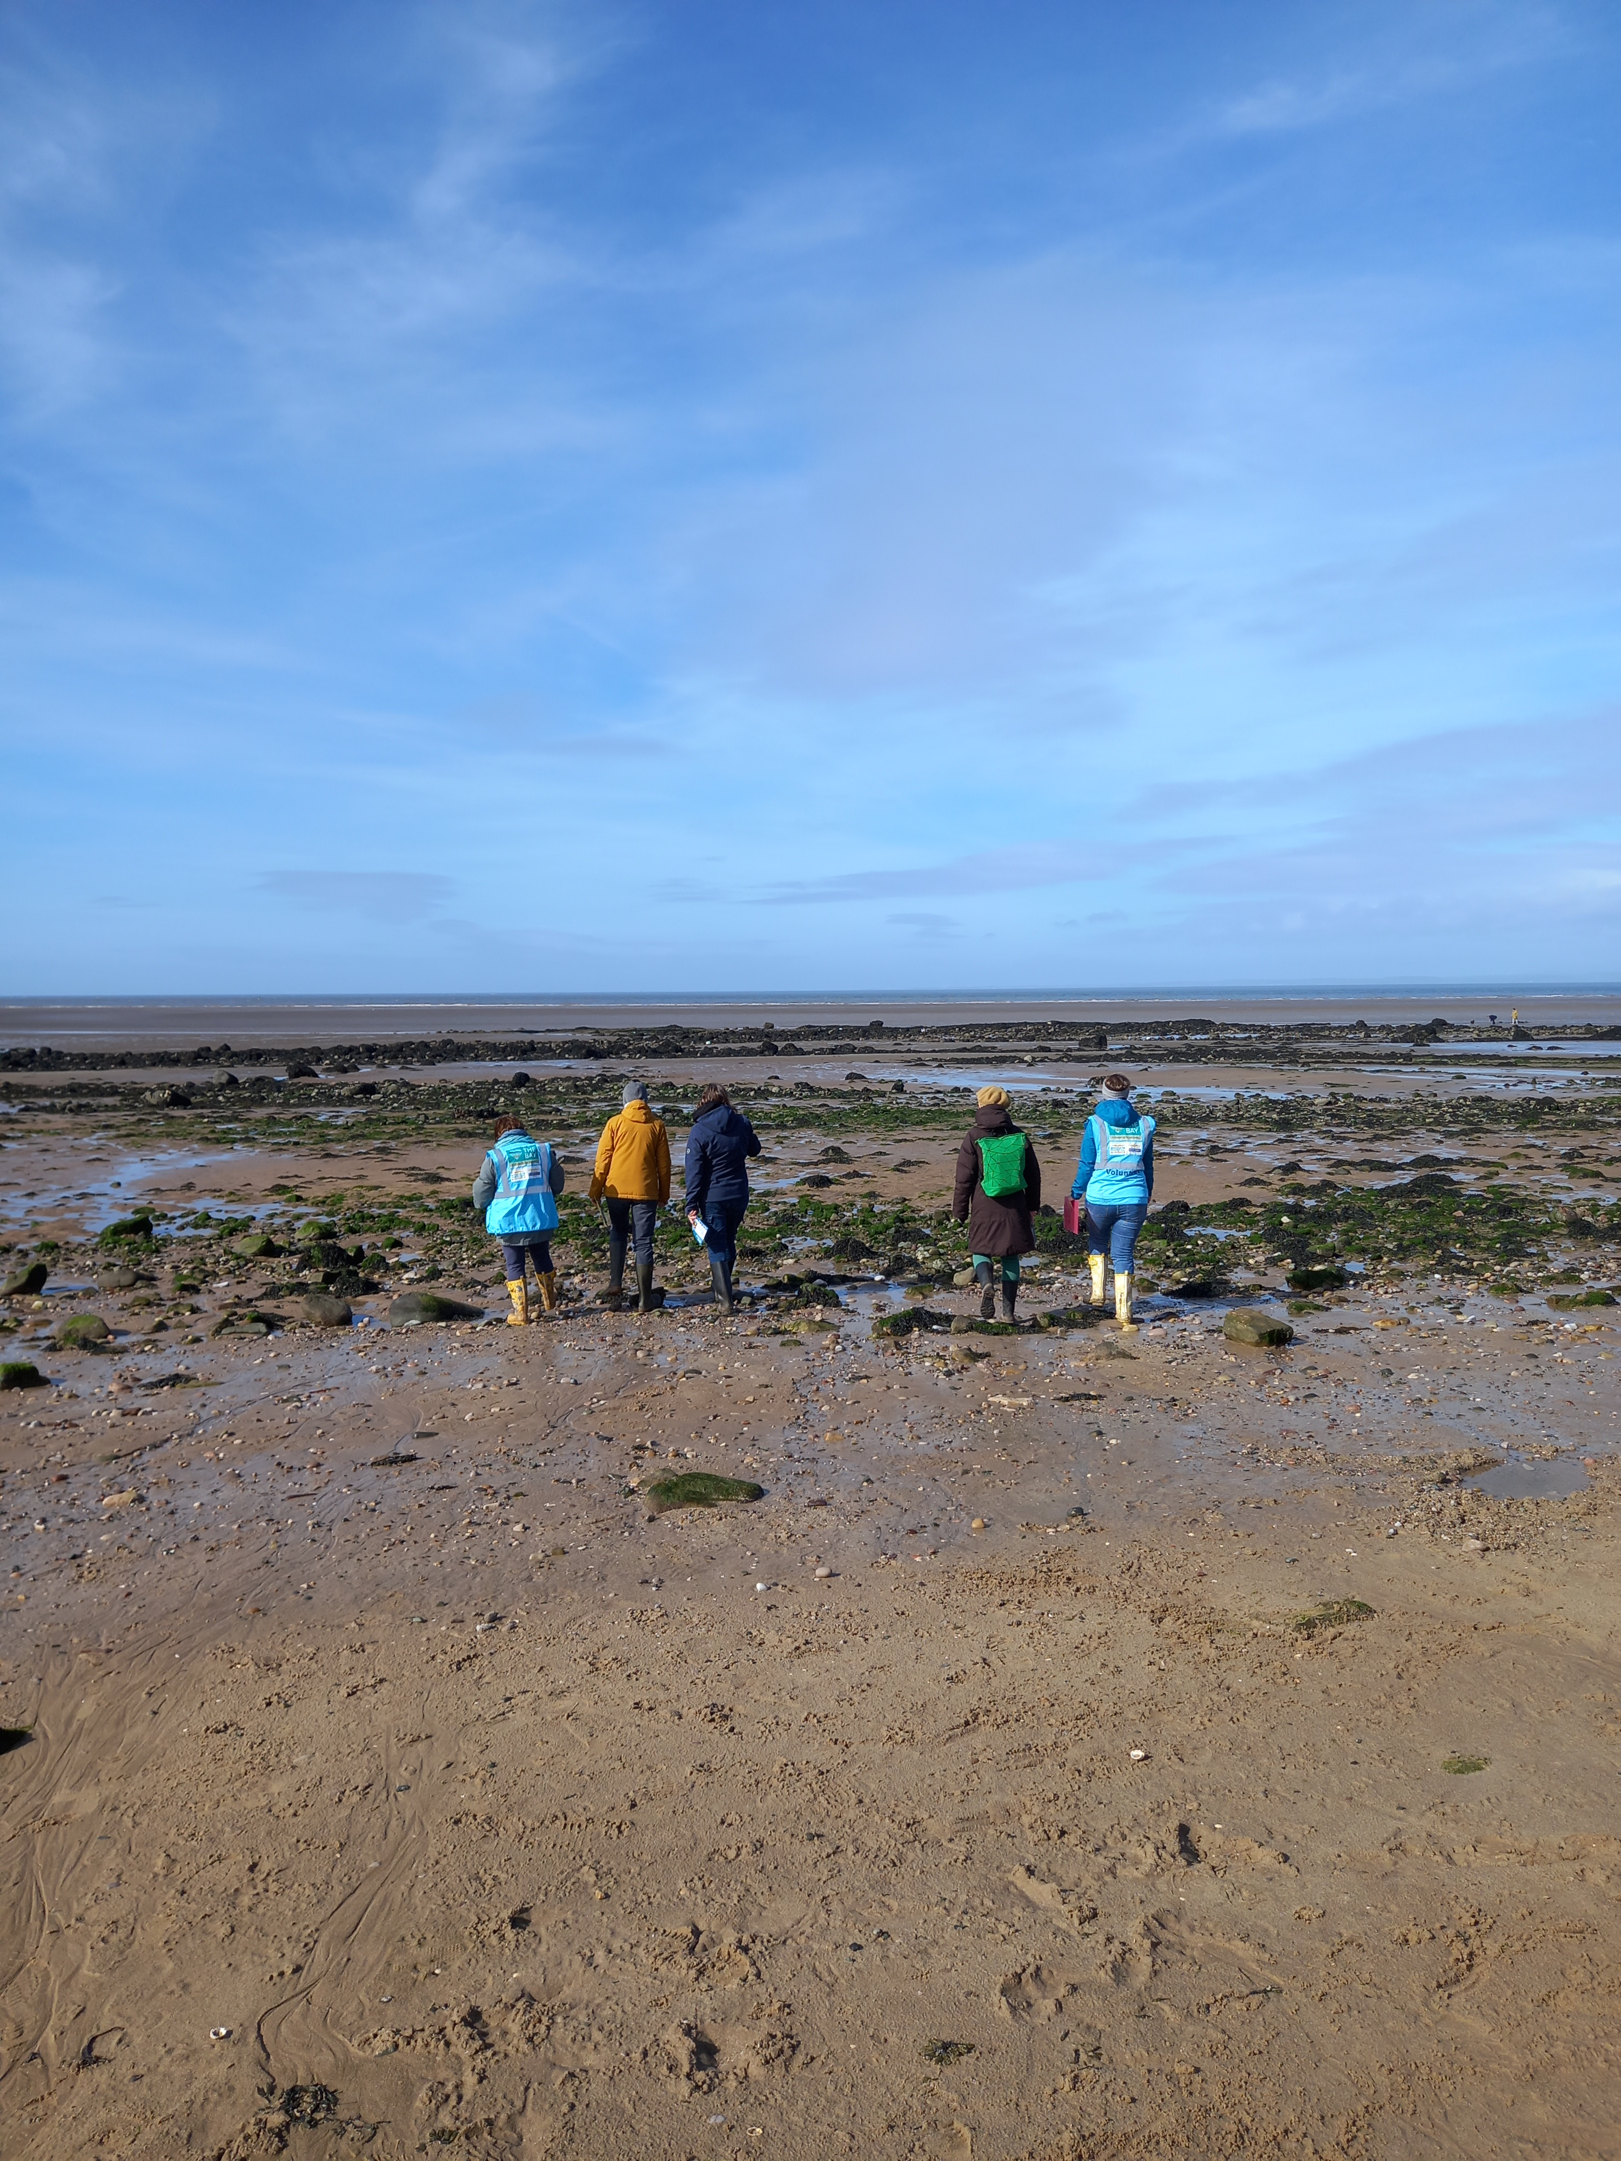
Participant Testimonials
It’s helped me to feel more grounded. When I go out now I take more notice of the nature and the birds rather than thinking of the people and anxiety of being out
Notes:
quotes from some of our group members – developing tools to take beyond sessions

Slide 8
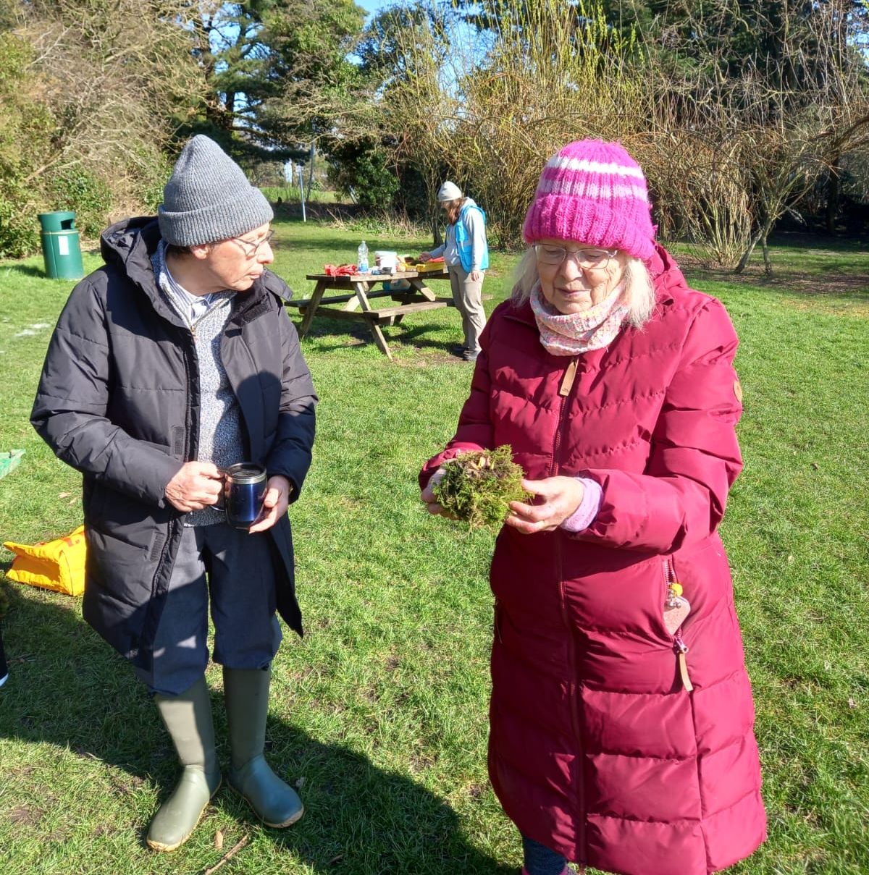
Participant Testimonials
We’d been shielding for the last 4 years, the only place we’d been was hospital appointments so this has just opened our world. We’ve grown in confidence with the group, it’s changed things completely for us
Notes:
Building confidence to do other things – now doing Morecambe Park run

Slide 9
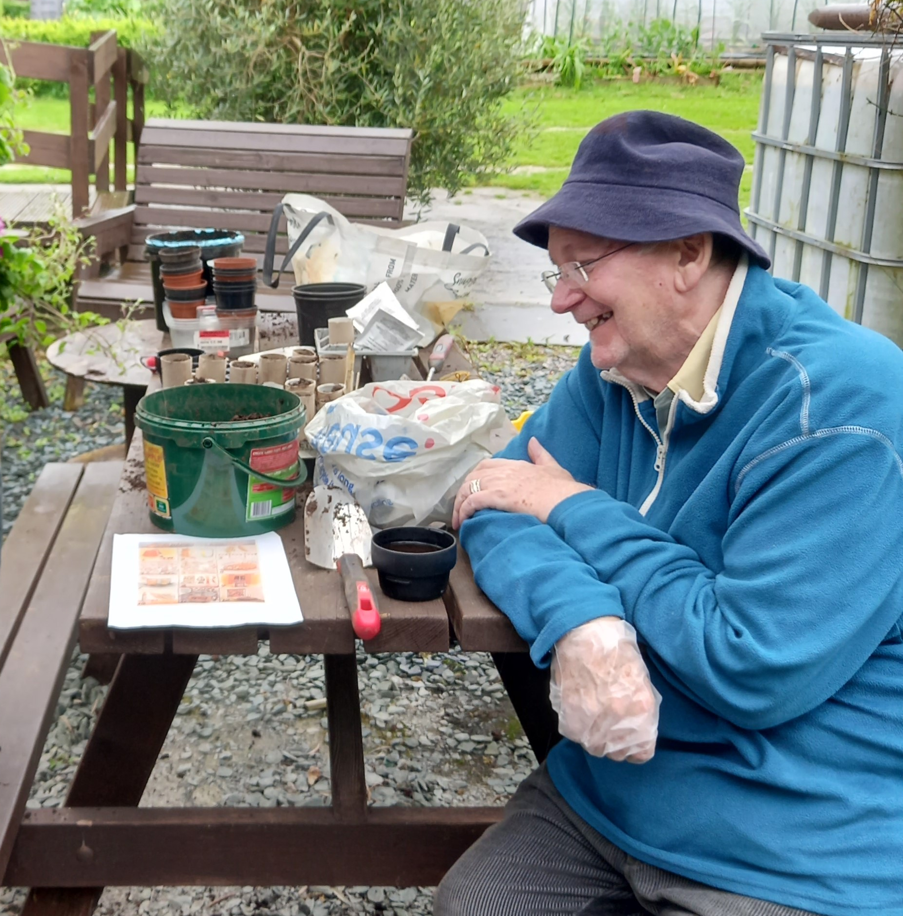
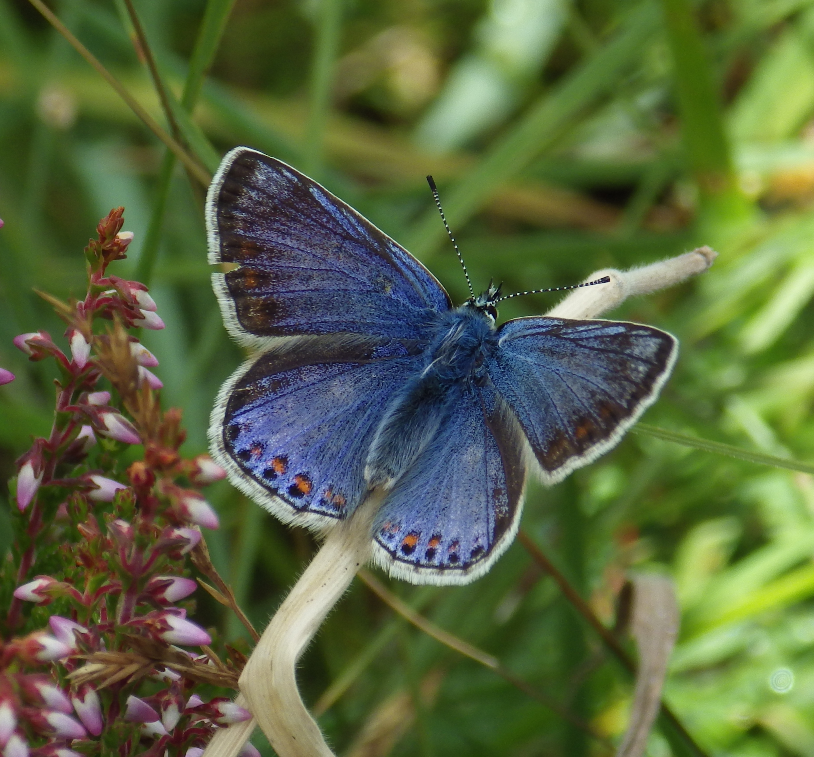
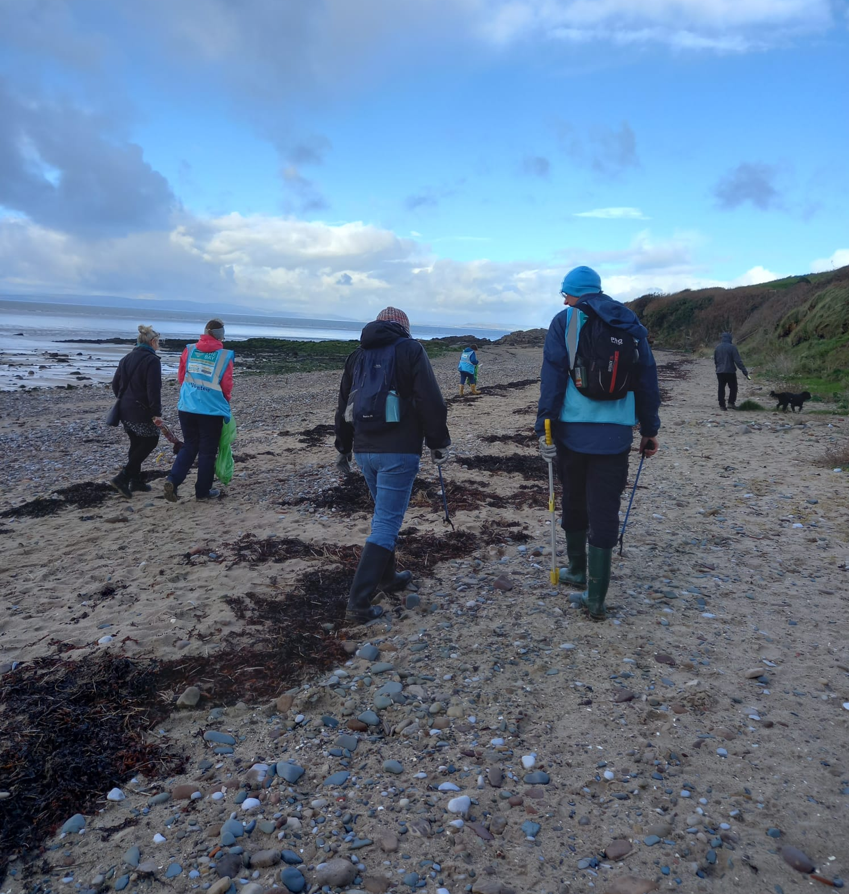
Engaging people in the lowest 15% of population for mental wellbeing
Evidence for Nature-Based Social Prescribing
95% experience improvement in wellbeing after 6 weeks
Every £1 invested leads to a cost saving of £2.16 on health care
Notes:
Bay evaluation – we are targeting the right people (lowest 15%)
And It is making a difference … to indivduals and the NHS in terms of cost saving
Analysis of the Myplace programme in Bury and Rochdale savings to NHS from MH care, additional from employment costs AND benefits to nature.

Slide 10
@thebayblueprint @thebaywellbeing www.thebay.org.uk
Notes:
https://www.youtube.com/watch?v=JRGVvKl9dKo

Slide 11
@thebayblueprint @thebaywellbeing www.thebay.org.uk
Notes:
https://wall.sli.do/event/qogve7RrkXEiKEXXM6TNtA?section=a3f297fd-1345-406f-8ffa-aa9be960b2fc

Slide 12
Do you/your team currently work with nature-based social prescribing projects like The Bay?
ⓘ Start presenting to display the poll results on this slide.

Slide 13
What barriers are there in place that prevent clinicians from referring to nature-based social prescribing projects?
ⓘ Start presenting to display the poll results on this slide.

Slide 14
What would enable clinicians to work more closely with nature-based social prescribing projects?
ⓘ Start presenting to display the poll results on this slide.

Slide 15
@thebayblueprint @thebaywellbeing www.thebay.org.uk
Notes:
References:
Ulrich RS. View through a window may influence recovery from surgery. Science. 1984 Apr 27;224(4647):420-1. doi: 10.1126/science.6143402. PMID: 6143402.
Pritchard, A., Richardson, M., Sheffield, D, & McEwan, K. (2019). The relationship between nature connectedness and eudaimonic wellbeing: a meta-analysis. Journal of Happiness Studies, 1-23.
The Wildlife Trusts, 2023. A Natural Health Service - Improving lives and saving money, The Wildlife Trusts. United Kingdom. Retrieved from https://policycommons.net/artifacts/4772575/a-natural-health-service/5608680/ on 07 Jun 2024. CID: 20.500.12592/v8vxrh.
Evaluation of The Bay: A Blueprint for Recovery Sue Holden & Dr Andy Yuille Lancaster University July 2023

