Slide 2
Social Care Research Capacity Building

Slide 3
Professor Mark Gabbay Director, ARC NWC We want to make this work for you with you We need your input to co-design in detail

Slide 4
The story so far….
ARC NWC awarded £260,000 from NIHR
Key aim: Support building research capacity in social care
Our approach is to work with our Social Care member organisations, and through their networks and colleagues, to identify and seek to address their needs for research and implementation and its evaluation

Slide 5
How do we plan to consult for collaborative delivery?
Hold virtual / face-to-face events for member organisation leads and staff, public advisors and scope ideas and identify operational areas for consideration to .
Identify and recruit staff from our member organisations to join our peer groups of Social Care Research and Implementation Champions.
Hold 1:1 meetings with all the social care member organisation leads, tailoring involvement
Workshops to identify, shortlist and priorities topics for research and implementation
Recruit representatives from our Social Care member organisations and Public Advisors to join our Social Care Research Development Network and Implementation Roundtable (SCReDNIR).

Slide 6
What are our ideas? In summary…
Establishing a bespoke Partner (member) Priority Programme (PPP) for Social Care Research/Implementation incorporating ten groups with ten knowledge mobilisation internships under supervision and cross group mentoring.
Identify priority research questions / areas
Establish and support a community of practice for Social Care champions within member organisations for research and its implementation.
Key outputs to be utilized by members including on/offline resources in addition to linking up with the national resource library being administered by Kent / Surrey / Sussex ARC.
Capitalise on existing ARC infrastructure and initiatives such as our Connected Research Communities, Health Equity mainstreaming work and existing capacity building infrastructure.
Offer bespoke training/support for external courses
Offer RaCES in Social Care.
Develop Communities of Practice

Slide 7
Developing Communities of Practice/ Connected Research Communities Using our established ARC NWC Connected Research Communities approach we will build a platform to sustain social care research and implementation capacity. This approach incorporates practitioner communities of practice alongside public advisors and academics, supported by the wider ARC infrastructure. Focus subjects will arise from the Interns and the projects they lead, others directly from research priorities adopted in ARC themes alongside those highlighted during roadshows and associated research topic identification and prioritising exercises (we will be doing one of these later!). Lets learn more of their benefit and how they have been used in ARC NWC…

Slide 8
Developing Communities of Practice Dr Clarissa Giebel Senior Research Fellow, ARC NWC / University of Liverpool Older Adult Subtheme Lead ARC NWC

Slide 9
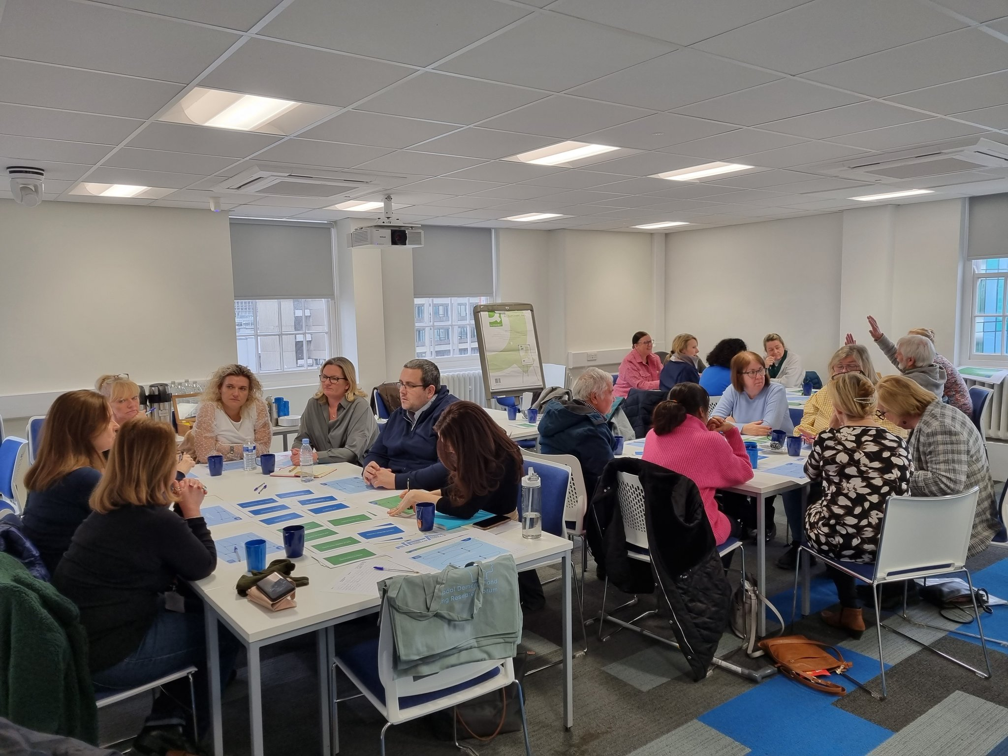
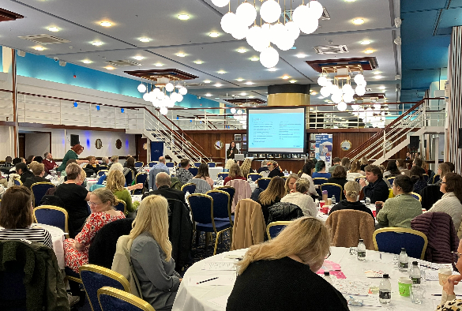
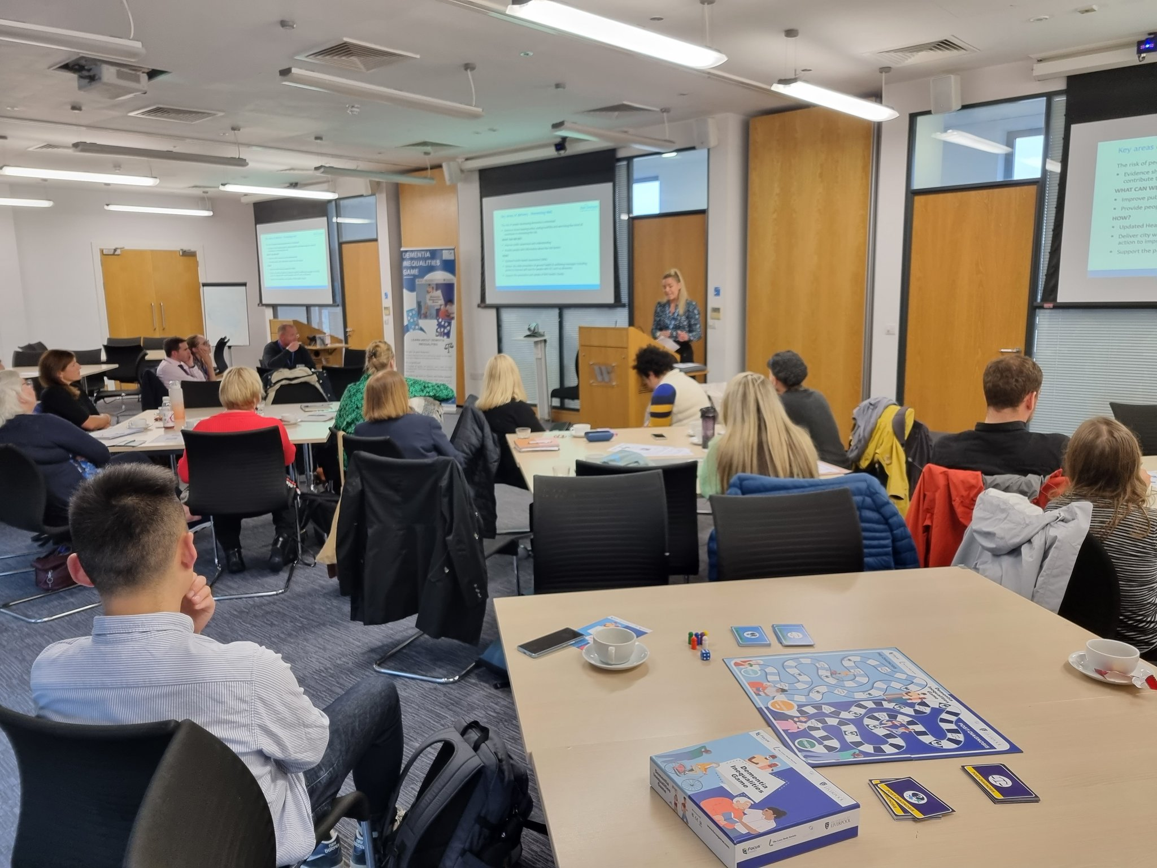
Liverpool Dementia & Ageing Research Forum

Slide 10
SOON
[full details to follow shortly]
20 H&SC research internships on dementia inequalities
(2025-2029)

Slide 11
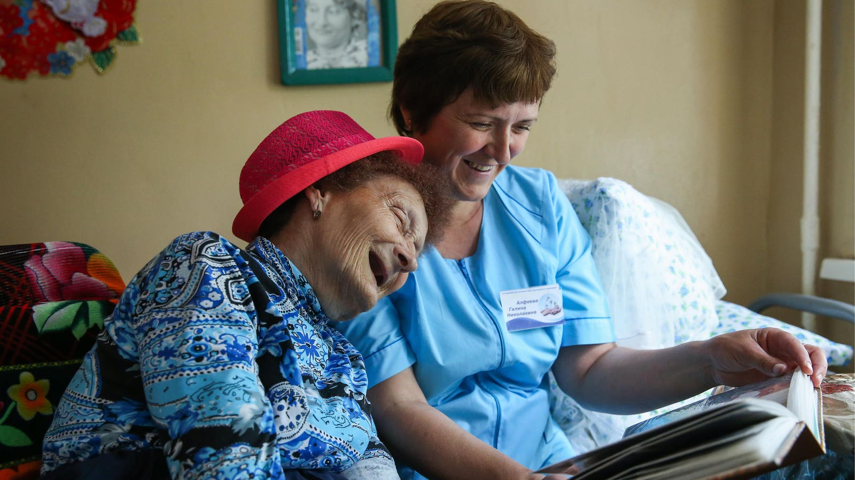
The NWC Living Lab in Ageing & Dementia

Slide 12
Day care
Home care
Respite care
Residential care
Researchers & Social Care staff

Slide 13
Aims of our NWC Living Lab
Improve collaboration between researchers and social care practitioners
Improve knowledge and capacity in social care practitioners and academics
Understand the various issues facing social care organisations
Develop joint ideas for research and implementation

Slide 14
What’s offered
1 Linking Pin (researcher) to be linked up with a social care organisation, based some times at a desk at the organisation
Joining wider network of the Living Lab and connecting with other organisations (including internationally)
Annual in-person members meeting (organisations, researchers)
Opportunity to increase knowledge in workforce

Slide 15
Improving staff knowledge and skills
Improving care for people living with dementia & older adults
Contact: Clarissa.giebel@liverpool.ac.uk

Slide 16
Professor Mark Gabbay Director, ARC NWC

Slide 17
Discussion What gaps currently exist in social care provision in North West Coast where training / mentoring / capacity building is most needed and could be targeted via Communities of Practice? Discuss on table then add individual comments / ideas to the titled posters on the wall? Please return to tables.

Slide 18
Getting involved with delivery - Round Table - Establishing social care research and implementation champions - Accessing national resources (from other ARCs) to help deliver and disseminate

Slide 19
How can we establish and support a community of practice for Social Care champions, within member organisations, for research and its implementation? Feedback to us on the blank sheet: - Name / organisation if you would you like to be involved? - How can you help deliver and enhance value of this network? - Tell us your preferred engagement methods for delivery in your organisation.
Table exercise / discussion

Slide 20
Knowledge Mobilisation Internships
Dr Kathryn Berzins
Senior Research Fellow, IMPaCT / University of Central Lancashire

Slide 21
Research capacity building - Putting this into practice
ARC NWC - Implementation and Capacity Building Team (IMPaCT)
Research internships: Scheme to support increasing research capacity in the health and social care workforce. (Not open to university staff.)

Slide 22
Eligibility
Any staff member from an ARC NWC member organisation – any grade
Do not need previous research training or experience
Require management support to be released one day a week for 12 months (including to attend university training sessions)
Application process: form, then interview
£6k backfill to the home organisation

Slide 23
All interns receive: Academic supervision, Peer support within their cohort Research Methods or Implementation Science training
Further benefits:
Personal development: Research and implementation experience
Increases research capacity of the organisation
Service potentially benefits from research
Service users benefit from improved quality of care

Slide 24
ARC NWC - Internship types
1. Research project: support individuals to undertake a small research project under supervision. Next closing date: September 2024
2. RaCES (Rapid Conversion Evidence Summary)
Develop academic writing skills and understanding of systematic reviews. Supported to disseminate findings, e.g., publishing a journal article. Next closing date: 17th September 2024
3. Prepare an NIHR Research Fellowship application
Development of Pre-Doctoral, Doctoral, or Advanced Fellowships. Next closing date:14th September 2024

Slide 26
Examples:
How was a mental health support worker service implemented within children’s centres?
How has the introduction of the Dynamic Support Database affected placement breakdown for people with learning disability?
Psychoeducation groups for people with bipolar disorder
Sharing learning from parent-led CBT among the wider family network

Slide 27
Detailed information and more examples on our website
https://arc-nwc.nihr.ac.uk/impact/impact-internships-2/
https://arc-nwc.nihr.ac.uk/impact/impact-internships-2/races-internships/
https://arc-nwc.nihr.ac.uk/impact/impact-internships-2/research-project-internships/

Slide 28
Get in touch:
Email: arcnwc@uclan.ac.uk
Web: arc-nwc.nihr.ac.uk
Twitter: @arc_nwc

Slide 29
Professor Mark Gabbay Director, ARC NWC

Slide 30
We have a list of research questions from sources to reflect national PRIORITY topics in Adult Social Work.
Which of these questions should be a priority for ARC NWC’s research on this programme? As a group, discuss and rate them 1-6 in priority order using the form on the table. Add your own priority question if the group agree.
https://www.jla.nihr.ac.uk/priority-setting-partnerships/adult-social-work/top-10-priorities.htm
Waterman, C., & Manthorpe, J. (2022). Did it make a difference? Uses of the James Lind Alliance Adult Social Work research priorities partnership report. NIHR Policy Research Unit in Health and Social Care Workforce, The Policy Institute, King's College London. https://doi.org/10.18742/pub01-079
https://www.sscr.nihr.ac.uk/wp-content/uploads/NETSCC-Research-priorities_Report.pdf
https://assets.publishing.service.gov.uk/government/uploads/system/uploads/attachment_data/file/1141532/Independent_review_of_children_s_social_care_-_Final_report.pdf

Slide 31
Opportunities in Social Care RaCES Dr Mark Goodall Research Fellow ARC NWC / University of Liverpool

Slide 32
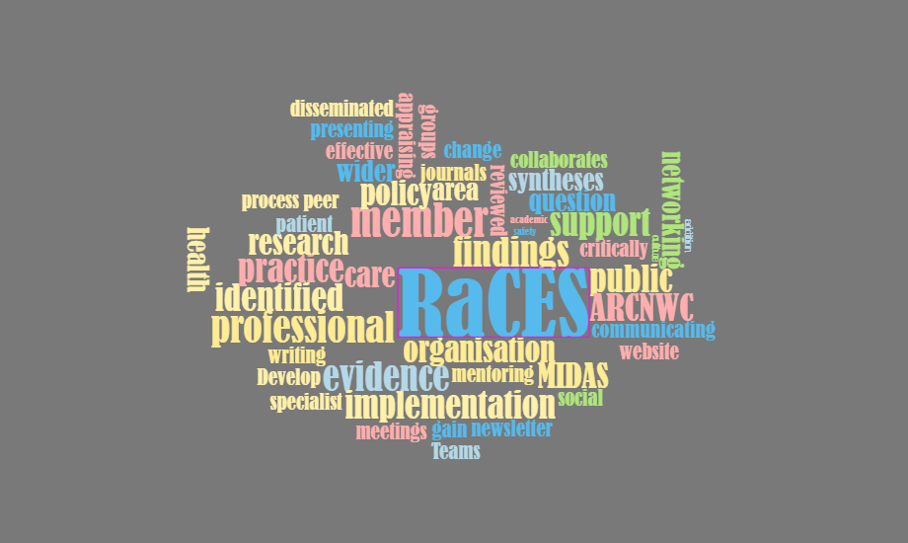
Rapid Conversion of Evidence Summaries (RaCES)
Methodological Innovation, Development, Adaptation & Support Theme (MIDAS)

Slide 33
Plan
Overview of the RaCES process
Current and completed RaCES projects

Slide 34
Rapid Conversion of Evidence Summaries (RaCES)
About RaCES
1. Increase health and social care professionals’ skills in critically appraising, interpreting and applying findings from evidence syntheses through mentoring and on-line support;
2. Integrate findings from evidence syntheses into policy and practice supported by implementation specialists;
3. Disseminate findings within the care professionals organisation, to the wider ARCNWC members and public, and through professional and academic networks via the website, newsletters, presentations and peer reviewed and professional journals; and,
4. Develop a network of communities across the ARCNWC members and professional groups to support the production of RaCES and implementation of findings.

Slide 35
Rapid Conversion of Evidence Summaries (RaCES)
About RaCES
1. Increase health and social care professionals’ skills in critically appraising, interpreting and applying findings from evidence syntheses through mentoring and on-line support;
2. Integrate findings from evidence syntheses into policy and practice supported by implementation specialists;
3. Disseminate findings within the care professionals organisation, to the wider ARCNWC members and public, and through professional and academic networks via the website, newsletters, presentations and peer reviewed and professional journals; and,
4. Develop a network of communities across the ARCNWC members and professional groups to support the production of RaCES and implementation of findings.
1. Identifying policy and practice question
Questions are identified through: (i) an ARCNWC member raising an issue associated with organisational policies or an area of their day-to-day practice where there is uncertainty; or, (ii) through an area identified more generally as a priority area for health and social care (e.g. NHS, National Institute for Health Research, Royal Colleges, other professional bodies or through public and patient representatives). Examples of questions include: ‘Which safety culture survey should I use?’, ‘Is virtual reality effective in treating post-traumatic stress syndrome?’ and ‘Is strength training effective for Multiple Sclerosis patients?’

Slide 36
Rapid Conversion of Evidence Summaries (RaCES)
2. Finding the evidence and guiding the assessment
Having specified a question, guidance is given on identifying and assessing relevant evidence. Support is provided through mentoring by MIDAS and via an interactive, step-by-step process using Microsoft Teams (MT). The MT group allows members to collaborate, gain support from MIDAS and for MIDAS to manage progress.
1. Identifying policy and practice question
Questions are identified through: (i) an ARCNWC member raising an issue associated with organisational policies or an area of their day-to-day practice where there is uncertainty; or, (ii) through an area identified more generally as a priority area for health and social care (e.g. NHS, National Institute for Health Research, Royal Colleges, other professional bodies or through public and patient representatives). Examples of questions include: ‘Which safety culture survey should I use?’, ‘Is virtual reality effective in treating post-traumatic stress syndrome?’ and ‘Is strength training effective for Multiple Sclerosis patients?’

Slide 37
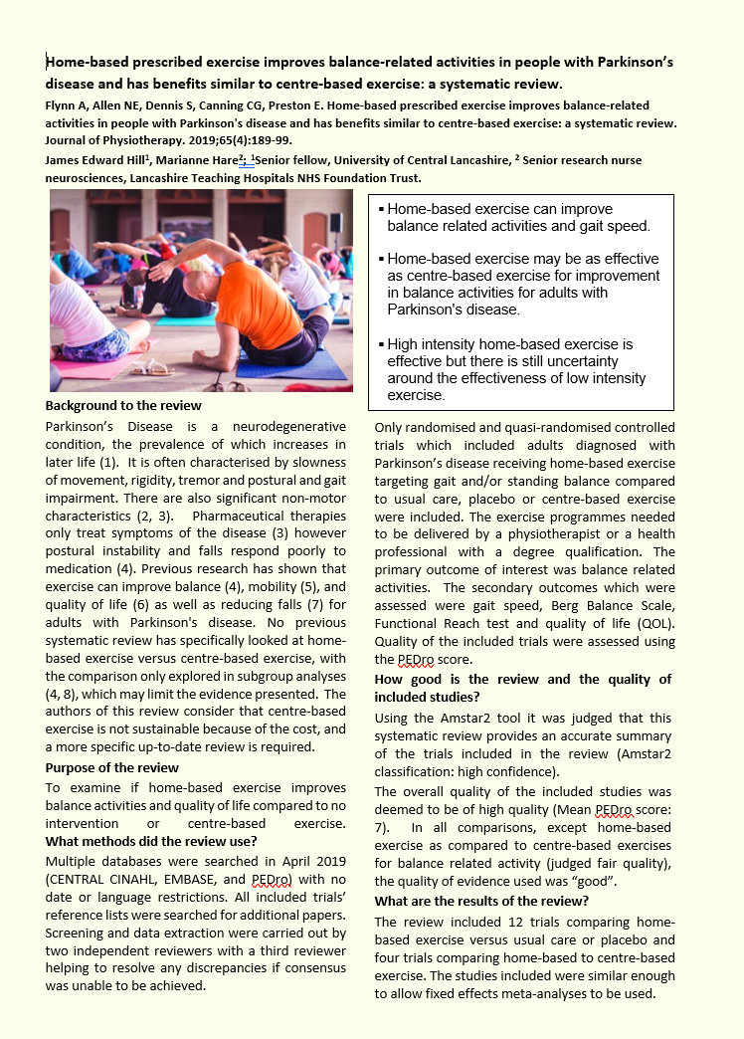
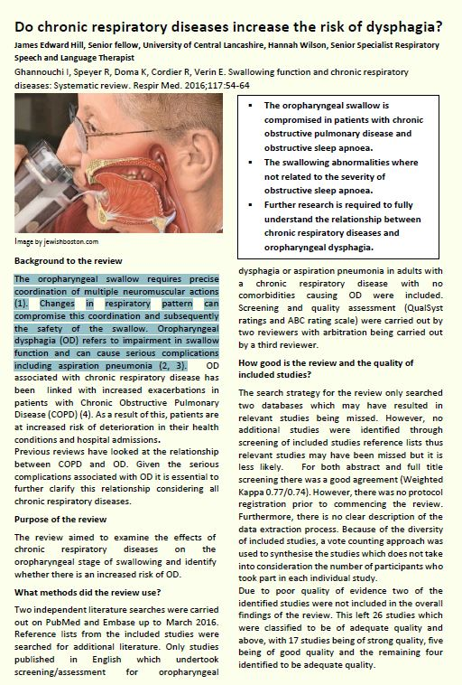
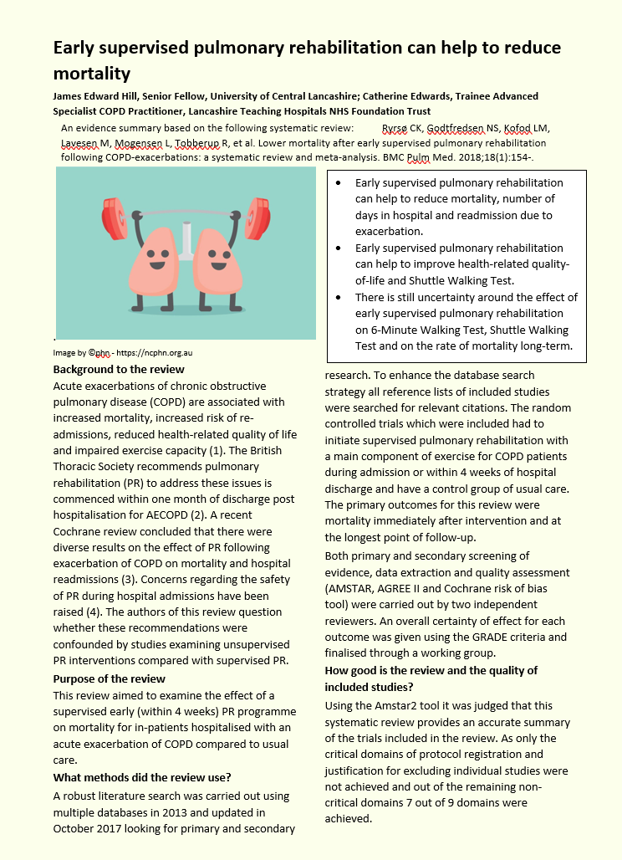
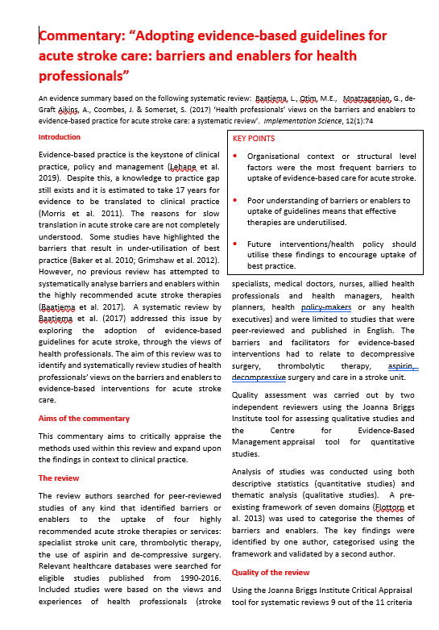
Rapid Conversion of Evidence Summaries (RaCES)
3. Summary of evidence
In addition to critically appraising the evidence, the member is guided through considering the implications for policy and practice, their implementation in the care setting and communicating their findings through writing a two-page summary. This process helps to up-skill the member's knowledge around evidence synthesis and implementation. All stages and outputs are quality checked by MIDAS.
2. Finding the evidence and guiding the assessment
Having specified a question, guidance is given on identifying and assessing relevant evidence. Support is provided through mentoring by MIDAS and via an interactive, step-by-step process using Microsoft Teams (MT). The MT group allows members to collaborate, gain support from MIDAS and for MIDAS to manage progress.
1. Identifying policy and practice question
Questions are identified through: (i) an ARCNWC member raising an issue associated with organisational policies or an area of their day-to-day practice where there is uncertainty; or, (ii) through an area identified more generally as a priority area for health and social care (e.g. NHS, National Institute for Health Research, Royal Colleges, other professional bodies or through public and patient representatives). Examples of questions include: ‘Which safety culture survey should I use?’, ‘Is virtual reality effective in treating post-traumatic stress syndrome?’ and ‘Is strength training effective for Multiple Sclerosis patients?’

Slide 38
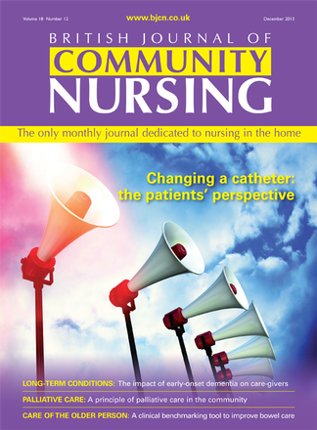
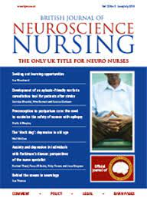
Rapid Conversion of Evidence Summaries (RaCES)
4. Communicating findings
Findings are disseminated widely: (i) directly within the member’s organisation through research and practice meetings, and (ii) externally to all ARCNWC members and the public as part of a monthly newsletter, quarterly ARCFEST events and the ARCNWC website, as well as through publication in peer reviewed and specialist professional journals. This allows the member to gain experience of writing for publication, presenting at meetings and wider networking.
3. Summary of evidence
In addition to critically appraising the evidence, the member is guided through considering the implications for policy and practice, their implementation in the care setting and communicating their findings through writing a two-page summary. This process helps to up-skill the member's knowledge around evidence synthesis and implementation. All stages and outputs are quality checked by MIDAS.
2. Finding the evidence and guiding the assessment
Having specified a question, guidance is given on identifying and assessing relevant evidence. Support is provided through mentoring by MIDAS and via an interactive, step-by-step process using Microsoft Teams (MT). The MT group allows members to collaborate, gain support from MIDAS and for MIDAS to manage progress.
1. Identifying policy and practice question
Questions are identified through: (i) an ARCNWC member raising an issue associated with organisational policies or an area of their day-to-day practice where there is uncertainty; or, (ii) through an area identified more generally as a priority area for health and social care (e.g. NHS, National Institute for Health Research, Royal Colleges, other professional bodies or through public and patient representatives). Examples of questions include: ‘Which safety culture survey should I use?’, ‘Is virtual reality effective in treating post-traumatic stress syndrome?’ and ‘Is strength training effective for Multiple Sclerosis patients?’

Slide 39
Rapid Conversion of Evidence Summaries (RaCES)
5. Implementing into policy and practice
Where the RaCES identify the need for a change to policy and practice or opportunities for further research, the MIDAS team collaborates with the member organisation to implement change or further develop the evidence base through grant funded research.
4. Communicating findings
Findings are disseminated widely: (i) directly within the member’s organisation through research and practice meetings, and (ii) externally to all ARCNWC members and the public as part of a monthly newsletter, quarterly ARCFEST events and the ARCNWC website, as well as through publication in peer reviewed and specialist professional journals. This allows the member to gain experience of writing for publication, presenting at meetings and wider networking.
3. Summary of evidence
In addition to critically appraising the evidence, the member is guided through considering the implications for policy and practice, their implementation in the care setting and communicating their findings through writing a two-page summary. This process helps to up-skill the member's knowledge around evidence synthesis and implementation. All stages and outputs are quality checked by MIDAS.
2. Finding the evidence and guiding the assessment
Having specified a question, guidance is given on identifying and assessing relevant evidence. Support is provided through mentoring by MIDAS and via an interactive, step-by-step process using Microsoft Teams (MT). The MT group allows members to collaborate, gain support from MIDAS and for MIDAS to manage progress.
1. Identifying policy and practice question
Questions are identified through: (i) an ARCNWC member raising an issue associated with organisational policies or an area of their day-to-day practice where there is uncertainty; or, (ii) through an area identified more generally as a priority area for health and social care (e.g. NHS, National Institute for Health Research, Royal Colleges, other professional bodies or through public and patient representatives). Examples of questions include: ‘Which safety culture survey should I use?’, ‘Is virtual reality effective in treating post-traumatic stress syndrome?’ and ‘Is strength training effective for Multiple Sclerosis patients?’

Slide 40
Current and completed social care RaCES projects
We have completed over 70+ publications/projects in a range of health, mental health, community and social work services.
Currently/pending publication:
Simpson A, Filipe L, Benedetto V, Hill J. The impacts of housing conditions on physical and mental health: a critical mini-review informed by a rapid conversion of evidence from Alidoust and Huang (2021). Sec. Housing Conditions and Public Health Volume 3 - 2024 https://doi.org/10.3389/fenvh.2024.1352580
Health and social care: The link between social care deficiencies and health care pressures (Accepted by British Journal of Healthcare Management)
Health and social care: Is integration of care to meet growing demands effective? (Accepted by British Journal of Healthcare Management)
Under Development:
Commentary: At the Edge of Care: A Systematic Review and Thematic Synthesis of Parent and Practitioner Views and Experiences of Support for Parents with Mental Health Needs and Children’s Social Service Involvement“
Commentary: Relational practice in health, education, criminal justice, and social care: a scoping review - PubMed (nih.gov)
Commentary: Telehealth v. face-to-face provision of care to patients with depression: a systematic review and meta-analysis - PubMed (nih.gov)

Slide 41
Rapid Conversion of Evidence Summaries (RaCES)
Process of undertaking a RaCES
(James Hill Jehill@uclan.ac.uk)
(Joanna Harrison JHarrison12@uclan.ac.uk)

Slide 42
Professor Mark Gabbay Director, ARC NWC

Slide 43
Use of our existing infrastructure for delivery HIAT / HEMS Identifying current theme projects to link up with Member Forum / Network CoREN Public Advisors Academic expertise Communications / dissemination and co-working with ARC KSS for national resources What else do you want us to utilise to benefit you?

Slide 44
Now tell us the challenges and solutions you think we need to consider for delivering our ideas for Research Implementation and Internships within this programme. Feel free to add your own ideas for other support methods you feel we should consider.
Table exercise / discussion
Use this form

Slide 45
Thank You – Next steps….

