Slide 1




Using Civic Data research to minimise the risk to children.
Ben Barr
HIPR (health inequalities policy research)
Department of Public Health, Policy and Systems
University of Liverpool
RESTORE

Slide 2
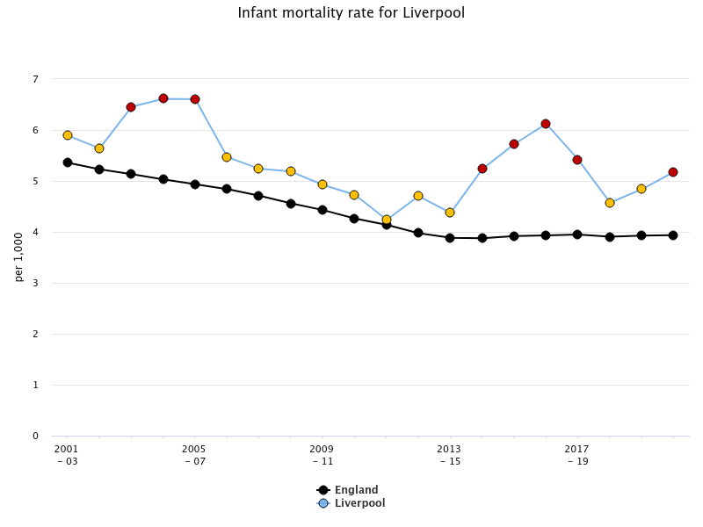
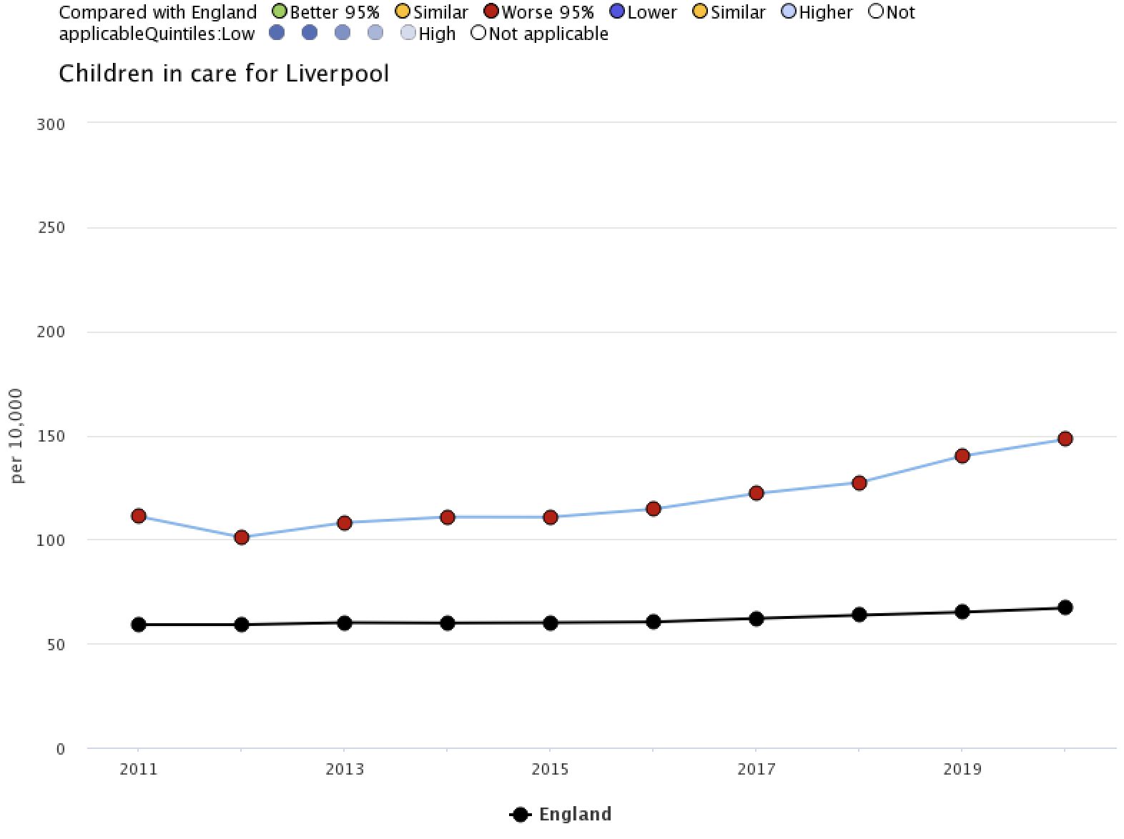
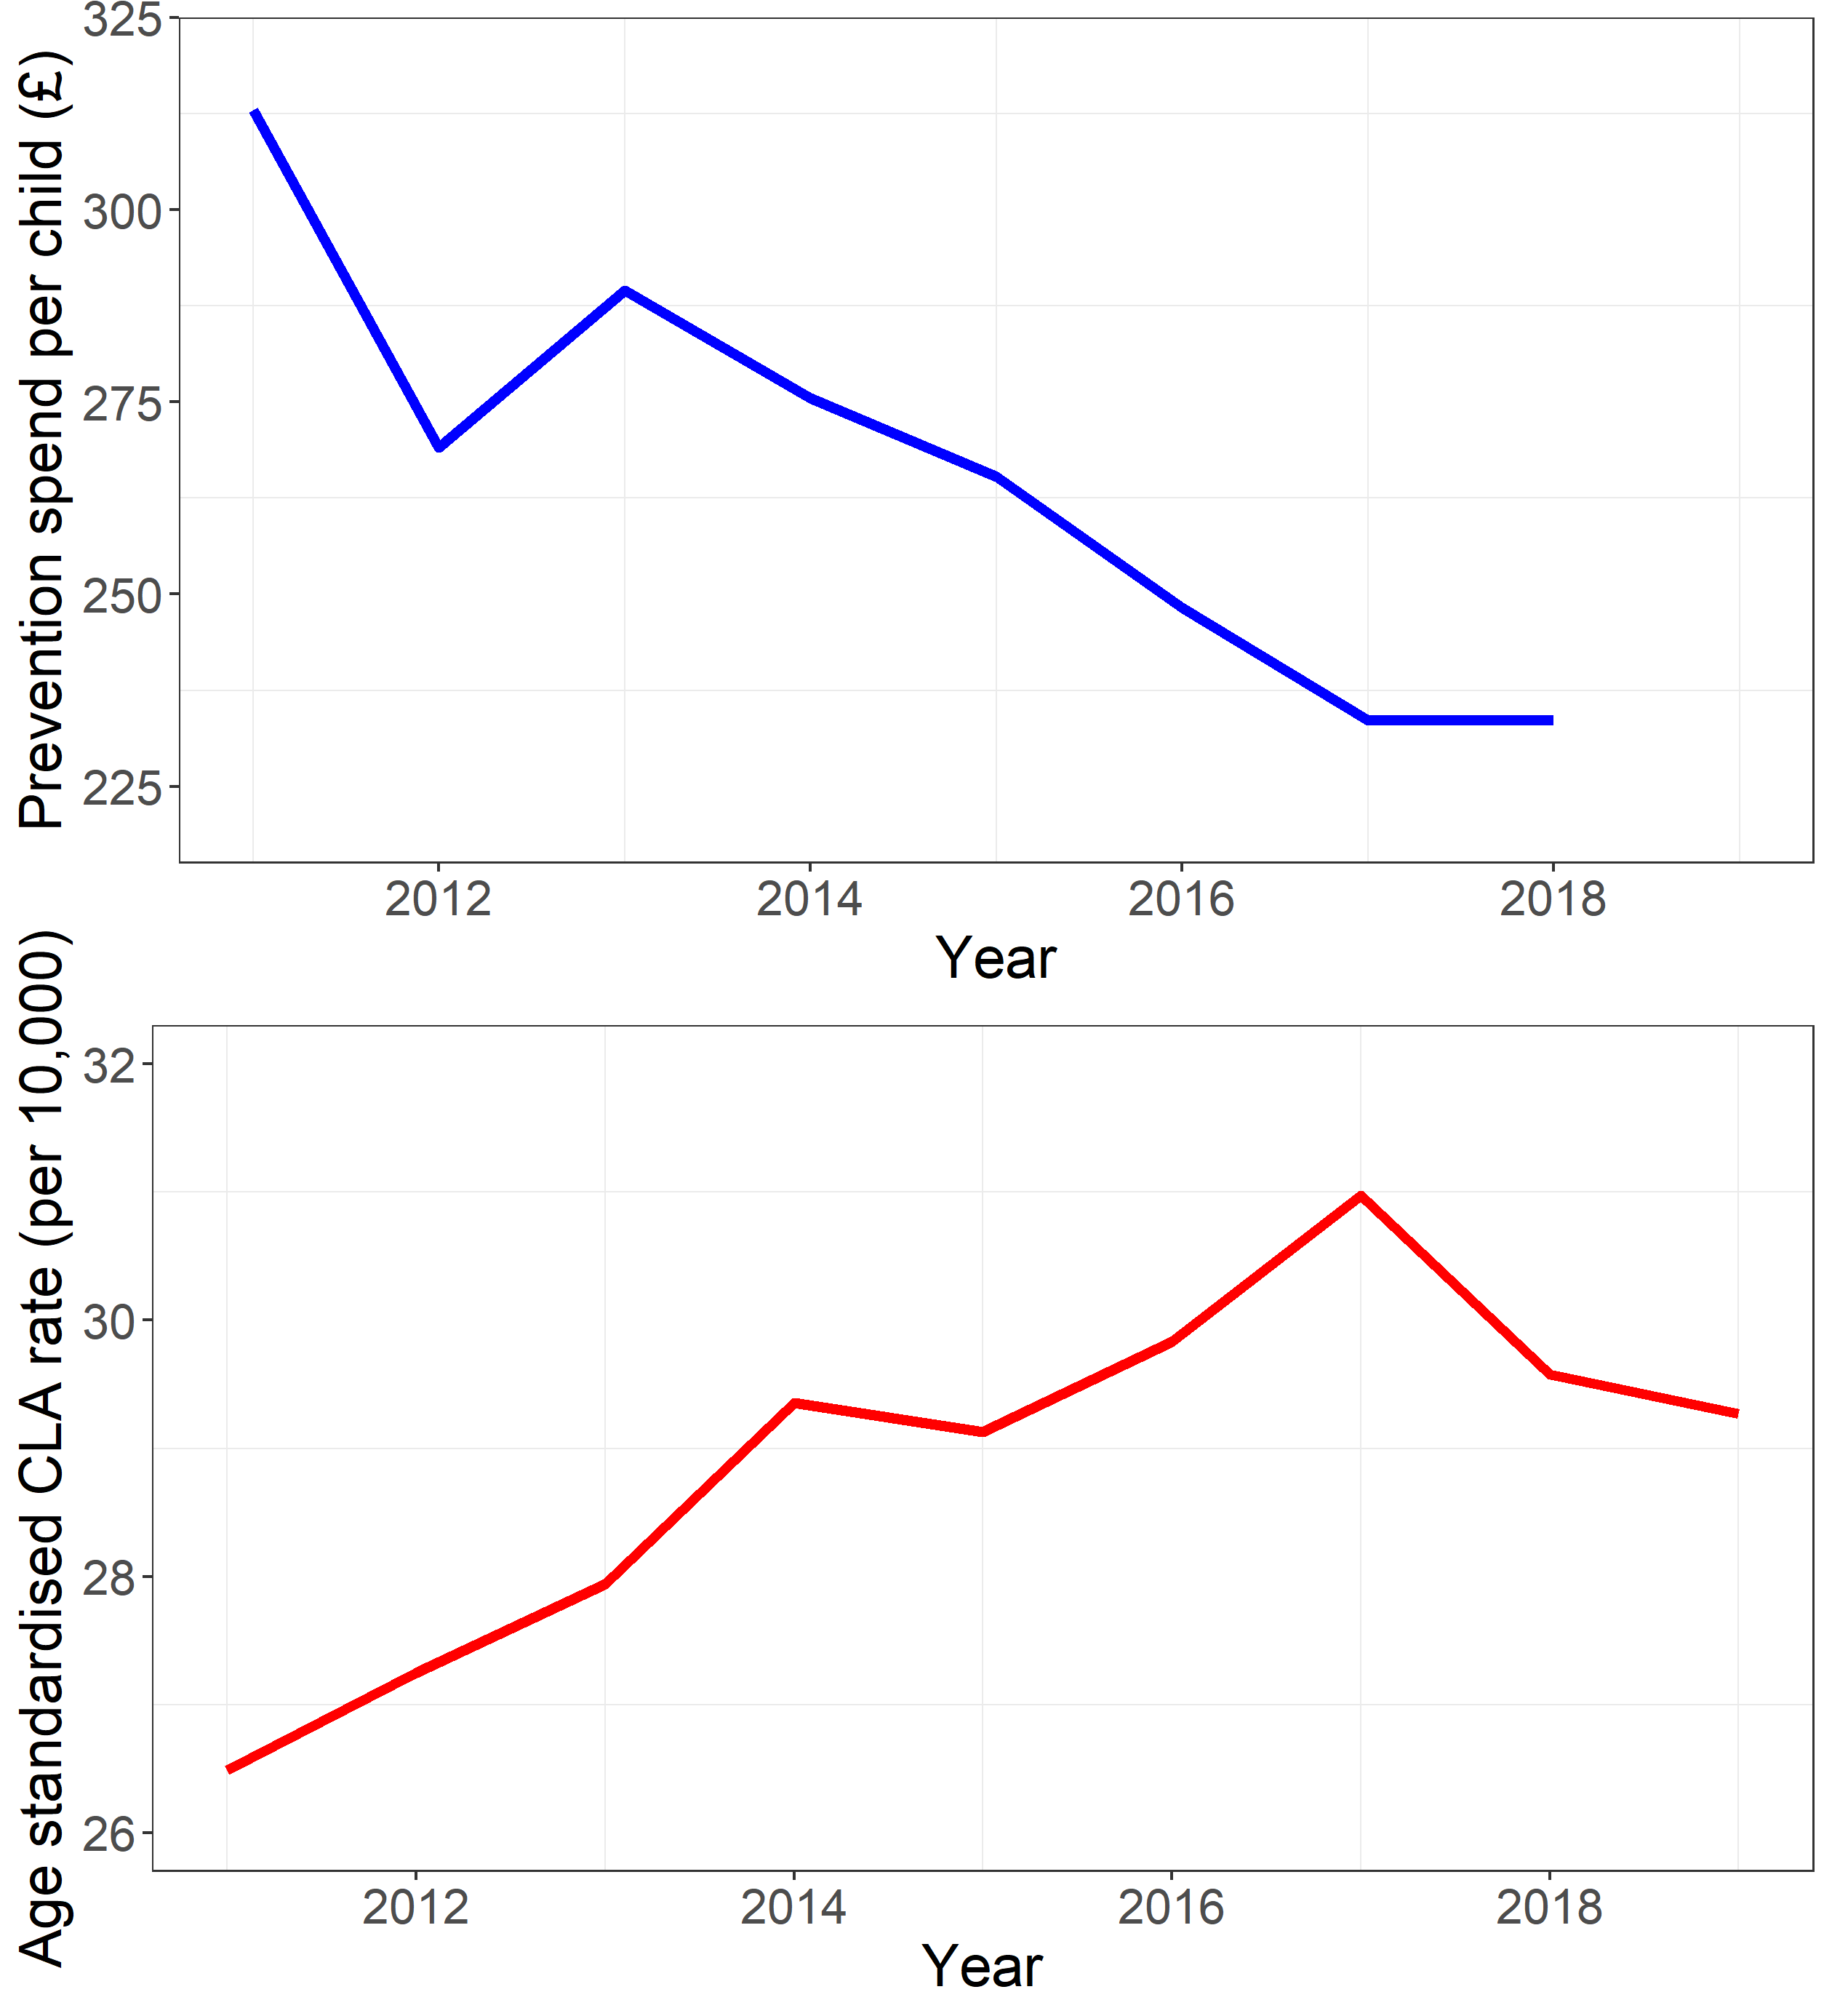
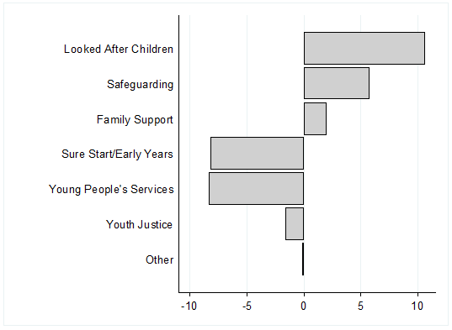
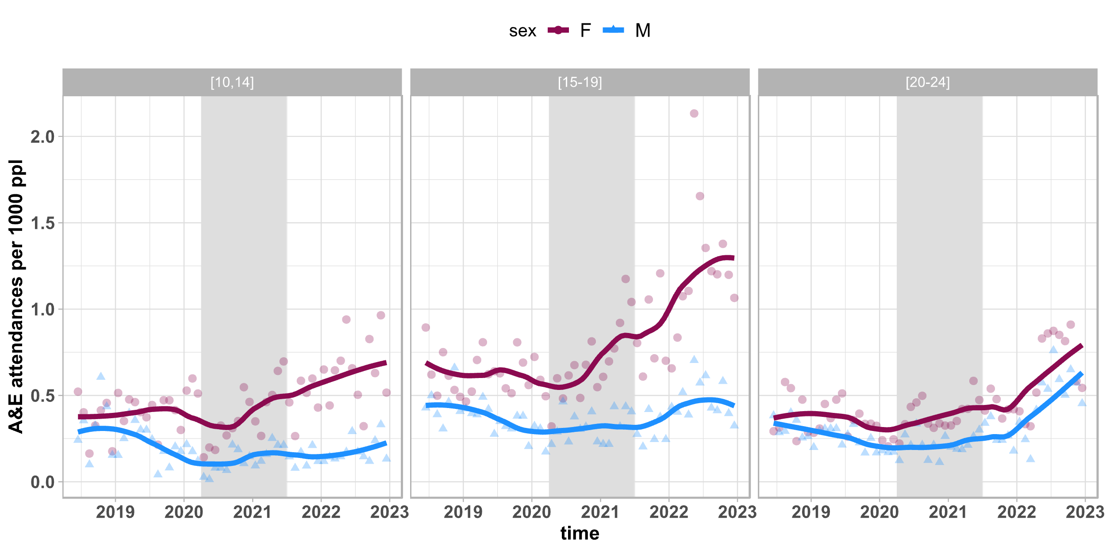
Context: Child health and wellbeing in Liverpool
Child Health is deteriorating in Liverpool.
Increasing numbers of children looked after.
Decreased investment in prevention.
£84 million
Decreased spend
Increased Spend
Spending on looked after children / Safeguarding
Spending on prevention

Slide 3
Learning system?
Early identification of risk and gaps
Evaluate – What works?
Change the system
What is the evidence – what do we already know
Notes:
Put evaluation in friendly Schiapparelli pink! Need to emphasise that there is nothing about performance management in our evaluation.

Slide 4
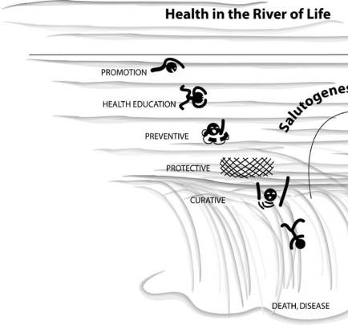



Slide 5
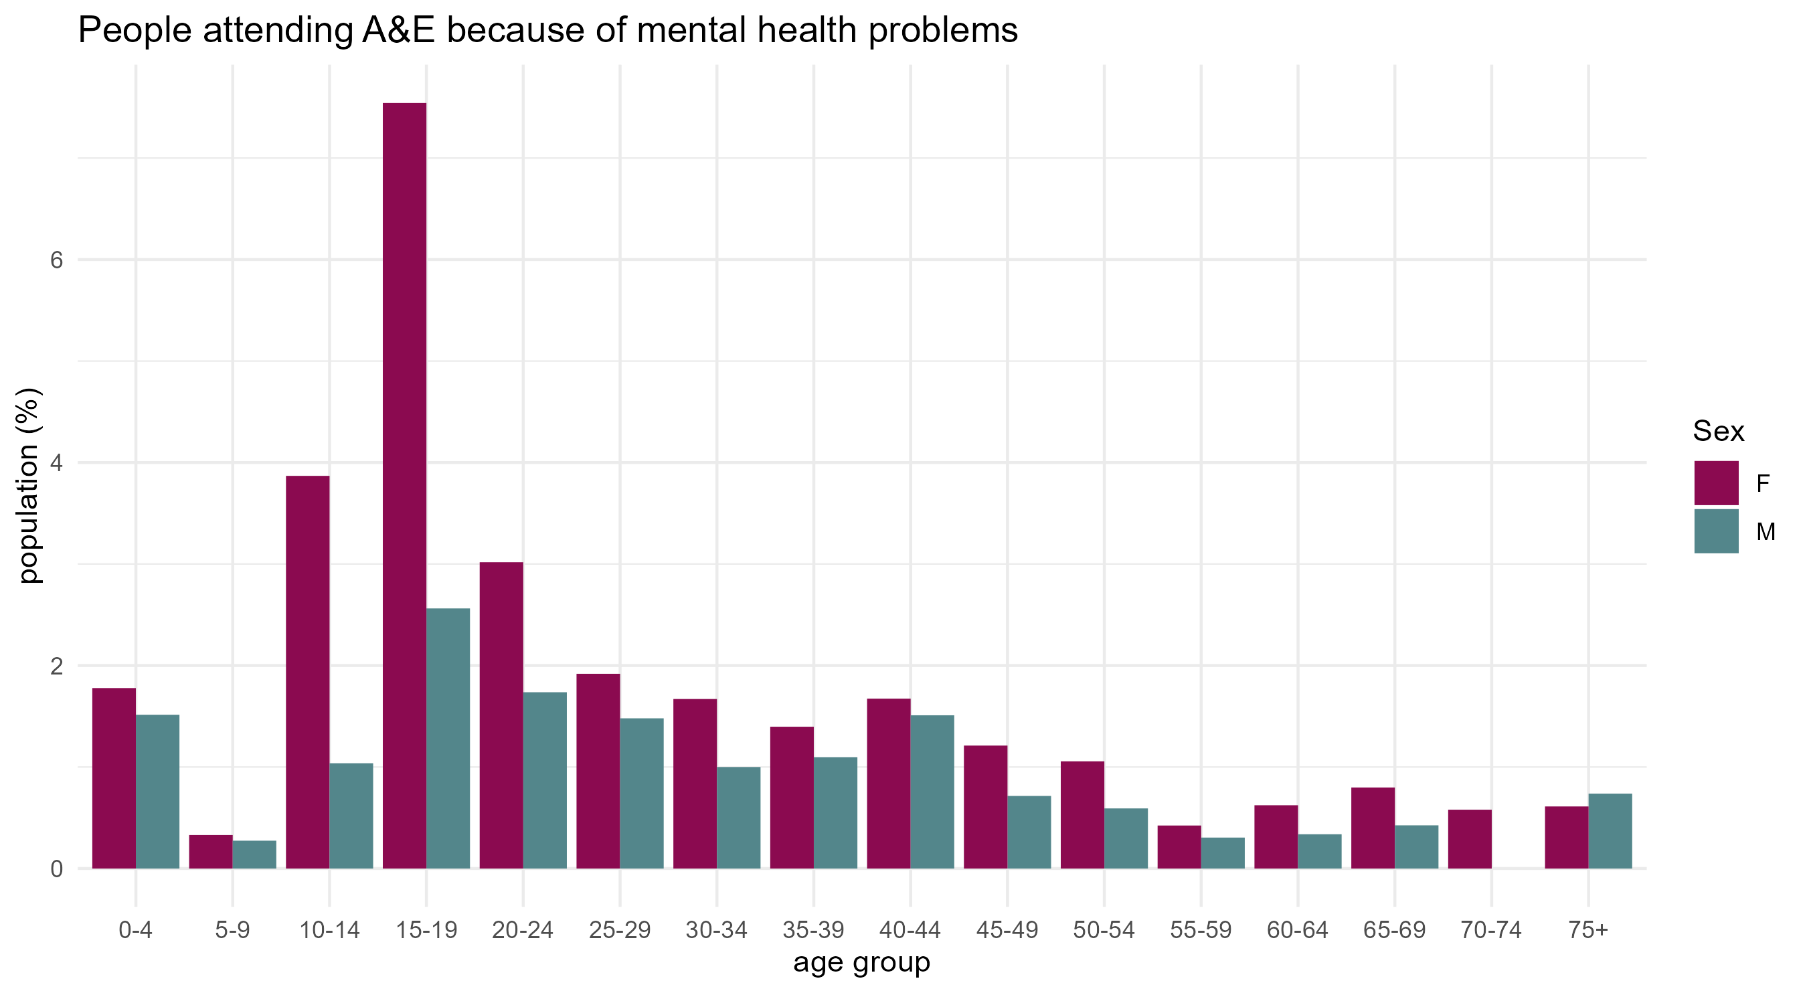
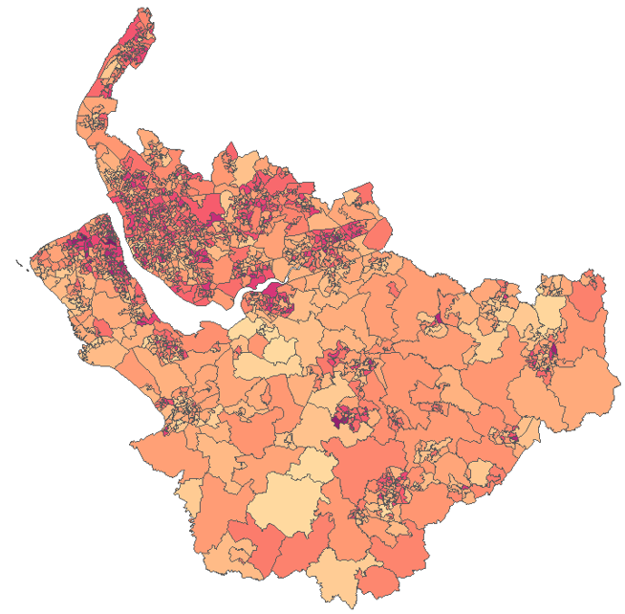
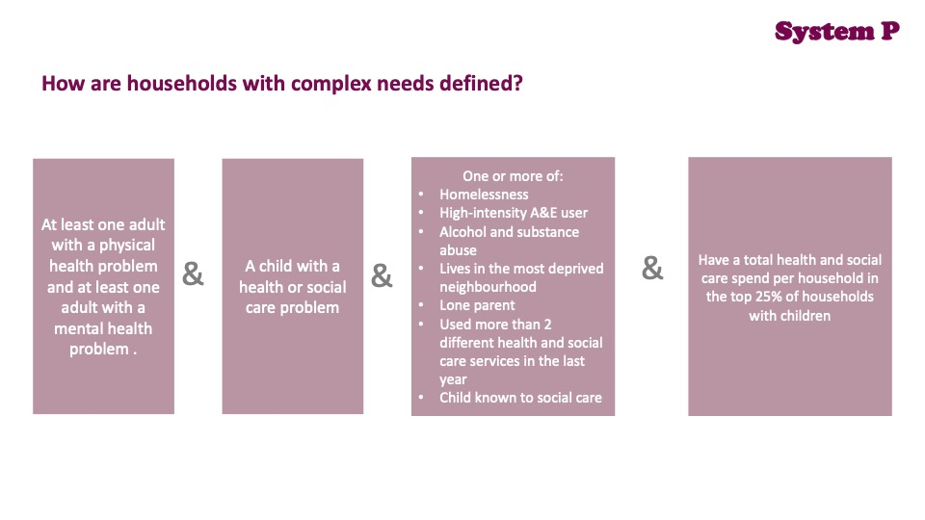
Identifying children in households with complex needs.
12% children with learning difficulties / autism.
22,000 households, 41,000 children.
60% of women
40% of men with mental health problems
RESTORE
£365 million per year, £17,000 per family

Slide 6
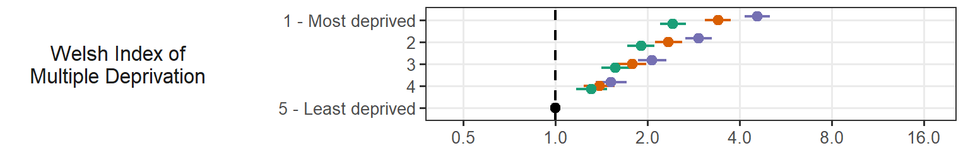
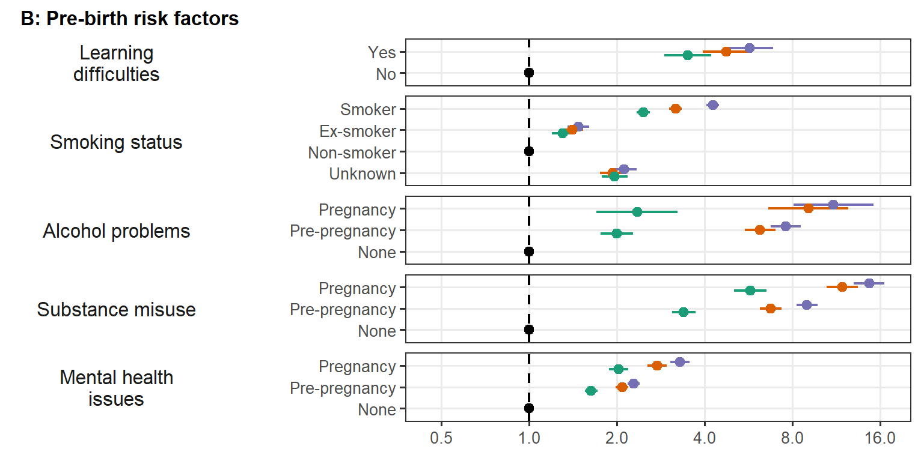
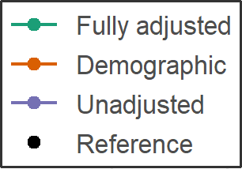
Hazard ratios for risk of becoming looked after: maternal demographic factors
Notes:
This is reflected in the hazard ratios. I’ll summarise some core findings here.
Children born into the most deprived quintile (of the Welsh Index of Multiple Deprivation, see here at the bottom) were 3.4 times more likely to enter care compared to those living in the least deprived quintile after accounting for potential confounders (demographic adjusted HR 3.40, 95%CI 3.08, 3.74).
Maternal age was also strongly associated with LAC risk.
Maternal age of 16-17 was associated with a 3.8 times hazard compared to maternal age >30 (demographic adjusted estimate (aHR 3.81, 95% CI 3.19, 3.99).
Relative to households with two adults, mothers living alone had the greatest risk of child removal (demographic adjusted HR 1.28, 95% CI 1.21-1.135). Presence of other children in the household is associated with lower risk in the first five months from birth (demographic adjusted HR 0.58, 95% CI 0.53, 0.62), but increased risk after 12 months (demographic adjusted HR 1.51, 95% CI 1.42, 1.61).

Slide 7
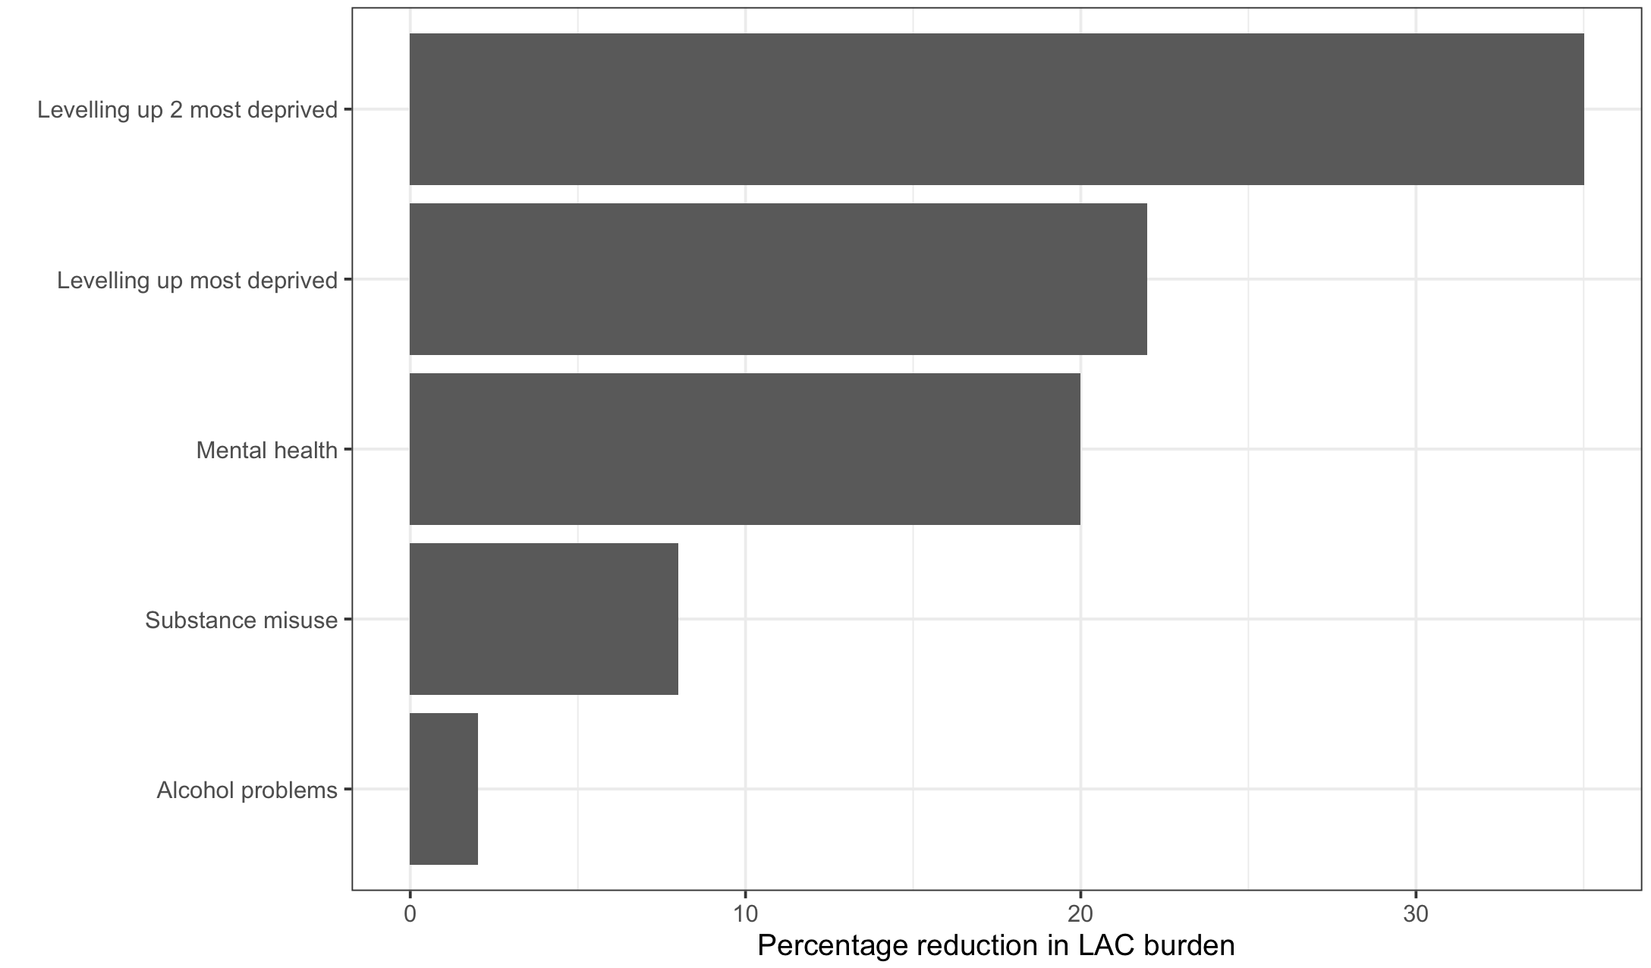
Population attributable fractions
Represent the burden of LAC potentially attributable to the exposure
The reduction in LAC that could occur if exposure was
Notes:
reducing Now to help us grasp the policy implications, we estimated population attributable fractions. These basically represent the burden of LAC potentially attributable to the exposure, assuming a causal relationship. It tells us the reduction in the risk of LAC that might occur if we were to successfully intervene on that exposure.
If we levelled up the two most deprived quintiles in Wales, we’d get rid of over a third of the cases of children being looked after, assuming that relationship is causal.
If we successfully tackled mental health conditions, we’d get rid of 20% of the population burden of children in care. There are smaller reductions associated with tackling health behaviours.
Poor socioeconomic conditions and adult mental health – this is where we would focus policy attention.

Slide 8
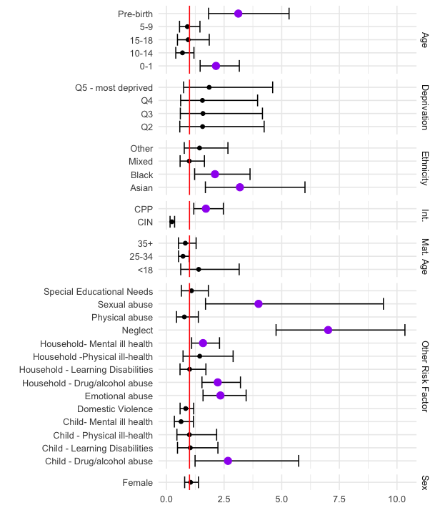
What increases risk of children known to social care becoming “looked after”

Slide 9

Citizens Advice on Prescription Liverpool.
Social welfare service for people at risk of poverty and mental distress.
65,000 people potentially benefited between 2018 and 2022 (13,600 children)
70% living in poverty
40% with at least 1 mental health problem.
Estimate that around 1 in 3 of the households with complex needs in Liverpool have used CAP at least once between 2018 and 2022.
20% reduction in depression and anxiety
73 ADQs per person per quarter (95% CI 25 to 121)
7 fewer A&E attendances per 100 clients per quarter. (95%CI 2 to 11)

Slide 10
Children at Risk – Research Development Network
Health Determinants Research Centre
ARC NWC
NIHR School of Public Health
NIHR School of Primary Care
NIHR School of social Care
What are the early indications of children being at risk and how could be identify these earlier?
What are promising approaches that can be evaluated and scaled up, where shown effective?
What are the outcomes we should be trying to achieve for children?
What are the opportunities for collaboration in research and implementation that improves outcomes for children?

