Slide 2
Welcome to the Spring 2024 ARCFEST at The Liner Hotel Liverpool
Join in the conversation today by tagging us on X using @arc_nwc or by using the hashtags #ImplementEquity or #ARCFEST24

Slide 3
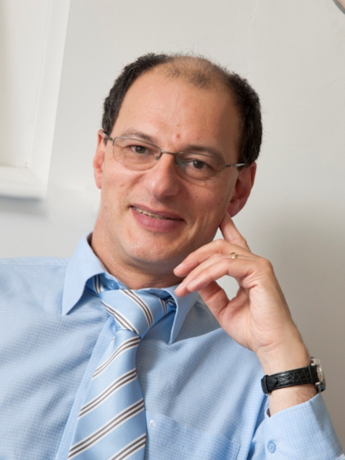
Professor Mark Gabbay Director, ARC NWC

Slide 4
Housekeeping

Slide 5
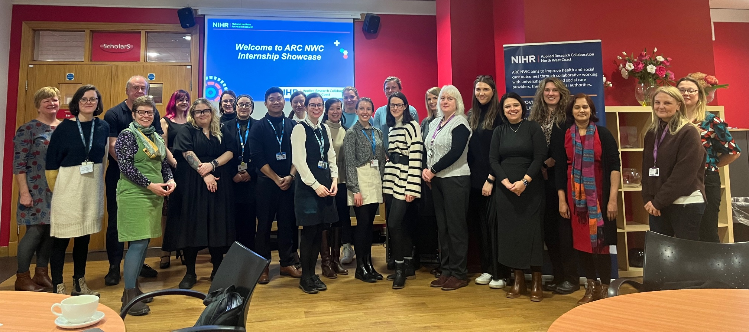
Overview
Recent Income :
£260,000 for Social Care Research Capacity Building Programme,
Extension to Dementia/Alzheimer’s Fellowships awarded ~£250k
Business case and budget for extension to 3/26 awarded £2.7
Funding for INSIGHT (Inspiring Students into Research Programme)
No research about us without us: ARC NWC coproduction offer to members
Launch of North West Coast Living Lab in Ageing and Dementia
Upcoming Opportunities: Mental Health Capacity Building programme 18 mth extension, Knowledge Mobilisation Fellowship programme
ARC 2 signals

Slide 6
Progress highlights
- ARC NWC part of National partnership to tackle health inequalities in coastal communities
- Evaluation of key projects in ARC NWC being undertaken
- ARC NWC plays a key role in securing funding for new member research collaborations - Health Determinants Research Collaborations (HDRC)
- 328 Publications from ARC NWC (all available on website)
- Strong progress with RaCES programme and CoREN and theme work overall

Slide 7
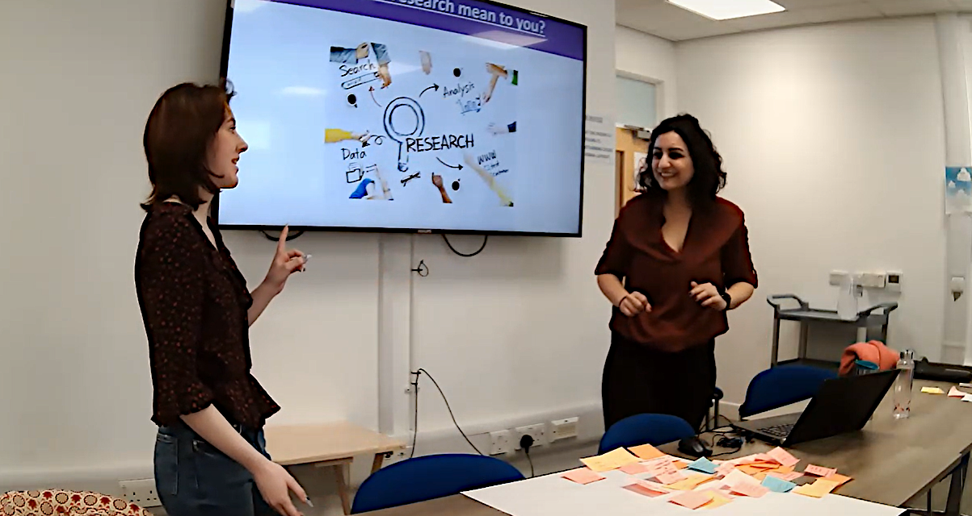
- Increase our coproduction and subsequent impact within the collaboration - Streamlining data collection, collation and reporting with an emphasis on demonstrating impact - Progressing “Out Nav” Impact Programme system outputs - NIHR ARC Visibility programme – designed to demonstrate national ARC impact
Priorities

Slide 8
Challenges
- Member Engagement – immense service pressures on health and care organisations making engagement and collaboration difficult
- Integrated Care Board Cash Match 2024-26
- Research Development Networks and roundtables progressing at different rates
- Clearer examples of implementation being requested from Department of Health and Social Care
- ARC 2 bid / Capacity to deliver newly funded programmes

