Slide 1


Developing a Cheshire & Mersey ICB research strategy:
Tackling health inequalities
Dr Greg Irving

Slide 2

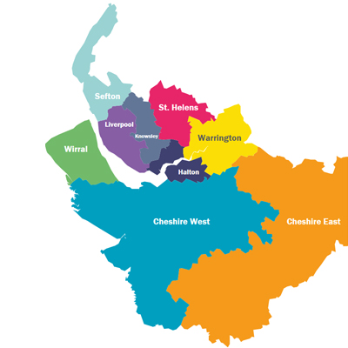
9 Local Authorities
18 Trusts (inc. NWAS)
2 provider collaboratives
51 Primary Care Networks
350 GP practices
1300 care homes
Notes:
Compared to the England average, the region currently has higher rates of premature cancer, cardiovascular disease (CVD) and respiratory deaths.
1 in 4 people in Liverpool and Knowsley live in Poverty
Even within the wealthier areas in the region, there is substantial deprivation and associated poor health – while 31 percent of neighbourhoods in Cheshire West and Chester are in the top two income deciles, compared to an England average of 20 percent, 16 percent of neighbourhoods in Cheshire West and Chester are in the lowest income deciles
School Readiness: Children achieving a good level of development at end of reception year ranges from 64.9% (Liverpool) to 73.6% (Warrington); England 71.8%
Unemployment; Levels of people claiming long term job seekers allowance in CM is 2.2, England 2.1, ranging from 0.7 in Warrington to 4.4 in Liverpool per 1000 population
Children in Care: Levels range from 66 (Cheshire East) to 125 (Liverpool), compared to an England average of 67 per 10,000
Children in Low Income Families: 26% of families in Liverpool live in relative low income compared to the national average of 19%

Slide 3


In 2022 …
All Together Fairer officially launched May 2022 with a keynote address from Sir Michael and exclusive coverage in BBC Newsnight
We knew we were doing something different;
  All Together Fairer deliberately and specifically focuses on the social determinants of health - the social, economic and environmental conditions in which people are born, grow, live, work and age
  Shifting to a social determinants of health approach means taking action on the drivers of ill health as well as treating ill health when it is presented in healthcare settings recognising that it is almost impossible to live healthily when in poverty
Since then, our fantastic group of local All Together Fairer Leads have been working in their local authority area and as one team to implement the Programme and the recommendations in the report, supported by the Champs Team

Slide 4
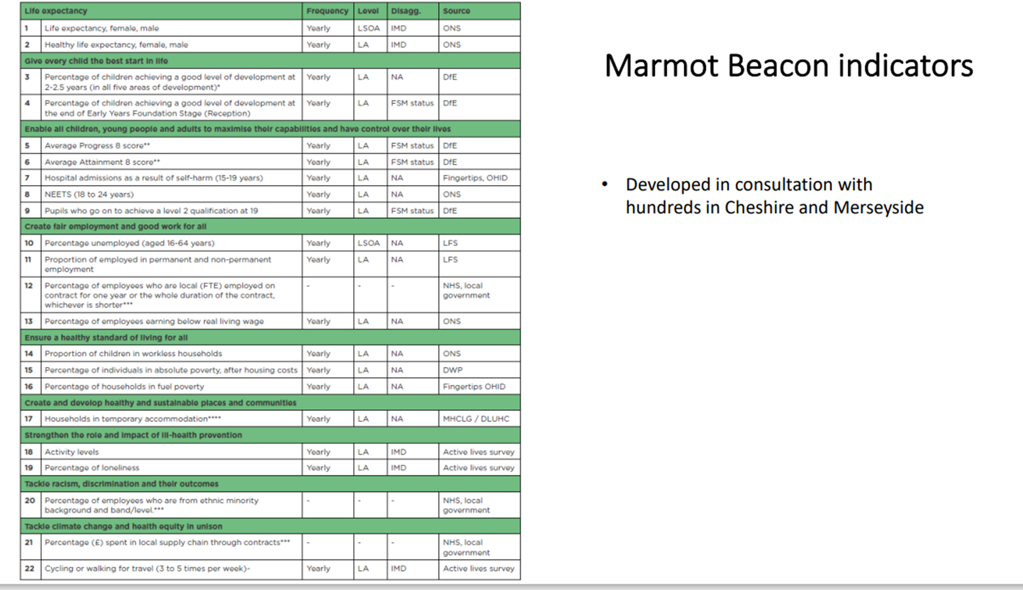

Slide 5
Implementing the recommendations
The IHE All Together Fairer Report is extensive and comprehensive. It is ground-breaking in setting the agenda on health inequalities for Cheshire and Merseyside.
A key point in all the IHE reports is that action is required across all the recommended areas. There is no one thing that will reduce inequality in health; health equity in all policies is the key.
Important we make this extensive programme feel doable and not impossible, accessible and not overwhelming and enabling of action.
The establishment of a Beacon indicator set is helping us to monitor progress and the result of extensive engagement across the sub region and the dashboard is now live on the CIPHA website

Slide 6
Key themes
Give every child the best start in life
Enable all children, young people and adults to maximise their capabilities and have control over their lives
Create fair employment and good work for all
Ensure a healthy standard of living for all
Create and develop healthy and sustainable places and communities
Strengthen the role and impact of ill health prevention
Tackle racism, discrimination and their outcomes
Pursue environmental sustainability and health equity together
Notes:
Within the All Together Fairer report, these eight themes have been identified that will inform our priorities for the next five years

Slide 7

Recommendations on improving our system
Increase and make equitable funding for social determinants of health and prevention
Strengthen partnership for health equity
Create stronger leadership and workforce for health equity
Co-create interventions and actions with communities
Strengthen the role of business and the economic sector in reducing health inequalities
Extend social value and anchor organisations across the NHS, public service and local authorities
Develop social determinants of health in all policies and implement Marmot Beacon Indicators
Notes:
As well as the eight priorities set out in the All Together Fairer report, Cheshire and Merseyside’s Integrated Care System (ICS) has also committed to this set of system-wide recommendations and actions for the subregion that will greatly influence and support our work
These commitments – alongside the ICS’s pledge to include every single All Together Fairer recommendation within its own five-year strategy – demonstrates how closely linked our organisations are and our desire to ‘act as one’ to tackle health inequalities and improve health

Slide 8
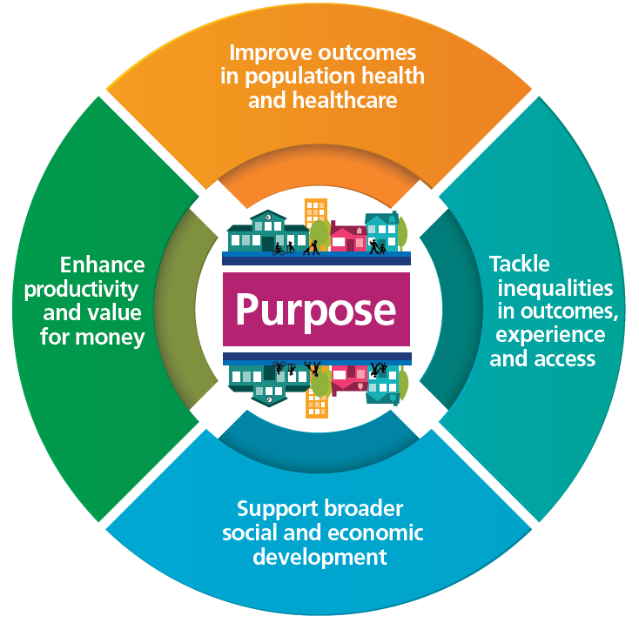
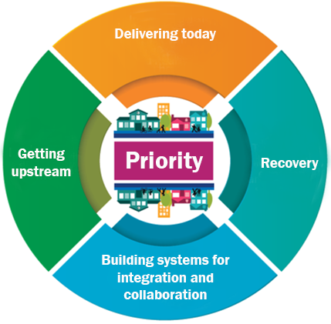

Notes:
Common purpose and ICSs as Partnerships of organisations that come together to plan and deliver joined up health and care services to improve the lives of people in their area
Graham’s short term priorities

Slide 9
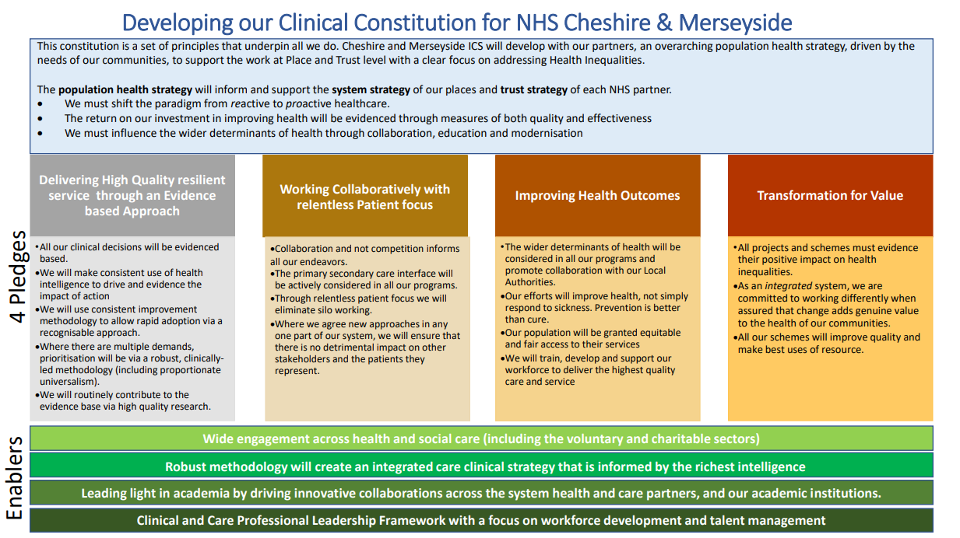

Slide 10
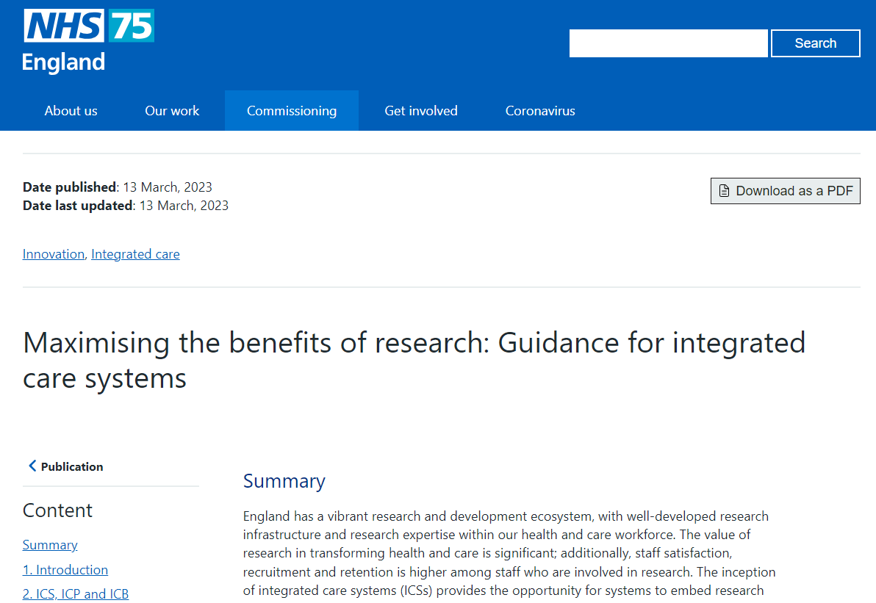

Slide 11
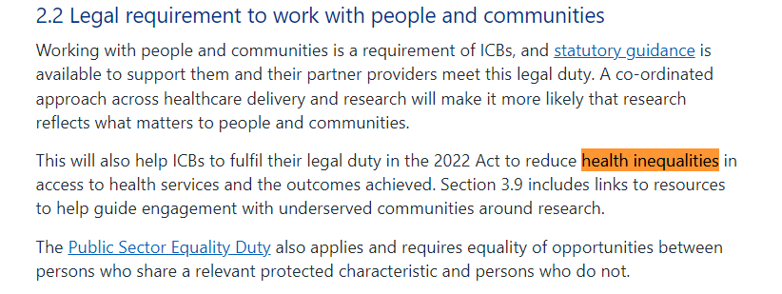

Slide 12
Maximising the benefits of research:
ICSs are encouraged to develop a research strategy that aligns to or could be included in their integrated care strategy.
Identify and address local research priorities and needs, and work collaboratively to address national research priorities
Improve the quality of health and care and outcomes for all through the evidence generated by research
Increase the quality, quantity and breadth of research undertaken locally
Extend and expand research in settings such as primary care, community care, mental health services, public health and social care
Drive the use of research evidence for quality improvement and evidence-based practice
Influence the national research agenda to better meet local priorities and needs
Improve co-ordination and standardisation within and between localities for the set up and delivery of research
Harness the patient and economic benefits of commercial contract research
Co-ordinate and develop the research workforce across all settings.

Slide 13
Integrated Research and Innovation System (IRIS)

Slide 14





ICS Research Engagement Network Development Programme (ICS REND)
Collaborative 4-month project, funded by NHS England to help reduce health inequalities through increasing diversity in research engagement. Aligned to NHSE’s CORE20PLUS5 approach.
£100K awarded to two VCSEs within NWC, building capacity for communities to be engaged in future co-production of research by developing community research hubs in Liverpool and Morecambe Bay
Using NIHR existing programmes of community research engagement (e.g. CRN NWC Research Ready Communities and ARC NWC Community Research Engagement Network) to develop a network of Community Research Champions, building capacity for future co-production of research and identifyng community research priorities.
A “kick start” approach in phase 1 – awaiting news on phase 2 funding.

