Slide 1





Evaluating Liverpool Citizens Advice on Prescription (CAP)
Ben Barr, Katharine Abba, Rachel Anderson De Cuevas, Aregawi Gebremariam, Clare Mahoney, Roberta Piroddi
Notes:
To add content, overtype the details of your presentation above. This will automatically pick up the font, Arial Black, which should be used throughout your presentation. Try to keep titles to at least 36pt and body text should be a minimum of 12pt throughout.
To add in a blank slide at any stage of the presentation, click on ‘Insert/New Slide’. This will pick up the blue colour of the presentation automatically, as well as the appropriate font.

Slide 2

Citizens Advice on Prescription Liverpool
Set up in 2015, to provide a rapid and proportionate social welfare service for people at risk of poverty and mental distress.
Barriers are conceived as being both internal (mental health/low mood) and external (practical, social and financial).
Covers primary, community, secondary and mental health services
Works closely with PCNs to enhance their social prescribing offer

Slide 3
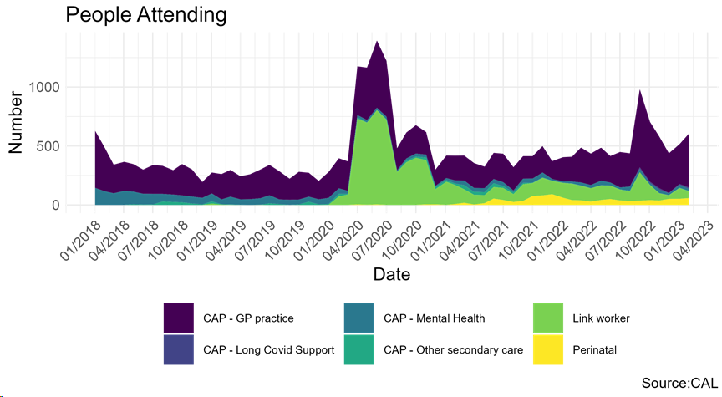
Use of CAP across types of service access
Between January 2018 and December 2022 there were approximately 58,000 referrals to CAP, from more than 25,000 households.
Service use doubled during the pandemic and has remained 50% higher than pre-pandemic levels during 2022.
Ethnic minority groups
Families with Children
More deprived

Slide 4
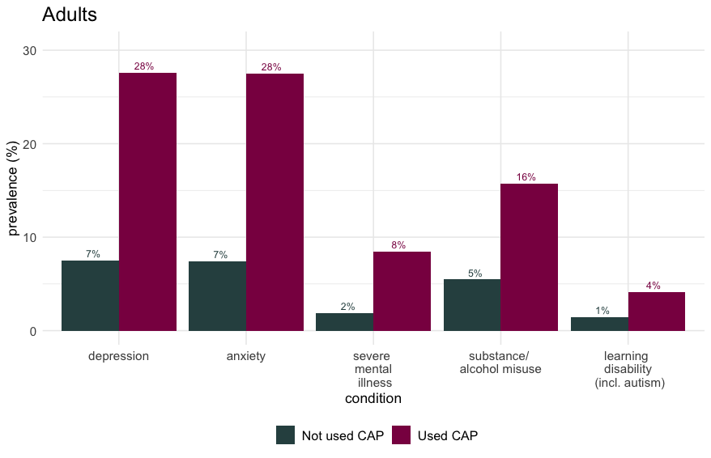
Citizens Advice on Prescription (CAP). Uptake and Impact
Large number of high need people potentially benefited.
65,000 people potentially benefited between 2018 and 2022 (13,600 children)
70% living in poverty
40% with at least 1 mental health problem.
60% with multimorbidity
Average 30 GP consultations per 100 clients in the 3 months before intervention.
Around1 in 3 of the households with complex needs with children in Liverpool have used CAP at least once 2018 - 2022.

Slide 5
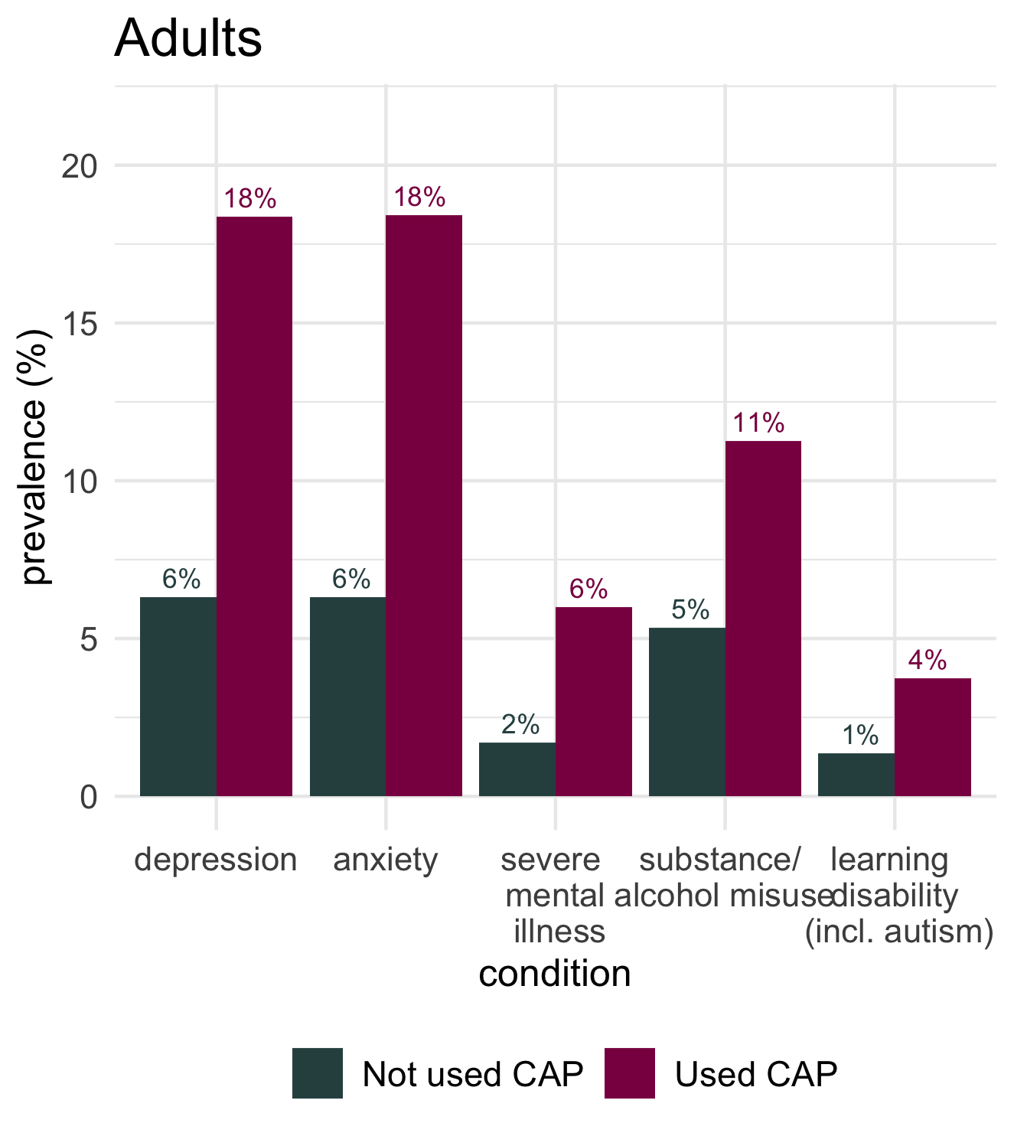
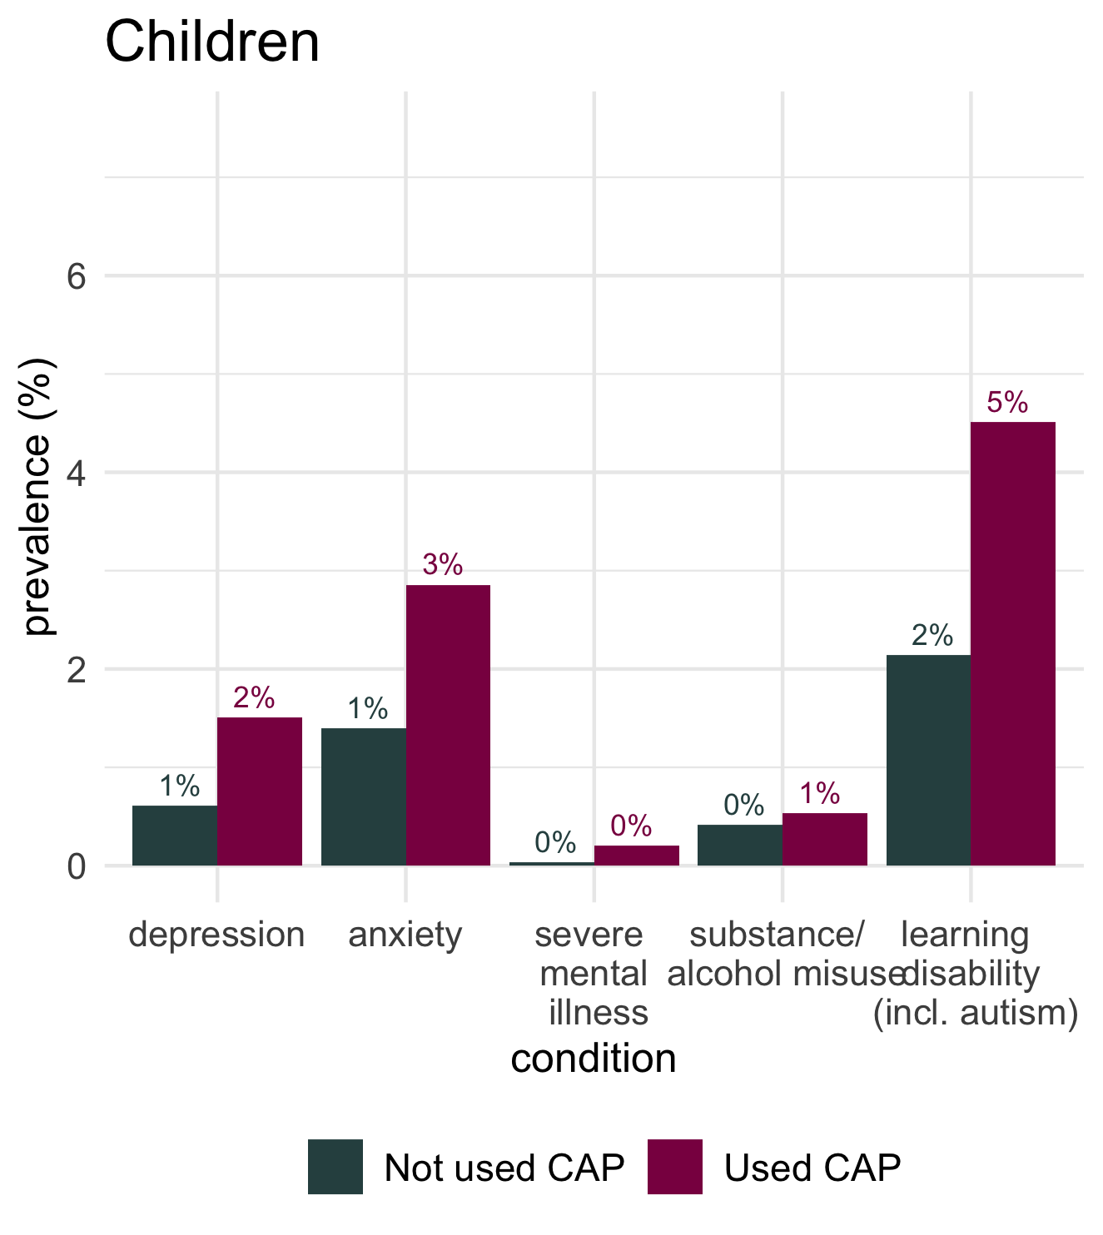
Mental health conditions and learning disabilities in all adults and children in households using CAP compared to the rest of the Liverpool population.

Slide 6
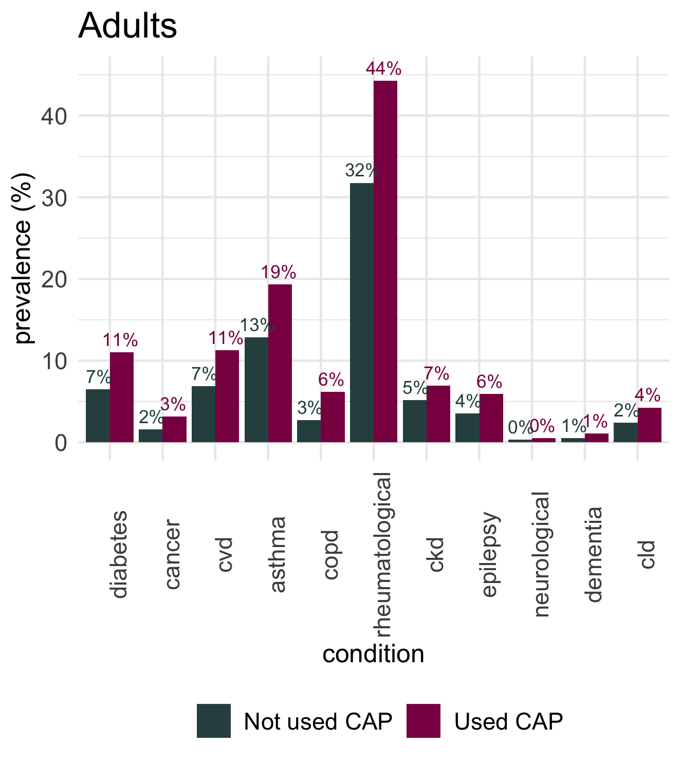
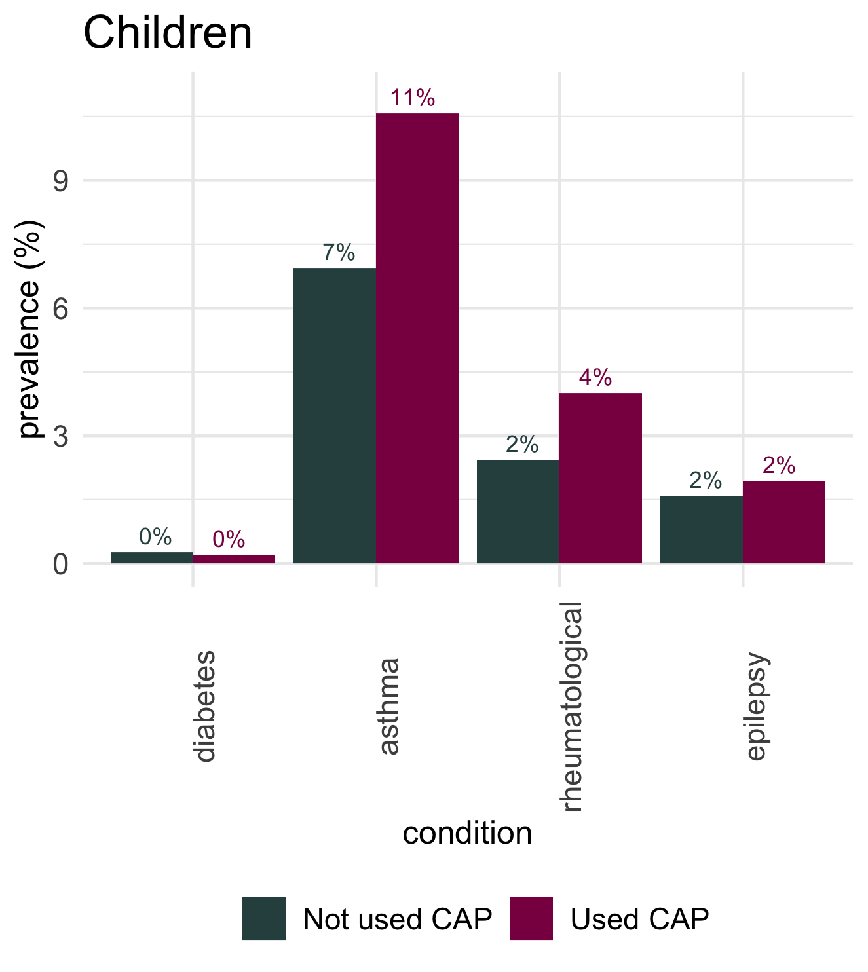
Physical health problems in households using CAP

Slide 7
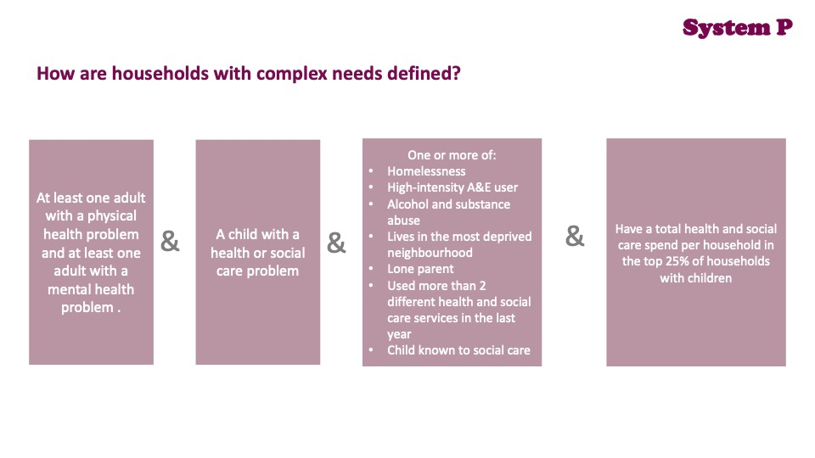
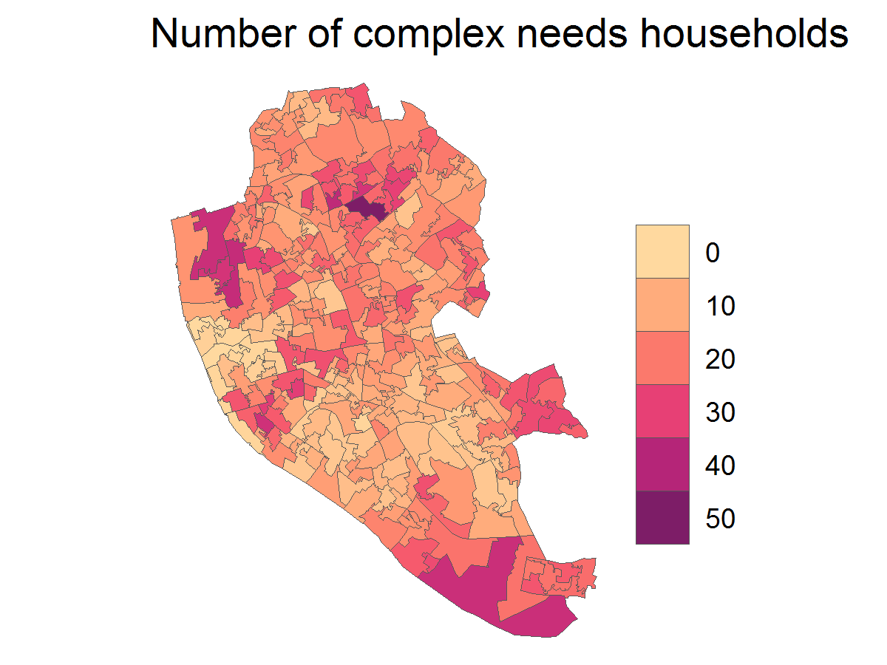
Citizens Advice on Prescription (CAP). Uptake and Impact
Large number of high need people potentially benefited.
Estimate that around 1 in 3 of the households with complex needs in Liverpool have used CAP at least once between 2018 and 2022.
In Liverpool 4519 households have complex needs. These households with complex needs include 19218 people ( 8648 children and 10570 adults). This 9 % of families, account for 36 % of health and social care costs for families with children. This is £ 70 million in total.

Slide 8
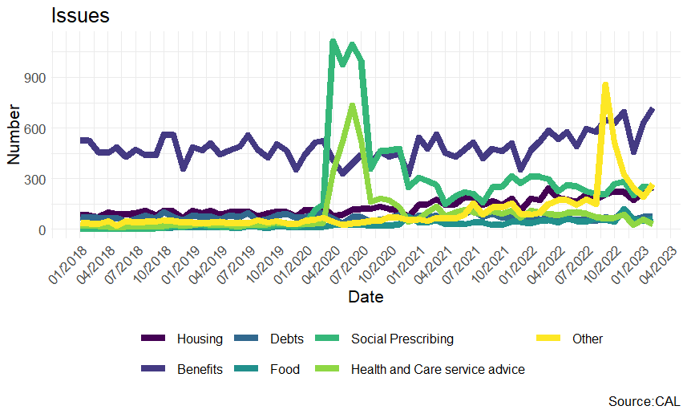
Types of issues and support provided
Support for benefits and debt continues to be the major welfare issue, with housing a marked increasing trend in recent data.

Slide 9
Does this support go farther than this?

Slide 10
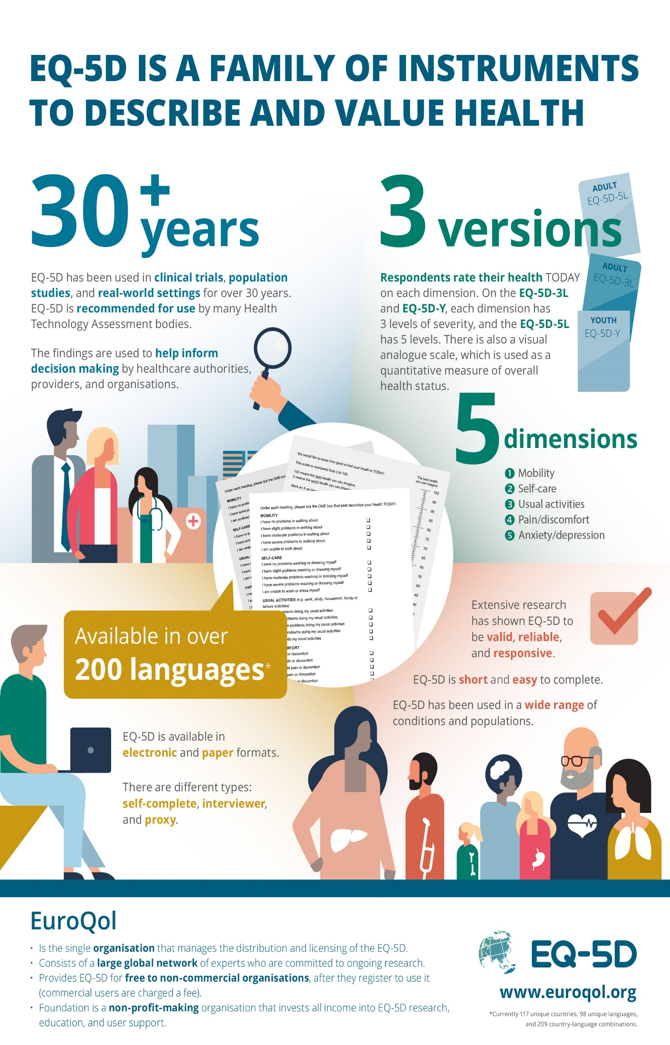
Client reported outcomes.
EQ-5D, SWEMWBS
Assessment
2 months
6 months
- Reduced anxiety and depression, reduced by 20% (OR 0.8) (p=0.03)
- Improved self reported health, increased by 6 points on 1-100 scale (7%)
- Improved wellbeing.

Slide 11



Impact on health care utilization.
Anonymized data linkage
- Reduction in antidepressant prescribing by 73 ADQs per person per quarter. (95% CI 25 to 121)
- 7 fewer A&E attendances per 100 clients per quarter. (95%CI 2 to 11)
- No effect on attendances for GP consultations.
- Small decrease in emergency admissions
Electronic linked cohort
Instrument (provider preference)
Referral to CAP
Mental health care utilization:
- Antidepressant prescribing
-A&E attendances.
-GP consultations.
Admissions

Slide 12
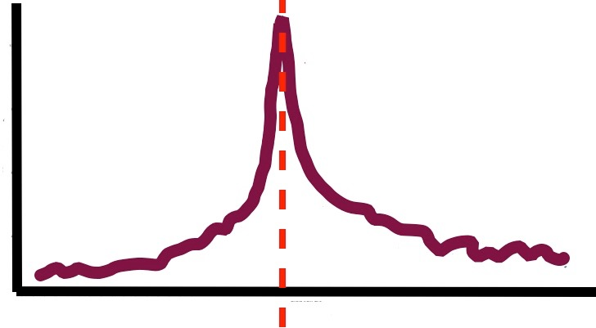
Support in a time of crisis (should we/can we shift support to the left?)
12 per 100
GP consultations for mental health problems
Months before CAP
Months after CAP

Slide 13
What do service users and wider stakeholders think?

Slide 14
Programme impact on referring services: identifying people furthest from service provision
‘staff on the ground [are] reporting they’re able to pass things over, whereas [previously] a lot of health visitors would have done a lot of the [housing and finances] work that [LCAP] are doing now. They’d be trying to refer to different teams. So it’s good to have that one agency that we can refer into that will […] coordinate everything for us and then feed back.’
Presence of specialist welfare advice service frees up professional time
Referring on for housing applications, benefits claims, debt relief
Single gateway
Licence to explore socioeconomic circumstances with families
Previously hindered by lack of service capacity to respond
Developing a reflex to regard the SDH as integral to routine practice
‘looking at experience of economic oppression […] these aren’t […] extras that we do […] once we’ve sorted everything else out. Actually they’re […] key, they’re fundamental. […] That’s definitely sharpened my thinking [..] that’s changed that as a priority for me’.

Slide 15
Programme impact on Liverpool residents
‘one thing is […] feeling validated. Is Mum – are parents – feeling that it’s ok to worry about these practical things because the fact that there’s a service for it means that other people are struggling with the same thing and you know it’s a recognised need.’
Referring professionals
Presence of specialist welfare service provides validation
Lessens perceived stigma, sense of individual failure
Recipients value longer term nature of LCAP
To build trusted relationship
And quick response time
Service users
‘Nobody had listened to
me before’
‘They’ve got my back’

Slide 16
Suitability & timing of mental health support
Mental strength required:
To engage with Talking Therapies
To confront debts, insufficient income and poor living conditions
Timing of mental health offer
Shortage of mental health provision
Long wait times
Right to turn offer down without losing place
State of readiness
Some people benefit from psychological support and practical issues in tandem
While others find access to TT premature, before having mental energy to engage
Challenges
Building capacity and flexibility into the system
LCAP signpost to wellbeing activities and community groups, such as confidence building while people are on waiting list
Local community based wellbeing services are precarious, with short term funding

Slide 17
Conclusion
Large number of high-risk people supported through the service.
Providing support at a time of crisis.
Improving mental health and wellbeing.
Reducing health service demand.
Potential for working further upstream especially for families with children
New emerging risks (housing)
Notes:
24,000 children in Liverpool in poverty

