Slide 1
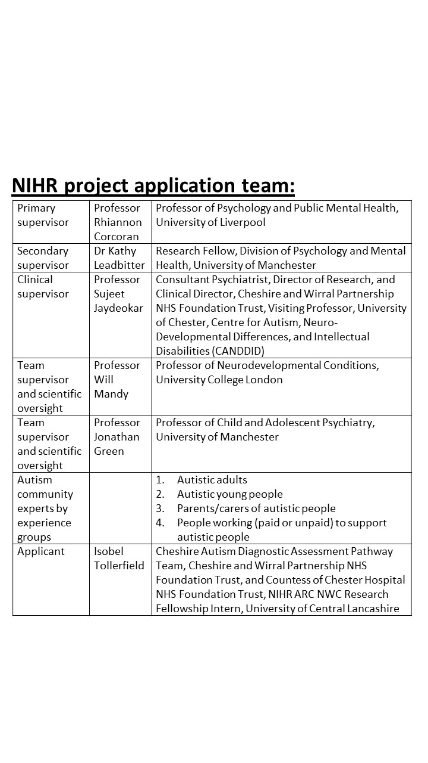
THINKING PATTERNS PROFILING MODEL PROJECT
WHY?
WHAT?
WHO?
Understanding, communication, advocacy, person-centred skill-building and support

