Slide 1
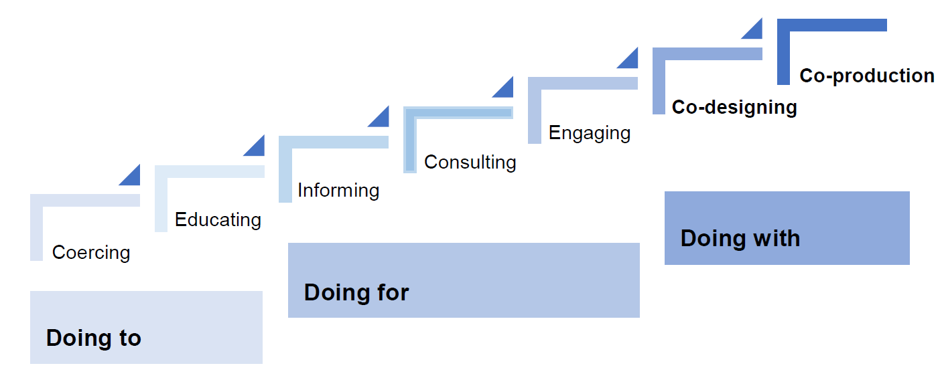
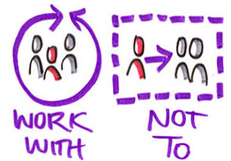
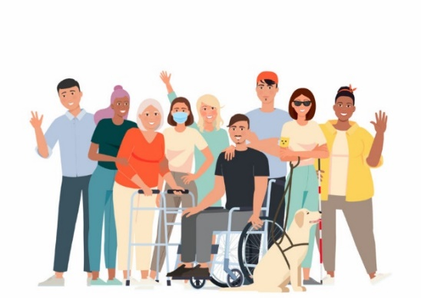
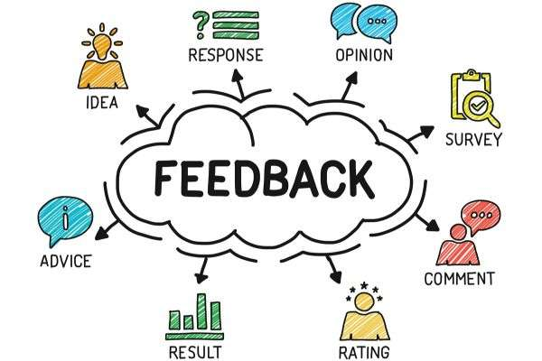
Coproduced Psychoeducation group for Bipolar Disorder
Finding Balance
Bipolar disorder
Mood swings
Mania
Depression
Psychoeducation
NICE
What happens next!
Recruit Patient Public Involvement (PPI) member
Aims / Goals
To coproduce a psychoeducation group for service users with a diagnosis of bipolar disorder, ensuring cultural sensitivity.
Continue to refine content
Coproduce and design between health professionals and PPI members
Conduct larger pilot
Why
The Psychosis and Bipolar Psychological Care Network (PBPCN) received feedback from service users stating that some of the contents of a previous psychoeducation group:
Was not up to date.
Could be more culturally sensitive.
Could be more inclusive towards minority groups, such as ethnic minorities and the LGBTQ+ community.
Pilot a group with PPI members
Assess online delivery
Refine the group materials
Collect feedback, measures and attendance rate
Outline of the course
Introduction
Understanding Bipolar disorder
Understanding Mania and how to cope with it
Understanding Depression and how to cope with it
Stress and Anxiety
Treatment and other support network
Emotional regulation
Putting it all together
Integration into regular clinical practice

