Slide 1
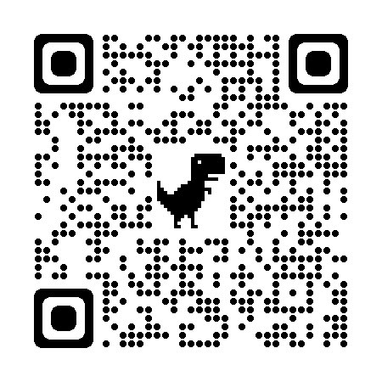
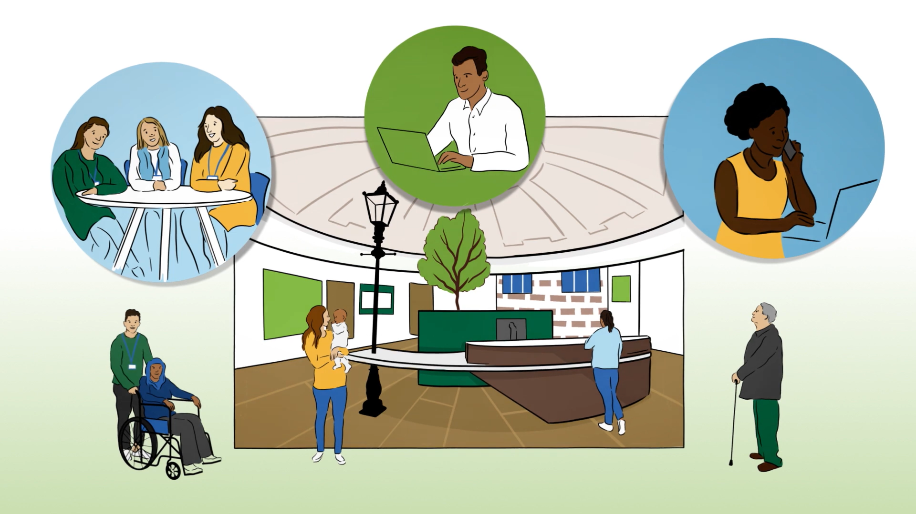
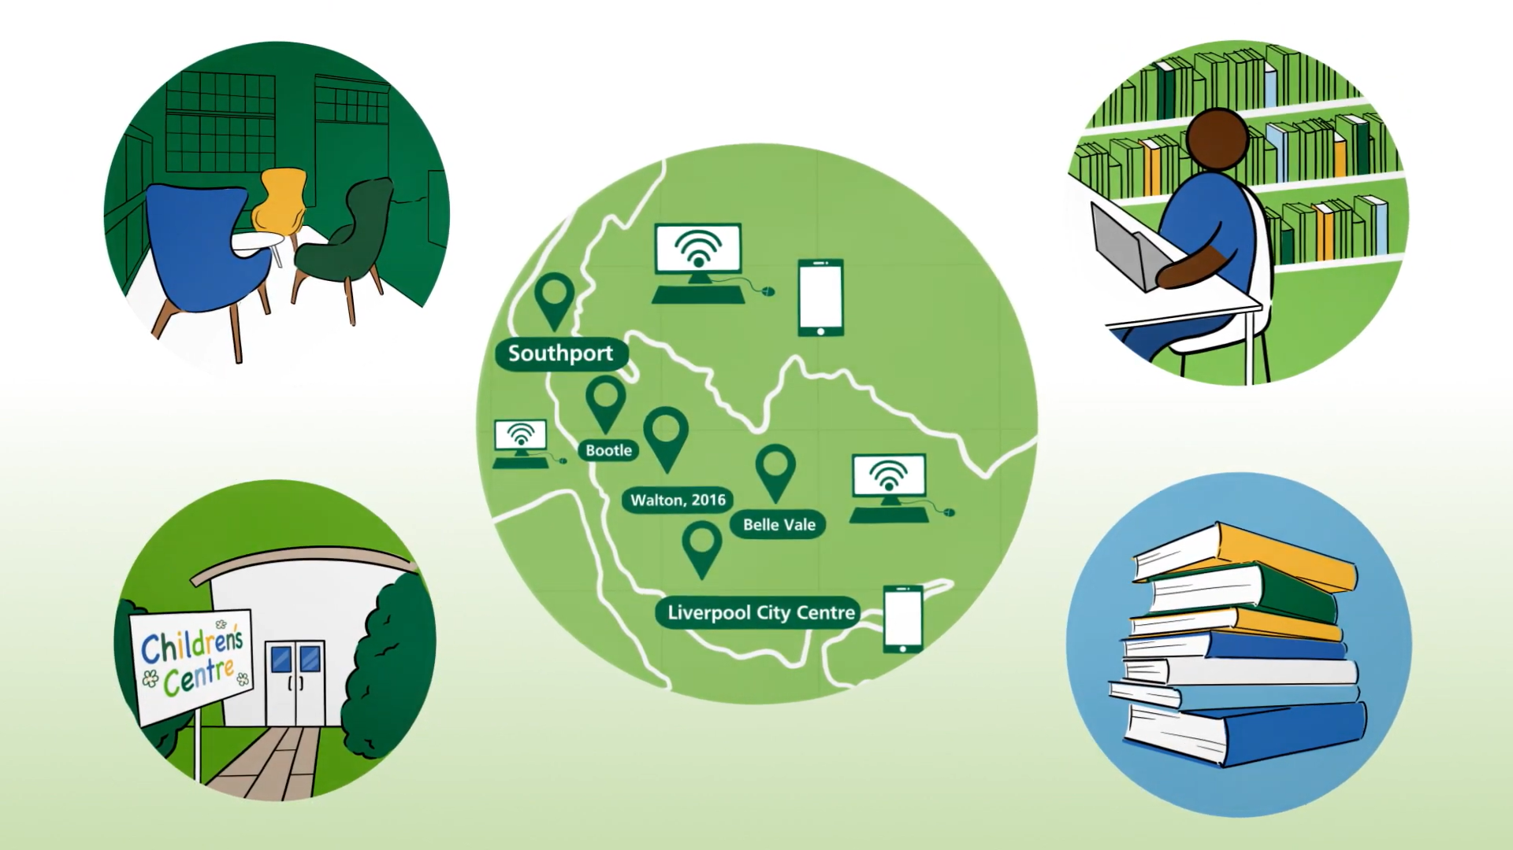
‘How was The Life Rooms Social Model of Health implemented and integrated into an Early Years setting?’
Georgi Byrne-Watts– NIHR Research Intern, Quality and Research Lead Georgina.byrne-watts@merseycare.nhs.uk
Supervisor: Dr Kathryn Berzins and Dr Danielle Christian.
Background
The study aims: • to understand the successes and challenges of the implementation of the Life Rooms from the perspective of staff at the Life Rooms and within Children’s Centres
The study will be conducted through the lens of Normalisation Process Theory (NPT)
Which seeks to surface factors that can promote, or inhibit, the normalisation of a set of practices and does so by identifying four core constructs needed for normalisation:
Coherence: how do people understand the process they will personally go through to routinely embed the practice?
Cognitive participation: to what extent do employees actively engage with the new practice that is being implemented?
Collective action: what is the operational work that employees due to enact a set of practices?
Reflexive Monitoring: are employees able to reflect and appraise the intervention once it has been implemented?
It is widely recognised that social factors such as housing, education, employment and social connections have a significant impact on health and wellbeing. A Social Model of Health, such as The Life Rooms, offers a holistic definition of health, that moves beyond the limitations and reductionism associated with the solely medical model of health.
In late 2021, Following the Covid-19 pandemic and the series of lockdowns, The Life Rooms was commissioned by Public Health Liverpool to launch a mental health initiative to support individuals and communities with their health and wellbeing. The 12-month pilot has enabled The Life Rooms to have a presence in local libraries, one stop shops and children’s’ centres across the city. The aim is to provide communities with practical support and learning opportunities to help their health and wellbeing, including support with family and caring responsibilities, mental health, physical wellbeing, financial difficulties and housing issues.
Aims and Objectives
Commissioner
Findings
Senior Leader
Early Years Staff
‘This model is the most inclusive social model of health I’ve ever seen that considers mental health outcomes. It gives the strongest potential and the evidence based surrounding the model to not only support social and economic health outcomes, but also to influence their mental health outcomes in parallel.’
‘The Life Rooms model brought people out directly into the community and gave a consistent root access. It was the one member of staff each week which was consistent and allowed us to build relationships, not just from a staff team perspective, wherein we could share knowledge and information and work together, but also for the families. They only have to tell their story once and that’s important. The whole model worked for everything that I wanted for my community.’
‘Creating a social front door and social one stop shop can alleviate huge pressures on that normal front door of the GP. What this taught me was, you meet people where they are at, not where you think they should be. The Children’s Centres had a huge proportion of the community who need support, attending there. I think that hub and spoke development for the future becomes key to our self-understanding.’
Initial Conclusions
The implementation of The Life Rooms’ Social Model of Health into an Early Years setting has been extremely successful. A key part of the effectiveness lies in the positive relationships that were formed at all levels. The relationship with the Early Years Sector and Public Health Liverpool has been a novel, innovative way of working. It has demonstrated the ways in which systems leaders can work better together to tackle the challenges of the health and care system. This joined up approach has put collaboration and partnership at the heart of planning, to build on the expertise of both systems to offer effective support for the communities that we serve. The partnership has been an exemplar of how systems look beyond those who are typically involved – building partnerships across traditional boundaries and working with people, communities and those who represent them to create real change (NHS England, 2022).
References: NHS England. (2022). Guidance on Working in Partnership with People and Communities. Retrieved from https://www.england.nhs.uk/wp-content/uploads/2023/05/B1762-guidance-on-working-in-partnership-with-people-and-communities-2.pdf.
Murray E, Treweek S., Pope C. et al. Normalisation process theory: a framework for developing, evaluating and implementing complex interventions.. BioMed Central 2010; 63(8)

