Slide 1
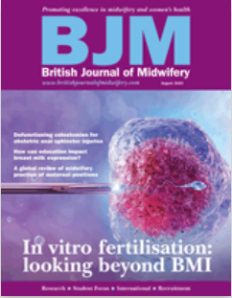
Improving the pathway for women with infertility within the Wigan and Leigh Specialist Weight Management Service through Implementation Science
Emma Schneider RD
Patient identified need to improve referral process (including reducing weight stigma) and increase understanding and access to service offer
Review of evidence around topic area:
Association between obesity and live birth rate following in vitro fertilisation
Lifestyle factors that may influence in vitro fertilisation outcomes
(Schneider et al., 2023)
Weight loss interventions for improving fertility
Baseline audit undertaken to review current pathway and outcomes:
28% of women were fast-tracked from referral
88% attended a new patient assessment
2 women conceived whilst taking liraglutide (safety issue)
3 women not referred to bariatric surgery until 17 months +
Weight loss outcomes poorly recorded
Aim to use the Consolidated Framework for Implementation Research (Damschroder at al., 2009) to assess the context of implementation and select strategies to improve the fertility pathway within the Specialist Weight Management Service
Implementation to date
Networks established
In-Service Training
Agreed fast tracking
Referral form changed
Patient leaflet developed
Patient and Public Involvement
References
Damschroder, L., Aron, D., Keith, R., Kirsh, S., Alexander, J. and Lowery, J. (2009) Fostering implementation of health services research findings into practice: a consolidated framework for advancing implementation science. Implementation Sci 4, 50 https://doi.org/10.1186/1748-5908-4-50
Schneider, E., Hamer, O., Smith, C. and Hill, J. (2023). Beyond body mass index: a synthesis of lifestyle factors that may influence in vitro fertilisation outcomes. British Journal of Midwifery 31, 8 https://doi.org/10.12968/bjom.2023.31.8.436
Acknowledgements
With thanks to James Hill, UCLan, for supervising the RaCES project, Alison McLoughlin, UCLan, for guidance throughout the internship process and Jessica Bryant and Michelle Kilmurray, LUHFT, for their constant support

