Slide 1
Methodological Innovation Development Adaptation & Support
Progress - Impact - Plans
ARCNWC-MIDAS@uclan.ac.uk
https://arc-nwc.nihr.ac.uk/midas/overview/

Slide 2
MIDAS Theme: What we do
Research | Help develop and deliver applied research, provide guidance on research methodology
Training & Education | Provide training and education on different research methodologies
Network Development | Support development, and coordination of, networks of people with an interest in different research methodologies
Methodological Innovation | Undertake research to develop new, or adapt existing, methods for conducting research to meet the needs of ARC members and local communities
Dissemination & Implementation | Disseminate evidence to assist with development and delivery of clinically and cost-effective health & social care services
All MIDAS’s activities underpinned by: Health Equity, Patient & Public Involvement & Engagement, Co-production, Capacity-building

Slide 3
MIDAS
Progress

Slide 4
MIDAS Progress (Oct 2019 – Feb 2023)
100 Publications (28 in 2019/20; 25 in 2021; 36 in 2022; and 11 to date in Feb 2023)
75 Rapid Conversion of Evidence Summaries (RaCES) projects (50 completed; 25 ongoing) (Target: 24 by 2024)
35 Reviews (23 published - 13 completed 2019-2021; 10 completed 2022; 12 ongoing) (Target:13 by 2024)
60 Co-produced grants (18 awarded totalling >£1.6m) (Target:18 co-produced by 2024)
11 Methodological sub-groups (Target:10 by 2021)
1 Health Equity Mainstreaming Strategy & Implementation Plan and associated activities
26 Seminars (Target: 24 by 2024)
41 individual Public Advisers involved in MIDAS-led projects and activities
29 cross-cutting projects supported

Slide 5
MIDAS
Impact

Slide 6
MIDAS Impacts – Rapid Conversions of Evidence Summaries (RaCES)
RaCES PROJECT | OUTCOME
Barriers and facilitators to health care for people with learning disabilities | Development of a training package for staff from the East Lancashire Hospitals NHS Trust
Approaches to the treatment and prevention of pressure ulcers | A staff survey to get clinicians to reflect on their current practice, which also provides recommendations around best practice (reflective educational intervention). Linked to optional educational programme with data from four more RaCES projects. Multi-trust collaboration
Non-invasive respiratory support in the management of COVID-19 | A patient information leaflet developed for patients who may decline this treatment to outline evidence. Currently collecting data and looking to improve rates of patients discontinuing treatment
Predictors of Post-Operative Negative Outcomes in Patients Undergoing Transcatheter Aortic Valve Implantation, | Developed predictive model for patients at higher risk of adverse events after Transcatheter Aortic Valve Replacement, which is being considered by Blackpool Victoria Hospital NHS Trust as part of pre-operative assessment.
Virtual reality for people in intensive care units (ICU) | Informed the development and evaluation of a virtual reality intervention for people in ICU

Slide 7
MIDAS Impacts – Systematic Reviews & Economic Evaluations
PROJECT | OUTCOME
Cost analysis of specialist community personality disorder services | Informed Mersey Care NHS Trust case for continued funding of their service
Prevalence and incidence of mental health conditions in health and social care workers during and after a pandemic | Systematic reviews have informed Lancashire & South Cumbria NHS Foundation Trust’s planning to support staff during the COVID-19 pandemic.
Effectiveness of psychological support interventions for those exposed to mass infectious disease outbreaks
Approaches to Evidence Practice for Speech and Language Therapists | Systematic review is informing the development of guidelines for training Speech and Language Therapists
Zinc requirements in infants and children | Systematic review informed World Health Organisation guidance
Interventions to reduce physical and verbal abuse | Systematic review informed World Health Organisation guidance

Slide 8
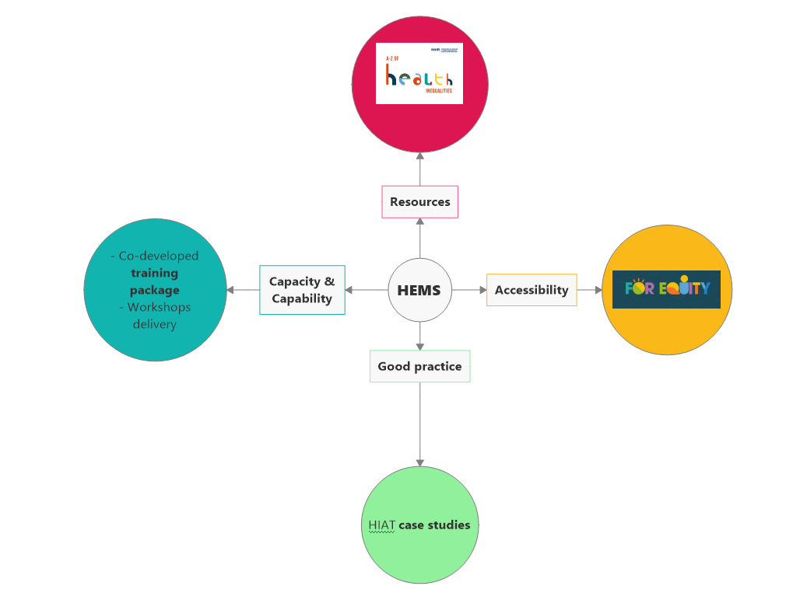
MIDAS Impacts – Health Equity Mainstreaming

Slide 9
MIDAS
Plans

Slide 10
RaCES
Health Equity
Capacity & Capability
Cost-effectiveness
Health Professionals
Social Care & Public Health
Patients & Public
Communities of Practice
Intervention Effectiveness
Communicat-ion
Informing Policy & Practice
MIDAS – Plans for Rapid Conversions of Evidence Summaries (RaCES)

Slide 11
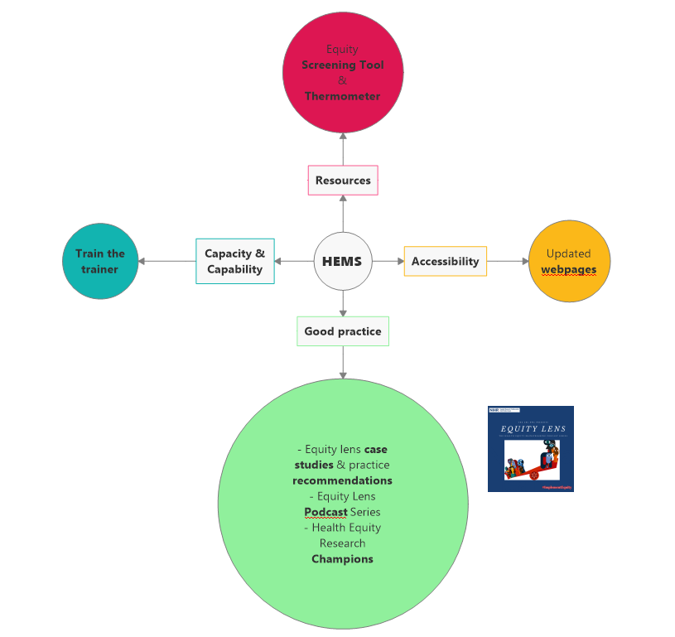
MIDAS Plans – Health Equity Mainstreaming

Slide 12
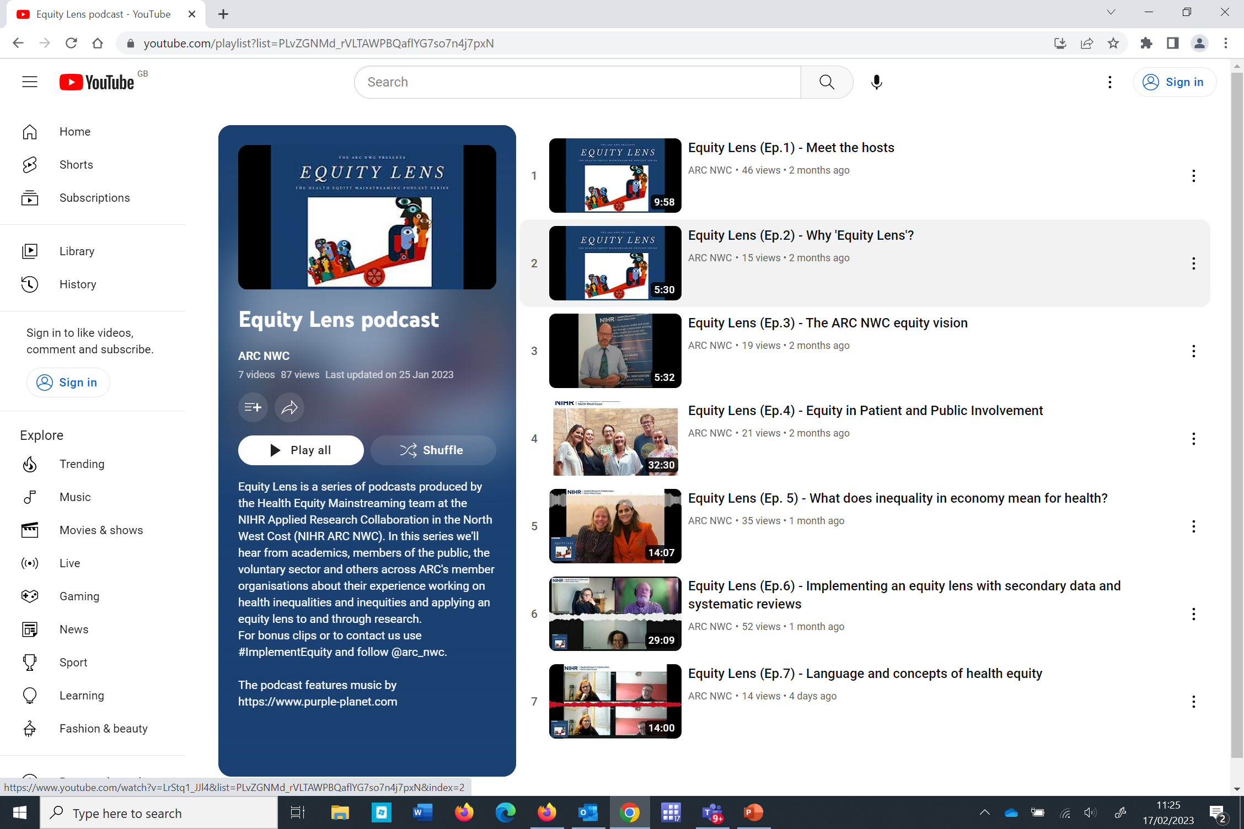

Slide 13
Thank you
Any questions?
#ImplementEquity
ARCNWC-MIDAS@uclan.ac.uk
https://arc-nwc.nihr.ac.uk/midas/overview/

Slide 14
Who we are: MIDAS Team & Specialisms
University of Central Lancashire
Professor Andrew Clegg MIDAS Theme Lead & Professor in Health Services Research
Dr. Alison Doherty MIDAS Theme Manager & Research Fellow in Evidence Synthesis (FTE)
Dr. Valerio Benedetto Research Fellow – Health Economics and Economic Modelling (FTE)
Paul Boland Research Assistant – Evidence Synthesis (PTE)
Dr. Oliver Hamer Senior Research Assistant & Rapid Insights Programme (PTE)
Cath Harris Information Specialist (PTE)
Joanne Harrison Research Fellow – Evidence Summary & Synthesis (PTE)
James Hill Senior Research Fellow – Evidence Synthesis (FTE)
Alan Smith MIDAS Admin Support (PTE)
Lancaster University
Dr. Luis Filipe Senior Associate Research Fellow – Health Economics & Economic Modelling (FTE)
Dr. Katerina Panagaki Senior Research Associate – Health Equity (FTE)
University of Liverpool
Dr. Mark Goodall Research Fellow – Quantitative and Mixed Methods (FTE)
Dr. Katalin Ujhelyi-Gomez Research Associate – Mixed Methods (FTE)
Gerry Allen and Pat Jamal MIDAS Public Adviser Co-Theme Leads

