Slide 1
Applied Research Collaboration (ARC) North West Coast (NWC)

Slide 2
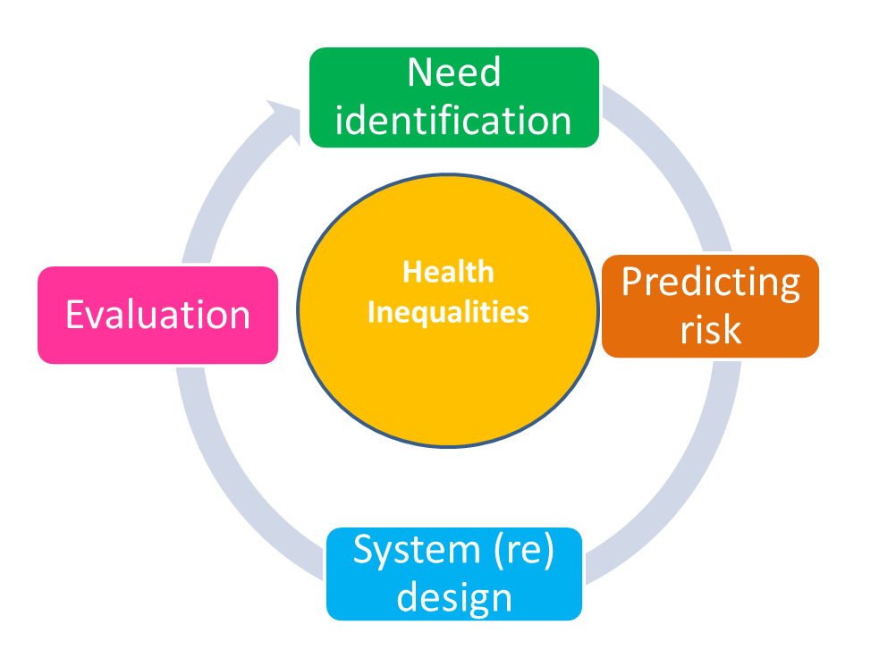
IPH – developing a learning health system
A predictive, preventative, precise approach to population, patient and person in a joined-up intelligence led system
1. Understanding needs.
How do multiple needs and services use cluster in households.
2. Predicting risk
What modifiable risks can we identify early to have the biggest impact on outcomes.
Service (re) design.
What redesign is possible and likely to make the biggest impact.
3. Evaluating impact of alternative strategies/interventions
How good are our current interventions and how can we adapt them for greater effectiveness interventions

Slide 3
IPH work so far.
1. Evaluating Air quality improvement actions across the North West Coast - Complete
2. Citizens advice on prescription - March 2024
3. Preston’s community wealth building model - March 2024
6. Promoting physical activity – through Together for an Active future. - Complete
7. Developing support for households with complex needs - March 2024
8. Improving employment support. March 2026
4. COVID-19 response – SMART community testing programme, vaccine outreach, shielding - Complete.
5. Modelling neighbourhood need for community nursing services- Complete.
9. Evaluating inequalities impact of health service initiatives. - March 2024

Slide 4
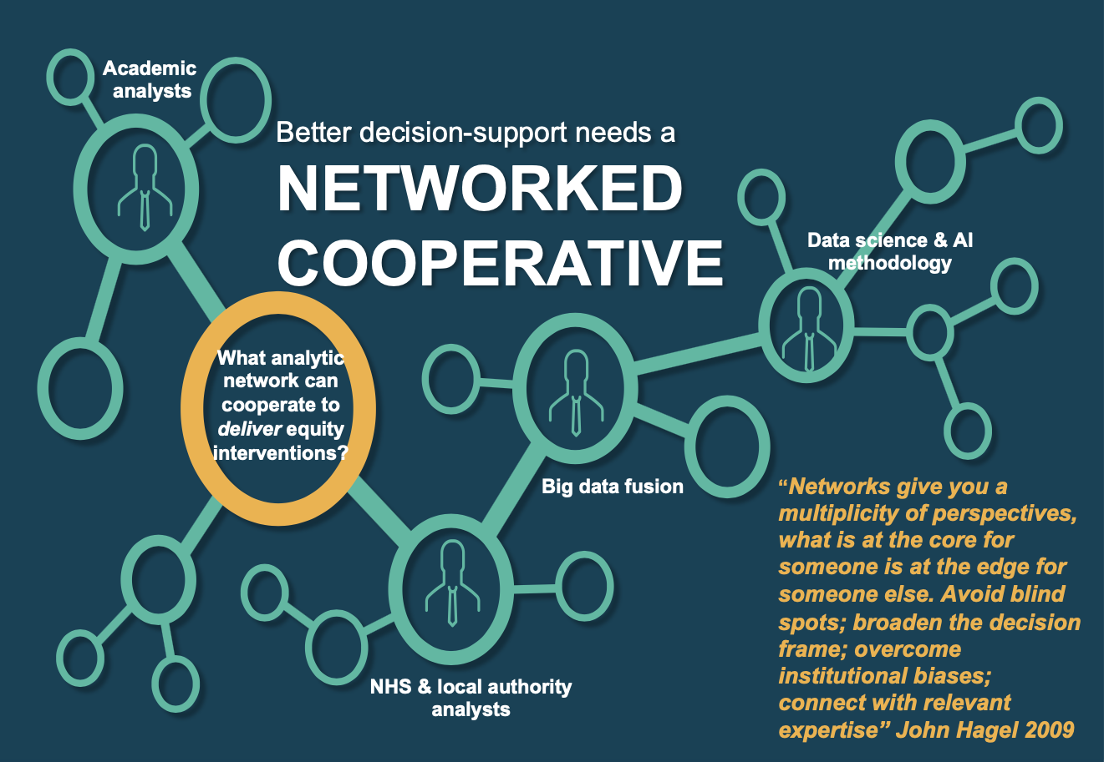
Strengths
Embedded responsive research

Slide 5
Priorities
National and local system priorities.
Major current challenges.
ARC NWC member and public priorities

Slide 6
Strategic Coordination of Heath of the Public Research committee (SCHOPR)
The environment
Create and maintain built and natural environments for better health
A place-based approach to reduce health inequalities
Life course
Set children and young people on the right path for good health
Respond to changes in how we work and what it means for health
Reshape food systems to improve health
Understand the role of the health and social care system in prevention
Better use of legal and fiscal levers to improve population health
Technology
Deploy new technologies for health protection and health improvement

Slide 7
Department for Health and Social Care's areas of research interest
ARI 1: early action to prevent poor health outcomes
ARI 2: reduction of compound pressures on the NHS and social care
ARI 3: shaping and supporting the health and social care workforce of the future

Slide 8
Improve population health and healthcare
Tackling health inequality, improving outcomes and access to services
Enhancing quality, productivity and value for money
Helping the NHS to support broader social and economic development.

Slide 9
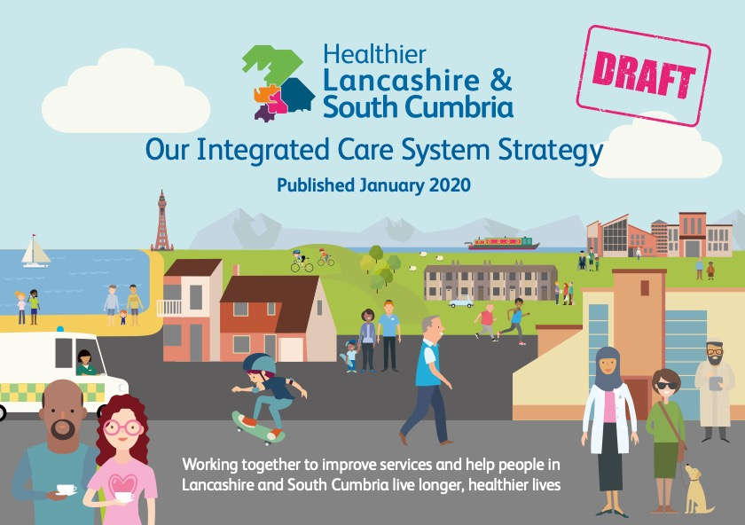
Reduce health inequalities
Improve our performance on national targets, particularly for waiting times for urgent treatment, cancer services and routine surgery
Provide more consistent, high quality care for everyone
Deliver more care in our local communities
Ensure good care at the end of life
Make better use of our collective resources and stop overspending on our budgets.

Slide 10
The big challenges
Young people’s mental health crisis.
Cost of living crisis / recession and equitable recovery.
Health and social care disruption.
Climate change and the environment

Slide 11
Criteria for prioritisation
Aligns with our strengths
Aligns with national and local priorities
Aligns with the big challenges
Seen as priority by ARC members and members of the public.

Slide 12
Next steps
Engagement with ARC members – Public Health Networks, Health and wellbeing Boards, Integrated Care Boards, Provider networks
Public advisors and third sector – engagement events.

