Slide 1
The Role of Socio-Economic Status on Stair Fall Risk in Older Adults during the COVID-19 Pandemic
Emily Wharton
Supervisors: Costis Maganaris, Thomas O'Brien, Richard Foster, Clarissa Giebel,
Public Health Advisors: Asan Akpan, Justine Shenton
ARC Theme: Improving Population Health

Slide 2
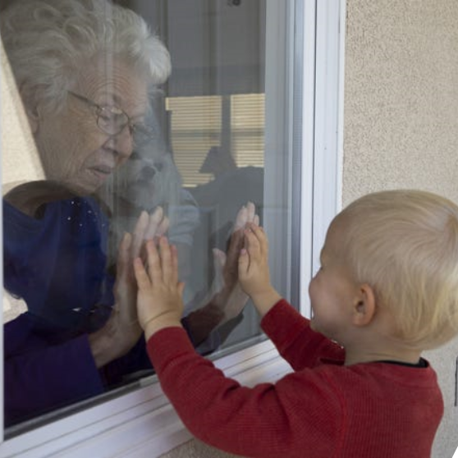
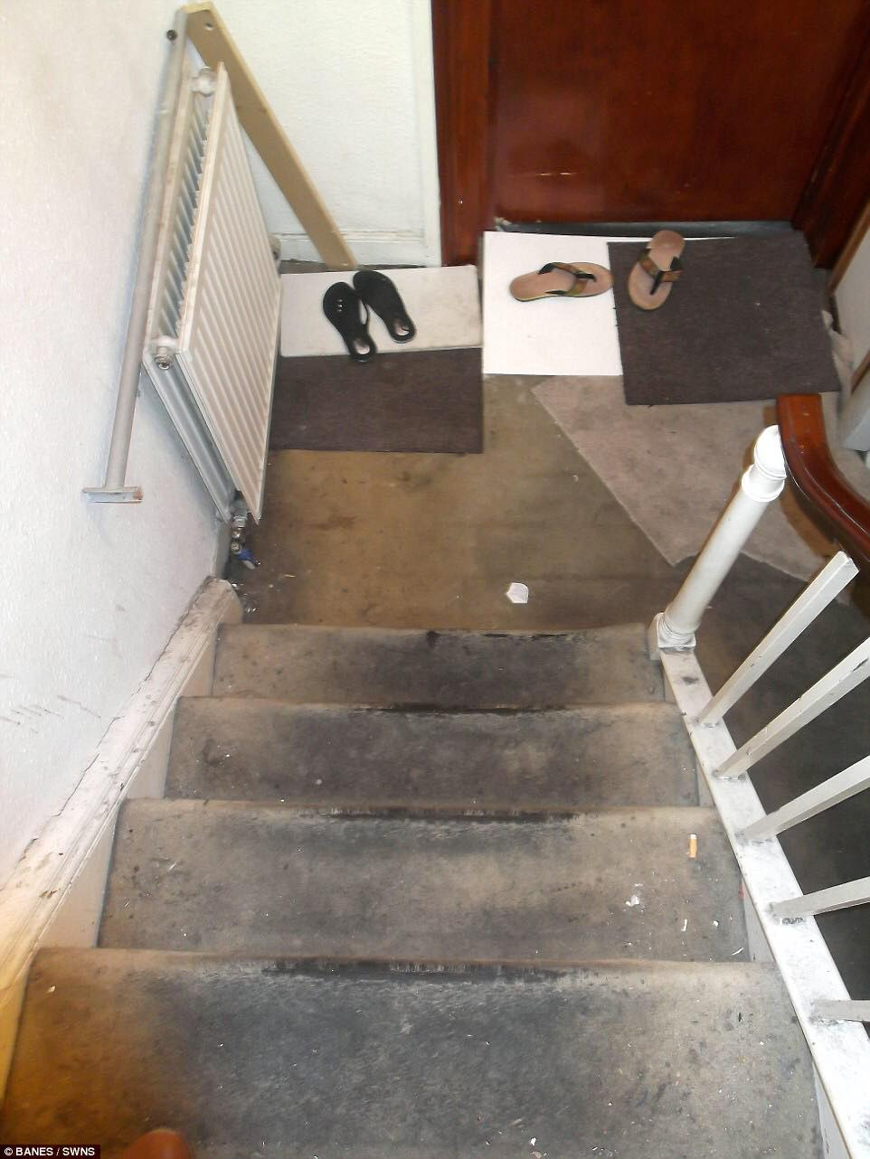
COVID-19 Pandemic Lockdown Restrictions
Physical decondition
More frequent use of stairs
MORE stair falls due to COVID
ESPECIALLY in low socio-economic areas
Increase risk of chronic disease
Poorer housing stock quality
High Deprived areas

Slide 3
Project Timeline
Month 1 – 12
Retrospective Study
Month 9 – 18
Month 18 – 36
Stepping Biomechanical Study
Improved awareness in deprived areas and poor housing stock, could help the movement to affordable adaptations for community dwelling elderly people.
Housing stock quality check and Semi-Structured Interviews

Slide 4
Patient and Public Involvement and Engagement (PPIE)
Justine Shenton
Asan Akpan

Slide 5
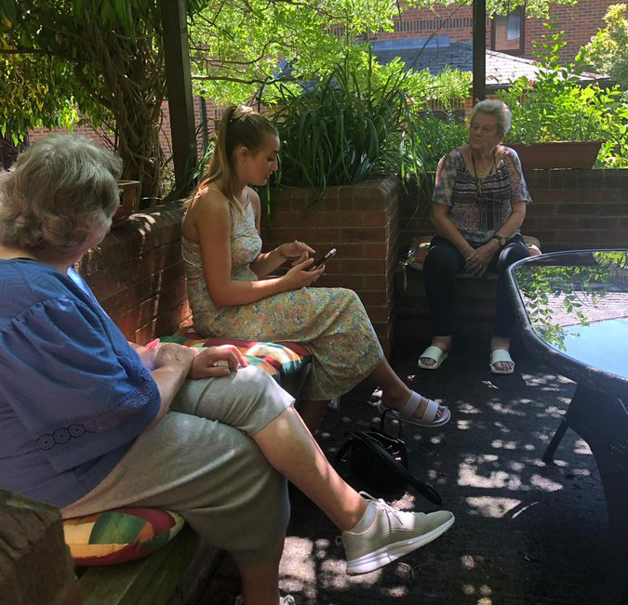

Slide 6
Thanks for listening
References
1] DTI. 23rd Annual report of the Home and Leisure Accident Surveillance System - 1999 data. DTI/Pub 5349/3k/03/01/NP.2001.
[2] The Office of National Statistics. Mortality Statistics - Injury and Poisonings. DH4 publications 1996/7/8.
[3]. Davidson et al. (2010). The real cost of poor housing (FB23). BRE
[4]. Narici et al. (2020). Impact of sedentarism due to the COVID-19 home confinement on neuromuscular, cardiovascular and metabolic health: Physiological and pathophysiological implications and recommendations for physical and nutritional countermeasures. Eur J Sport Sci ;1-22. doi: 10.1080/17461391.2020.1761076.
[5]. https://www.who.int/news-room/fact-sheets/detail/noncommunicable-diseases
[6]. Euijung et al. (2017). Individual housing-based socioeconomic status predicts risk of accidents falls among adults. Annals Epidem 27, 415-420. http://dx.doi.org/10.1016/j.annepidem.2017.05.019.
[7]. Handsaker et al. (2014). Contributory factors to unsteadiness during walking up and down stairs in patients with diabetic peripheral neuropathy. Diabetes Care 3, 3047-53. doi: 10.2337/dc14-0955.
[8]. King et al. (2017). Sagittal plane joint kinetics during stair ascent in patients with peripheral arterial disease and intermittent claudication. Gait Posture 55, 81-86. doi: 10.1016/j.gaitpost.2017.03.029.
[9].https://assets.publishing.service.gov.uk/government/uploads/system/uploads/attachment_data/file/817408/EHS_2017_Stock_Condition_Report.pdf
[10]. https://www.eurocare.org/cares.php?sp=alcohol-and-health&ssp=alcohol-consumption-in-times-of-covid-19
[11]. HM Government (2013). Building Regulations 2010. Approved Document K Protection from Falling, Collision and Impact.
[12]. BSI (2010). BS 5395-1: Stairs. Code of Practice for the Design of Stairs with Straight Flights and Winders.
[13]. Ackermans et al. (2020). Prediction of balance perturbations and falls on stairs in older people using a biomechanical profiling approach: A 12-month longitudinal study. J Gerontol A Biol Sci Med Sci :glaa130. doi: 10.1093/gerona/glaa130.
[14]. American Geriatrics Society, British Geriatrics Society, and American Academy of Orthopaedic Surgeons Panel on Falls Prevention (2001). Guidelines for the prevention of falls in older persons. J. Am. Geriatr. Soc. 49, 664–672. doi: 10.1046/j.1532-5415.2001.49115.x
[15]. Startzell et al. (2000). Stair negotiation in older people: a review. Am Geriatr Soc, 48, 267-580
Emily Wharton
E.H.Wharton@2021.ljmu.ac.uk
@EmilyhmWharton

