Slide 1
Chronology in multimorbidity clustering and its effect on treatment burden and the utilisation of health and social care services
Lucy Kaluvu
PhD (Health)
Faculty of Health, Social Care & Medicine
Edge Hill University
ARC NWC Theme: Equitable Place-Based Health and Care
17th MARCH 2022

Slide 2
Research team and collaborating organisations
Supervisory team
Dr Greg Irving (GP, Consultant in Primary Care and Director of Studies)
Professor Paola Dey (Professor of Public Health and Epidemiology)
Professor Rowan Pritchard-Jones (Medical Director, St Helens and Knowsley NHS Trust )
Dr Mohammed Moinuddin (Post Doc Medical Research Statistician)
ARC NWC Patient and Public Advisors
Mrs Dorcas Akeju
Mrs Saiqa Ahmed
Collaborating organisations
St Helens and Knowsley Teaching Hospitals NHS Trust (STHK)
St Helens Clinical Commissioning Group (CCG)
Graphnet Health Limited and the St Helens Shared Care record
ARC NWC
Edge Hill University

Slide 3
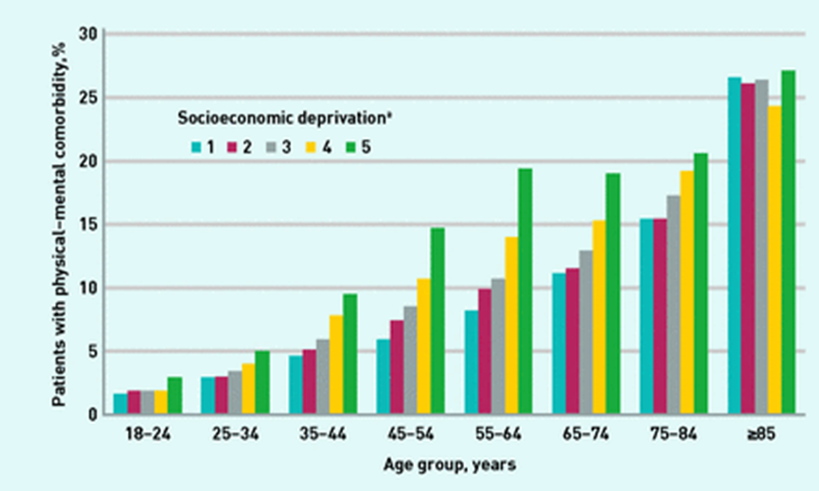
Multimorbidity: What do we know?
Co-occurrence of two or more long-term chronic conditions (physical, physical-mental, mental conditions) within an individual.
Affects 2 in every 3 individuals aged >65 years in the UK
Early onset >8 years in socioeconomically deprived settings (Barnett et al., 2012)
Hypertension, depression/anxiety and chronic pain are the most prevalent conditions within multimorbidity (Cassell et al., 2018).
Multimorbidity patients are the highest users of health and social care services.
High rates of unplanned hospital admissions and readmissions emergency care visits use, GP services, and social care services (Gopfert et al., 2021)
Figure: Cassell et al 2018; Prevalence of physical–mental comorbidity by age and socioeconomic status.1 is the quintile with the least socioeconomic deprivation, 5 is that with the greatest

Slide 4
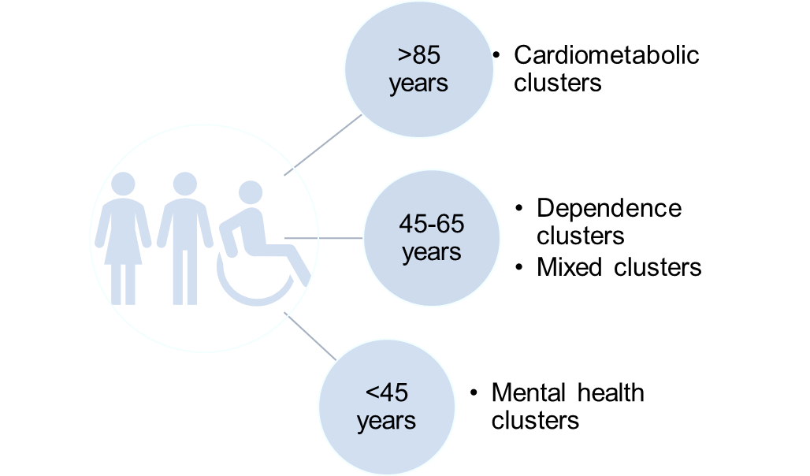
Why more research into multimorbidity clusters?
Figure: Lucy Kaluvu
Biological, psychological, behavioral, socioeconomic and environmental factors are associated with a higher risk of developing multiple conditions.
Understand the interaction between physical and mental health conditions (Associations, causal interactions, trajectories)
Shift in research from single disease pathways to disease cluster pathways in order to understand how risk factors and lifestyle factors interact to produce specific clusters of conditions.
Multimorbidity disease clusters and patient clusters identified across studies (Zemedikun et al 2018, Zhu et al 2020, Bisquera et al 2021, Soley-Bori Marina et al 2021)
Depression is most common as a starting condition in individuals < 65 years of age.
Diabetes and chronic heart disease are more common in those > 65 years of age (Ashworth et al 2019, Kudesia et al., 2021, Cizerad et al., 2021)

Slide 5
Methodology
Literature Review
Identification of gaps in literature
Formulation of study objectives and research questions
Study 1: Retrospective cross-sectional analysis of the St Helens Shared Care record
Trustworthy Research Environment TRA using CIPHA
Order of acquisition of chronic conditions, cluster identification and analysis
Study 2: Qualitative study
Semi-structured interviews of multimorbidity patients from high impact multimorbidity clusters regarding treatment burden
Use of de-identified health and social care data

Slide 6
Health Inequalities Assessment Tool (HIAT) report
What are the health inequalities that influenced or created this problem?
How will your proposed work tackle the socio-economic causes of the inequalities in health you identified in section 1?
What wider effect might your activity have on health inequalities and their causes and how can this be delivered?
How will you make sure that your evaluation and monitoring shows the effect of your activity on health inequalities and their causes?
Poorer health outcomes and health inequalities in the North compared to the South.
The evaluation and monitoring processes will be guided by the HIAT assessment.
Active engagement with service users and PPI involvement.
Multi-stakeholder collaborative project with NHS Trust, CCG group, local borough.
Translation of research into practice via knowledge mobilization workshops, dissemination to both academic and non-academic audiences.
Study setting is St Helens area, a deprived region in the North.
Highest among the least educated, those earning the lowest income, living in deprived area, the unemployed/those in informal employment.
Use of local health and social care dataset from one of the most deprived areas in the Nort West.
Co-production with PPI involvement and multiple stakeholders.
Multimorbidity is a key area of interest for the NIHR and the NHS.
Study findings will:
Social care utilisation within multimorbidity management.
Contribute to changes within existing multimorbidity programs.
Advice policy changes or open a dialogue into future research ideas.
The identified key stakeholders have a high interest in local health and social care service utilisation and policy.

Slide 7
Patient and Public Involvement in Research
Co-production of research with members of the public improves the quality of research output, facilitates immediate feedback and significantly improves how the impact of research is measured (Staniszewska et al., 2017).
The research project has recruited 2 ARC NWC Patient and Public Advisors
Regular meetings with PPI advisors.
Active involvement in the development of the study research protocols and HRA IRAS application forms.
The HIAT tool was updated together with PPI advisors
Involved in the design and review of data collection tools-interview topic guides, letter of invitation and participant information sheet.

Slide 8
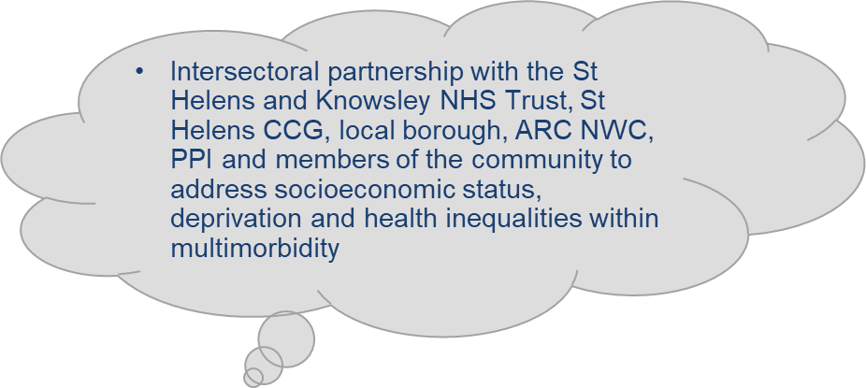
Equitable Place-Based Health and Care (EPHC) theme
To support place-based approaches to address health inequalities with a vision to ‘support local systems aiming to integrate health and care so that they are able to operate responsively to the needs of people, community and place’.
How does the research project align with the theme focus?
Theme focus
Place/Geography
Improving the social determinants of health and lifestyle factors
Collaborations and valuing partnership working
Involvement and influence of local people and communities– working to support improvements to population health.
This Photo by Unknown Author is licensed under CC BY-NC

Slide 9
AI-Multimorbidity Clustering Research Group NIHR Primary Care Research Group University of Southampton
Co-author “Understanding social care need through primary care big data: a rapid scoping review” (Publication under review BJGP Open)
HIAT working group-Social and Community Mental Health and Well-Being Research Development Network
Develop skills in writing, collaborating and evaluating a HIAT tool.
Workshops, trainings and courses-qualitative research, grant writing, writing conference presentations.
International student; moving to England; transitioning from working to being a full-time student.
Starting my PhD during the COVID-19 pandemic.
Getting acquainted with the UK Health and Social Care system, Local authorities and the NHS Trust.
Oral conference presentations
ARCFest April 2021
2021 Society for Academic Primary Care SAPC North Conference
2nd World Conference on Public Health WCPH 2021

Slide 10
PhD Timeline
01/01/21-21/06/21
Project proposal submission
Project registration viva
Approval of project registration
Transferrable skills training and workshops
19/07/21-17/03/22
Research study protocols-Study 1 and 2
HRA Ethics Approval-Study 1
HRA IRAS Application-Study 2
NHS Research Passport, Data Sharing Agreement, Trust Laptop and STATA
Chapter 2 Literature Review
Transferable skills training and workshops
18/03/22-01/09/22
Chapter 3 Methodology
Transferable skills training and workshops
Data analysis-Study 1
HRA Ethics Approval-Study 2
Submission of Progress Report
Progression/Transfer viva
01/09/22-01/09/23
01/09/23-01/02/24
Revision of thesis chapters and drafts
Submission of PhD thesis
Final PhD thesis viva
Data collection for Study 2
Research internship
Chapter 4 Data Analysis
Chapter 5 Discussion
Chapter 1 Introduction and Abstract
Chapter 6 Conclusion and
Implications for Policy and Practice

Slide 11
Thank you for your attention To learn more about my research, let us chat 24885703@edgehill.ac.uk @Kaluvu_LM

