Slide 1
A realist evaluation of a digital intervention, aimed at supporting independent living in older adults
Lauren Fothergill
PhD Student at Lancaster University
Supervisors:
Professor Carol Holland
Professor Niall Hayes
Health across the life course

Slide 2
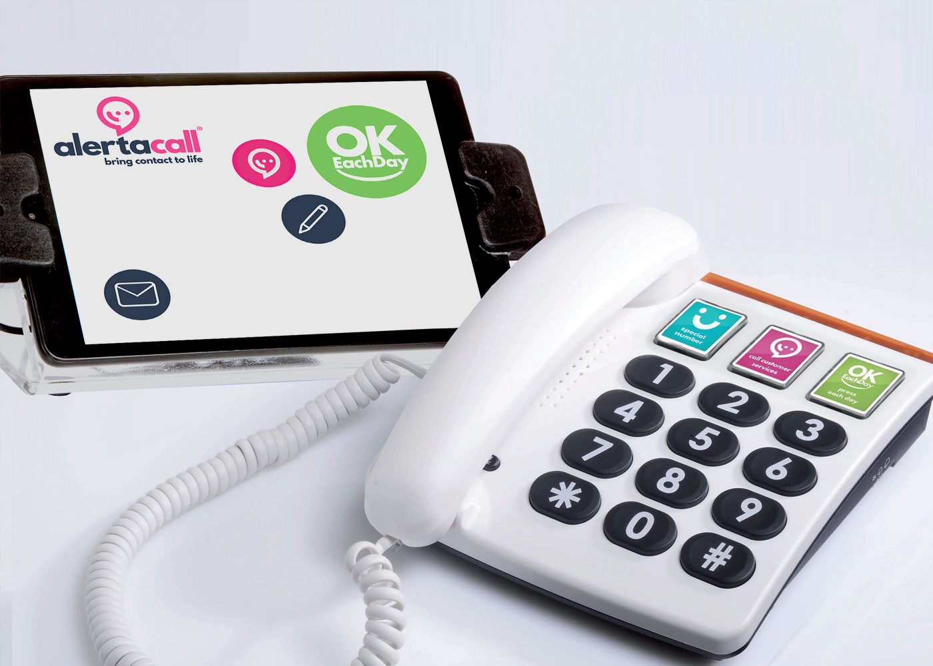
Background
UK has an ageing population
More older people wish to live in their own home, however they may experience challenges, including declining health, social isolation and loneliness.
Technology may help older people to live more independently, but there are still barriers to uptake and use of technology.
OKEachDay is a digital tool that provides well-being monitoring and daily contact services to older adults in health and social care within the UK.
Notes:
UK populations are ageing – by 2068 there is projected to be an additional 8.2 million people aged 65 and over – whilst this is great progress, we need to make sure people can age healthily and happily to sustain good health.
Many older people wish to stay in their own homes, as it is viewed as important for individual independence – however some older adults may face challenges living independently, including ill health, social isolation and loneliness.
Technology may provide aid to older adults who wish to remain at home, but who might need extra support. However, some technologies, can be viewed as intrusive and negatively impact an individual's agency and self-efficacy.
My PhD is looking to evaluate a digital well-being monitoring system called OKEachDay. The organisation agrees times with the customer to confirm their wellbeing, once a day, or as often as desired. Confirmation is made by pressing an ‘OK’ button or having a personal call from the specialist team. Thus, the service provides as much or as little human contact as the customer wishes and may not be viewed as intrusive and use can be controlled by the individual. If no ‘OK’ button is pressed the team makes contact to confirm wellbeing, and to exchange information, or have a chat. If contact cannot be established the call is escalated to nominated contacts
OKEachDay has the potential to provide low level support to older adults, and increase individual safety through surveillance of wellbeing, however it is yet to be evaluated.
The overall aim of this research for this PhD is to conduct an evaluation of the impact of OK each day on physical and mental health outcomes, such as functional capacity, anxiety, quality of life, loneliness, social isolation, and psychological resilience.

Slide 3
Aims of research
To assess the impact of OKEachDay on the health and well-being of older adults
To understand who OKEachDay might work for, how, and under what circumstances to facilitate future uptake and improvements
Qualitative study
Realist evaluation
- mixed methods
Realist review
Phase 1
Phase 2
Notes:
(anxiety, loneliness, psychological safety, agency and self efficacy, functional capacity)
such as functional capacity, anxiety, quality of life, loneliness, social isolation, and psychological resilience.
Realist review on how assistive living technologies can improve psychological health outcomes in community-dwelling older adults.
Qualitative study with OKEachDay users and stakeholders to inform the evaluation programme theory and design.
Subsequent mixed method evaluation, using both quantitative and qualitative methods.

Slide 4
How does the project align with ARCs aims?
Reducing health inequalities in older adults is a main focus of the research
Emphasis on engaging and networking with various stakeholders to inform research from design to dissemination
Direct implementation of findings that address health priorities
Notes:
Strong connections with digital tech company – keen to make changes and improve their service for older users

Slide 5
Using the HIAT
Focus on reducing health inequalities in older adults from vulnerable groups living in the community (people living with frailty, people living alone etc).
Evaluation of a digital tool that could help a wider group of older adults with differing health and well-being needs.
Person-centred approach, rather than focussing on technological innovation.

Slide 6
Public advisors and PPI
To date:
Two public advisors have been recruited
Public advisors reviewed ethical documents and protocol for PhD.
Sefton Older Persons forum were also involved in research design and reviewed ethical application.
Moving forward:
Public advisors are involved in developing realist evaluation protocol and informing realist review
Stakeholders will be involved in developing final protocol
Notes:
interview guides, information sheets and consent forms

Slide 7
Successes and challenges
Success
Completion of the first study (qualitative study – 33 semi-structured interviews)
Challenge
Learning realist methodology
Opportunity
Presenting research at various conferences this year (hopefully)

Slide 8
Questions?

