Slide 1
In the Summer of 2020 we asked our Public Advisers to tell us their experiences of being in lockdown during the COVID-19 pandemic. Each slide will remain on screen for 30 seconds and the presentation is approximately 20 minutes. It will be shown at lunch and at breaks throughout the ARCFEST day on a loop.

Slide 2
These are abridged versions from their submissions. In their own words but anonymised. We thank them all for sharing the following stories with us. Change of colour on background of slide indicates a new story. Images are from public advisers taken during lockdown.

Slide 3
“On the 21st of March I got a letter from the Department of Health that I should isolate for 12 weeks with contact with other person in my household. My reaction was how I would I cope. Personally I am an active person involved in many voluntary work from being a Trustee to Public Adviser. My husband also had to go into self isolation from the 18th of March because of his lungs. I decided to live day by day and keep occupied as much as possible.
By the end of April I was very depressed but determined to fight it. I made up my mind to live day by day and kept repeating the Serenity Prayer as follows “ God give me the serenity to accept what I cannot change, the Courage to change what I can and the wisdom to know the difference”. I accepted the fact that I have to accept the isolation and to look for positive aspect of it. I tried not to plan for tomorrow as it is written in Matthew chapter 6 verse 34 “Therefore do not worry about tomorrow as tomorrow will worry about itself. Each day has enough trouble of its own.” I took each day as it comes and give thanks for each day.”

Slide 4
“I was only using Whatsapp video to make contact but through my months of captivity I have learnt a lot. I learnt to accept things I could not change, to do exercises on video and “keep still” as commanded by God. Then I got a call from the NHS that I should not go out till the 30th of June which will be my 110 days. What choice have I got but to keep focussing on God each day. I must at this point thank those who have been doing my shopping for me, bringing food parcel and food gifts and big thanks to my husband who has also cared for me during the lockdown.” - ARC NWC Public Adviser

Slide 6
“We received quite a few letters and phone calls about what to do regarding our medication if we feel ill or get Covid 19 symptoms, about the local Mencap club which I run (which we had to close) about me having to inject massive doses of one of my medications should the need arise etc.
To be honest, I found all these contacts quite comforting, because it meant that somebody cared.
Between our two birthdays the whole world changed. It was like going from a real world to a surreal one. It was like things went into slow motion. Oddly enough, the weeks following seemed to fly by. I still can’t figure that out.”

Slide 7
“I have heard some great quotations over the weeks from Government sources, my favourites being ‘We are not in the same boat. We are in the same storm but in different boats’ and ‘We put lives before livelihood’.
I’m not sure that the scientific advisors would agree that the second of these is still the case.”
- ARC NWC Public Adviser

Slide 9
“My friend Sandra and I both come from the same belief that if someone needs help let’s give it weather it be social or emotional or wellbeing. We came up with a plan to put posters and flyers up as we were going to help the shielded and vulnerable with shopping calls, medication, pick ups and recruit some volunteers which we did very quickly as our estate has a great community so we did a leaflet drop then we did a rota for volunteers. Some could do the odd hour here or there which worked well. This is fantastic community coming together.”

Slide 10
“Then on the news there are pleas from care homes, hospital and community nurses for PPE so we come together, myself and Sandra and decided to put a GoFund page up to start doing PPE in our Borough and North West wide. We have a group of ladies who are very keen to help and support our course to make surgical scrubs, kit bags washable masks and surgical gowns. The orders flooded in and our go fund page received donations up to £1100 - fantastic.” - ARC NWC Public Adviser

Slide 11
“I have had an antibody test to see if I have antibodies – YES, I have them so I have had Covid-19. But beautiful things that happened to me included on VE Day delivering food parcels to tower blocks in beautiful weather and Vera Lynn playing from balcony upon balcony; There’ll be blue birds over the white cliffs of dover. How wonderful.” - ARC NWC Public Adviser

Slide 12
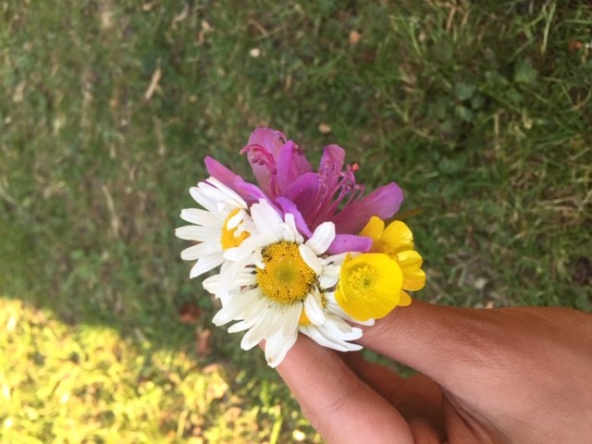

Slide 13
“As the world started to shut down slowly due to the pandemic I found myself worrying for my children the most. As a mother of three young children it was difficult to make them understand about the happenings taking over our usual activities. Parks, school, libraries and their favourite places started shutting down. The unfortunate news of my husband losing his job, as he used to work in the travel industry, made things more difficult. It was a hard time as we were struggling to stay optimistic. End of March one week under school closure my younger to came down with fever which got settled in three days with lots of rest and paracetamol. As they got better I fell ill with high temperature and other symptoms. As I have coeliac disease I have a very weak immune system. It took me three weeks to fully recover. During my illness I thought that this could be covid 19 but I was not tested and 111 only said to self-isolate. That period was extremely difficult. Having family close by was a blessing that provided support and help.”

Slide 14
“With a new sense of looking at things differently I started doing different activities with my children. We started to make good memories by painting, doing crafts, reading, baking, cycling and going for walks. We took part in lots of different online competitions like writing short stories. As Ramadan came we held on to our faith more closely as all the worship places were closed. Praying at home brought a lot of peace. Eid was celebrated in lockdown without any parties or family gatherings. We as a family started exploring our lovely countryside, walked on some new paths and discovered some amazing green spaces. These walks really helped us. Being in nature made us pause and reflect on our surroundings. It was very calming to just appreciate the beauty and be grateful for the things we take for granted.”

Slide 15
“This pandemic is surely something that has shaken us from a deep slumber I think. Being appreciative of key workers, thankful for family and just being content for the little things in life. Although it must have been hard for lots of people who have lost their loved ones or struggling financially but there is always hope and that’s what I believe. Even though I still worry but I try not to let negative thoughts overcome me. I am counting my blessings every day as this lockdown made us come closer as a family, made us learn new technology and helped me pickup new activities. It has surely slowed life down but the thing that has helped our mental health in all these months is faith, hope and nature.” - ARC NWC Public Adviser

Slide 16
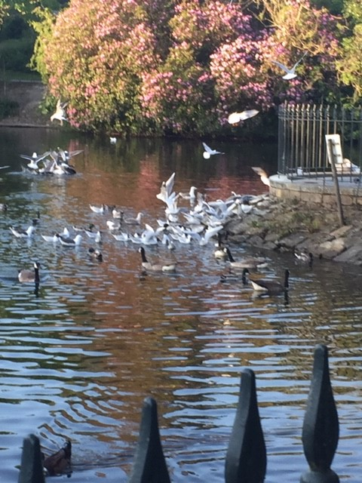

Slide 17
“I’m very frustrated. I love actively helping others, its deep within my DNA. The tables have turned, suddenly I’m one of the vulnerable ones. People are offering ME help. I have got to do something, I’ve got to play my part in this national, no global, tragedy. I sign up as a ‘Caller’ in response to the national cry for volunteers, to the Chester city cry, to the local villages cry. No one calls.
So, I call them instead. Neighbours, friends, elderly relatives, people I haven’t seen in years. I make recommendations to our Business Alliance of ways to help our local people. I share helpful documents about looking after yourself. It’s not enough, I want to be driving the delivery van for the supermarkets or collecting prescriptions from the pharmacy. I want to be visiting those lonely and isolated, helping my friend who works for the Red Cross. I want to be part of the teams setting up the Nightingale Hospitals!
Instead, for once, I must accept I have to put myself first, not just for me but for my family too. This is extremely hard.”

Slide 18
“It has become a period of high anxiety for me personally as well as millions across the country. The level of deaths and fear have grown rapidly. Reports have poured in of highly distressing stories and situations, statistics, and photographs. All graphically portraying this new environment we are living in. Particularly distressing is the nature and circumstances of COVID related deaths. One cannot imagine the degree and complexity of pain being experienced by all concerned.
On the back of this I get the call. A friend has become a victim. The reality kicks in. I link into his moving funeral virtually and say my goodbyes.”

Slide 19
“Another call. This time from hospital. I’m to have my operation. As a shielded person It feels like going into the lions den. We split our home into two so I can isolate from my husband on my return and protect him from any germs. In hospital safety is clearly paramount but it doesn’t make it easier.
I now live life through the window with touching hands. Tears fall with regularity as I withdraw from friends and the outside despite wonderful acts of kindness and support. Whatever must it be like for those who have none. I feel guilty for being so privileged.”

Slide 20
“It is with great relief that I have come through the journey so far.
My passion for improving the heart health of our region intensifies, as I work to make a measurable difference through our events for World Heart Day. My life has been given structure and connectivity once more, as I zoom into meetings and work on projects including many with ARC. Community life remains strong despite its virtual nature. It’s a pleasure to spend more time with colleagues, to understand everyone’s perspective more and to value the gifts we all bring in times of hardship.
I am safe, my family is safe, our appreciation of each other is even stronger. We have learned to ‘Live Slower’ and put a higher value on small things and those that matter most.”
- ARC NWC Public Adviser

Slide 21
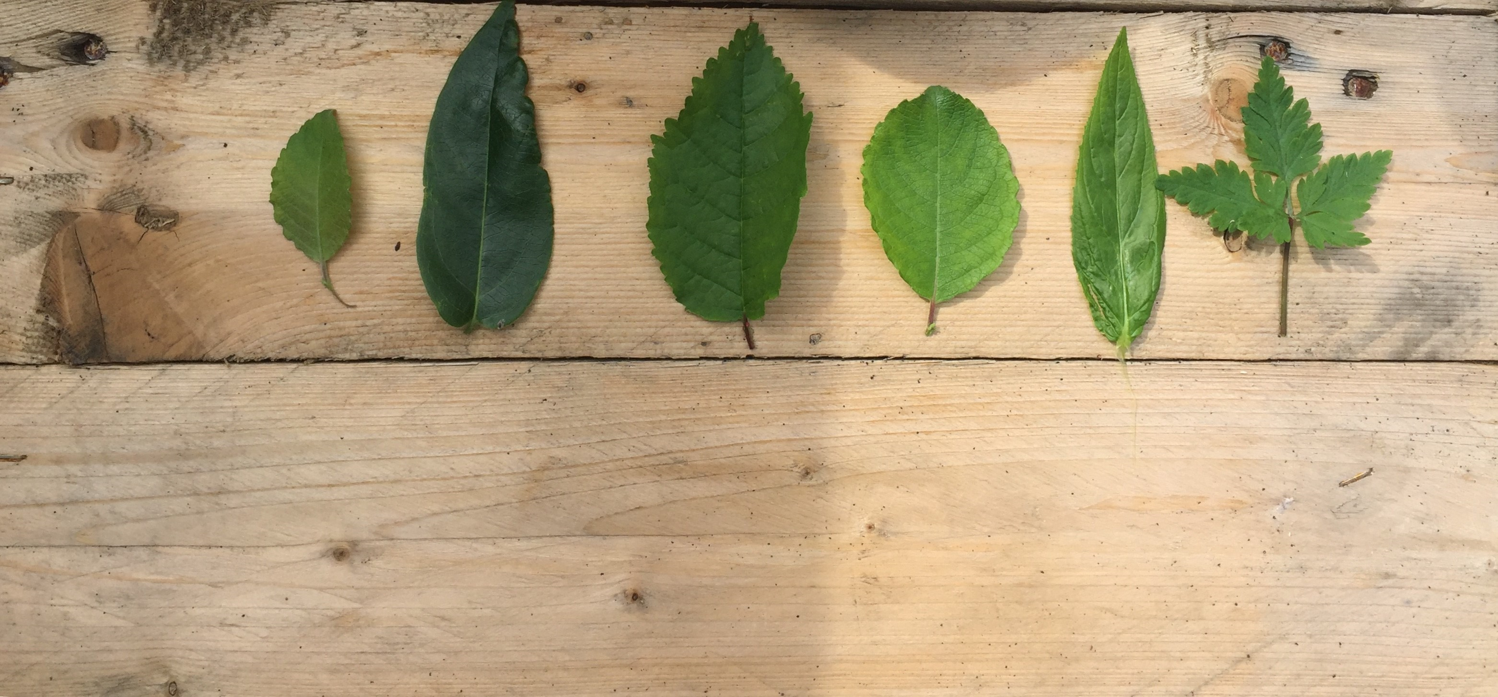

Slide 22
“Over 13 weeks I found myself queuing, buying food and essential goods, preparing, cooking, packaging and delivering bags of groceries, fruit, hot meals, sandwiches, snacks and sanitisers to some of the most appreciative, warm, kind, good natured people I have ever met. This meant being out early 5 days a week to prep, cook, package and deliver the support parcels to residents. Conversations were had through half opened kitchen windows, over garden fences and gates as people told me about their beloved families, sons, daughters , nieces, nephews, grand and Great grand children and separated friends. There was much flirting and laughter with some of our older female citizens, some in their 80's and 90's, and pearls of wisdom shared by men who, expressed their gratitude despite having lived through a World War, or travelled Continents to build a future here and for many years have contributed (and are still contributing) to society.”

Slide 23
“During those early weeks in late March to mid April, I regularly found myself walking back to the delivery van moved to tears. The constant message was relief from residents that they had not been forgotten and one of us would be at their door, same time tomorrow. I have learned so much from the past few months. I feel humbled, thankful and proud to be a part of my community. " - ARC NWC Public Adviser

Slide 24
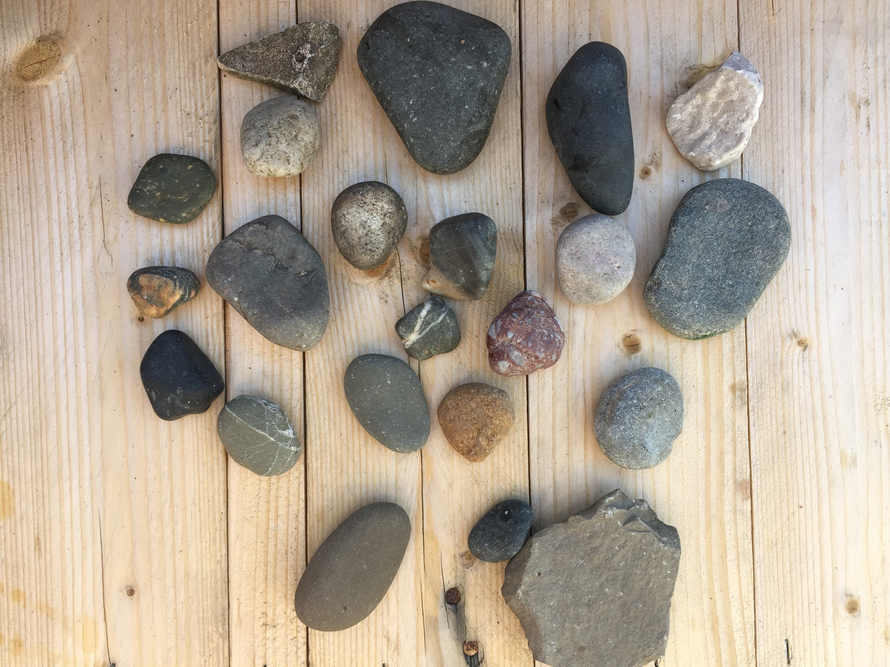

Slide 25
“One day my husband told me that in his office everybody was talking about high risk groups and I fall into this grouping as I have lung disease (respiratory problem).
I self isolate in my home….even from the starting days I dropped kids to school and they walk/ go alone in school and at the time of pick up I just pick them from gate while staying in the car….so time passes until Government announce fully lockdown….so the actual journey starts from here when kids and husband at home all day long….from the beginning I feel irritated, frustrated but as the time passes I got used to of it…. I just went out once in a day time in the evening with my daughter…I went for a walk around the block and in 15-20 minutes come back…. we discuss about everyday routine.
What I noticed in this lockdown about myself is I feel pain in my joints because I stayed at one place not to do much physical activity…even at the start I did not go in the back garden as I heard that you can catch the virus in the air as well… so stay at home all day long is tiring…my husband do all the groceries and we make sure that he did not go out more often as then there is a more chance to get a virus…so he usually go 1-2 times in a week for the grocery and when he comes back we clean everything using sanitizer (this is a hard job)…..”

Slide 26
“Everyday is same as it passes…nothing new but what I think is everyone has its own battle to get through…someone feels its easy and someone said its difficult…I will admit that I have struggled a lot in the lockdown period….I was worried, I was anxious, Sad, afraid and I have to realise that I am not alone in this boat….
In this Lockdown I was in working in one project that is Diary writing…and it is only one thing which is new in my life otherwise all the other things were usual….and I found out it is very interesting and enjoyable thing to write a diary….what I feel that there is someone who reads your activities and keen to know more about….and to get a call once in a week from my fantastic lady name Koser is again very nice experience..
I hope that this time will pass quickly so we can go out and invite others free lt as we did before this virus….Stay Safe..Take care.”
- ARC NWC Public Adviser

Slide 27
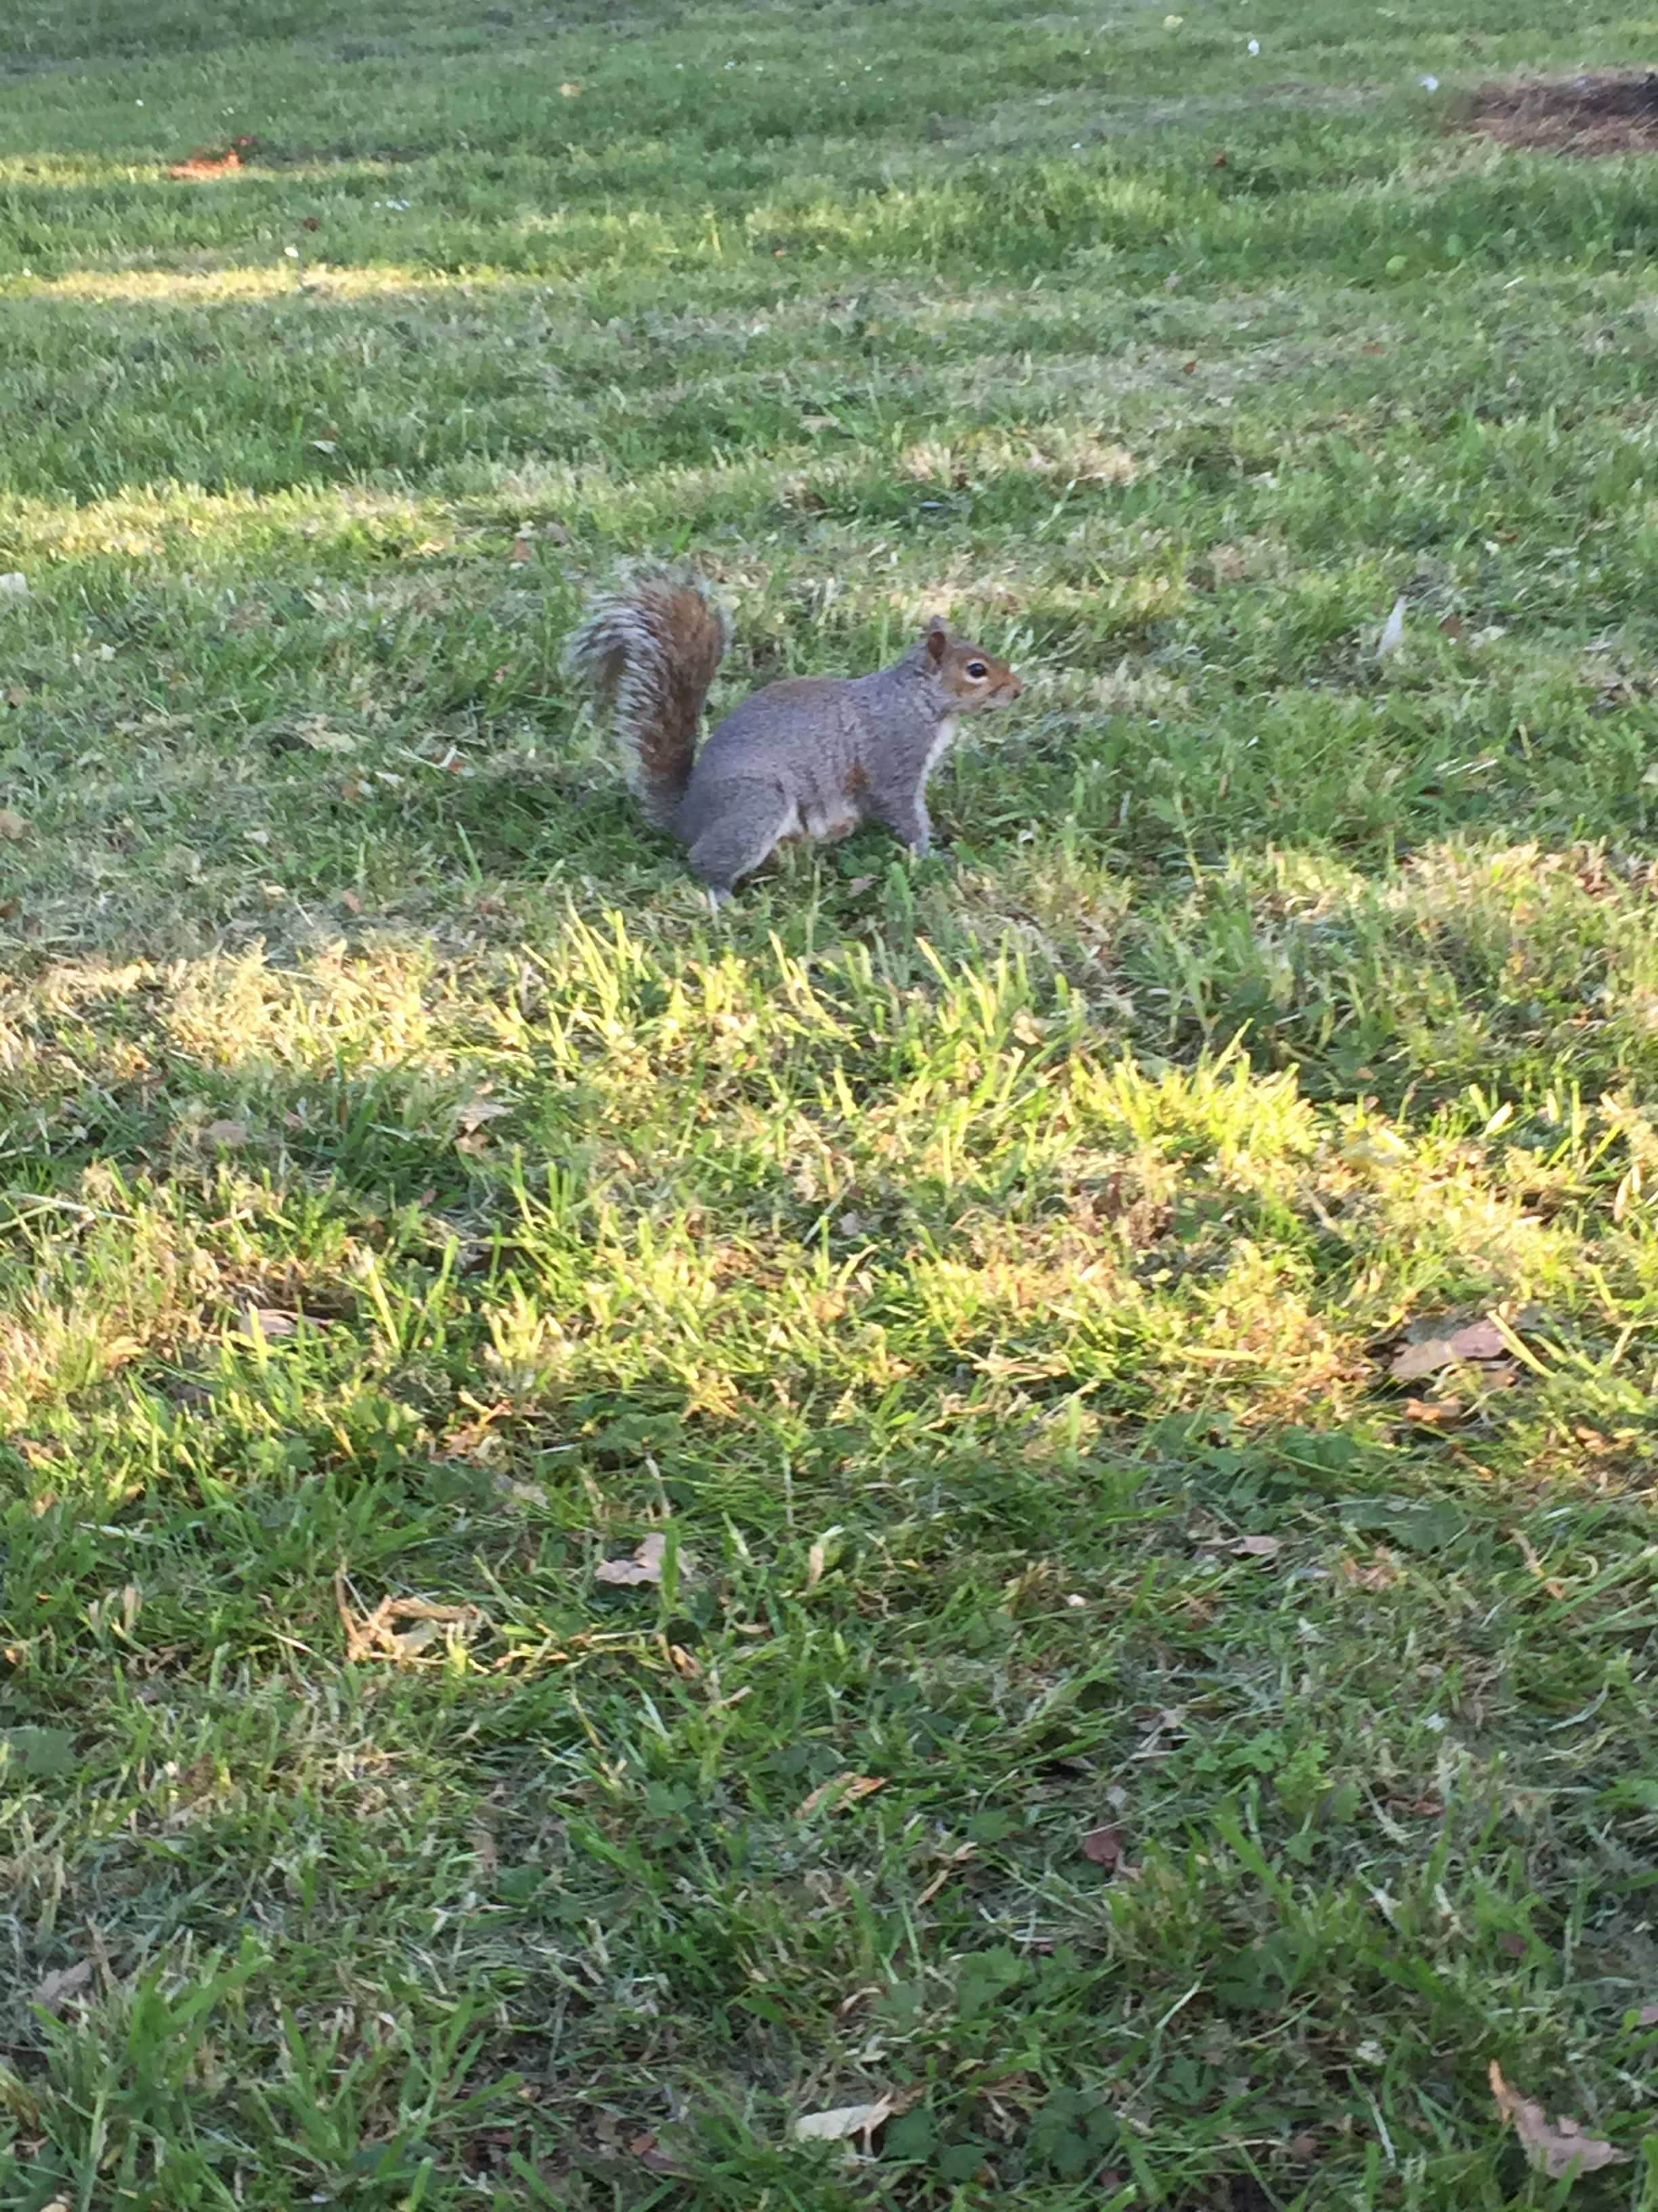

Slide 28
“Overall this lockdown period has brought me and my family closer than ever, however it has not been all positive, as at times I have felt worried and lonely and most of all uncertain about the easing of the lockdown.
During the lockdown I have learnt many skills, especially with technology. For example using Microsoft teams and Zoom on a regular basis, which I was trained to use by a researcher. However, home schooling for my three children was very stressful at times, particularly for my eight years old daughter. Even though this was challenging for me, I feel this will help me with technology in the future.
My husband works as a doctor which our whole family was worried that he may catch COVID-19 and then pass it to the rest of the family. Due to him being a key worker I have to do all the shopping where I would wait in queues for up to 3 hours. My elderly neighbours have been shielding for the past few months so at times I have helped them with the shopping and picking up medicines for them.”

Slide 29
“I have been working remotely for the governors sub group and have took part in multiple research studies. These include: British Muslim’s experiences and perception of social distancing and isolation recommendations to reduce the risk of COVID-19 transmissions, which was conducted by the University of Liverpool. I helped the researchers to organise around 25 interviews and 4 focus groups within the Muslim community.
I circulated the online survey across the North West, from John Mores University where Dr Pooja Saini was interested in views from BAME communities. In this project we learned how people in the North West of England have responded to and how they have been affected by social distancing in response to COVID-19.
The next project I took part in was the COVID-19 Diary project by ARC WNC EPHC theme. I wrote my experiences on a daily basis for 8 weeks. Throughout the 8 weeks I though positively and every morning I was relieved that everyone in my family was well but when I completed the 8 week experience the next day, my father sadly passed away in Pakistan and due to COVID-19 the lockdown restrictions meant I could not attend his funeral in Pakistan as there was no flights available.
We had previously booked a flight to Pakistan on the 1st of April to attend my niece’s wedding and to see my parent’s who were 90 plus years old. However the wedding and flights were all cancelled due to COVID-19, meaning I couldn’t visit my parents and family, which was very sad for me.”

Slide 30
“During this lockdown Ramadan, which is a holy month for Muslims, came around in May. This Ramadan was very different as we were not able to go to mosques and pray together. But this month was more peaceful and less stressful than in other years as our family spent a lot more time together and there was no rush to pick up the kids from school. To celebrate the end of Ramadan, we have an Eid festival. Where we usually go the Mosques, exchange presents, share food and visit family but this year we could not do any of this.
I will never forget these coronavirus circumstances, mainly because of my father passing away which has been very challenging and sad for me and my whole family.”
- ARC NWC Public Adviser

Slide 31
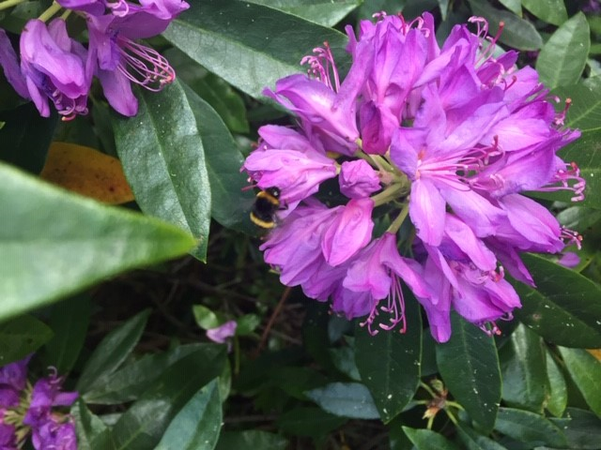

Slide 32
“What happened as I got into lockdown took me by surprise. Before I knew it the weeks were passing and I realised that I was actually enjoying myself. I had discovered my inner introvert. Despite a career in sales and management, I am not a much of a people person. An evening in a pub, or a large social event, with lots of strangers, are things I try to avoid. I am far happier at a dinner party with a few friends or in the more formal setting of a committee meeting.
Now in lockdown, I was still in touch with Ellen by phone and every Saturday we always have a three course meal together via Skype. I also keep in touch with friends and family by phone and Skype. Plus a few Zoom meetings with organisations and groups I belong to, e.g. the local ward environment group that I am secretary of and a Glastonbury based alternative spirituality group. That still left a lot of free time that I had not had previously. This gave me space to think beyond the immediate and superficial. About my life, how it was and how it will be in future. Being in my 70s the possibility of death is always in the back of my mind, but Covid19 has highlighted the fragility of life for everyone. We should all make the best of every day. I also think a lot about politics and economics. Especially the effects of Covid19, as a still active pandemic, with its economic consequences that will be made far worse with a no deal end to Brexit transition on 1st January 2021.”

Slide 33
“Despite my gloomy predictions for the future of the United Kingdom, here at home in a lockdown that I will continue voluntarily, until a vaccine or viable cure is available. I have also been able to work on my family history project, read more books, listen to music, practice keyboard, learned to bake bread, returned to an old hobby of painting, that's pictures not houses! When I feel I am missing travel, I can visit old favourite places and discover new ones using Google Earth at street level. Shopping is not a problem, I have been online shopping for years, books being my main weakness. Last but not least I am a foodie, so still enjoy cooking Mediterranean and middle eastern food.
I do feel I am very lucky in not having to worry about my business or job surviving or have sleepless nights worrying if I will be able to pay the mortgage or rent. I don't have to face health risks every working day, as my son who is a paramedic does. He has had Covid19, he was on oxygen but thankfully survived and is back at work.
So personally the lockdown experience has been positive. Its helped keep me safe, health wise. It has given me a clearer perspective on life, appreciating what I have, both materially and the lovely kind people I know. I am also grateful for the personal resilience I have, to be able to cope mentally with lockdown. Though I don't underestimate the value of regular contact with friends and family. Stay safe, stay positive, be happy!”
- ARC NWC Public Adviser

Slide 34
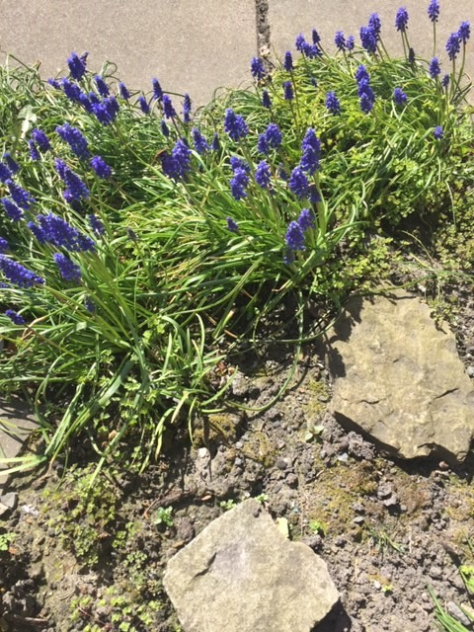

Slide 35
“What to do now having the awareness that anxiety has come to be another problem to deal with. I know being in the fresh air is a good
coping strategy and a good nights sleep for anxiety, but trying to get a balance when psychosomatic problems occur, easier said than done.
The need to keep warm, it may seem obvious but so important just to feel comfortable.
Covid 19, brought more challenges especially when Lockdown came into fruition. My main aim was to try to continue with the things I would do normally whilst limiting myself prior to the official Lockdown, that is doing things away from home.
With all the media coverage of the pandemic, the realisation each day, this is changing everything. Straight away things seemed unreal, surreal, the neighbourhood so very quiet, getting use to necessary restrictions being put in place, adjusting to what is happening and being positive.”

Slide 36
“April brought more sinus problems leading to a cough coming from my chest, I did not think I had contracted the Covid-19 virus, using the usual medications and a small drop of alcohol at night helped clear the cough, and possibly contributed to help with sleep. I’m fortunate that I’m able to drive to the two Fylde coast estuaries and inland countryside for a change of scenery, keeping a social distance. Most of my time outdoors has been productive around the house, garden and keeping my next door neighbours property tidy he has been missing for some time now. Now getting use to the virtual contacting meetings. Life is so much easier when you feel well the anxiety has gone and feeling more confident.” - ARC NWC Public Adviser

Slide 37
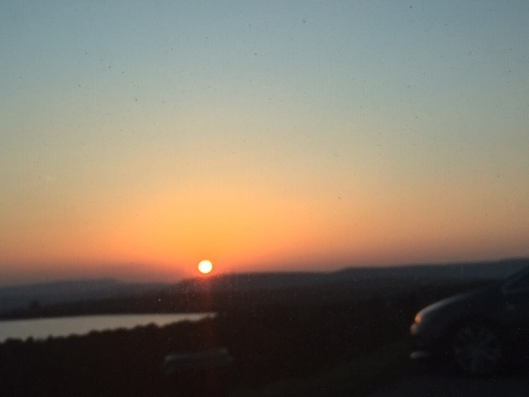

Slide 38
“No one could have forecast events of COVID-19 when we met in Blackpool and later in Liverpool. Looking at it now, all aspirations could have been lost or at best put on hold until such time as regular activities could be resumed. Amazingly, this has not been the case. Mark Gabbay’s bulletins have kept us up-to-date but equally impressive is the research and other work that have continued. Impressive momentum has been maintained, even for someone like myself in the out-post of Chester. There have been opportunities galore for public advisers to become involved in a range of opportunities. It seems to me that I could have opted into projects based at University of Liverpool, Lancaster University or UCLAN……..and a few others further afield. The Innovation Agency has also done its bit to promote activity.
After cancellations or postponements of meetings and conferences that would normally have involved me, I found invitations to join different projects tempting, but it was important not to take on too much work, even when in COVID-19 lockdown and isolation. I opted for involvement in the ARC NWC Stroke Roundtable Project based at UCLAN and after making application, I was invited to join the evolving team. This project aims to examine, and hopefully improve, stroke care across the North West and beyond. A big attraction of this invitation was to become involved from the outset. The challenge of assisting to establish the project’s aims and objectives, together with planning research methodology, evaluation, reporting and dissemination seemed to fit with my career experience. Although not being a medic, I sensed that I possessed skills that could be transferred into this new situation. I was also assured that although my awareness and contact with victims of stroke was second-hand, being restricted to my wife and close colleagues, it would not be an impediment in joining the team.”

Slide 39
“So off we went. Clearly, we would be working in unconventional ways and we would have to learn how to interact with each other in a virtual world instead of in person. All you need is a link and you are in a meeting. Besides having to gear-up our computers to incorporate Microsoft Teams and/or Zoom, this new way of working has at least one advantage. It is no longer necessary to drive miles and miles and find a parking space to attend a meeting; all very economical in all sorts of ways and you still get to see familiar faces, if only on screen. One pitfall I encountered was when, in error, I received a link to join a meeting at which I was not meant to be present. This meeting went on for several minutes before everyone realised I’d Zoom-bombed the meeting!! How many public advisers have the distinction of being a Zoom-bomber?!
Our project is still in the early stages. A detailed outline and terms of reference have been produced and fully discussed. Chairing on-line meetings brings new ways of ensuring that everyone has opportunity to contribute and team members have to learn to signal by hand if they wish to speak instead of just butting in!! Something to remember when eventually we return to conventional meetings! Considerable discussion has taken place on refining the project’s aims and objectives and I think all team members had ample opportunity to express their feelings and opinions. The team includes members with vast professional experience of stroke but the public advisers, all three of us, were given plenty of opportunities to contribute in detail to the discussion. We still have to clarify for ourselves what is meant by integrated care for patients who have suffered a stroke. There are still the challenges of examining different strategies to improve care and analysing the barriers that exist when caring for patients. After this promising start, all seems set for the long-term success of the project.”

Slide 40
“For many public advisers, there have no doubt been many inconveniences of isolation and lockdown, particularly for those who are seen as vulnerable, a category into which I fall. However, it has not been all gloom and doom. Whilst it has been necessary to curtail other aspects of my voluntary work with Cheshire Constabulary, The National Trust and my role as governor at Liverpool Heart and Chest Hospital, it has been possible to keep busy. Having work that can be done in the current circumstances has been a lifesaver. Apart from the on-going on-line links there have been other benefits.
A first-year course in German at Chester University has been completed. My garage has become a mini gym with the installation of a treadmill, my garden is spick and span and jobs that have been awaiting attention for years have been done. In many ways this has been a desirable package of events; one that may have been wished for under normal events but always avoided or found impossible to put in place. It will come to an end and hopefully will have not interfered too much with innovative work as a public adviser.”
- ARC NWC Public Adviser

Slide 41
Thank you for taking the time to read our public adviser experiences of lockdown.

