Slide 1
Applied Research Collaboration (ARC) North West Coast (NWC)

Slide 2
Aims:
Expand effective local public health action on the determinants of health and health inequalities.
Build capacity for rapid evaluation of public health action and translation of evidence into practice.

Slide 3
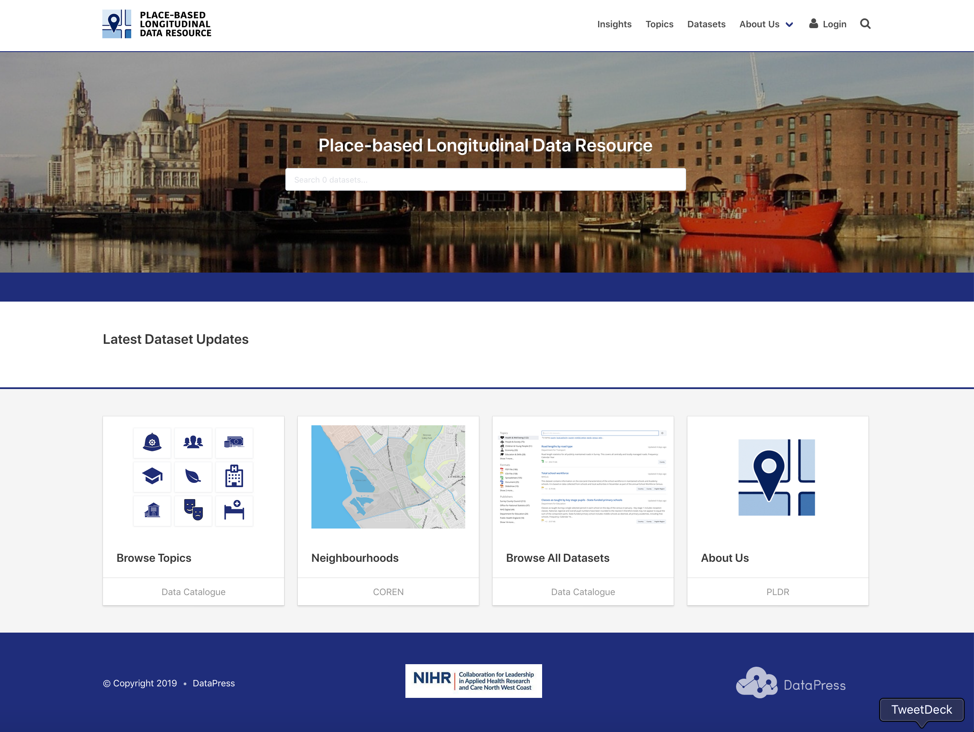
Data infrastructure
https://pldr.org
Portfolio of evaluation, modelling and implementation projects, supported through world class data infrastructure

Slide 4
IPH - projects
1. Evaluating Air quality improvement actions across the North West Coast
2. Ways to Well Being for All: Scaling up a wider determinants of health offer across first level services.
3. Assessing the Impact on health of North West Coast Local Economic strategies.
6. Together for an active future.
7. Rapid Intervention Causal Evaluation (RICE)
8. Preventing Self Harm
5. Equitable allocation of resources for community services and social care.
4. Place-based analysis and modelling of COVID-19 risk

Slide 5
ARCNWC IPH Research grants
Successful (£2.3 million) :
The health and health inequalities impact of a place-based community wealth initiative - £600,000
Accounting for Unmet Need in Equitable Healthcare Resource Allocation, NIHR HSDR, £897,000,
Together and Active Future. Evaluation of A sport England Local Delivery Pilot, NIHR SPHR, £154,000
Citizen Advice - Wellbeing for All. Scaling up a wider determinants of health offer across first level services, Health Foundation, £451,000
Analysis of the socioeconomic burden of digestive diseases and identification of relevant research gaps in the field of digestive health, UNITED EUROPEAN GASTROENTEROLOGY, £177,910
From data to decisions: embedding a Real-world Intervention Causal Evaluation (RICE) tool in the decision-making process, Health Foundation, £74,000
Submitted (£1.25 million)
Evaluating the health impact and cost-effectiveness of Ways-to-Wellbeing, a whole system approach to mitigate poverty over the life course. – £750,000
RESTORE - Research for Equitable SySTem RespOnse and Recovery - £500,000

Slide 6
The agenda
1. Intro and outline – Ben Barr 10.30-10.35 2. Evaluating the impact of Air Quality Management Areas – Tanith Rose 10.35-10.55 3. Small area COVID19 vulnerability – Kostas Daras and Rachel Anderson De Cuevas, 4. Rapid Intervention and Causal Evaluation (RICE) – Roberta Piroddi and Helen Duckworth -11.15-11.45

Slide 7
Discussion
Opportunities to share learning across the NWC from these projects.
Expanding member and public engagement in projects.
Developing capacity within members for evaluation and implementation.

