Slide 1
ARC NWC EPHC Theme Air Quality Work
15th September 2020
Fiona Ward (EPHC)
Hayley Jayne Lowther (IMPaCT)
Notes:
FW:
FW - I’d like to tell you about our AQ work – and also like to introduce Hayley Lowther from the Impact team at Uclan who will be telling you about our literature review

Slide 2
How can local ‘systems’ work together to undertake actions that will result in improved air quality?
Why air quality?
Impact of air pollution on health
Health equity - disadvantaged areas are disproportionately affected
Interest from ARC NWC members, public advisers and other residents
COVID-19 and ‘building back better’
Why a community engagement focus?
Communities should have a real voice in decisions that affect their lives
Review of documents across NWC suggests it is an area for development
Air quality cannot be controlled by individuals alone
Notes:
FW:
So focus of this work is to explore how local systems, that is the organisations and communities in an area, can work together to take actions that will result in improved air quality
air quality important to us
Exposure to air pollution has a detrimental effect on health and there is evidence that residents living in disadvantaged areas are disproportionately affected
We know it is an issue of concern for ARC members and advisers and other residents who took part in our group conversations earlier in the year
And the Experience of COVID-19, including improved AQ during lockdown, has also demonstrated things can be different and created certain amount of momentum to ‘build back better’
And the community engagement focus
Underlying argument of ARC NWC and EPHC that communities should have a real voice in decisions that affect their lives
And our recent review of community engagement in NWC air quality plans and actions, which I will talk about in a moment, suggests this is an area which could be developed further
Another reason for the community focus is an acknowledgement that alone, individuals have limited control over AQ but small changes across the whole community will have an impact
2:00

Slide 3
1. Community engagement in local authority air quality plans and actions across the North West Coast
Adapted an existing framework to community engagement (Morgan et al., 2010)
Community liaison – information sharing​
​Community liaison – consultation ​
​Community capacity building ​
​Inclusive strategic decision making​
​Community in control of service design/delivery ​
Increasing community engagement
and control
Notes:
FW:
So our first action was to look at On-line documents and resources from 21 NWC local authorities and Liverpool City Region and we used a existing framework of community engagement to categorise the different actions
This identifies a spectrum ranging from community liaison, through to capacity building and involvement in decision making to the community being in control of the design or delivery of services.
Moving through this spectrum represents increasing community engagement and control

Slide 4
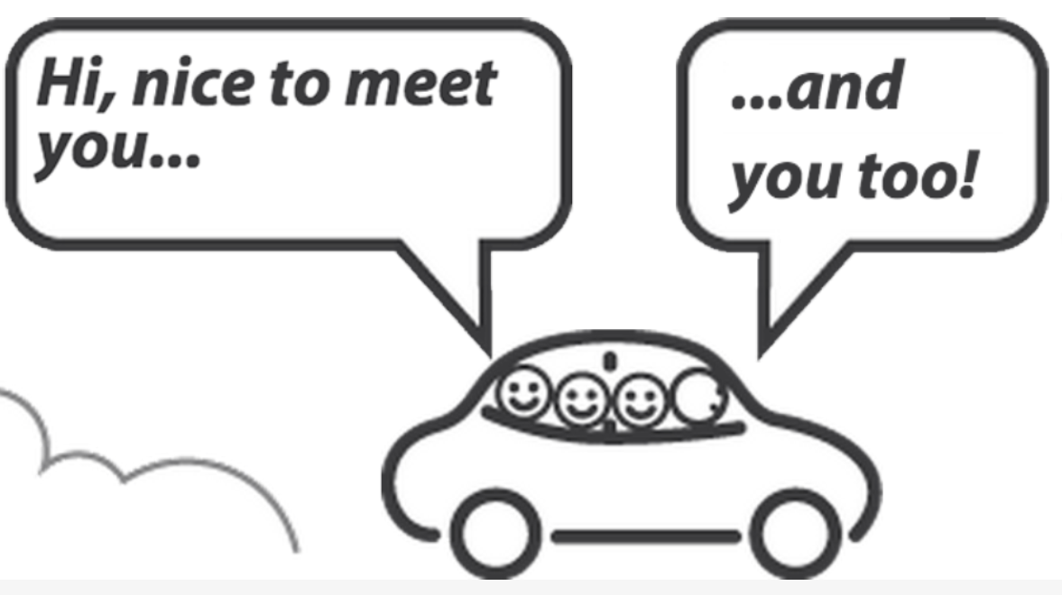
Community liaison
Most engagement is awareness raising: “the public can help by …”
Interactive materials - interventions often directed at travel planning, car sharing and active travel
Community consultation usually part of a statutory process
Notes:
FW:
So currently we found that most community engagement is awareness raising about sources of air pollution and the provision of information about things residents can do to reduce their contribution. We found there is particular focus on alternative travel arrangements with information about public transport, electric bikes and cars and driving tips to reduce fuel consumption, for example, but also advice about wood burning stoves, open fires, bonfires etc
Many authorities also provide interactive information – that is contact details for interventions such as travel planning, car sharing and active travel, including cycling training and walking buses.
At the next level - there are references to community consultations, often part of a statutory process – such as formation of Air Quality Management Area and clean air plans, planning applications. Some authorities also refer to less consultations such as councillors and officers attending residents meetings to discuss issues related to air quality.

Slide 5
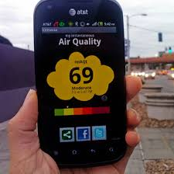
Capacity building, inclusive decision-making, community control
Citizen science
Steering groups, forums and strategies
Joint funding bid, a community interest company and money for community projects.
Notes:
FW:
There are fewer examples of activities further along the spectrum of community engagement –
There were a small number of references to ‘citizen science’ projects where residents, especially school children, were able to develop skills and knowledge
Most LAs had AQ steering groups to aid decision-making but they were primarily made up of councillors, officers, businesses, transport providers etc. There was one wider community Air Quality forum mentioned, however, and 2 LAs refer to desire to create local groups. AQ Strategies existed but only one, a cycling strategy, was explicit about any oversight by a public group.
There were two examples of community engagement in the design/delivery of a service (one was LA and residents working on funding application for electric car charging points and the other a community car club) and we found one reference to funding source for AQ community projects via a programme to support social investment and innovation to enhance community wellbeing.

Slide 6
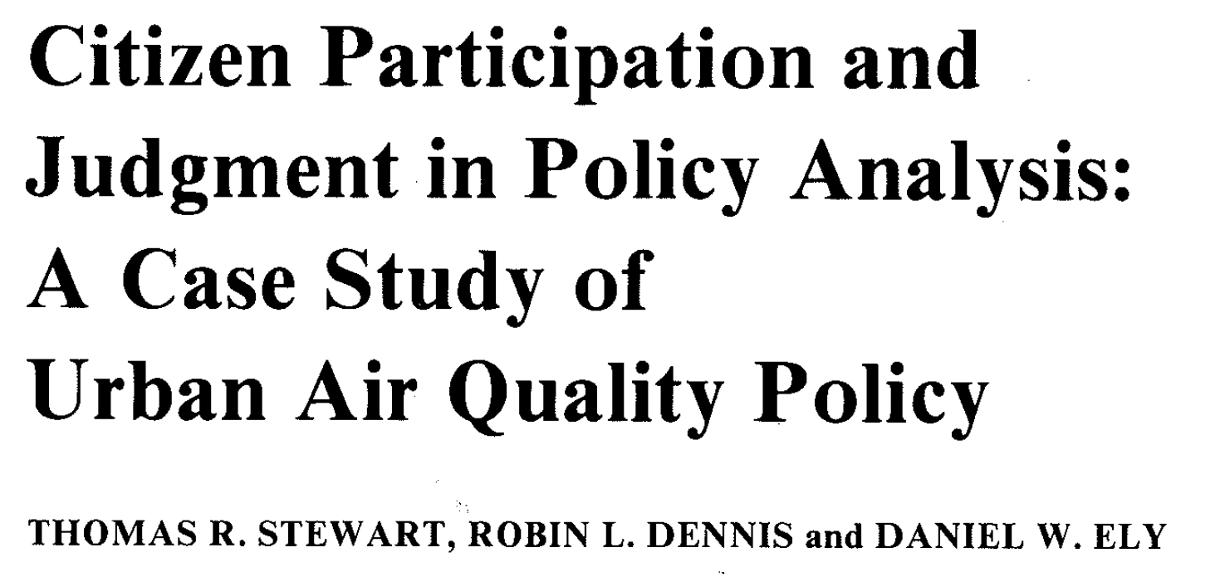
2. Scoping review of community engagement in air quality plans and actions
International insight
What sort of projects?
How have communities been involved?
Was there a health equity lens?
What outcomes were described?
Working collaboratively
EPHC & IMPaCT
Wider review working group
Notes:
FW:
So in order for us to learn from the work of others, we decided to search the international literature to look for examples of community engagement in AQ projects – we wanted to know more about the approaches that had been used, how communities had been involved and the successes and the challenges to inform the next stage of our work , that is the development of demonstration sites in the NWC
We (Hayley and myself) searched journal databases using key words related to air quality and community engagement and many happy hours of filtering, ended up with 43 papers to examine – these are just a few of the titles.
Review questions: What approaches have been used to engage communities in air quality plans and actions? What is the purpose/rationale for community engagement in identified approaches? What are the barriers and facilitators to community engagement in air quality plans and actions, and how do these differ across the approaches used? To what extent do approaches address health inequalities and health-related outcomes?
identified 3,146 potential relevant articles. We decided to include studies conducted in developed countries, were written in English and have clear evidence of active participation; we identified 104 articles which could provide some answers to our research questions after reading the title and summary of each article; we have now read the full texts, deciding to definitely include 43 articles in our review.

Slide 7
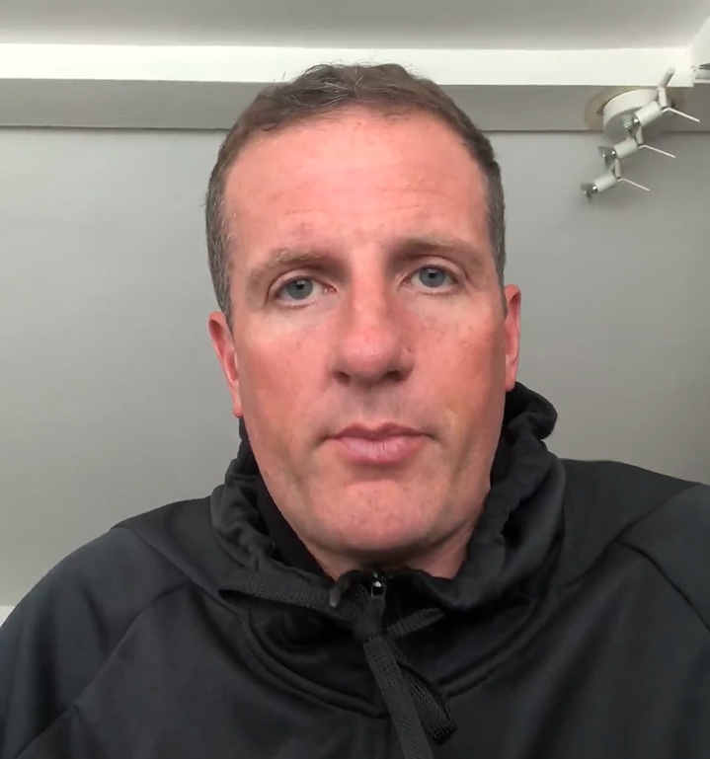
Air Quality Review Working Group
A social enterprise, public advisers, local authorities, researchers
Different background, experiences and different perspectives
Ruth
Paul
Keith
Notes:
FW:
The great thing about this review is that we are not ARC researchers working alone – we have established a Working Group which includes members from a social enterprise, 3 public advisers, 2 local authorities – each person is bringing valuable insights as a result of their different background and experience.
3 members - Ruth, Paul and Keith - have volunteered to tell you why they were motivated to get involved in the review group
(audio)
I’ll hand over to Hayley now to tell you about some of the studies we have looked at and the emerging themes
6.45
Tasks
Whether we are looking for the things in the literature
Important to have reflection on the findings – what elements of the studies are important, what is inspiring, would it work in the NWC
How to share learning with a wider audience
Opportunities if they want to get more involved or have the capacity to do so – in data extraction and in writing publications and other outputs and in wider dissemination

Slide 8
Scoping review of community engagement in air quality plans and actions – progress and emerging picture …
Data extraction progress
43 papers identified Currently looked at 24 papers Covering 17 different studies
Communities involved
Majority of studies undertaken in urban areas 7 studies identify community as socio-economically disadvantaged Most studies involve residents or community groups, 4 studies conducted specifically with children and/or young people
Notes:
HJL: Community engagement in air quality plans and actions scoping review progress
Data extraction progress:
Currently looked at 24 out of 43 papers to date, which cover 17 different studies (multiple papers on 3 projects – Imperial County AQ Monitoring Community Network; Community Action Against Asthma; Participatory Mapping in three UK cities)
Papers from USA (n=16), UK (n=6), Italy (n=1), Spain (n=1), Belgium (n=1).
Communities involved:
Majority of studies undertaken in urban areas, related to traffic emissions or close to industrial sites – a few are rural though (e.g. Imperial County AQ Monitoring Community Network – desert/agricultural area; Citizen Sense in a US County – hydraulic fracking sites; suburban Guildford – high levels of car ownership and busy roads)
7 studies identify community as socio-economically disadvantaged, some US studies we have yet to complete data extraction for use the term ‘environmental justice communities’
Most studies involve residents or community groups (geographically defined communities), 4 studies conducted specifically with children and/or young people (e.g. anti-idling outside school; action against childhood asthma).

Slide 9
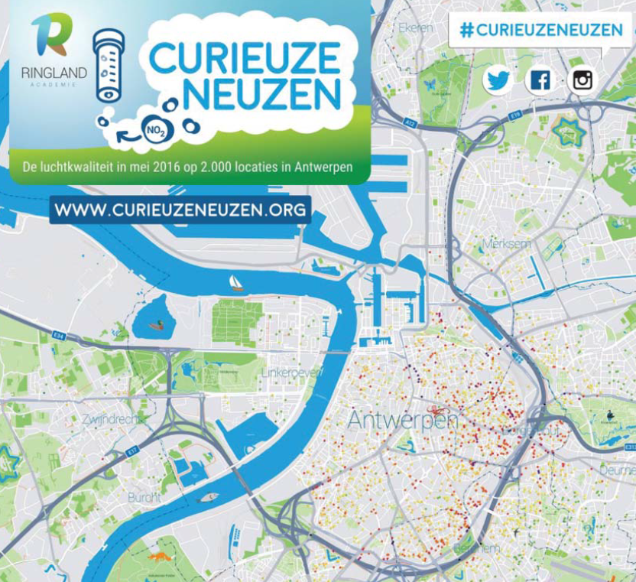
Emerging picture … study aims and methods
Study aims
Environmental health literacy – increasing individual and community knowledge and awareness with a view to: reducing personal exposure to air pollution empowering individuals and communities. Lay vs expert evidence – value of local knowledge and data collected by citizens as complementary to information produced by scientists and experts.
Study methods
Diaries Focus groups Interviews Mapping Monitoring Photos and videos Smartphone apps Workshops
Notes:
HJL: Community engagement in air quality plans and actions scoping review emerging picture
Study aims – the majority of studies looked at so far are focused around these two aims;
environmental health literacy – increasing individual and community knowledge and awareness with a view to: reducing personal exposure to air pollution, changing behaviour to decrease their contributions to air pollution, empowering individuals and communities to act and become advocates for better air quality
lay evidence vs expert evidence – value of local knowledge and data collected by citizens and communities as complementary to information produced by scientists and experts: using knowledge gained from citizens’ experience to feed into air quality planning and decision-making
Study methods – a wide variety of methods used across the studies we have looked at, these have included;
citizens completing diaries
conducting focus groups and interviews with citizens and community groups
mapping exercises to produce spatial representations of citizens’ local knowledge and experiences of poor air quality
air quality monitoring (e.g. low cost portable sensors)
citizens producing photos and videos as evidence of air quality problems
use of smartphone apps for citizens to report air quality problems
conducting workshops with citizens and community groups.

Slide 10
Emerging picture … the role of communities
Initiation | Planning and decision-making | Delivery | Further action
By residents and community action groups Public complaints, petitions and campaigns | Identifying environmental priorities Determining location of air quality issues and monitoring sites Establishing multi-stakeholder steering groups and committees Co-designing research methods and materials | Engaging with the wider community Recruiting participants and conducting surveys Collecting, analysing and interpreting air quality monitoring data As research participants | Public education programmes and community mentoring Dialogue with officials including regulators Advocacy and campaigns Community representation
Notes:
HJL: Emerging picture of the role of communities in the included studies, we have looked at the role of communities at each stage of the research/project, to get a better understanding of how the specified community engagement approach is executed.
Project initiation;
8 studies were initiated by concerned residents or actions groups and 9 studies were initiated by researchers
Degree of variability in how these projects were initiated – public complaints, reporting concerns, petitions, campaigns, collaborating with researchers.
Project planning and decision-making;
Residents involved in identifying environmental priorities - what is a problem for the community, what needs monitoring and what needs action
Determining the location of air quality issues and the location of monitoring sites
Establishing multi-stakeholder steering groups and committees – which involved members of the community
Co-designing research methods and materials – questionnaire design, citizens and scientists explore design options collaboratively.
Project delivery;
Engaging with the wider community – local champions of air quality, knowledge exchange activities
Recruiting participants and conducting questionnaires/surveys
Citizens collecting air quality data, maintaining air quality monitors, analysing and interpreting air quality data
Citizens as research participants – completing surveys or participating in focus groups.
Further action taken by communities as a result of research/project;
Public education programmes and community mentoring
Opening dialogue between communities and officials including regulators
Advocacy and further campaigns – supporting and enabling communities to potentially influence air quality planning and decision-making
Community representation on committees and in air quality planning and decision-making meetings.

Slide 11
Emerging picture … outcomes described
Individual | Community | Organisations | Air quality | Health
Knowledge and awareness of air quality Motivation and confidence to advocate or take action Capacity building e.g. leadership, research and communication | Improved networks and relationships Greater sense of ownership and control Empowered to input into decision-making and actions | Changes to plans and new ways of working Changes to air quality monitoring Public have a ‘seat at the table’ New channels to address residents concerns | Cleaner vehicles and less idling Emissions reduction framework Coke plant closure | Increasing protective health behaviours Identification of children with undiagnosed asthma
Notes:
HJL: Emerging picture of the outcomes described in the included studies, after consulting with our review group we have looked at the different types of outcomes described in the studies – for individuals, communities, organisations (other than community organisations) and outcomes related to air quality and health.
Individual;
Enhanced knowledge and awareness of air quality and air pollution
Increased motivation and confidence to advocate or take action on air quality issues
Capacity building - developing skills in, e.g. leadership, research and communication.
Community;
Improved networks and relationships within wider community and with organisations
Developed a greater sense of ownerships and control, greater sense of community
Empowered to input into decision-making and actions – shared knowledge of air quality issues, improved access to data to use as evidence, equipped to communicate with stakeholders.
Organisations (not community);
Changes to plans or policies and new ways of working
Changes to air quality monitoring – locations, number of sites, AQMAs
Public have a ‘seat at the table’ – included on boards and committee meetings
New channels to address residents concerns.
Air quality;
Cleaner vehicles and less idling
Voluntary missions reduction framework for recycling plant
Closure of a coke plant causing the poor air quality
Health;
As the focus of the review is around engaging communities with air quality plans and actions, the impact on health wasn’t our main focus and some literature was excluded as it was substantially focused on the impacts of poor air quality on health rather than the community engagement aspects.
Little reporting of health outcomes – community engagement initiative where future anticipated outcomes were to improve air quality and subsequently health.
Examples include increasing residents’ ability to protect their own health by changing their behaviour when air quality was poor and improved identification of children with undiagnosed asthma.
On the whole;
A positive picture from the studies emerging – however there are few negative outcomes/limitations e.g. frustration and disappointment at lack of changes from regulators, feelings of low controllability and increased concern about the severity of the issue (challenges with achieving control ??)

Slide 12
Next steps for EPHC project
Complete the review and share findings
Publications, posters, other outputs
Knowledge exchange activities
Develop work in demonstration sites
Identify interested parties
Discuss community engagement experiences
Identify possible projects
Implementation and evaluation
Seeking comments, questions and expressions of interest
Notes:
FW:
Next steps for the EPHC project are to complete the review and share findings;
Will be in the form of publications but also ensuring there are outputs which are useful to practitioners and communities
We are also planning appropriate knowledge exchange activity or perhaps a connected research community to enable wider information sharing about this work, about other initiatives or work being developed, and reports or grey literature which we have not been able to include in the review
All this is leading to the development demonstration sites in conjunction interested local authorities, organisations and communities and the IPH and CHI ARC Themes
Once interested parties are identified it is likely there will be some exploration of local community engagement experiences
Then discussions to ascertain organisational and community priorities and interests so that appropriate AQ projects can be developed
Over a period of time, new initiatives will be designed and implemented the evaluated, possibly with the aid of external funding
Next slide
If any has any questions, comments or you want to be involved in this work – please leave type in the chat – or contact us using these email address

Slide 13
Thank you. For more information please contact: Fiona Ward f.j.ward@lancaster.ac.uk EPHC ephcenquiries@lancaster.ac.uk Hayley Jayne Lowther hlowther@uclan.ac.uk

